Slide 1
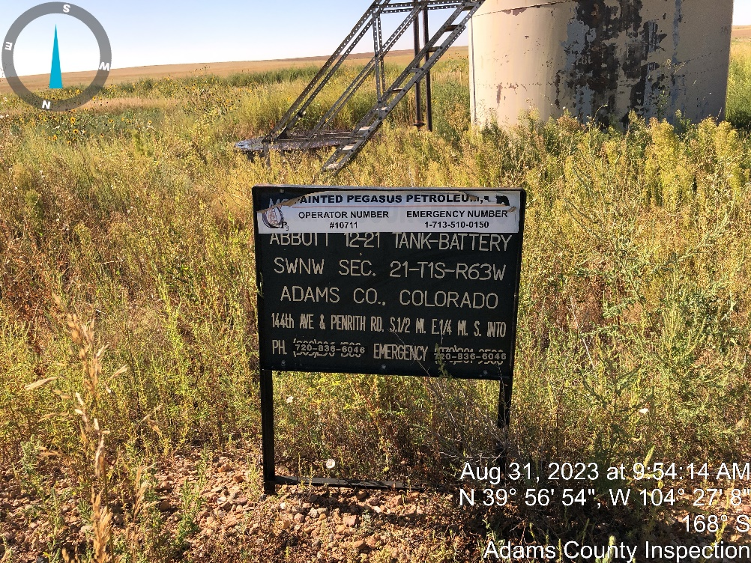
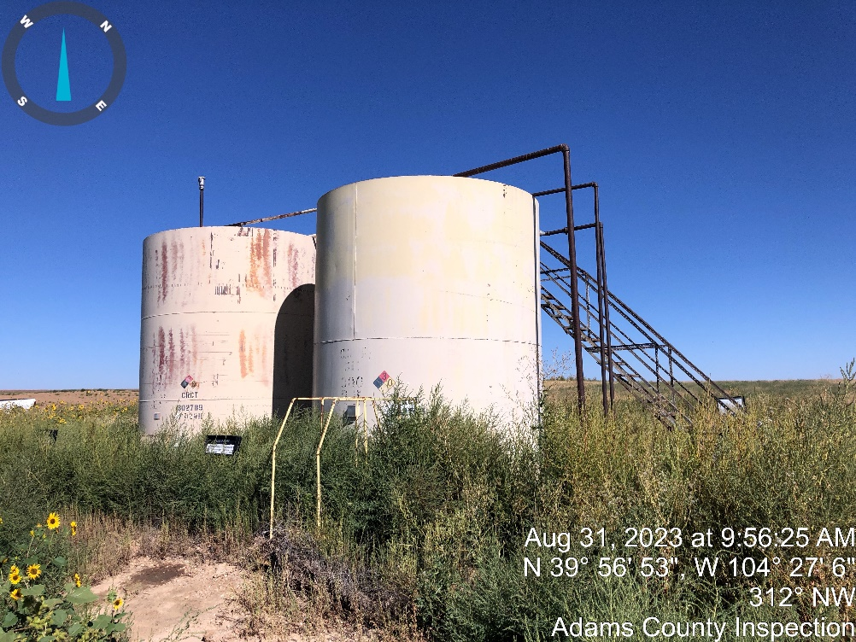
Inspection Photos
Location Name: ABBOTT_12-21
Location ID: 320477
Photo # 1 location sign.
Photo #2 Tanks,

Slide 2
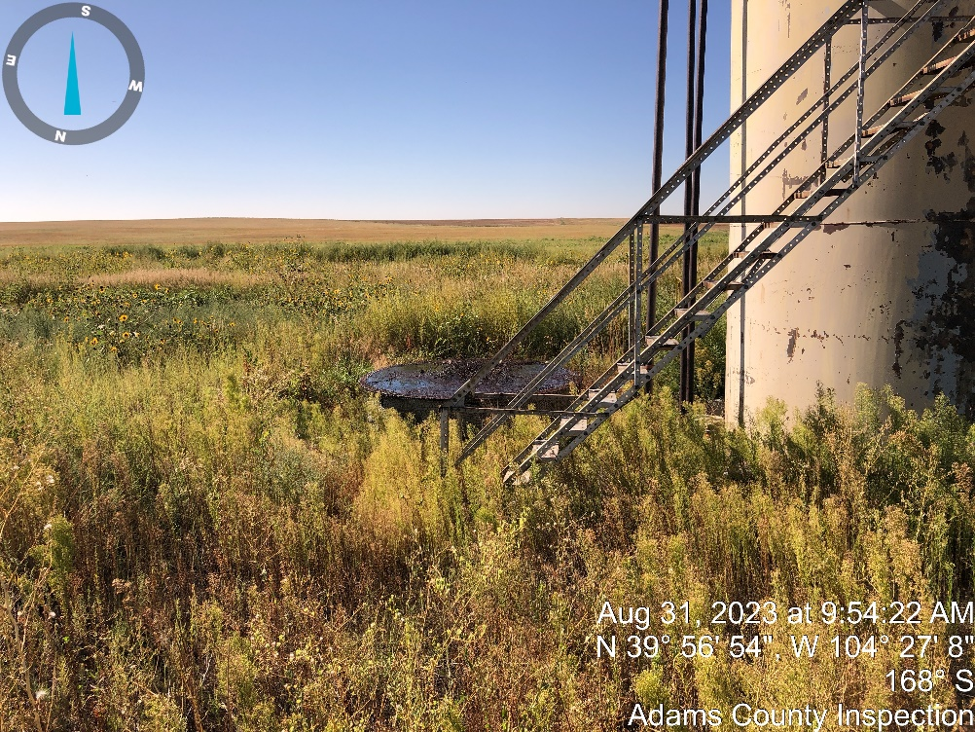
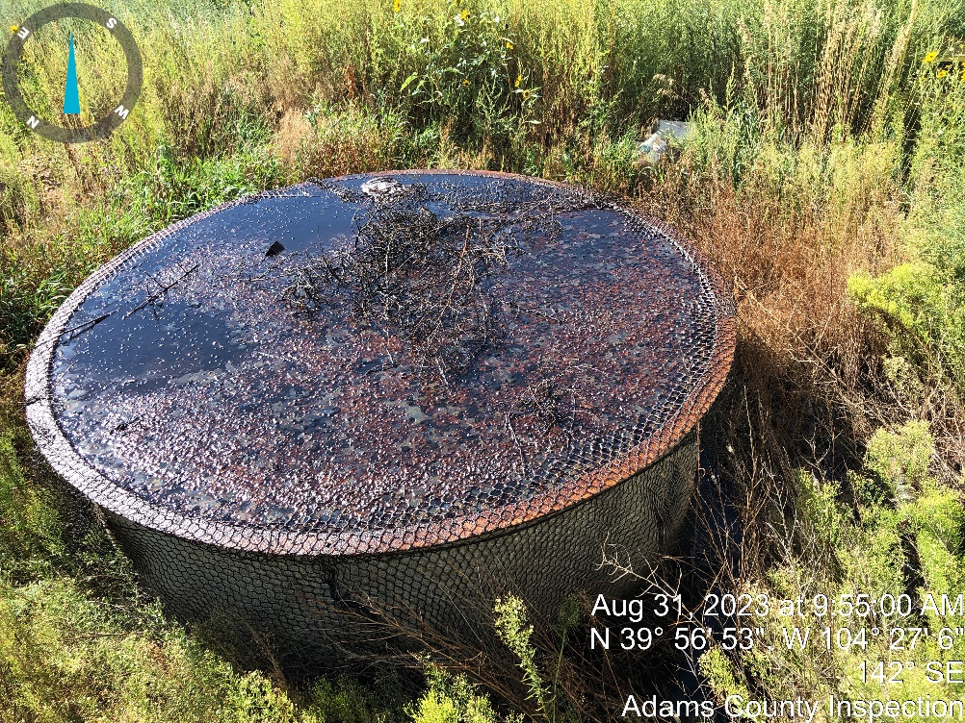
Inspection Photos
Location Name: ABBOTT_12-21
Location ID: 320477
Photo #3 Open top P/W tank.
Photo #4 Crude oil in P/W tank over flowing.

Slide 3
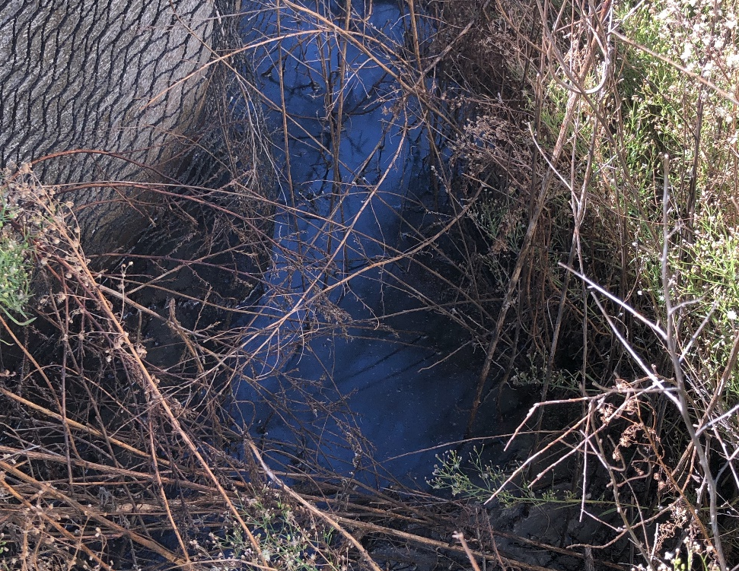
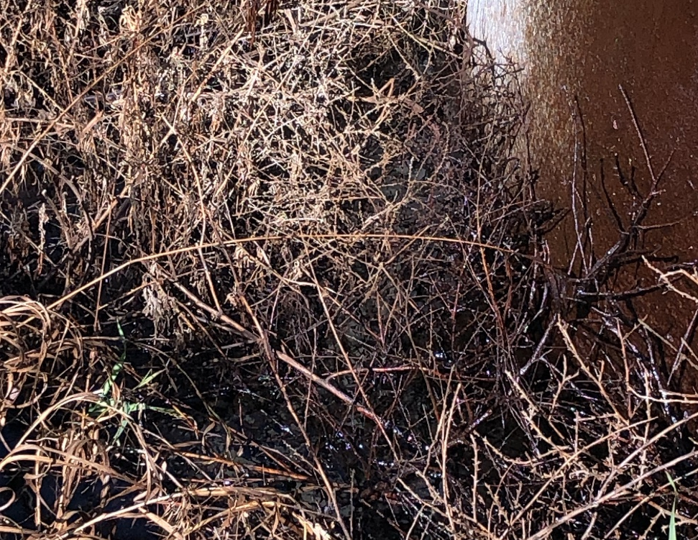
Inspection Photos
Location Name: ABBOTT_12-21
Location ID: 320477
Photo #5 Crude oil in berm around open top tank.
Photo #6 Crude oil in berm around open top tank.

Slide 4
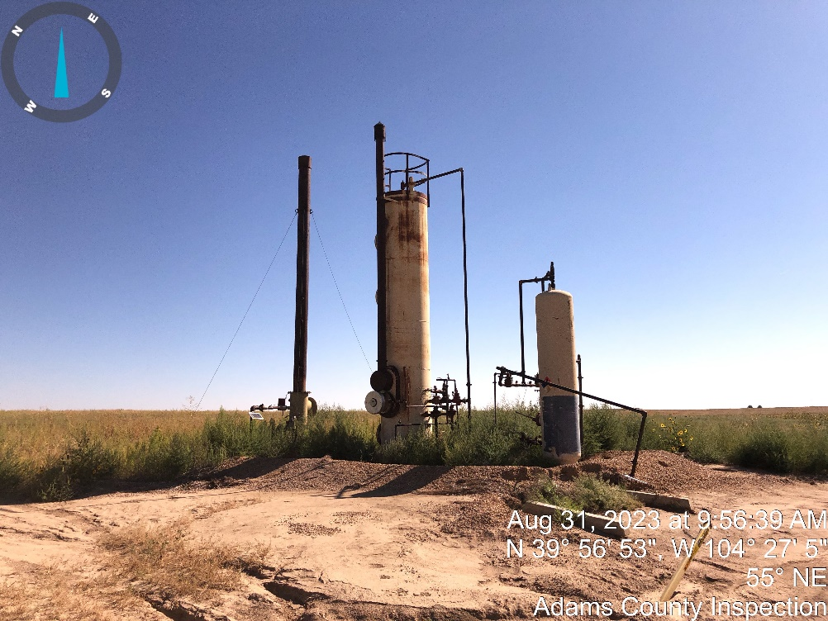
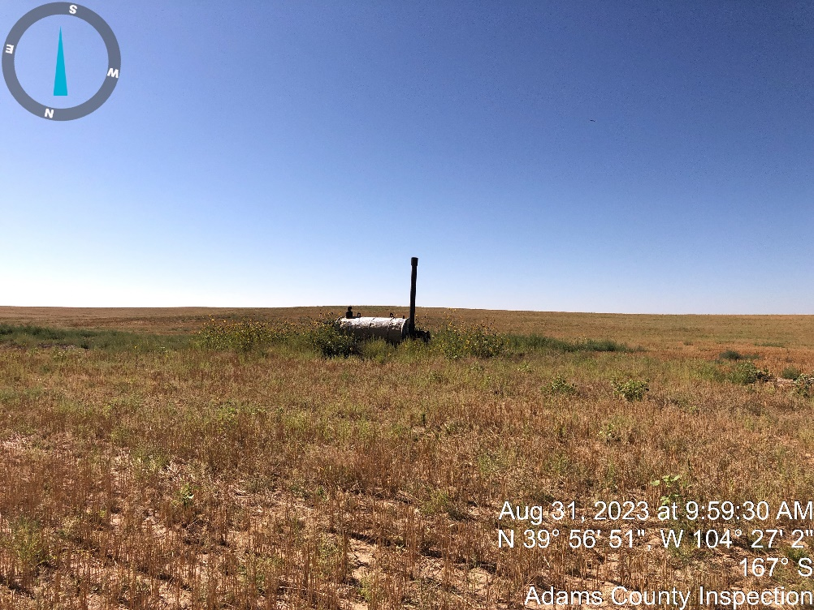
Inspection Photos
Location Name: ABBOTT_12-21
Location ID: 320477
Photo #7 Separators and ECD.
Photo #8 Separator in field in-between well head and location.

Slide 5
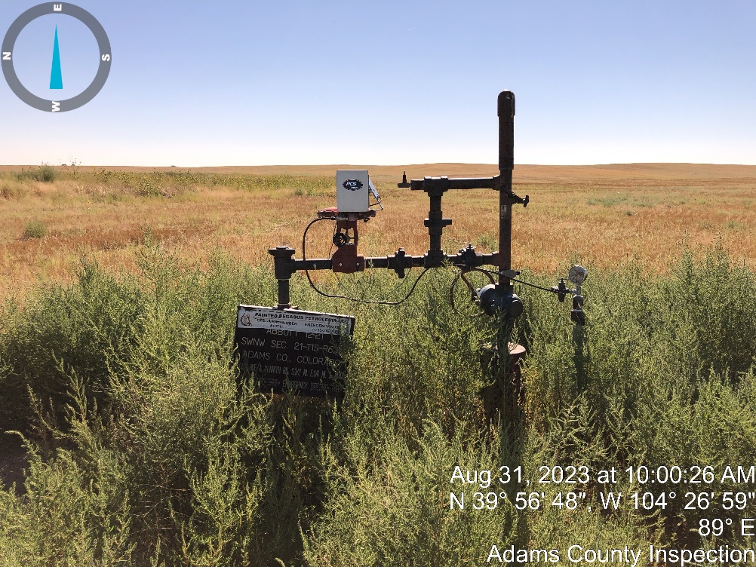
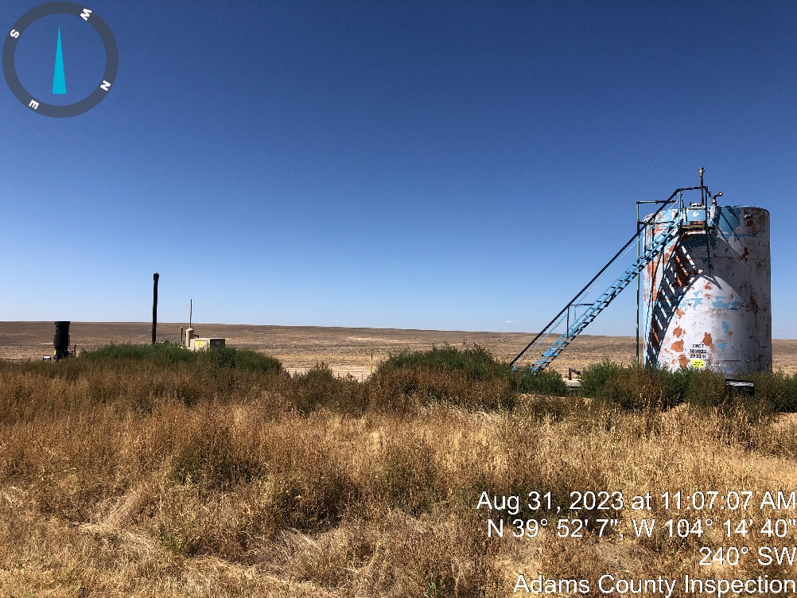
Inspection Photos
Location Name: ABBOTT_12-21
Location ID: 320477
Photo #9 Well head.
Photo #10 location with well head in background.

Slide 6
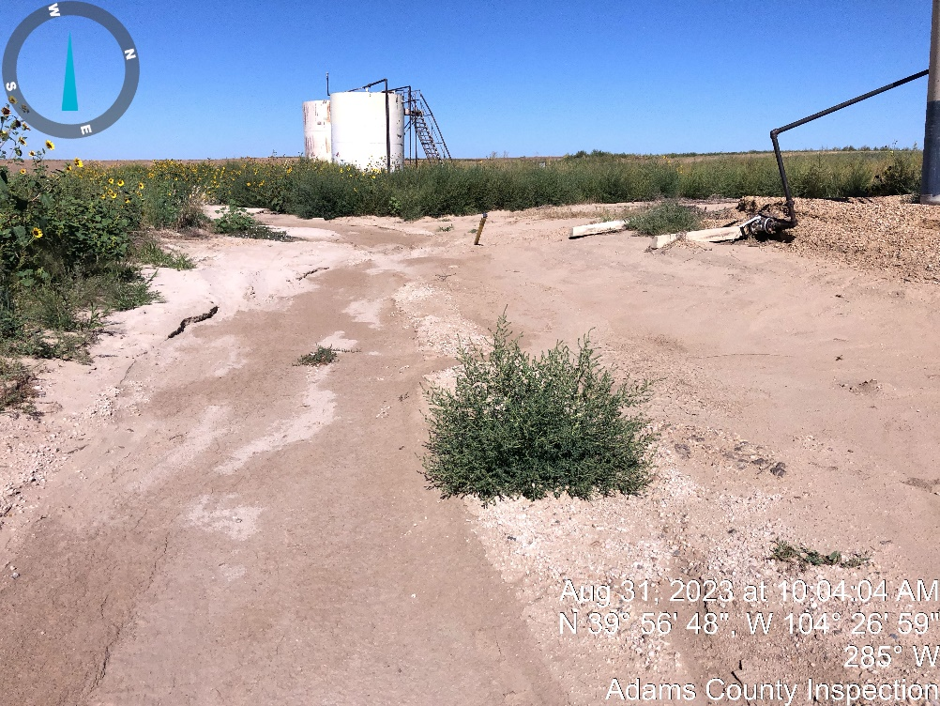
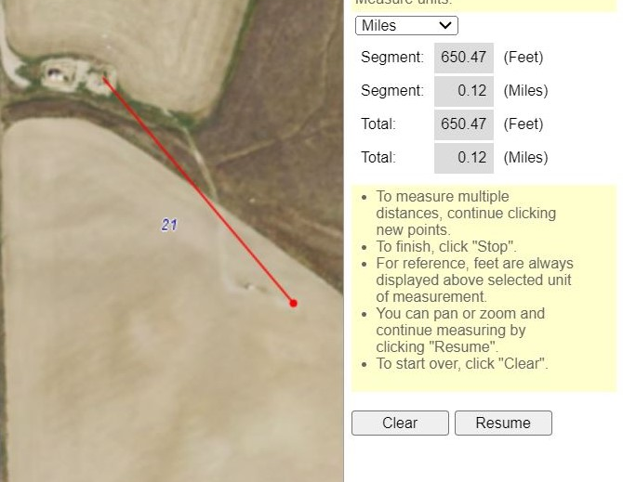
Inspection Photos
Location Name: ABBOTT_12-21
Location ID: 320477
Photo #11 washed out road to well head.
Photo #12 Distance from well head to location (650.07 feet).

