Slide 1
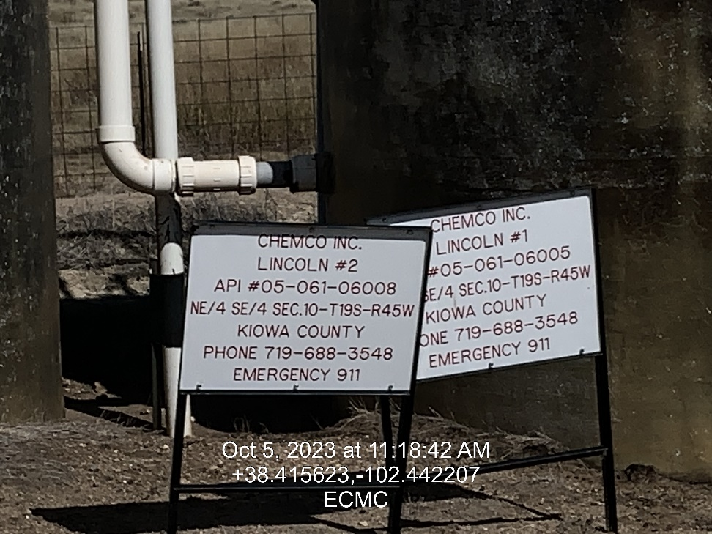
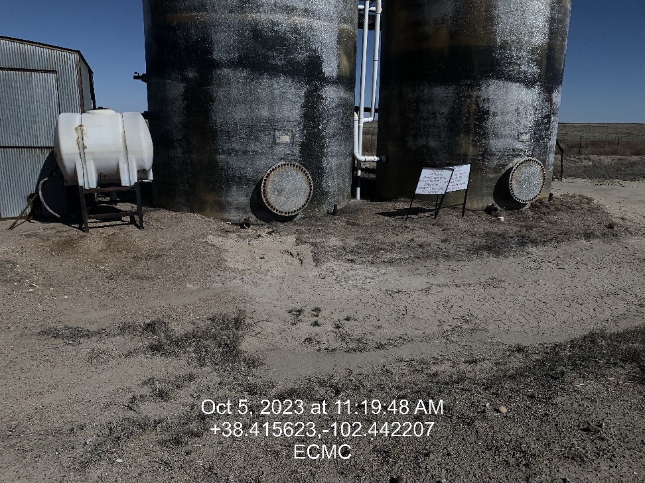

Inspection Photos
Location: Lincoln #2
Facility ID: 324794
Photo 1 –Wellhead Placard at Tank Battery
Photo 2 – Potential release from Valve on tank

Slide 2
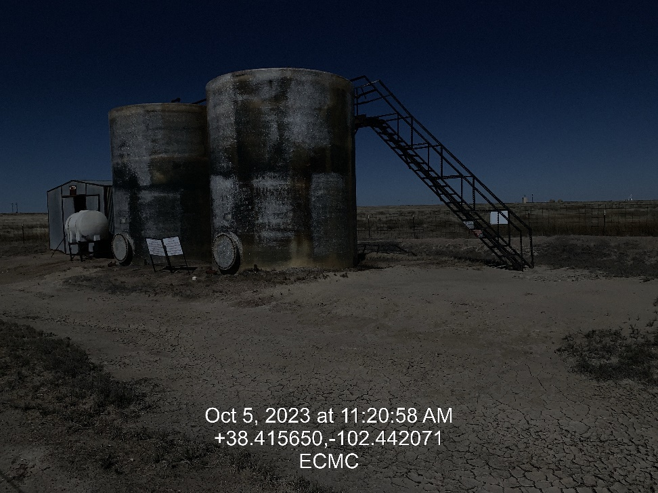
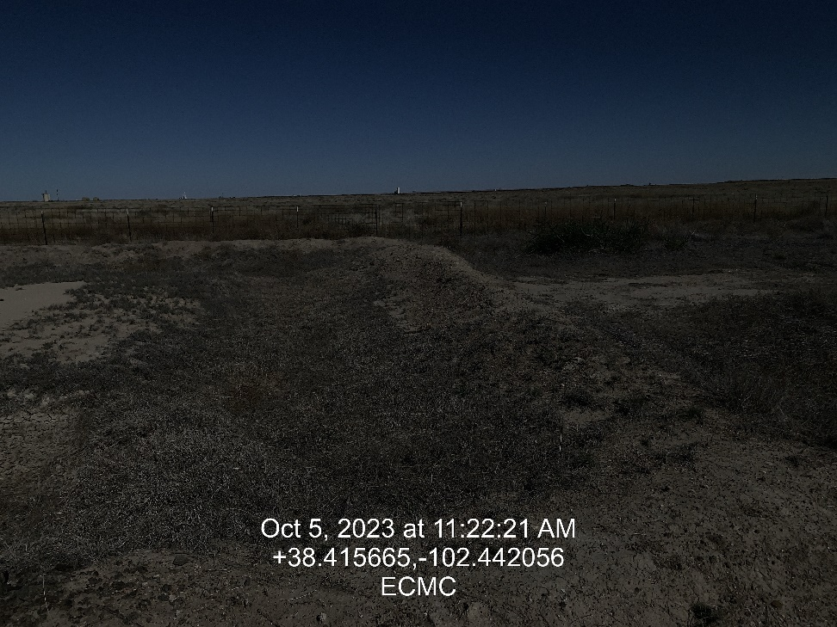
Inspection Photos
Location: Lincoln #2
Facility ID: 324794
Photo 3 – Tanks looking west, Potential flow path
Photo 4 – East end of Containment

Slide 3
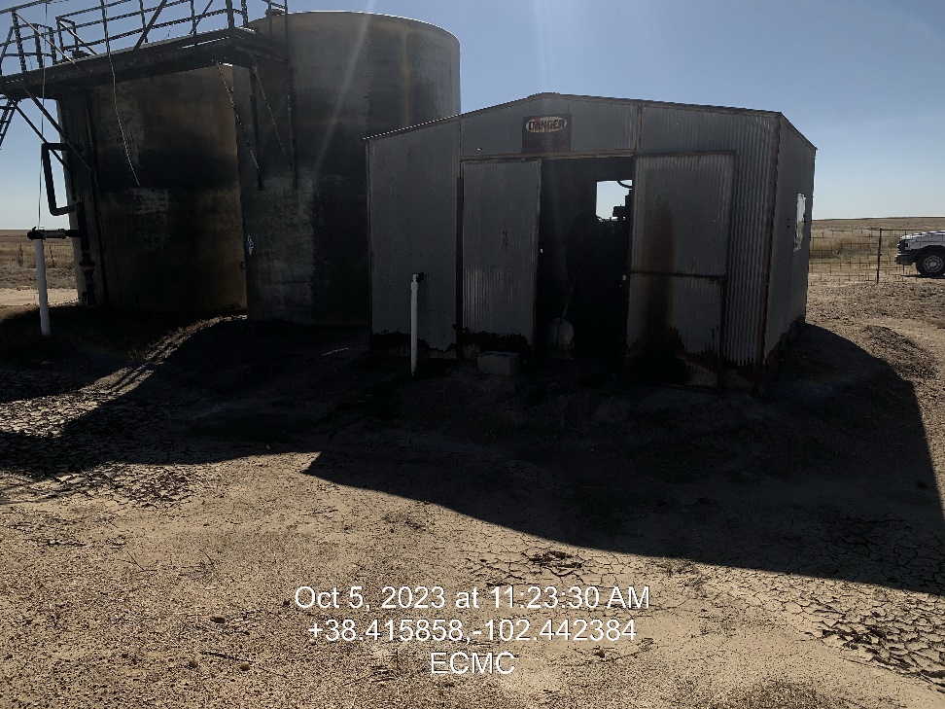
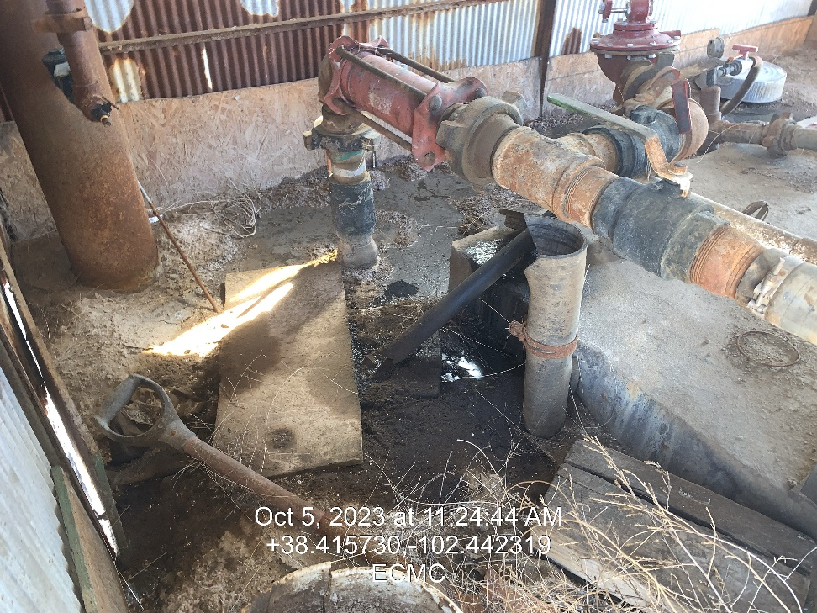
Inspection Photos
Location: Lincoln #2
Facility ID: 324794
Photo 5 – Engine Skid shed
Photo 6 – Soil Staining inside shed

Slide 4
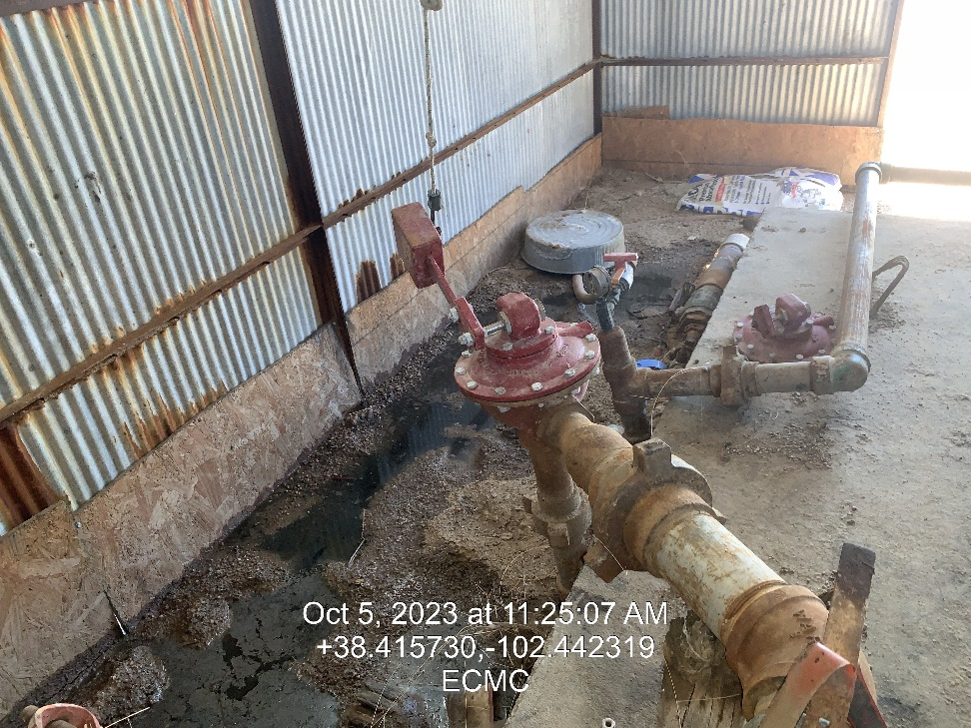
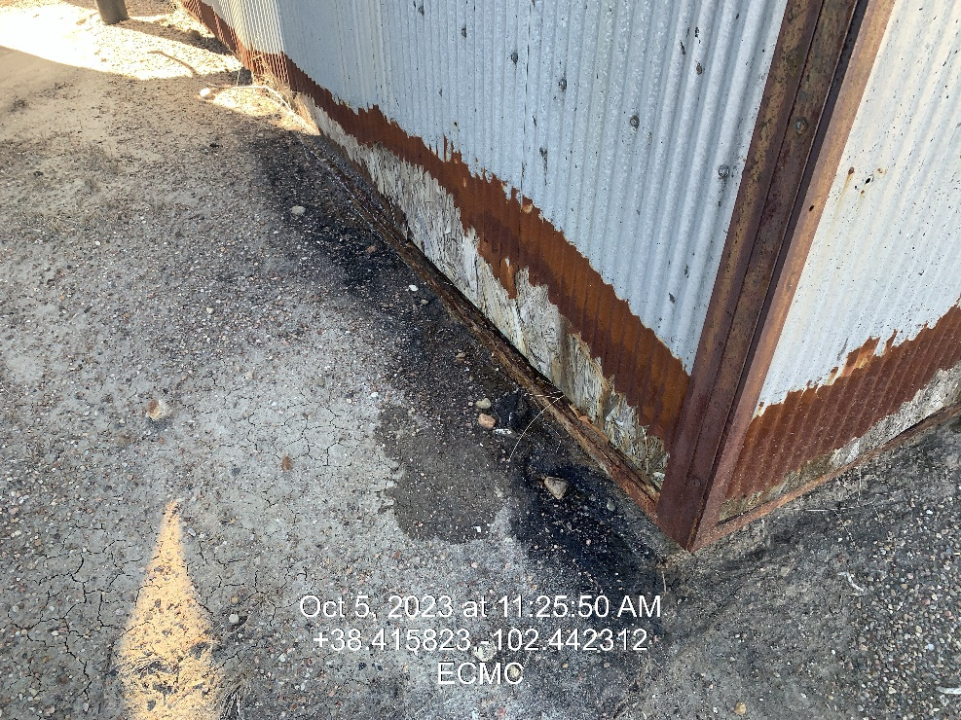
Inspection Photos
Location: Lincoln #2
Facility ID: 324794
Photo 7 – Soil Staining in shed
Photo 8 – Stained soil outside of shed

