Slide 1
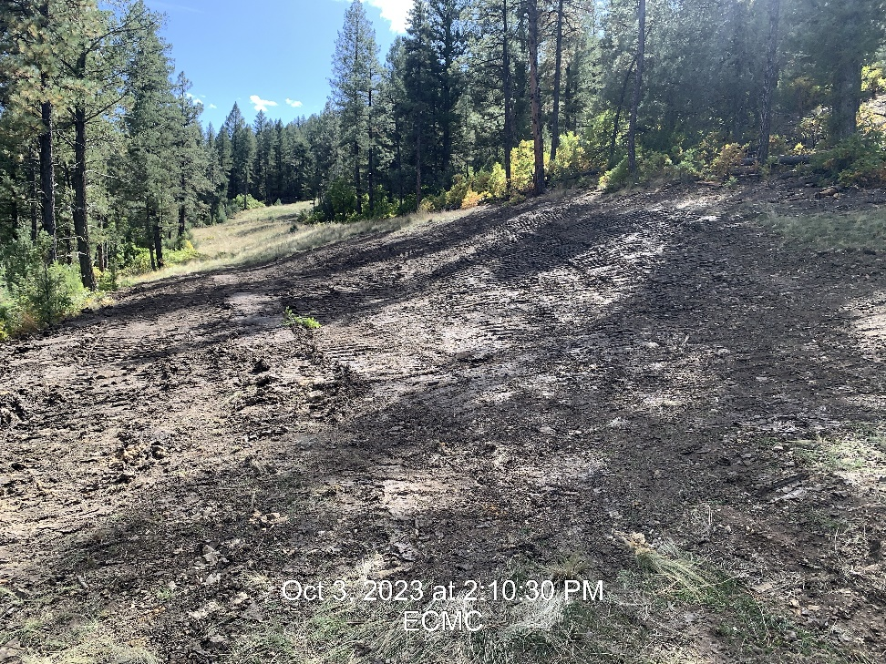
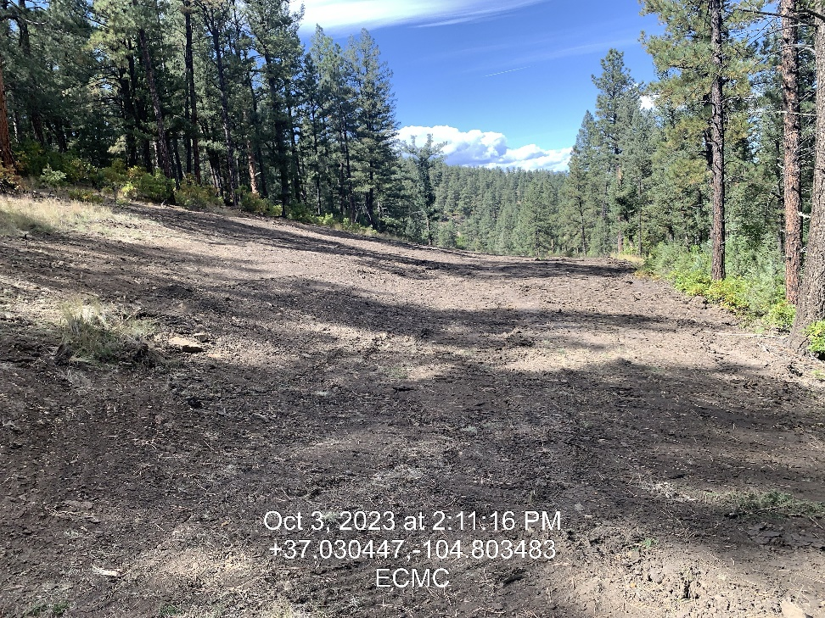

Inspection Photos
Location: Wapiti Water Transfer System Spill
Facility ID: 485210
Photo 1 –Spill Location looking up Pipeline R-O-W
Photo 2 – Spill Location looking down Pipeline R-O-W

Slide 2
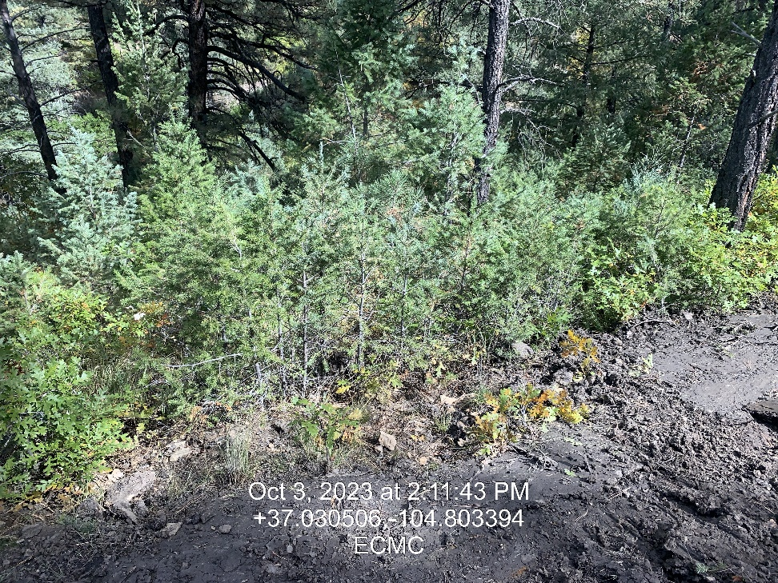
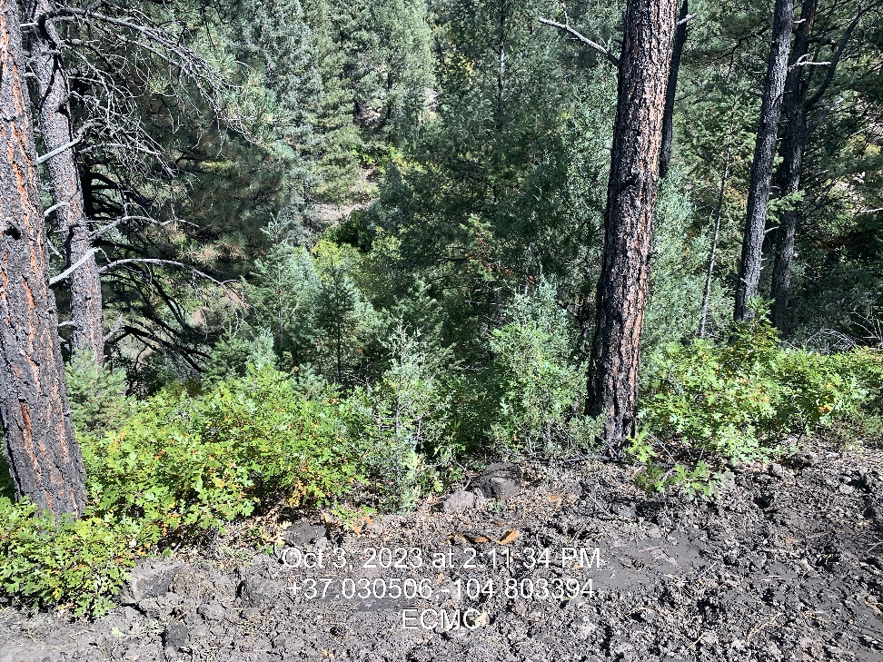
Inspection Photos
Location: Wapiti Water Transfer System Spill
Facility ID: 485210
Photo 3 – Site where water appears to leave Pipeline R-O-W
Photo 4 – 2nd site where water appears to leave Pipeline R-O-W

Slide 3
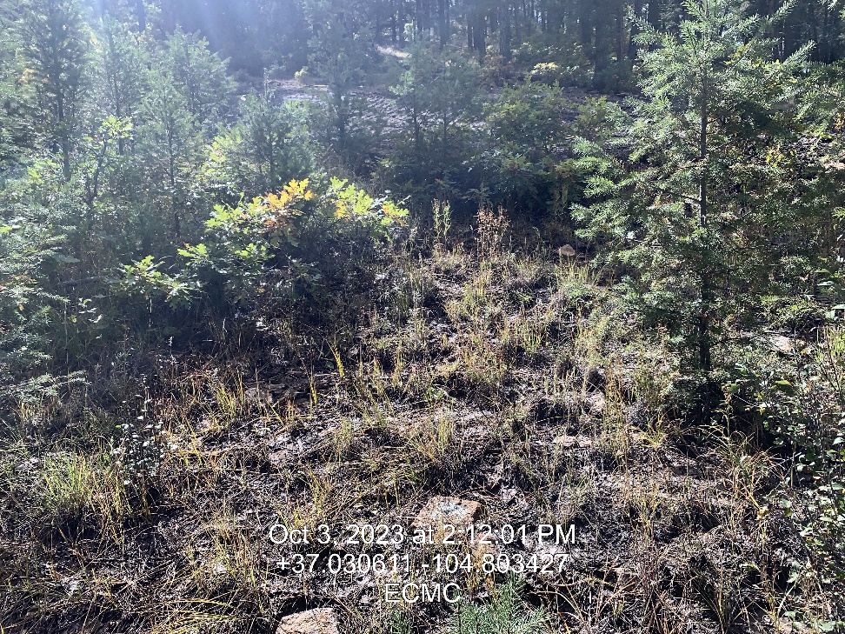
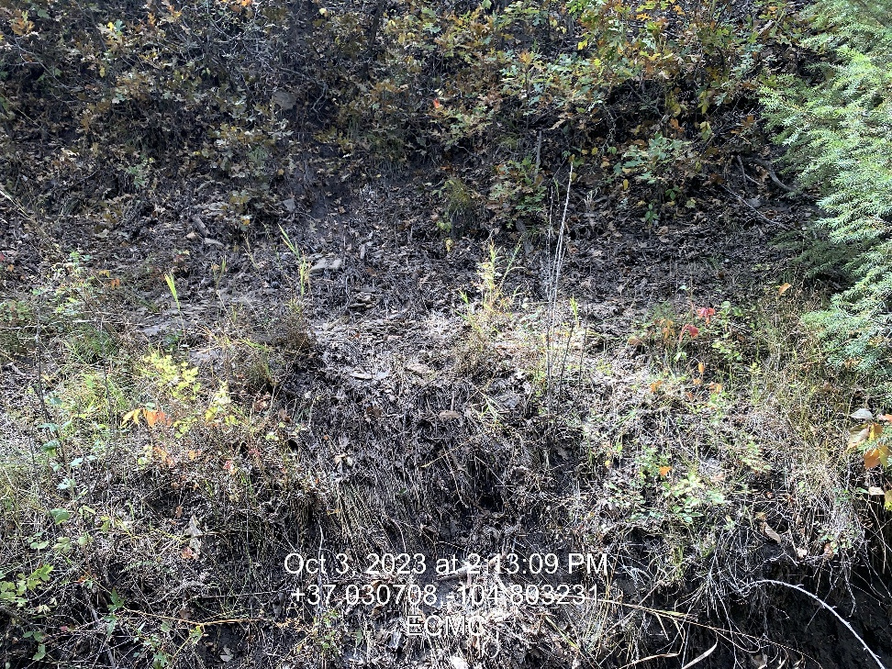
Inspection Photos
Location: Wapiti Water Transfer System Spill
Facility ID: 485210
Photo 5 – Water Flow Path
Photo 6 – Water flow path

Slide 4
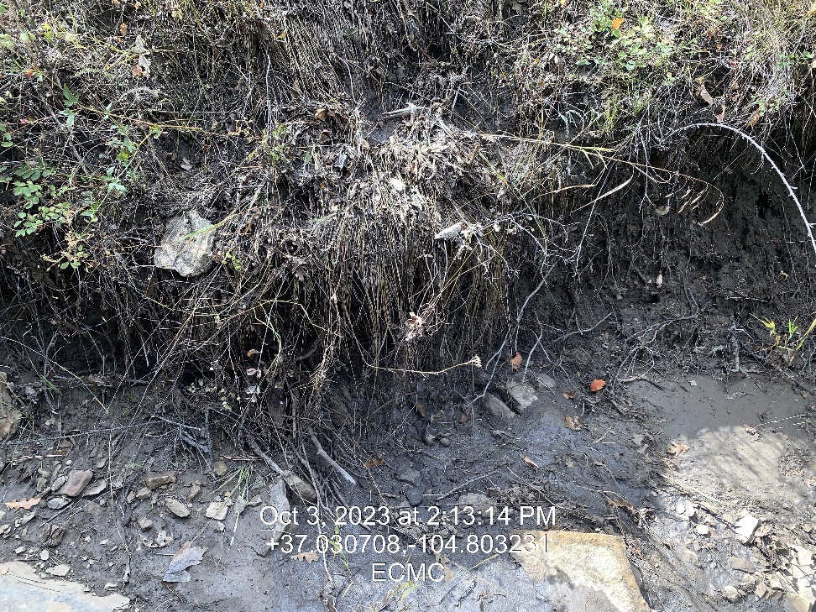
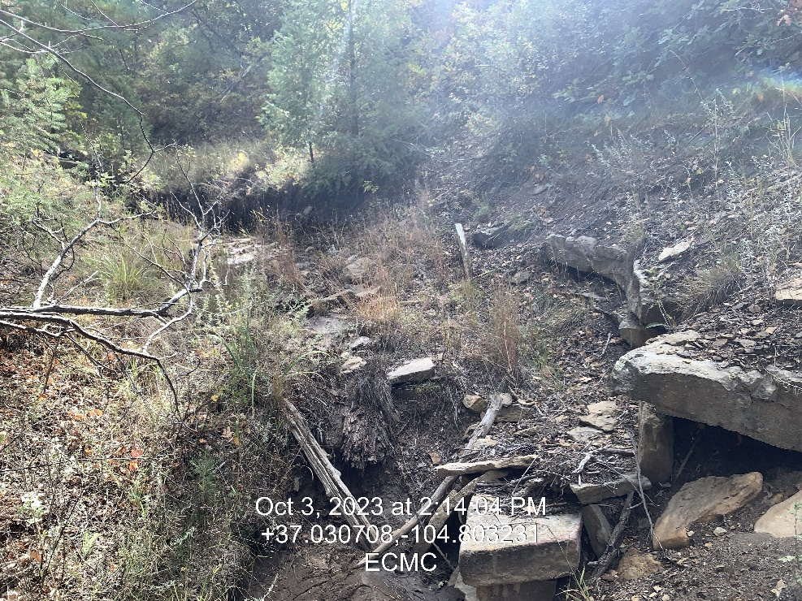
Inspection Photos
Location: Wapiti Water Transfer System Spill
Facility ID: 485210
Photo 7 – Dry Arroyo/Waters of the State where water appears to have entered
Photo 8 – Dry Arroyo/Waters of the State, below area where waters appear to have entered

Slide 5
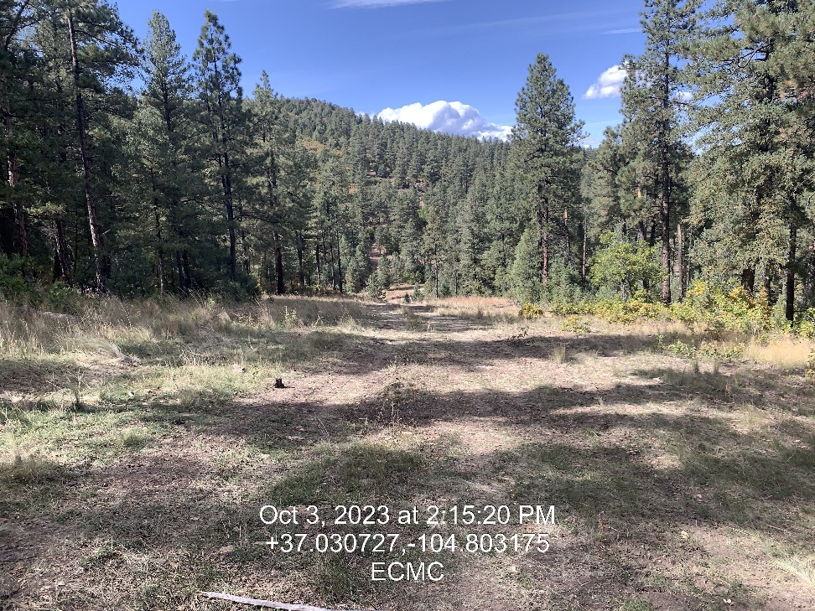
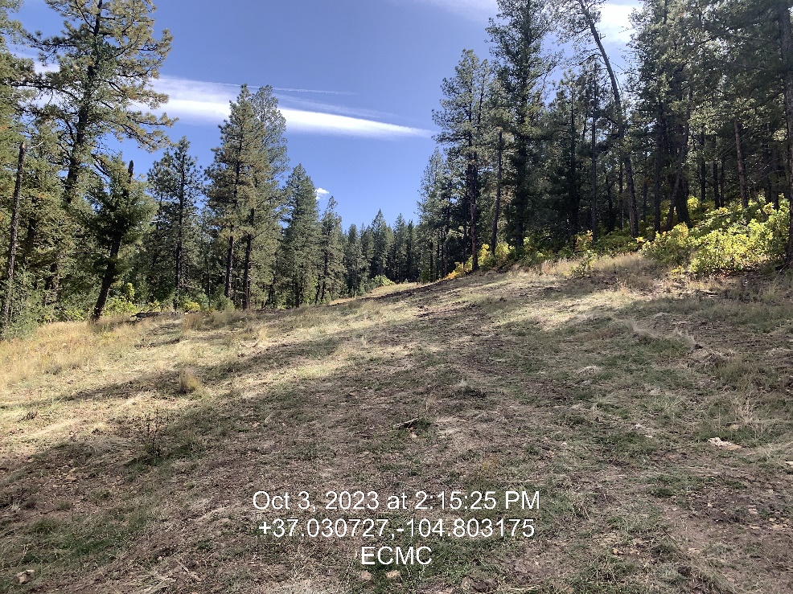
Inspection Photos
Location: Wapiti Water Transfer System Spill
Facility ID: 485210
Photo 9 – Pipeline R-O-W looking north to main road
Photo 10 – Spill/release area

