Slide 1
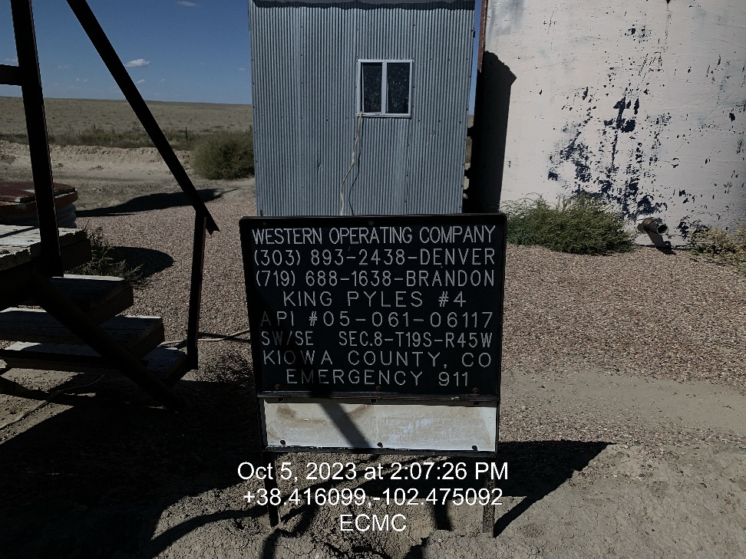
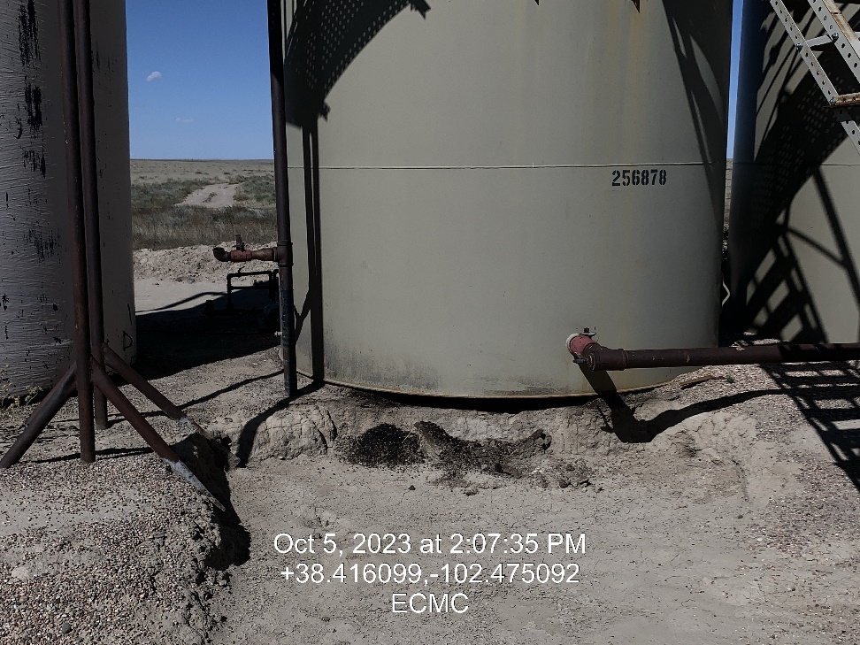

Inspection Photos
Location: King Pyles #4 Tank Battery
Facility ID: 480894
Photo 1 - Placard
Photo 2 – North Remediation Area, Impacted soil under tank

Slide 2
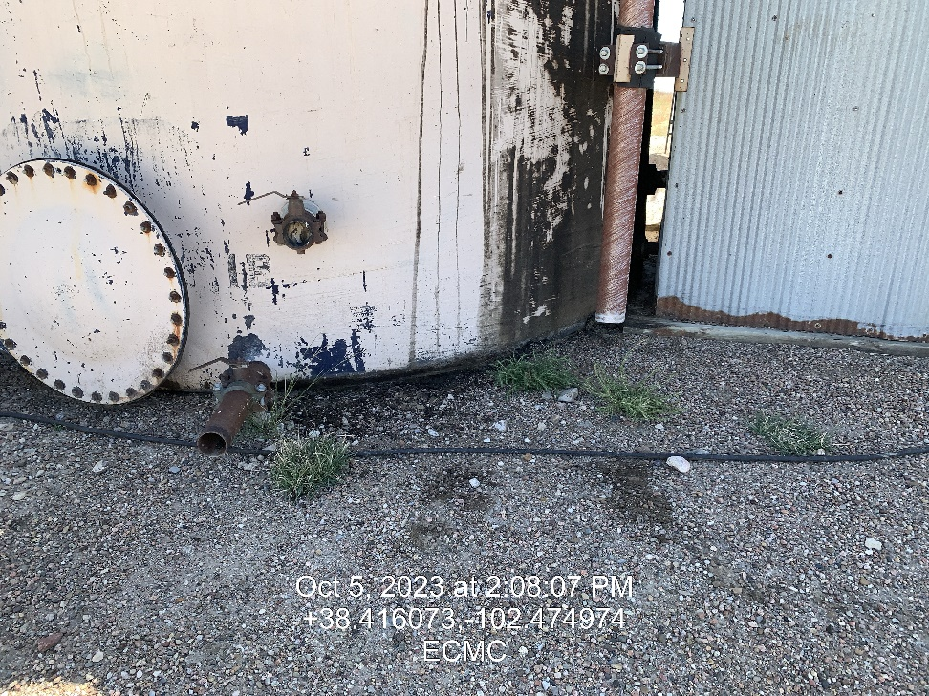
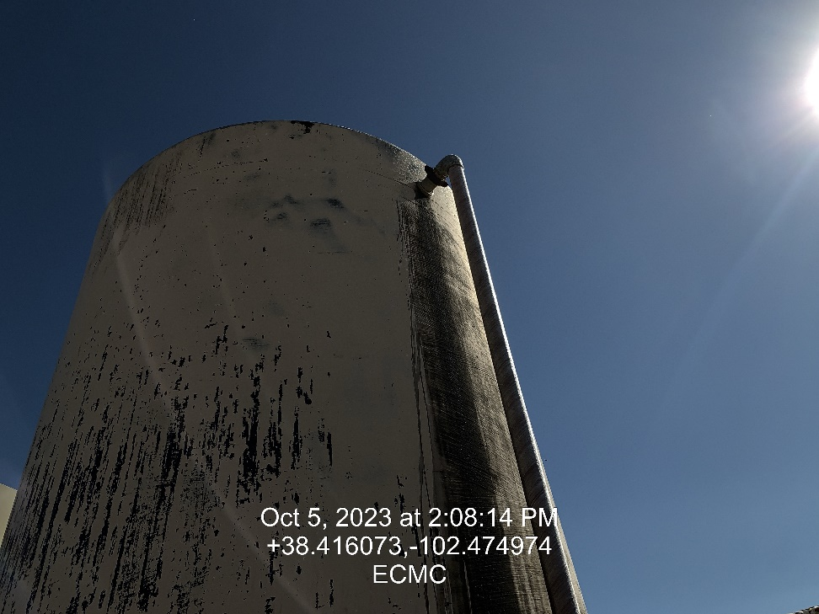
Inspection Photos
Location: King Pyles #4 Tank Battery
Facility ID: 480894
Photo 3 – Looking south Tank 1, area of impacted soil under tank
Photo 4 – Potential Historical leak

Slide 3
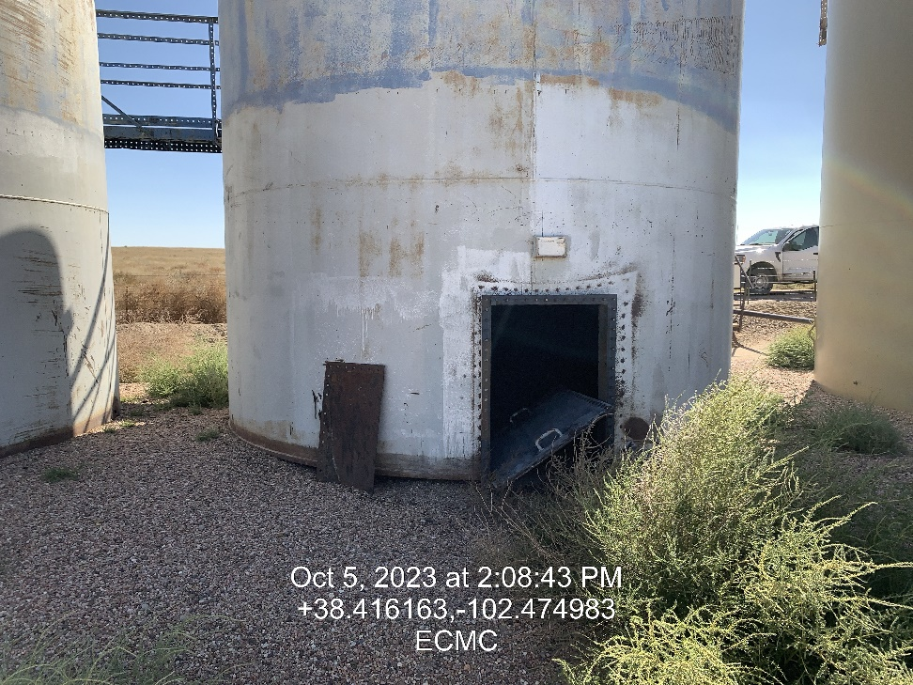
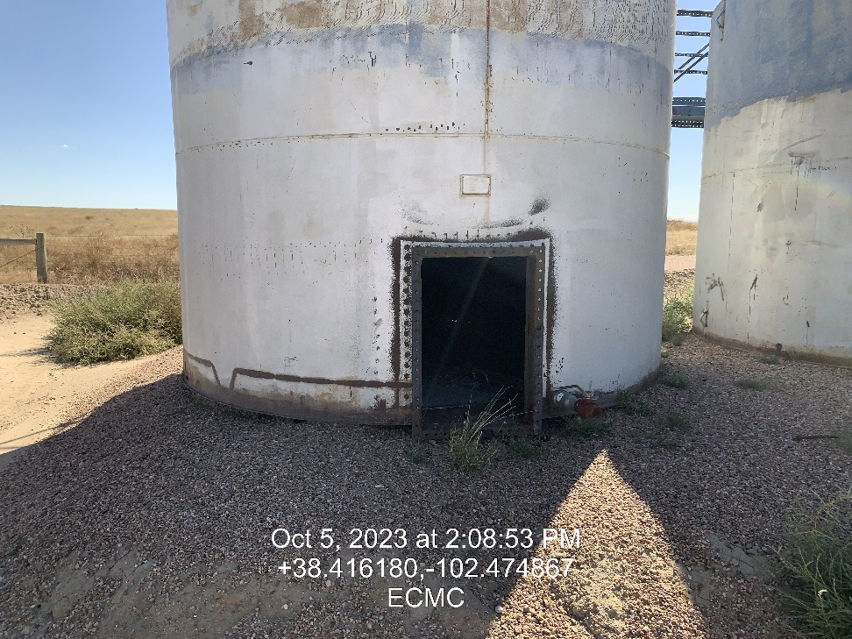
Inspection Photos
Location: King Pyles #4 Tank Battery
Facility ID: 480894
Photo 5 – Unused tanks
Photo 6 – Unused tanks

Slide 4
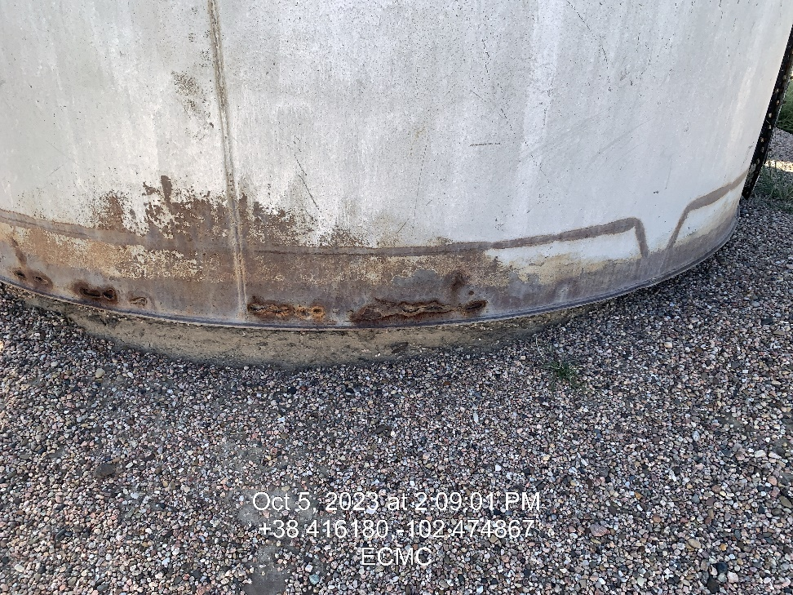
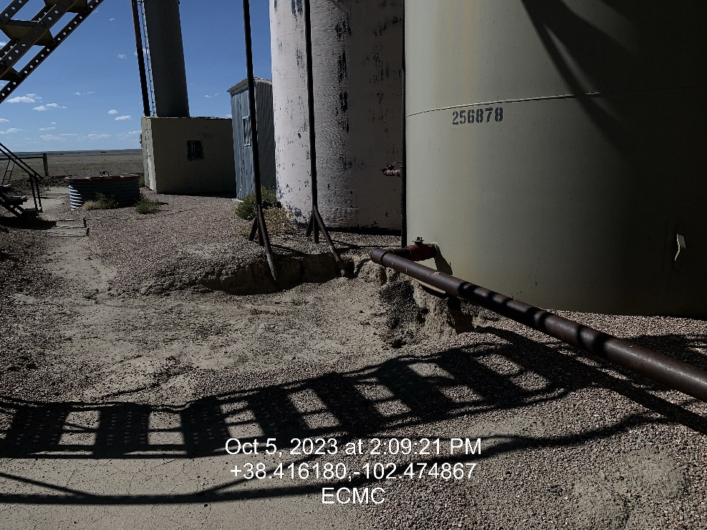
Inspection Photos
Location: King Pyles #4 Tank Battery
Facility ID: 480894
Photo 7 – Unused Tanks Rotted at base
Photo 8 – Looing west to remediation area

