Slide 1
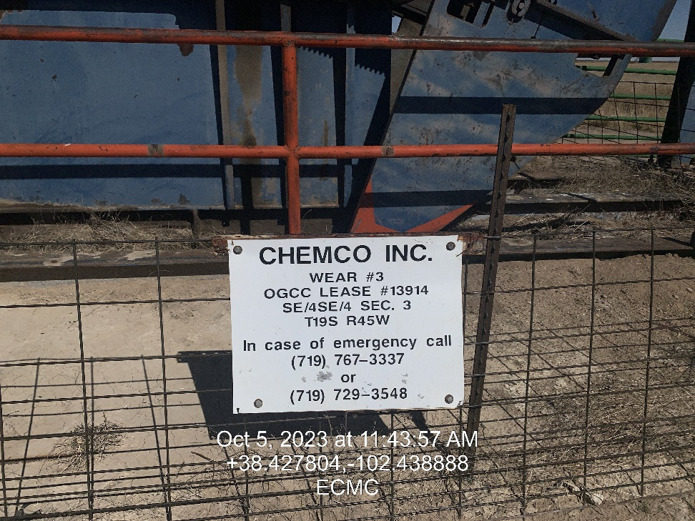
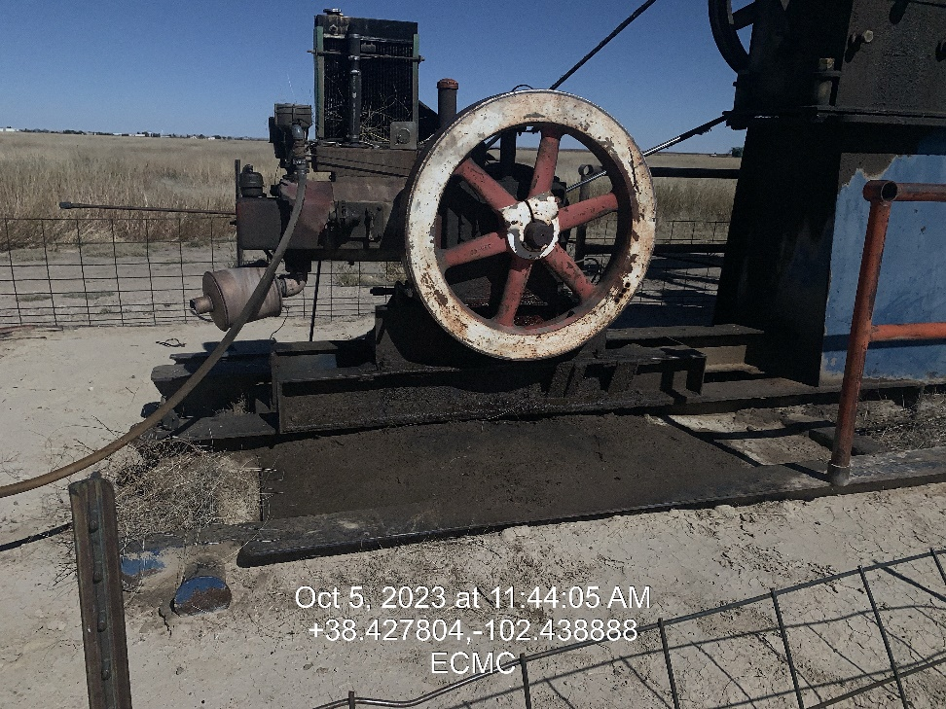

Inspection Photos
Location: Wear # 3
Facility ID: 324847
Photo 1 –Wellhead Placard
Photo 2 – Stained soil on south side of Pumping Unit

Slide 2
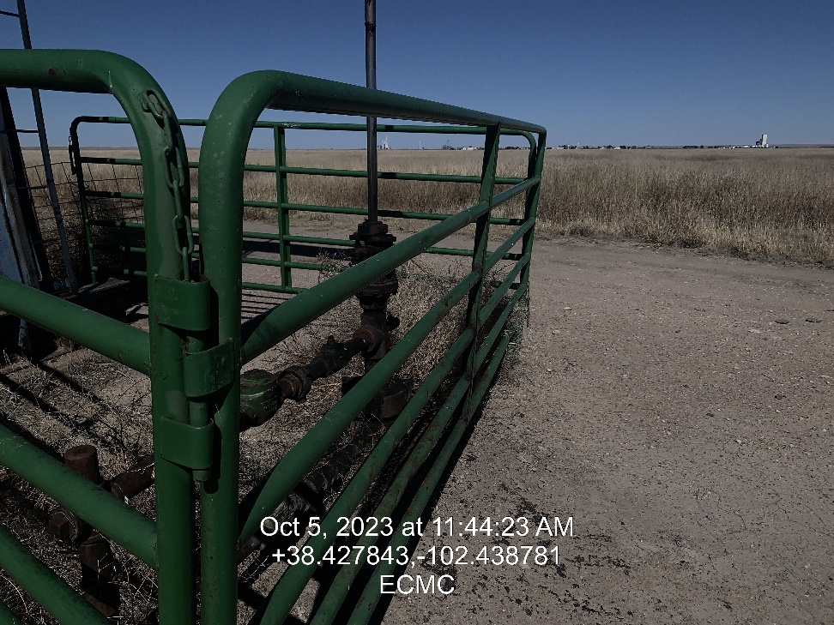
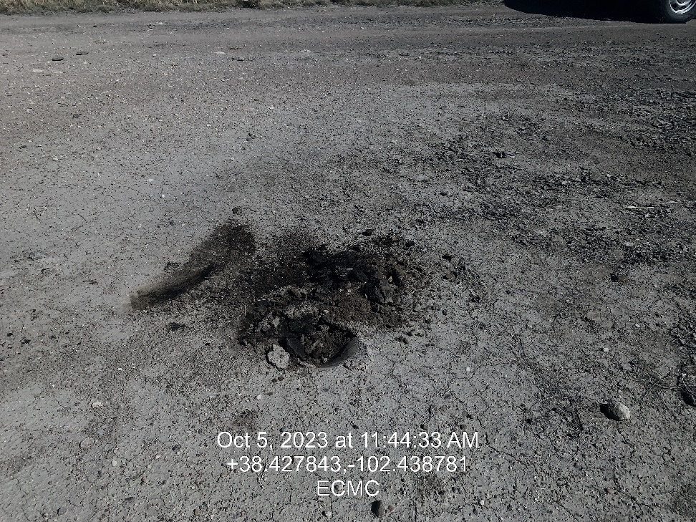
Inspection Photos
Location: Wear # 3
Facility ID: 324847
Photo 3 – Well Head
Photo 4 – Soil Staining on Well location Near well head

Slide 3
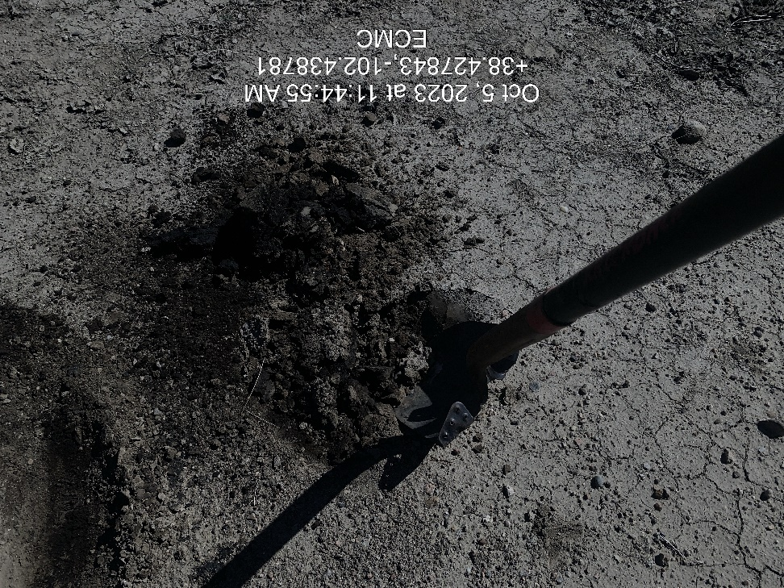
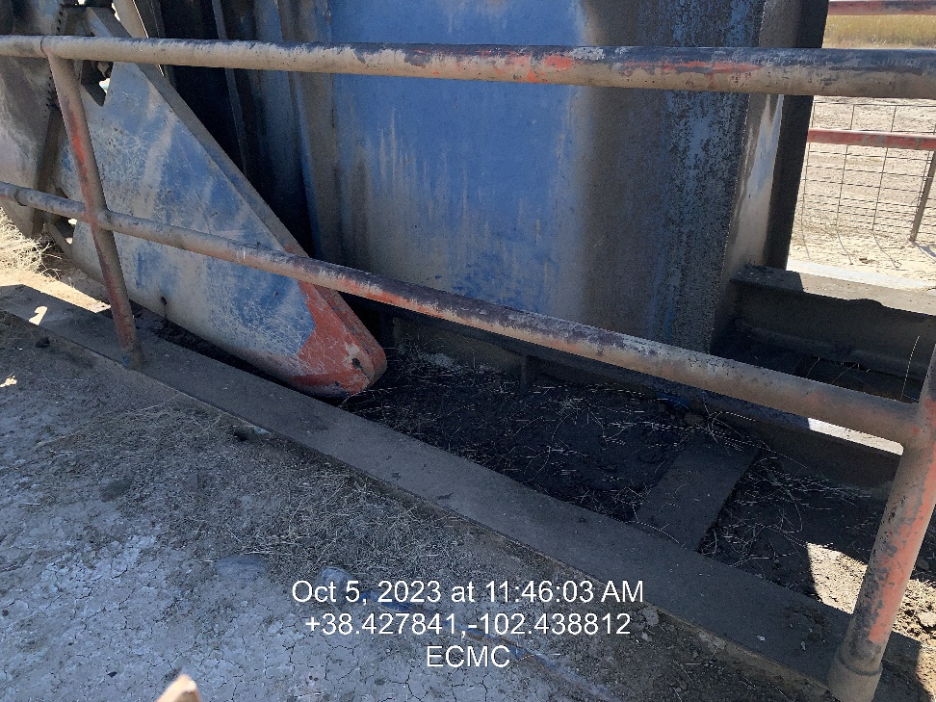
Inspection Photos
Location: Wear # 3
Facility ID: 324847
Photo 5 – Stained soil on location
Photo 6 – Soil Staining in pumping unit

Slide 4
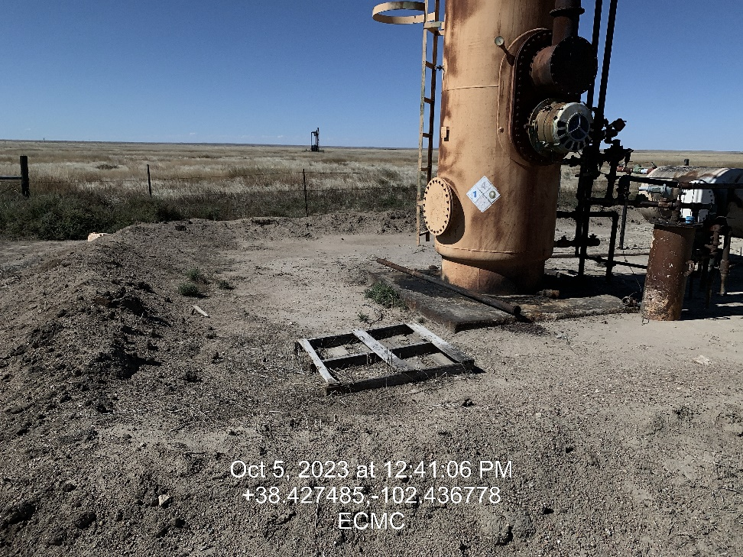
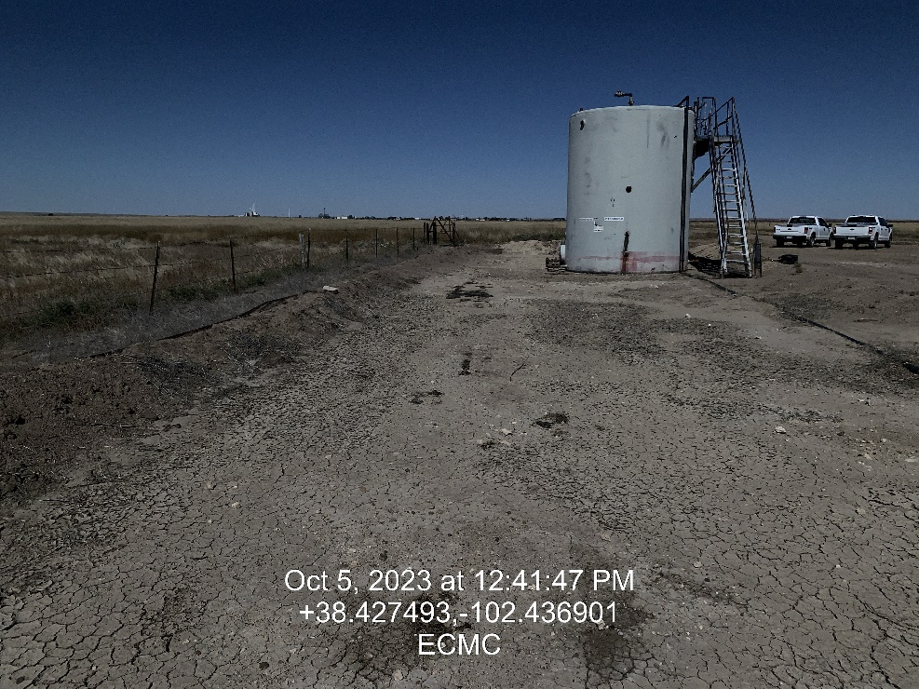
Inspection Photos
Location: Wear # 3
Facility ID: 324847
Photo 7 – Trash on location within Pumping Unit fencing
Photo 8 – Service ladder attached with Wire/Broken bracing

Slide 5
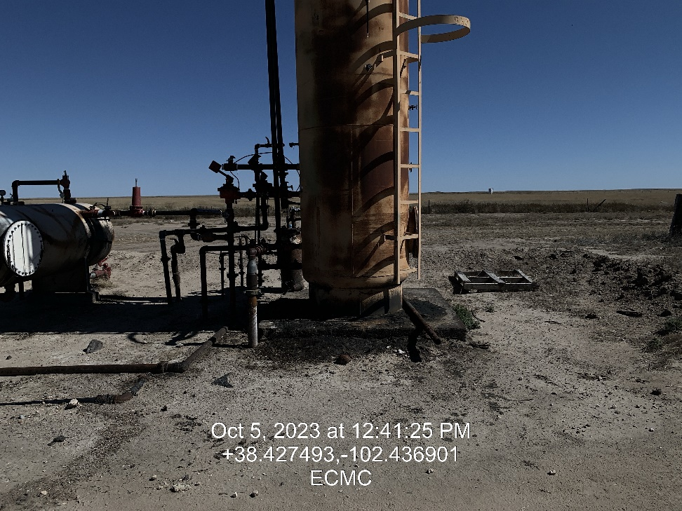
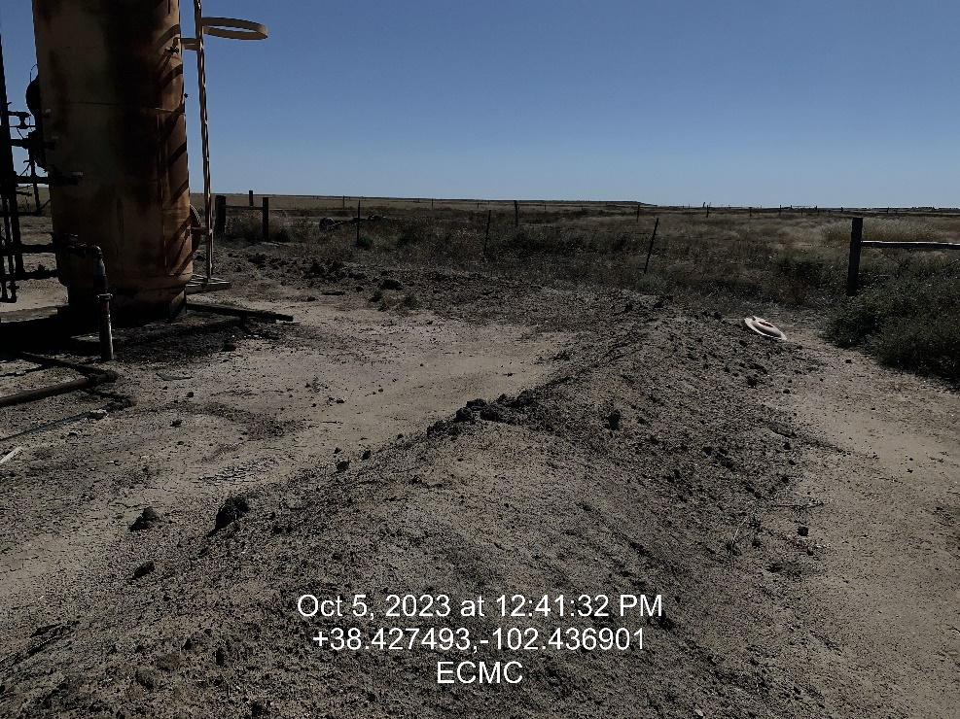
Inspection Photos
Location: Wear # 3
Facility ID: 324847
Photo 7 – Trash on location within Pumping Unit fencing
Photo 8 – Service ladder attached with Wire/Broken bracing

Slide 6
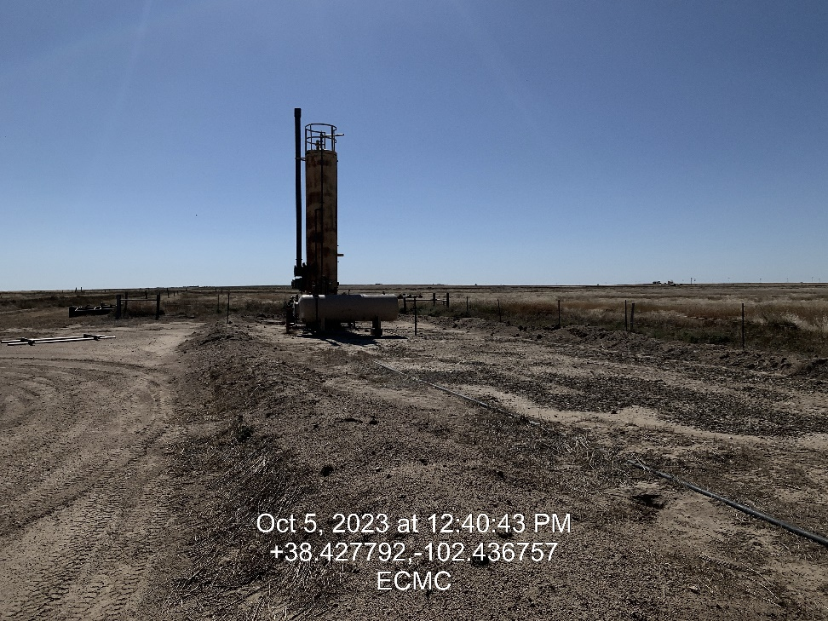
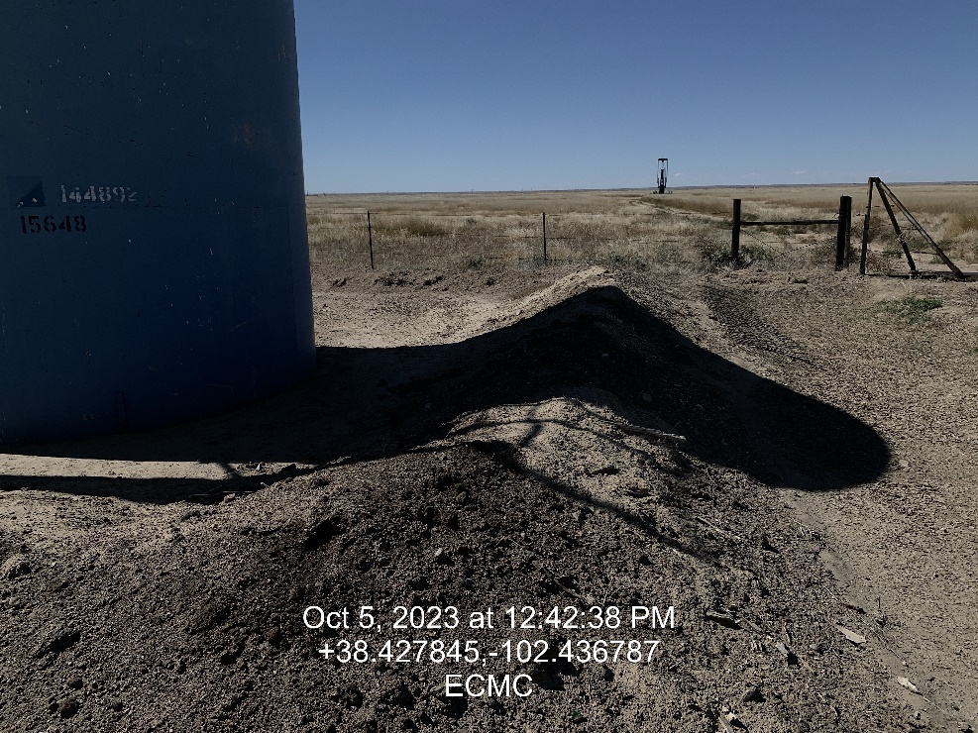
Inspection Photos
Location: Wear # 3
Facility ID: 324847
Photo 7 – Trash on location within Pumping Unit fencing
Photo 8 – Service ladder attached with Wire/Broken bracing

