Slide 1
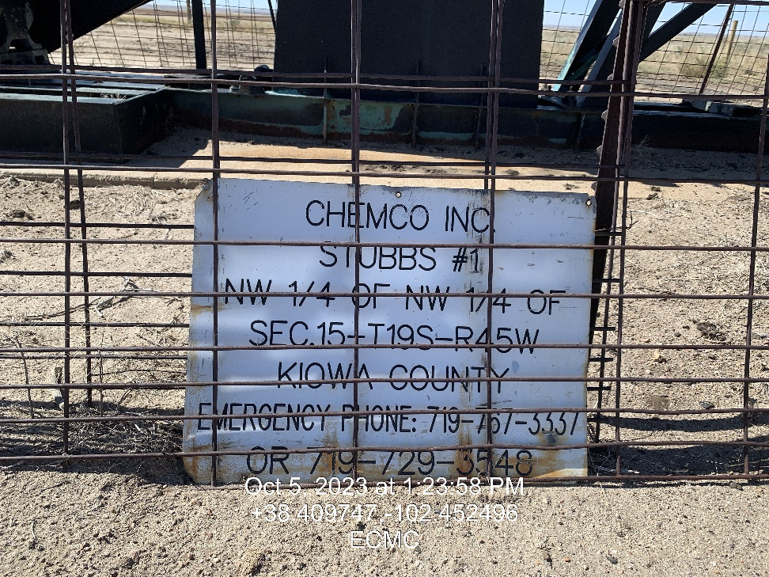
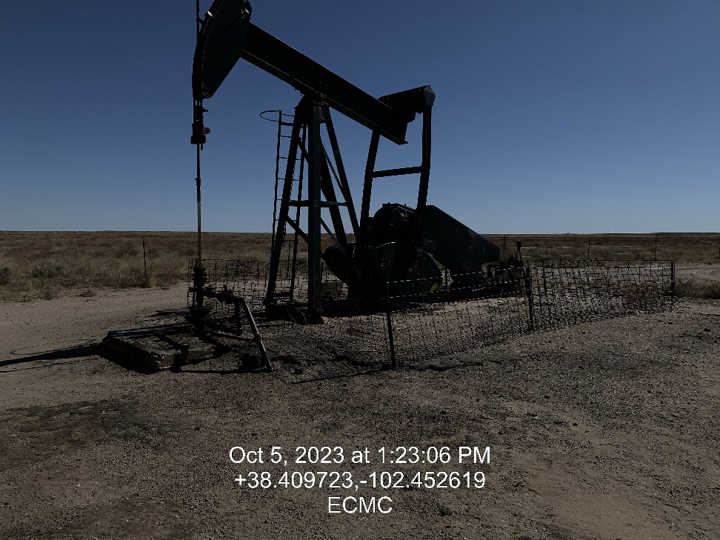

Inspection Photos
Location: Stubbs # 1
Facility ID: 324788
Photo 1 –Wellhead Placard
Photo 2 – East

Slide 2
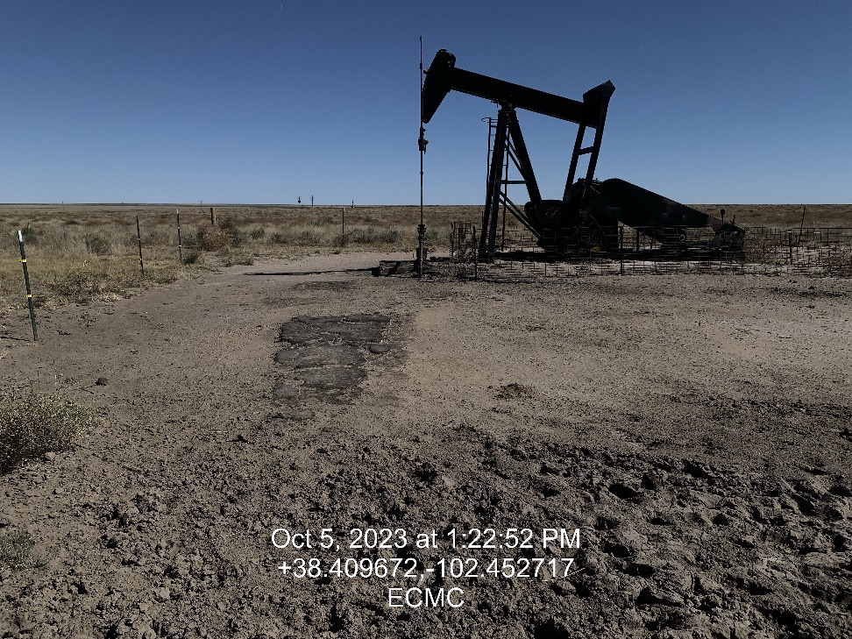
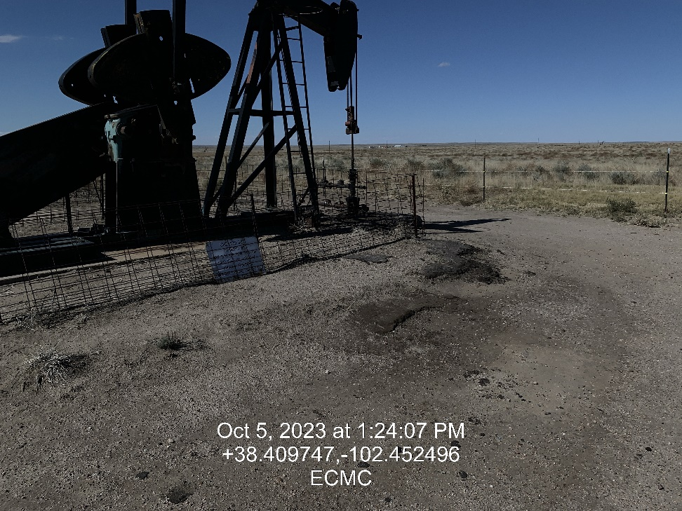
Inspection Photos
Location: Stubbs # 1
Facility ID: 324788
Photo 3 – East. Areas of impacted soil throughout the location
Photo 4 – Northwest Impacted soil

Slide 3
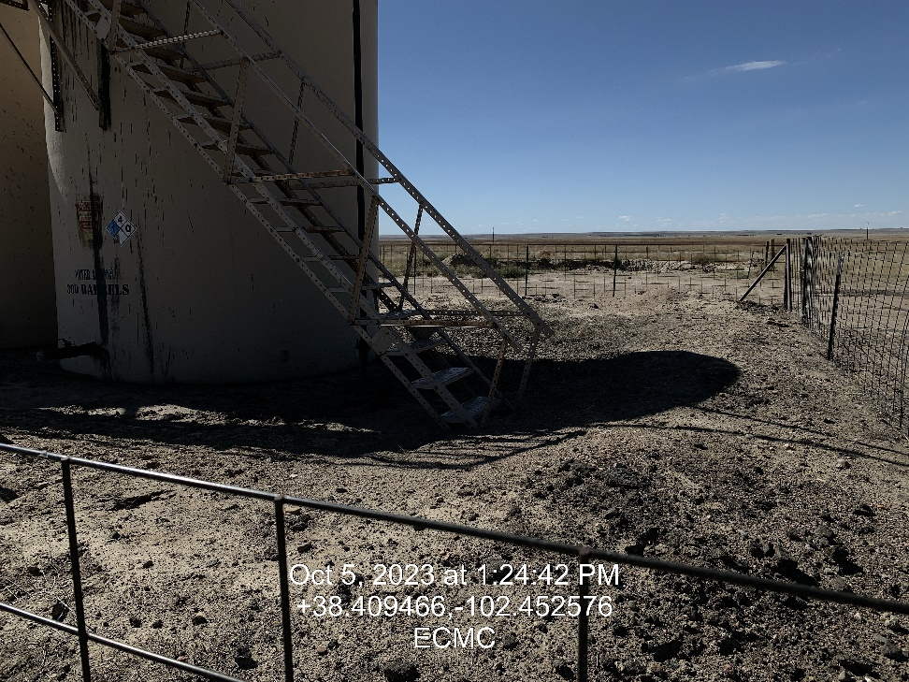
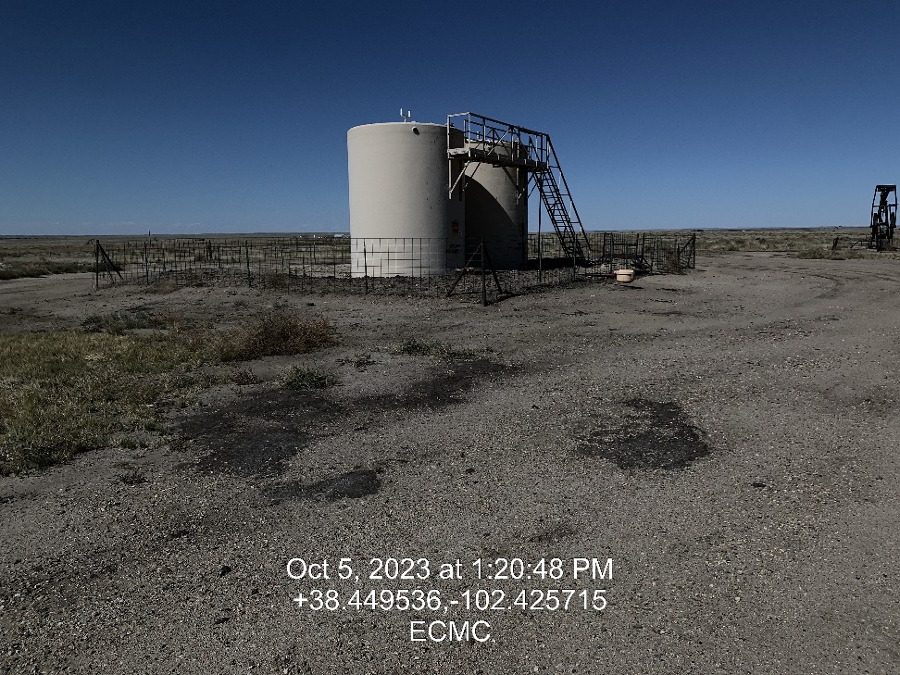
Inspection Photos
Location: Stubbs # 1
Facility ID: 324788
Photo 5 – Battery Berm has shows of impacted soils
Photo 6 – Entrance to location looking Northwest. Impacted soils

Slide 4
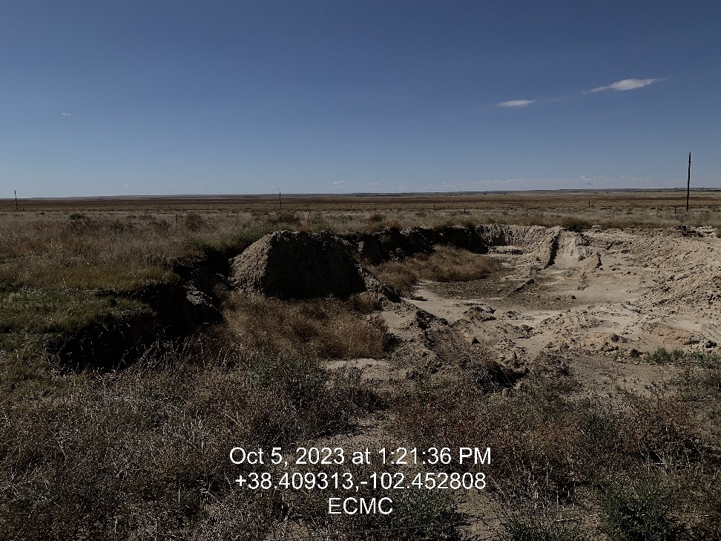
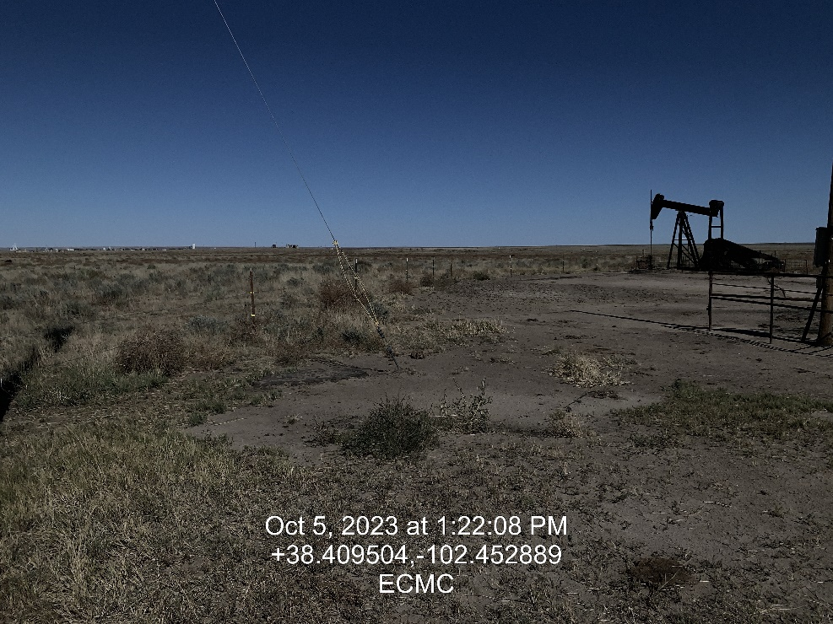
Inspection Photos
Location: Stubbs # 1
Facility ID: 324788
Photo 7 – Open remediation # 24962.
Photo 8 – Looking Northeast

Slide 5
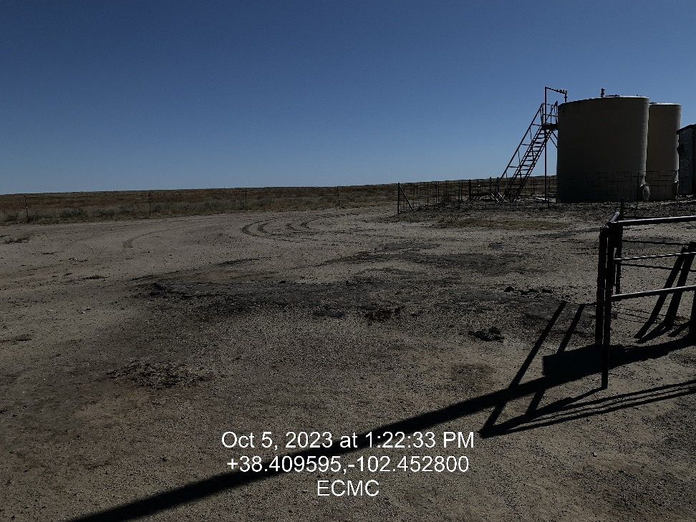
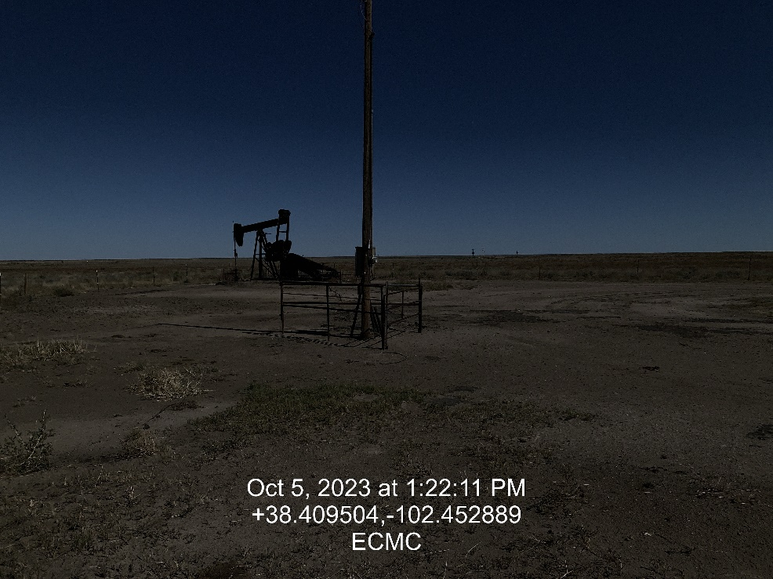
Inspection Photos
Location: Stubbs # 1
Facility ID: 324788
Photo 9 – Areas of impacted soil
Photo 10 – Areas of impacted soil

