Slide 1
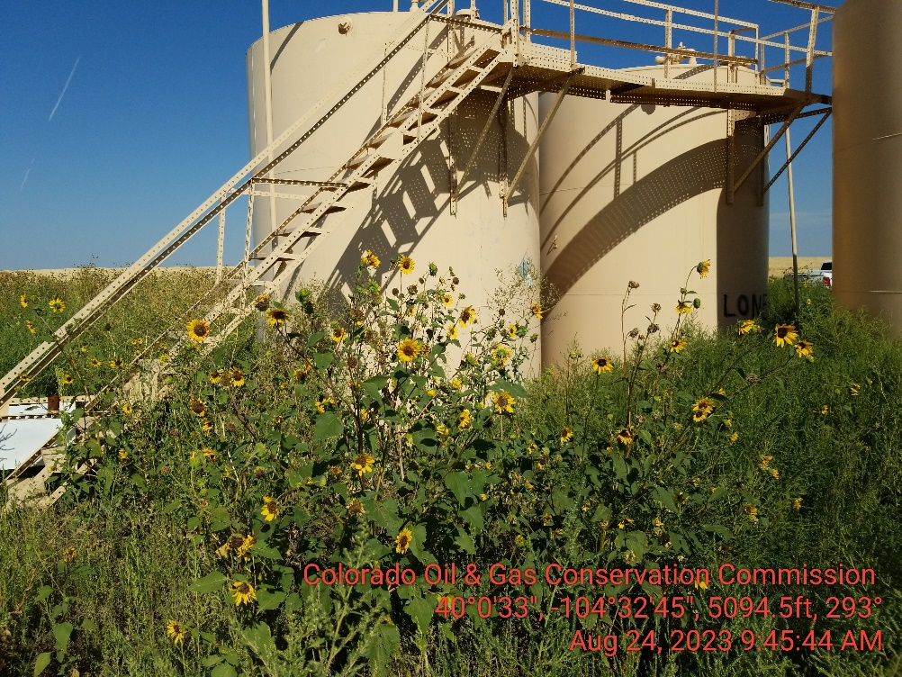
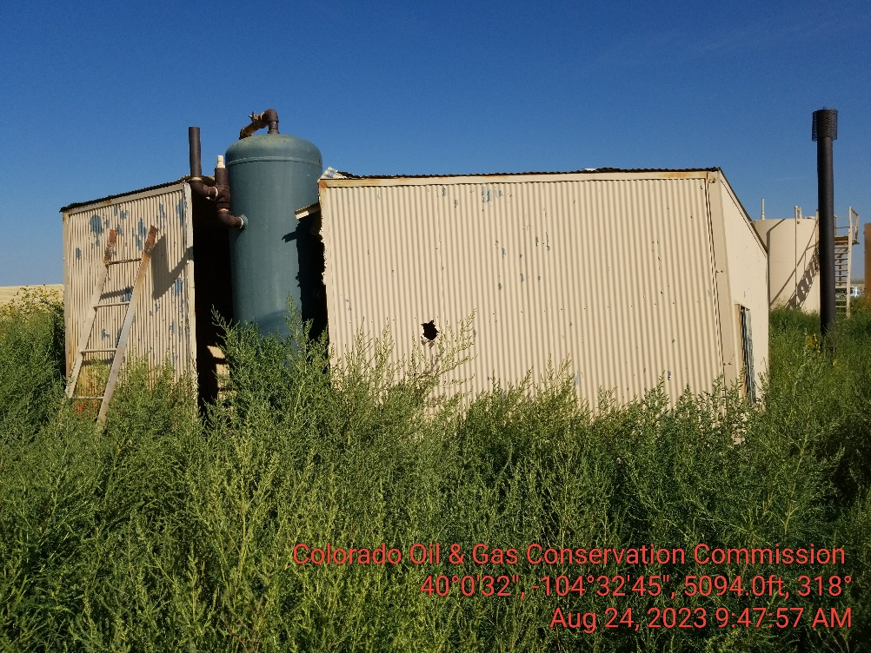
Inspection Photos
Location Name: Lone Eagle 13-34
Location ID: 464350
Weeds are not being controlled.
Weeds are not being controlled.

Slide 2
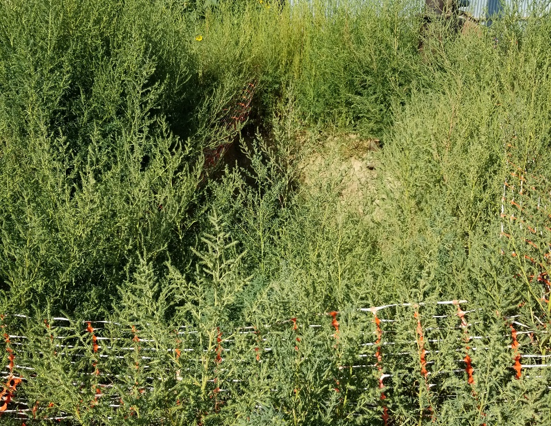
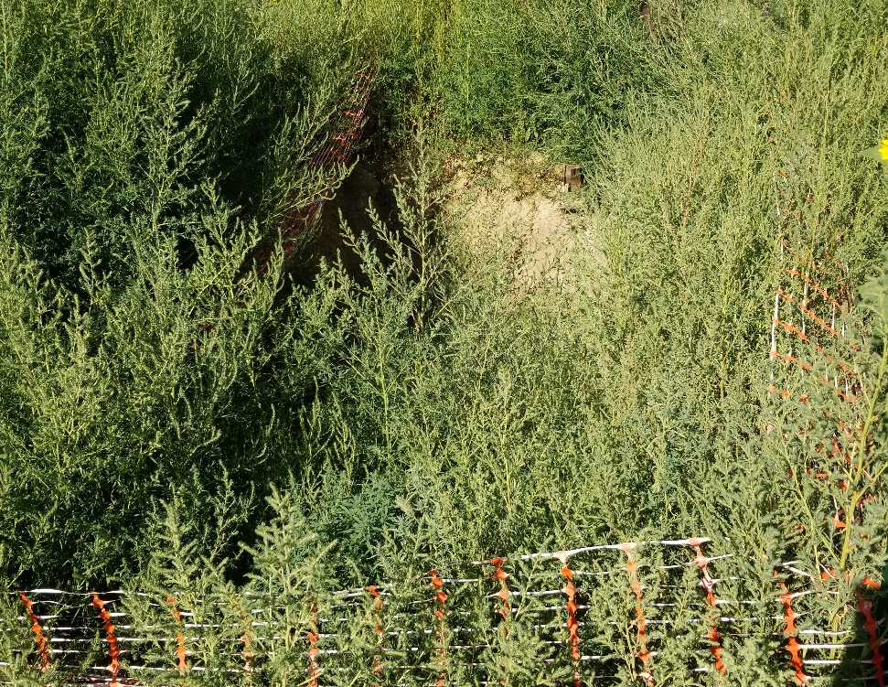
Inspection Photos
Location Name: Lone Eagle 13-34
Location ID: 464350
Open excavation overgrown with weeds.
Open excavation overgrown with weeds.

Slide 3
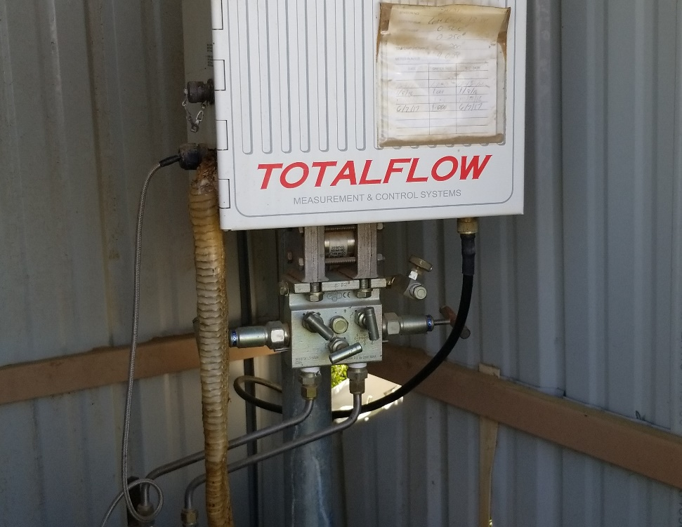
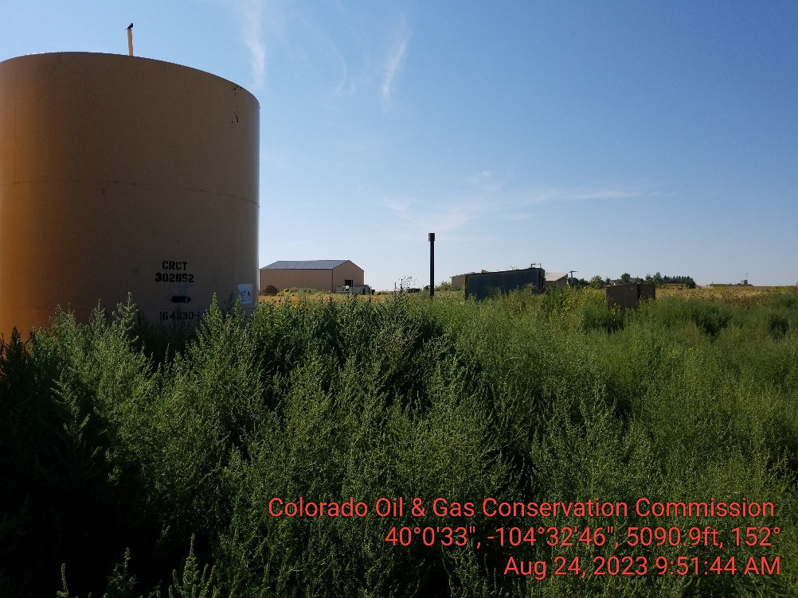
Inspection Photos
Location Name: Lone Eagle 13-34
Location ID: 464350
Dead snake hanging in meter shed.
Location overgrown with weeds.

