Slide 1
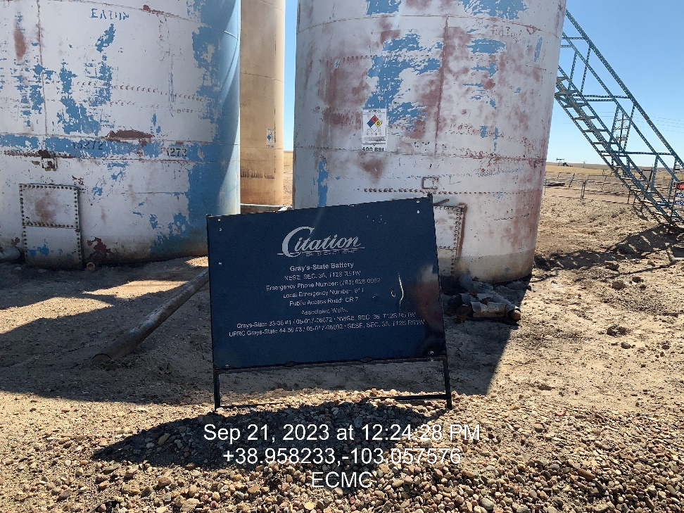
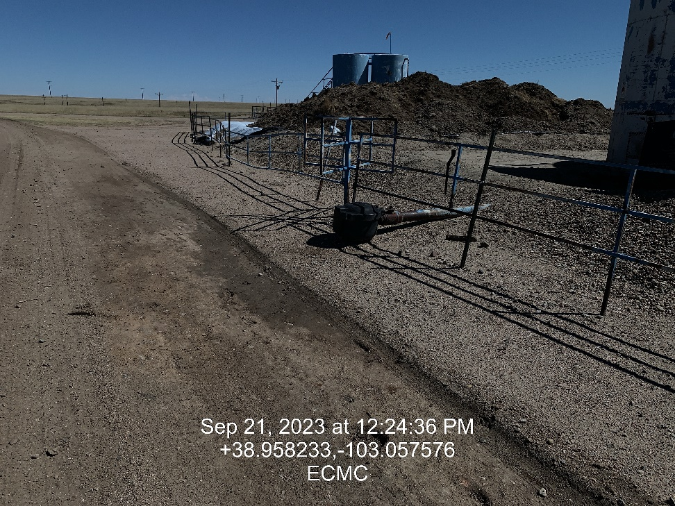

Inspection Photos
Location:
Gray’s-State Battery
Facility ID: 480547
Photo 1 –Wellhead Placard
Photo 2 – Load out

Slide 2
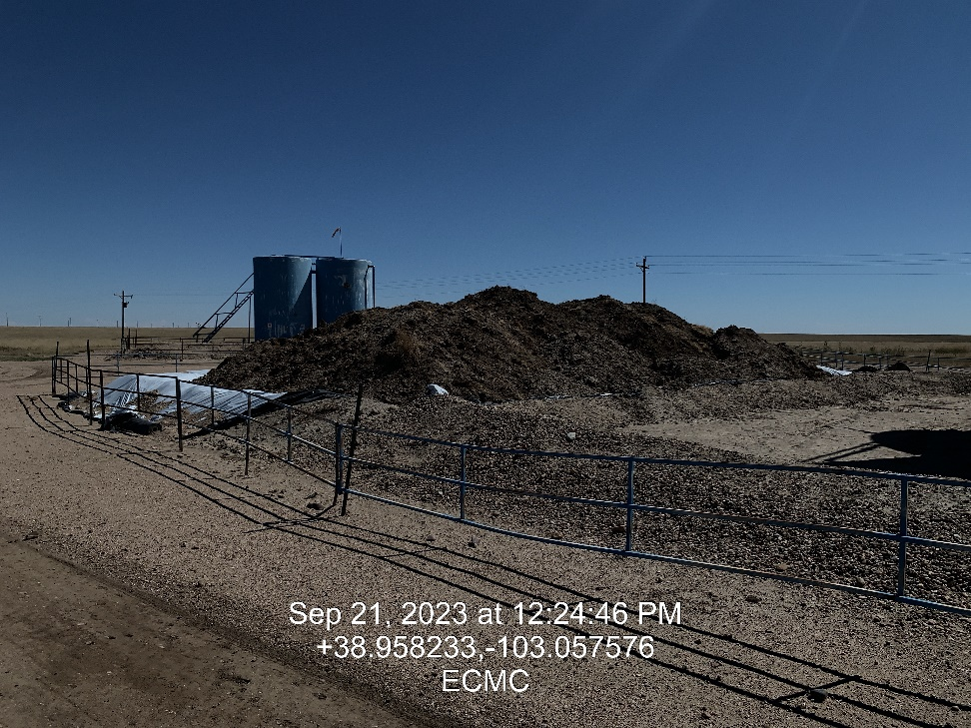
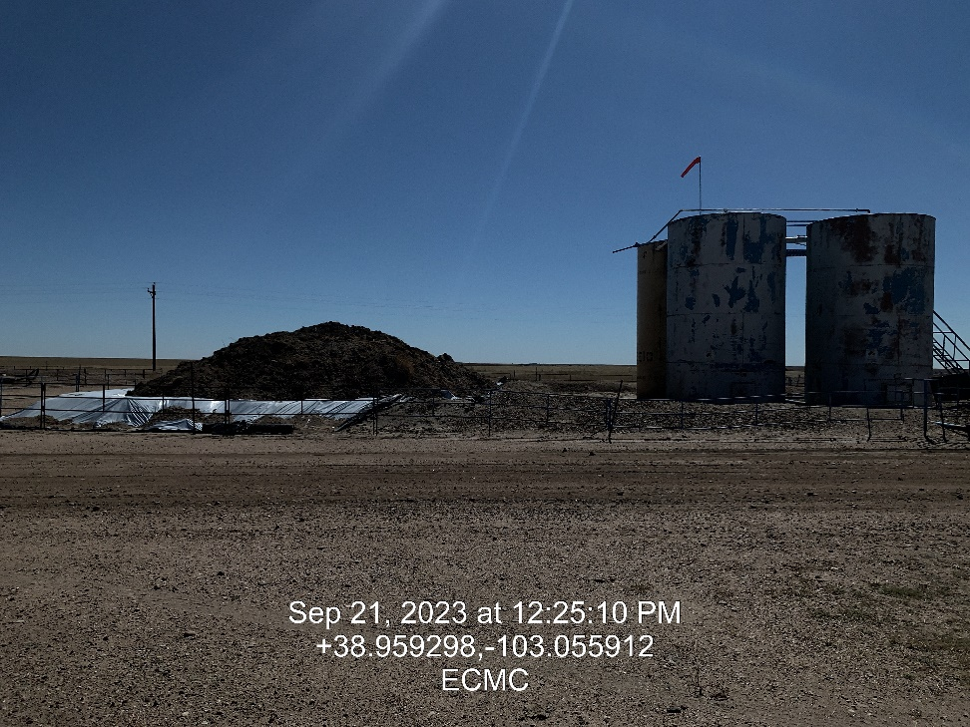
Inspection Photos
Location:
Gray’s-State Battery
Facility ID: 480547
Photo 3 – Looking north
Photo 4 – Looking east

Slide 3
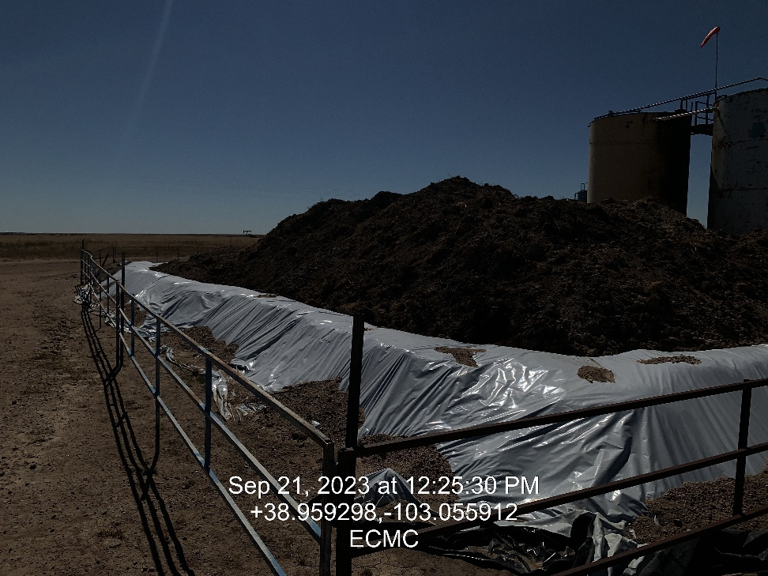
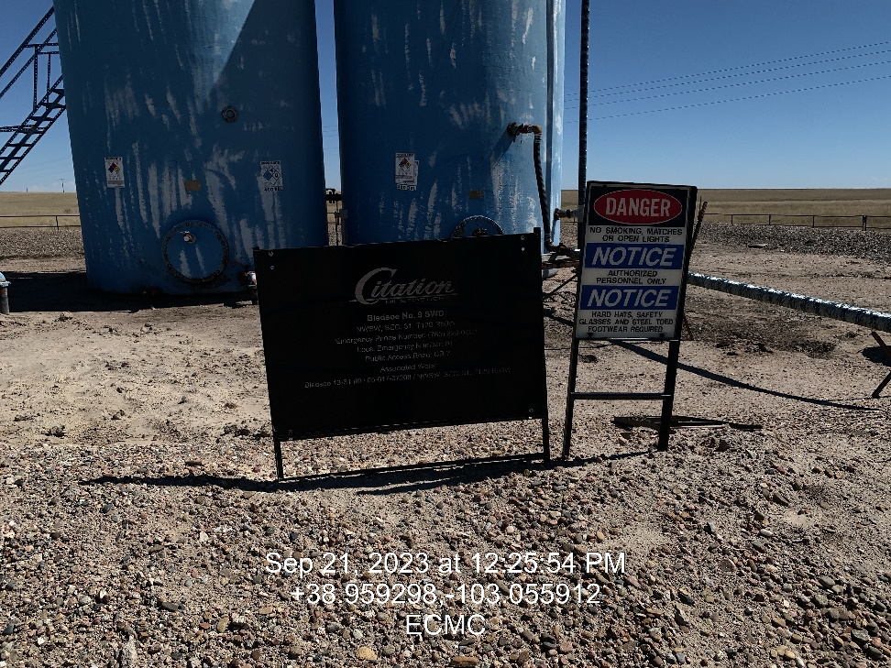
Inspection Photos
Location:
Gray’s-State Battery
Facility ID: 480547
Photo 5 – Contaminated soil form spill ID 480624
Photo 6 – SWD Well Placard

Slide 4
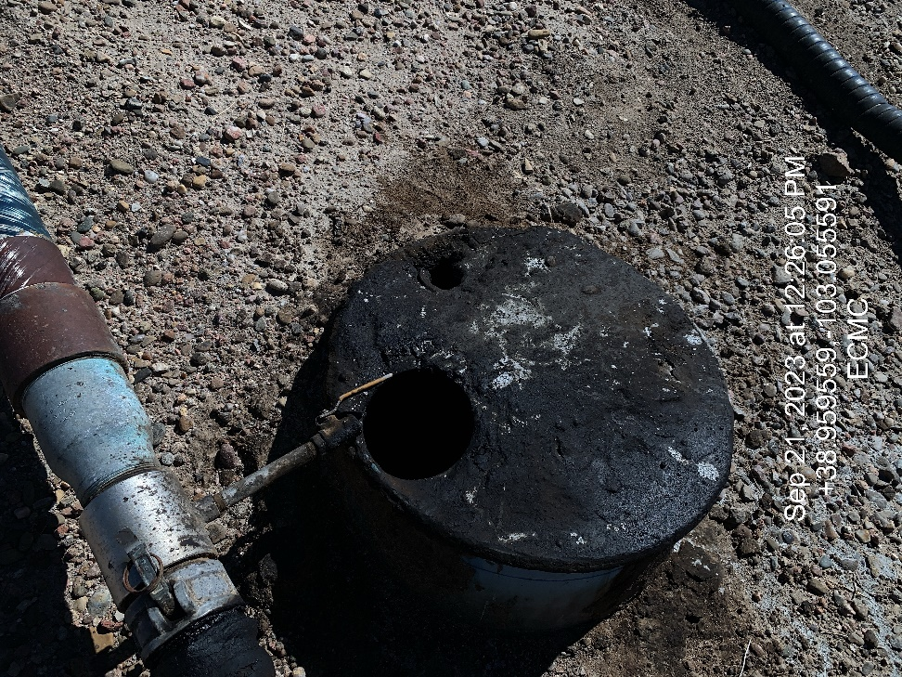
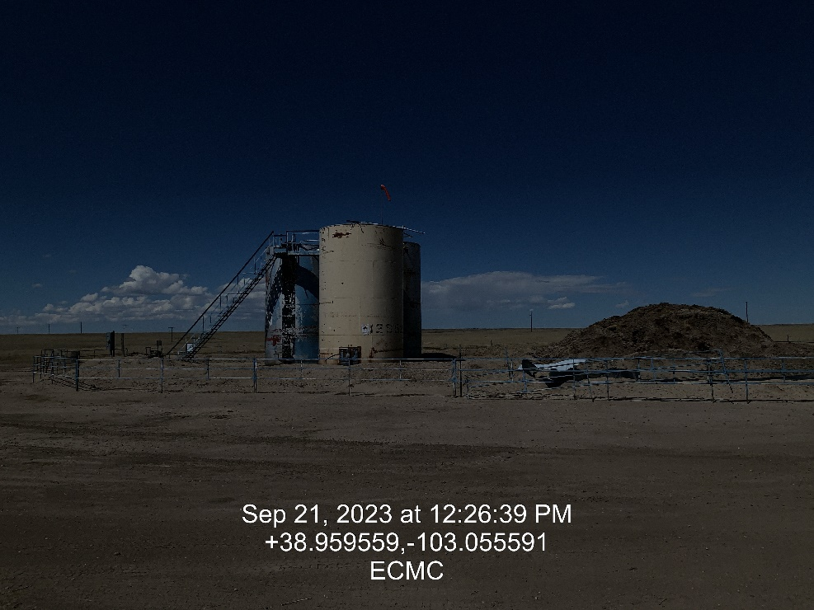
Inspection Photos
Location:
Gray’s-State Battery
Facility ID: 480547
Photo 7 – Vessel with no cap/netting
Photo 8 – Looking west

Slide 5
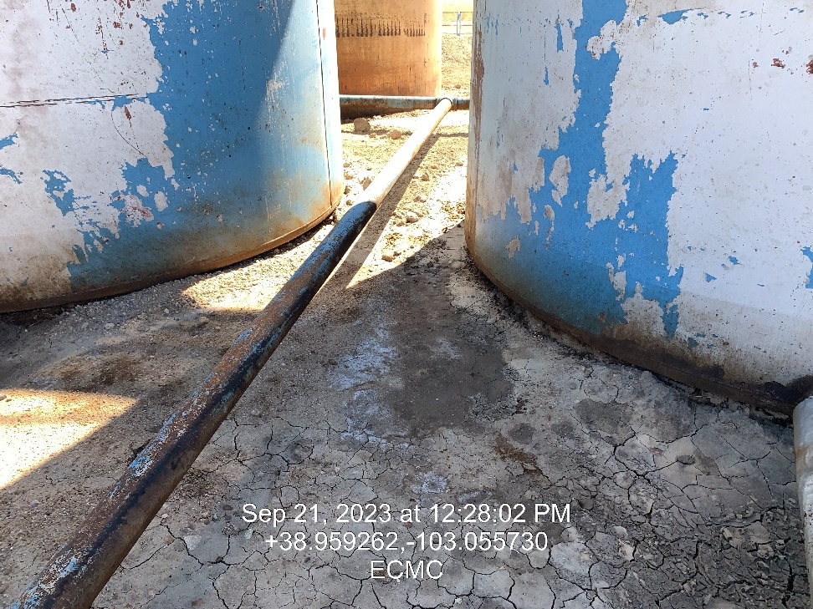
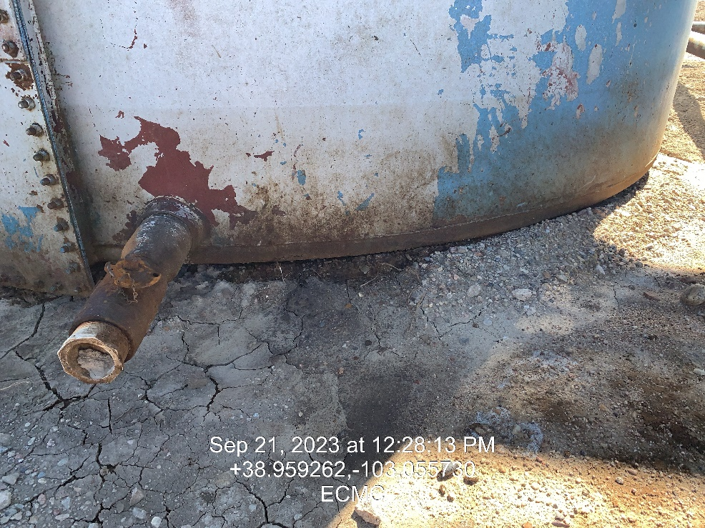
Inspection Photos
Location:
Gray’s-State Battery
Facility ID: 480547
Photo 9 – Impacted soil inside containment
Photo 10 – Impacted soil observed under tanks

Slide 6
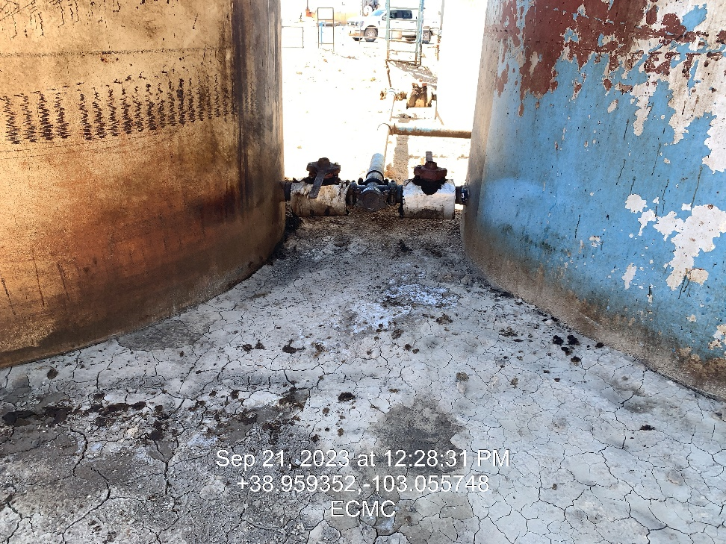
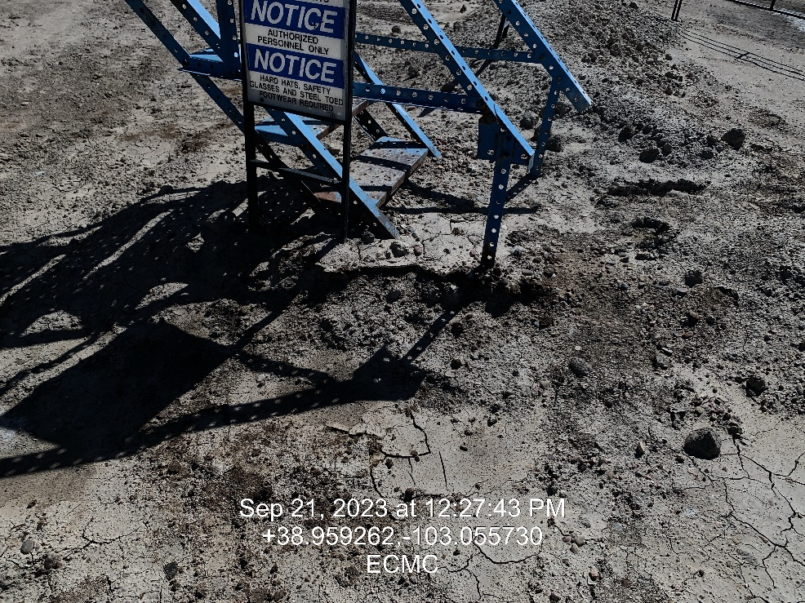
Inspection Photos
Location:
Gray’s-State Battery
Facility ID: 480547
Photo 9 – Impacted soil
Photo 10 – Impacted soil

