Slide 1
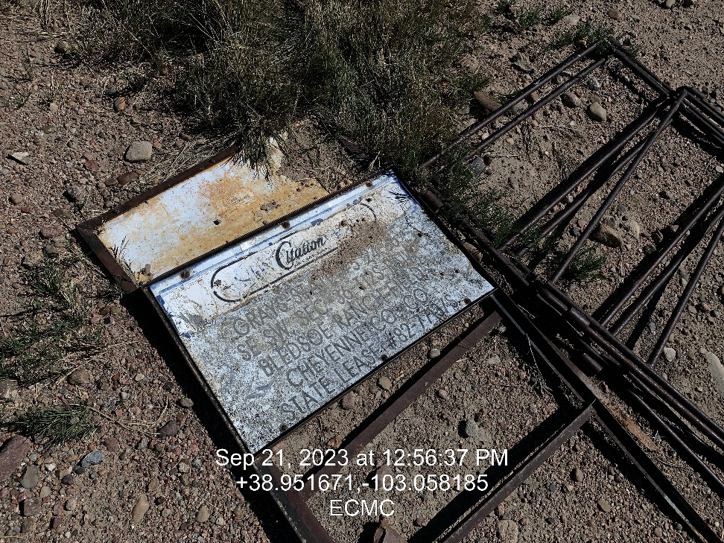
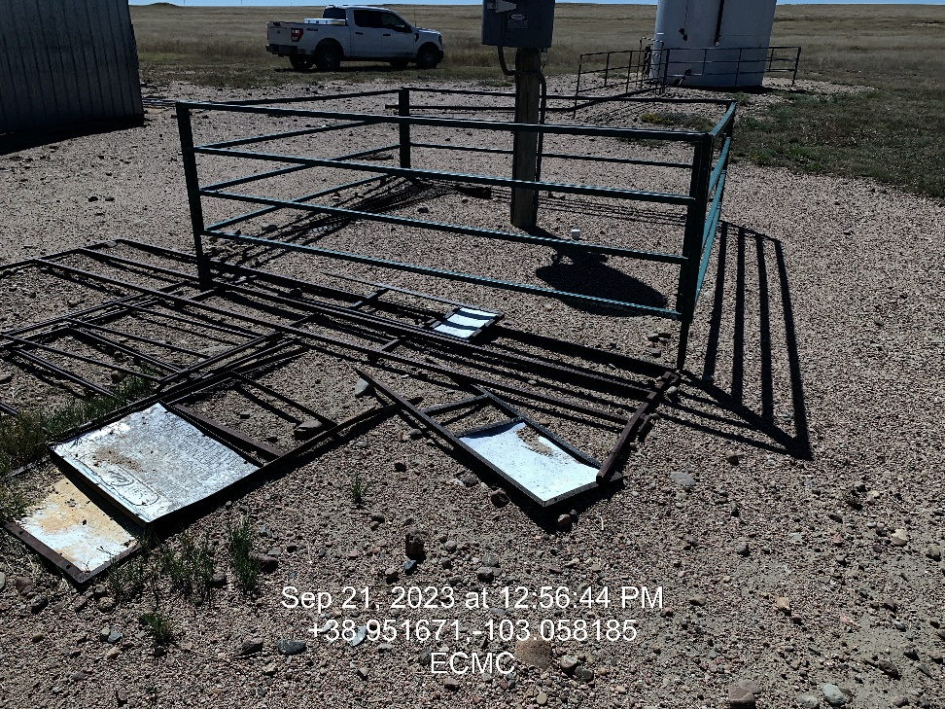

Inspection Photos
Location: Grays-State 24-36 # 5
Facility ID: 321687
Photo 1 –Wellhead Placard
Photo 2 – Well Placards not Visible

Slide 2
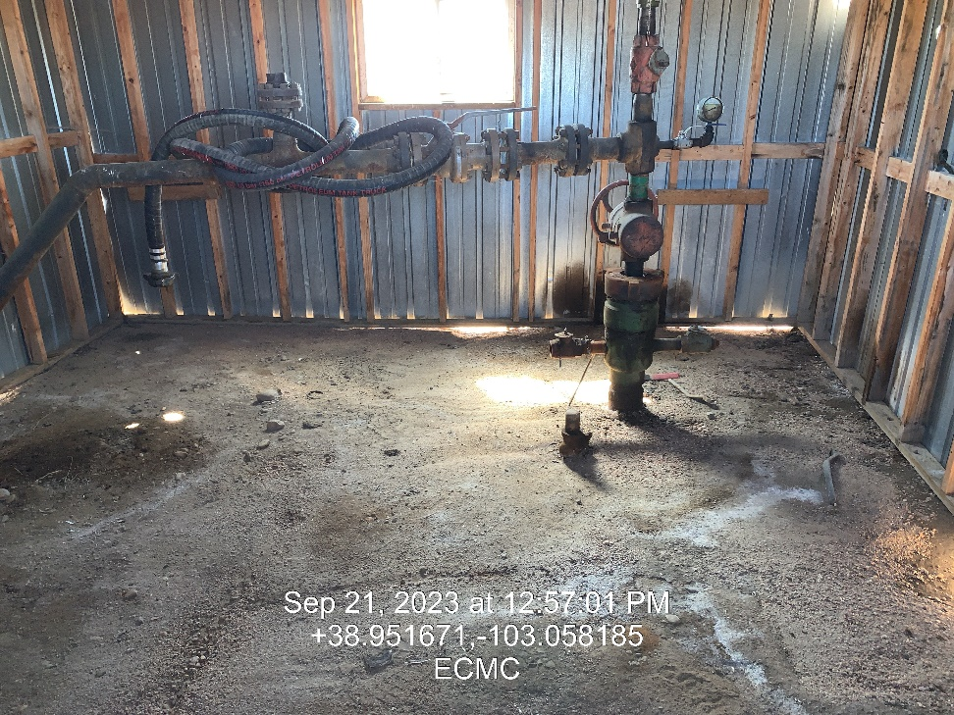
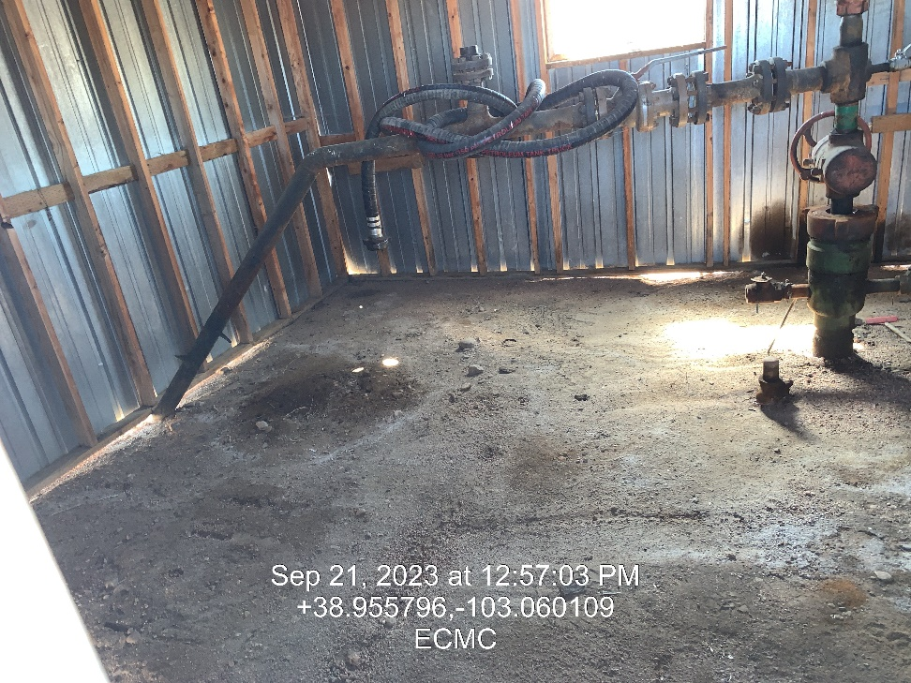
Inspection Photos
Location: Grays-State 24-36 # 5
Facility ID: 321687
Photo 3 – Impacted soil observed inside wellhead building
Photo 4 – – Impacted soil observed inside wellhead building

Slide 3
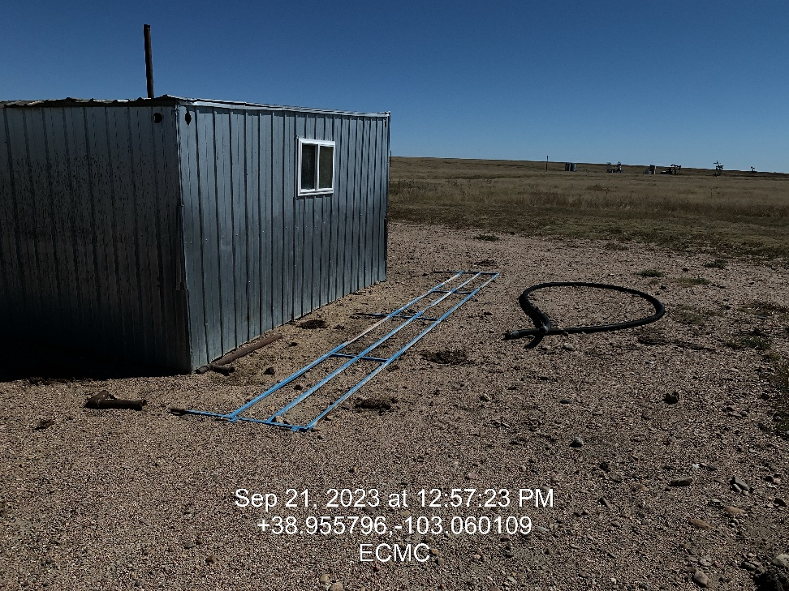
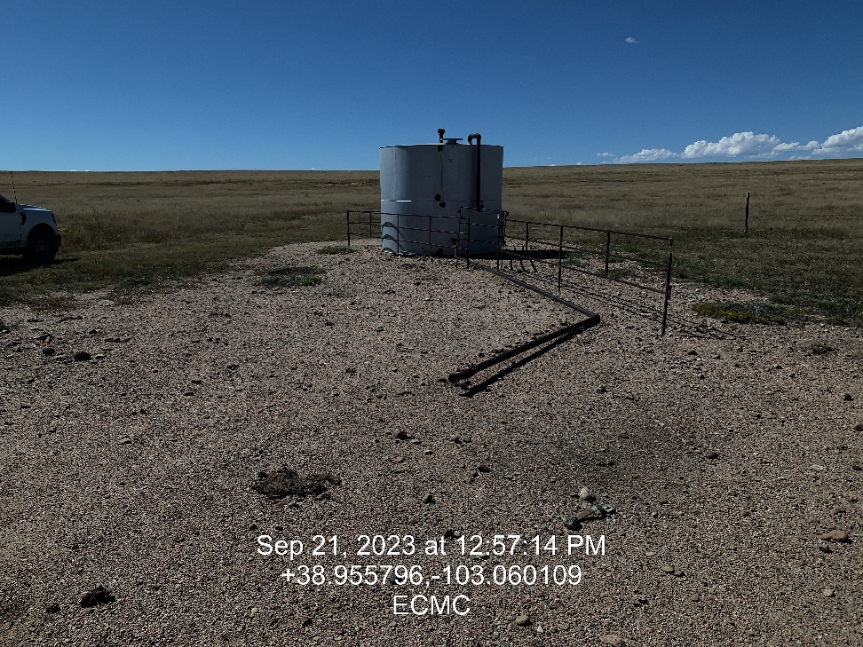
Inspection Photos
Location: Grays-State 24-36 # 5
Facility ID: 321687
Photo 5 – Unused Equipment
Photo 6 – Tank Not Plumbed to well. No Cap on end of line

Slide 4
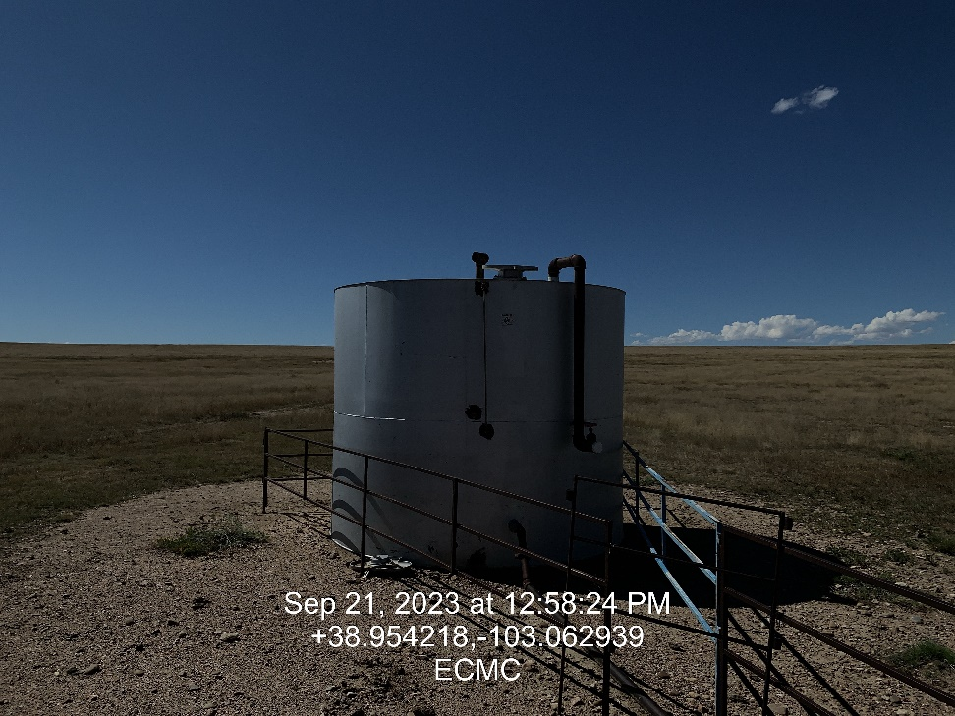
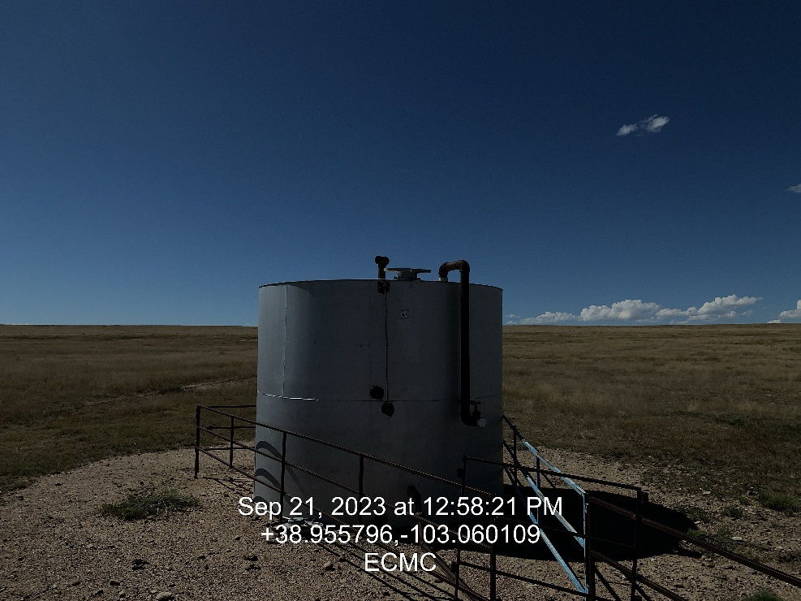
Inspection Photos
Location: Grays-State 24-36 # 5
Facility ID: 321687
Photo 7 – Vent Cover
Photo 8 – Tank on location with missing vent lid

