Slide 1
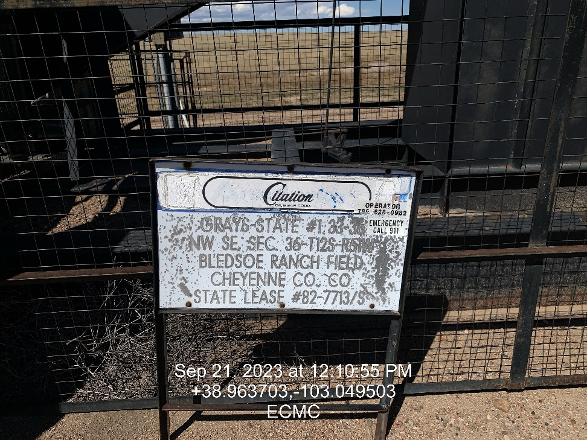
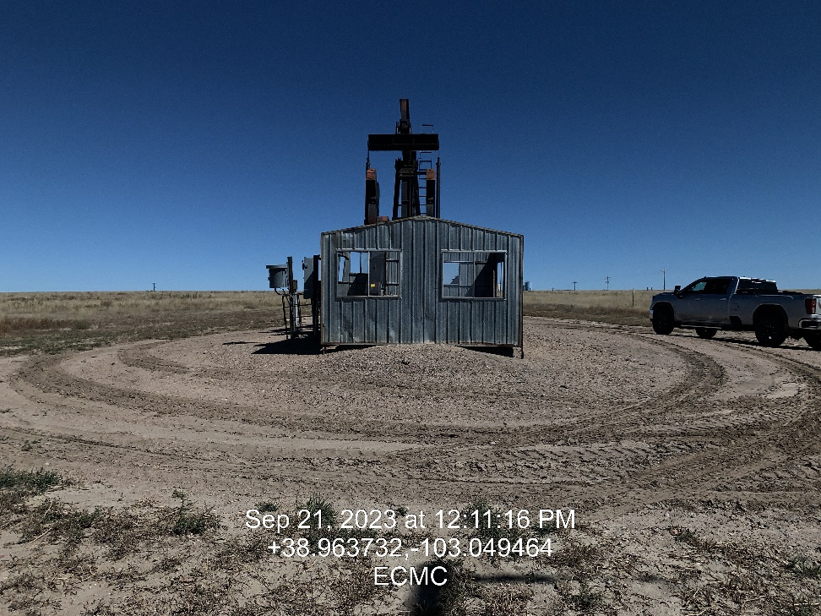

Inspection Photos
Location: Grays-State 33-36 # 1
Facility ID: 321673
Photo 1 –Wellhead Placard
Photo 2 – North

Slide 2
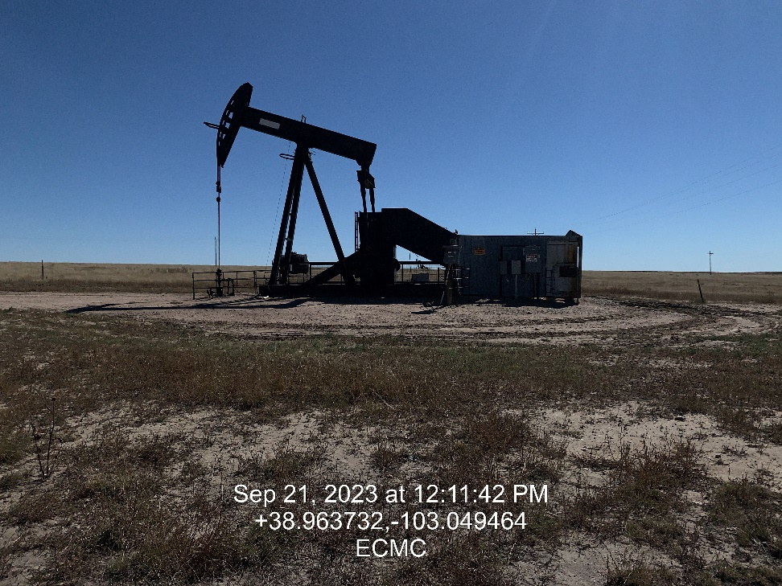
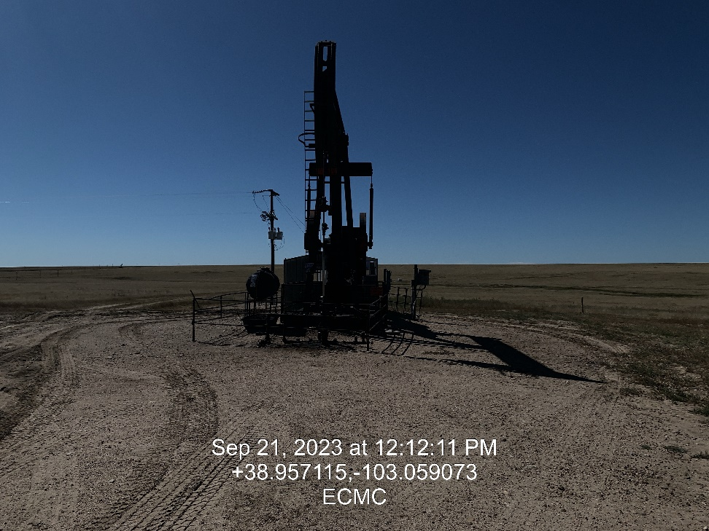
Inspection Photos
Location: Grays-State 33-36 # 1
Facility ID: 321673
Photo 3 – East
Photo 4 – South

Slide 3
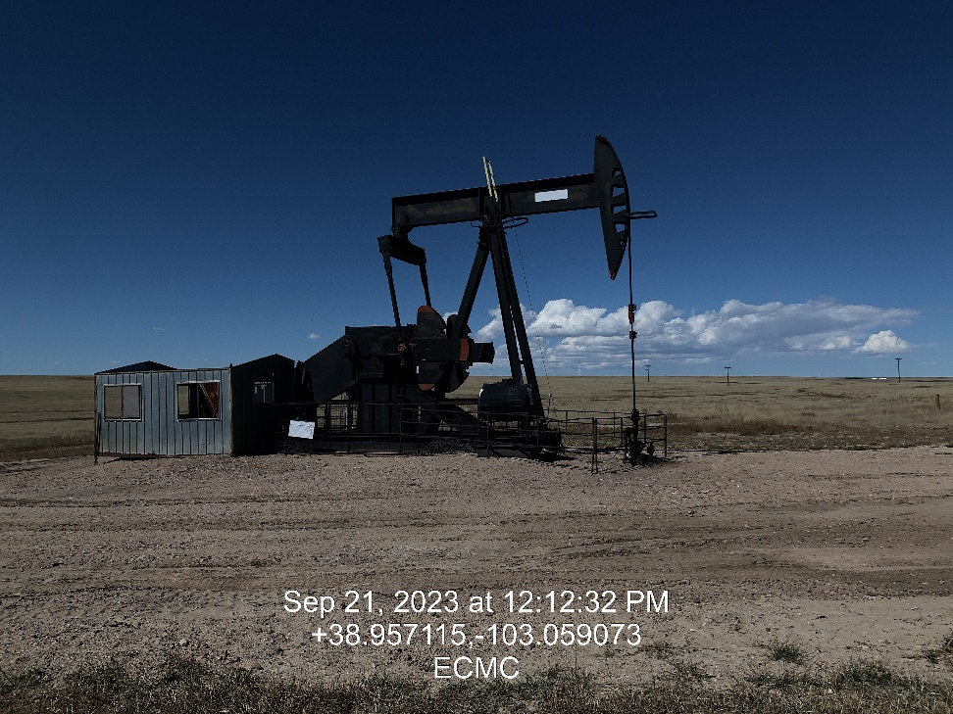
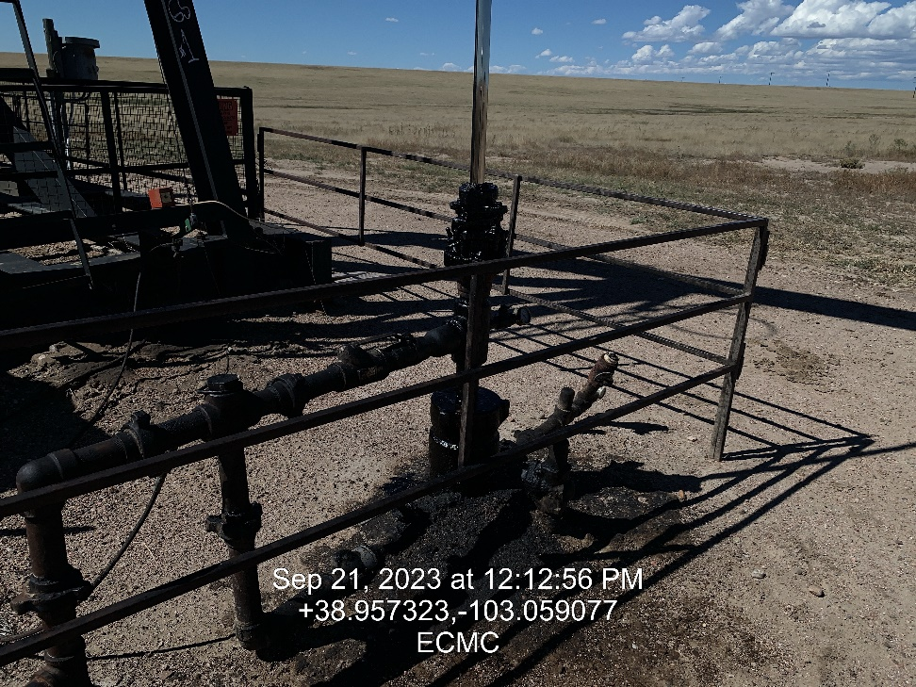
Inspection Photos
Location: Grays-State 33-36 # 1
Facility ID: 321673
Photo 5 – West
Photo 6 – Soil Staining

Slide 4
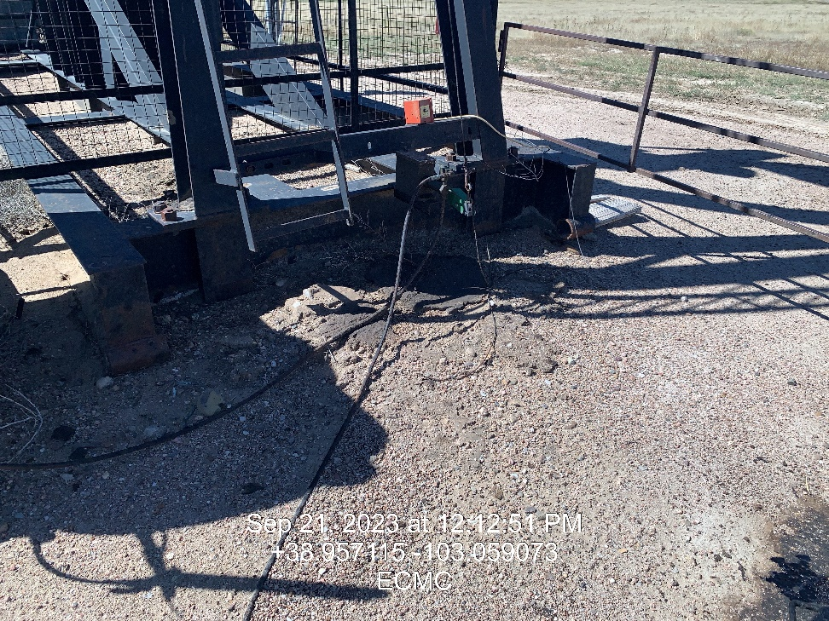
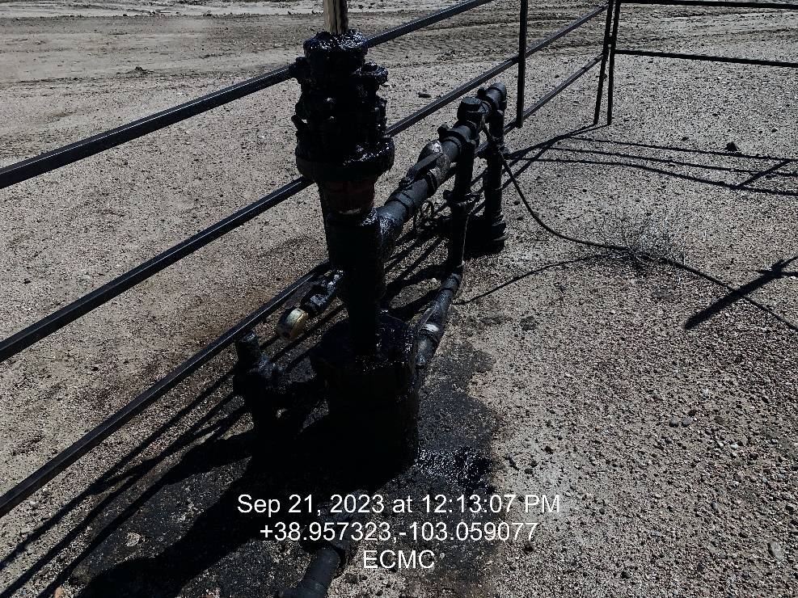
Inspection Photos
Location: Grays-State 33-36 # 1
Facility ID: 321673
Photo 7 – Stained soil near base of pumping unit.
Photo 8 – Stained soil around wellhead

Slide 5
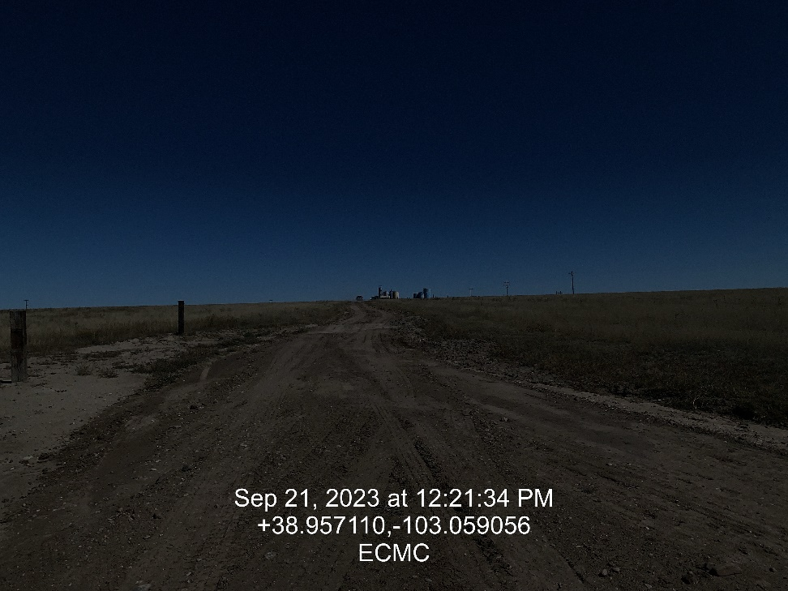
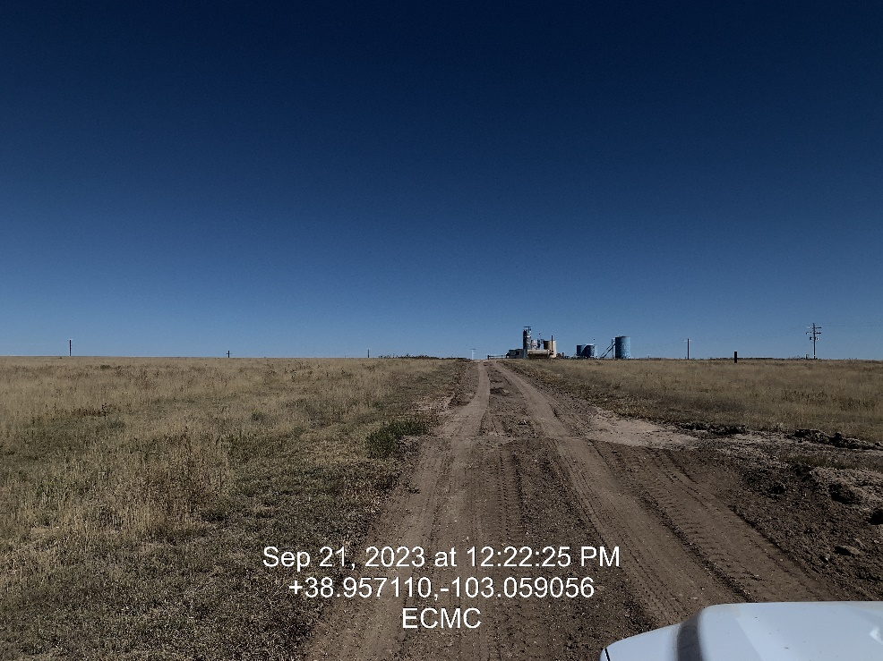
Inspection Photos
Location: Grays-State 33-36 # 1
Facility ID: 321673
Photo 9 – Lease road was recently graded
Photo 10 – Lease road to tank battery

