Slide 1
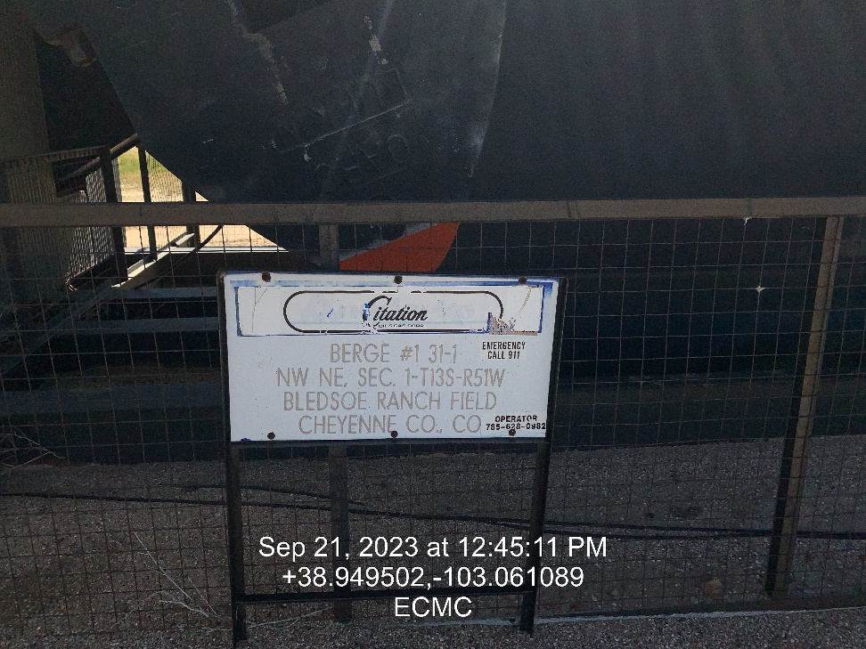
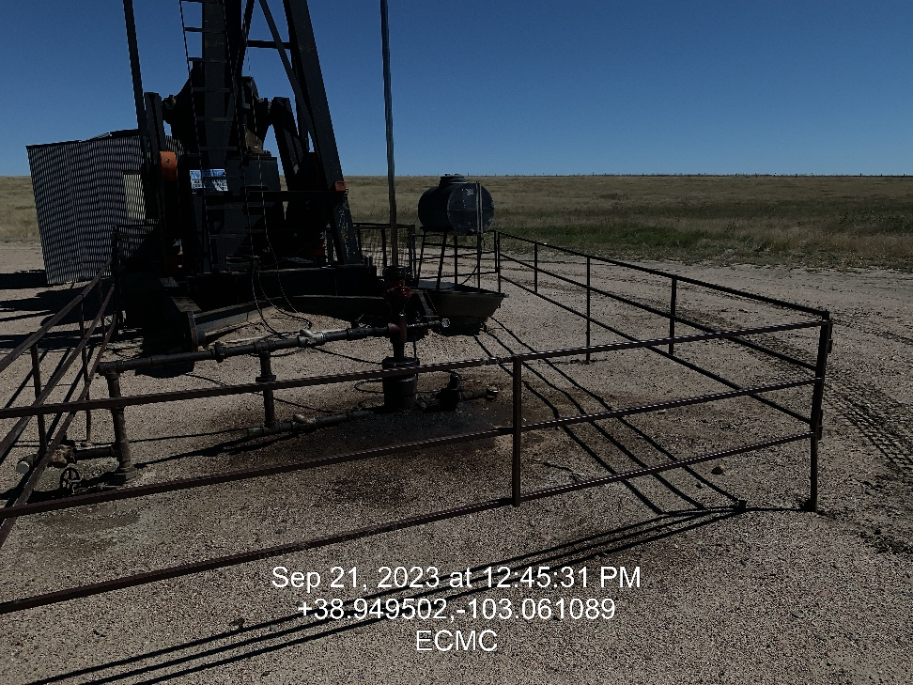

Inspection Photos
Location: Berge 31-1 #1
Facility ID: 321688
Photo 1 –Wellhead Placard
Photo 2 – Soil Staining around well head

Slide 2
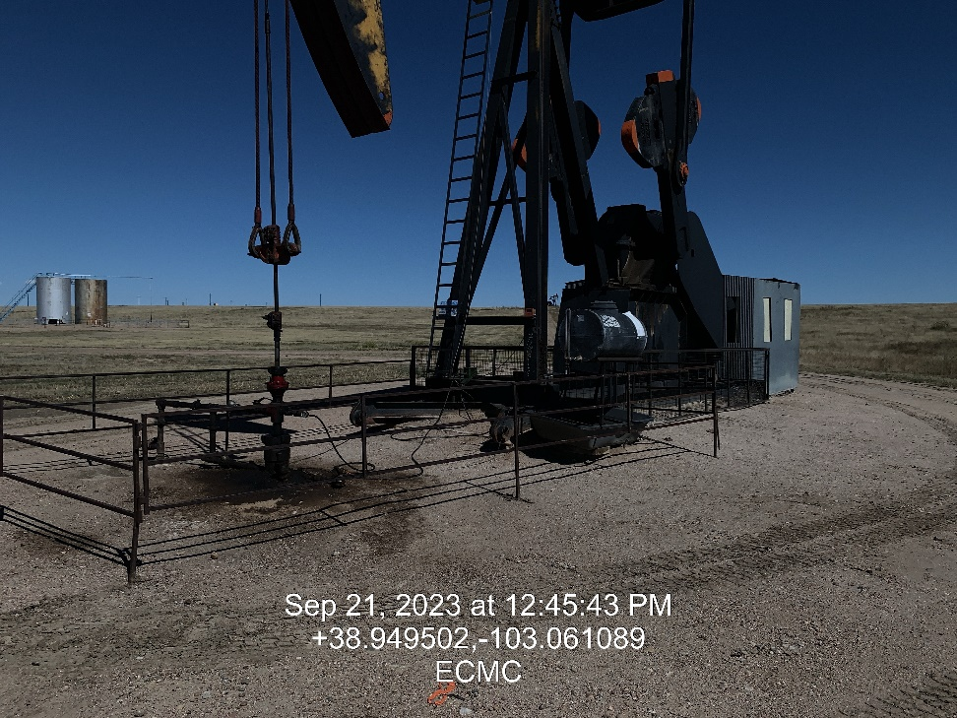
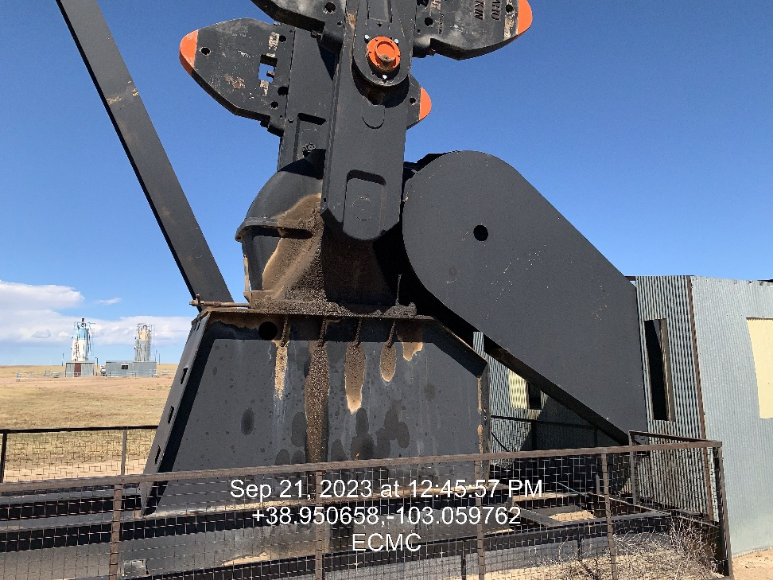
Inspection Photos
Location: Berge 31-1 #1
Facility ID: 321688
Photo 3 – Pumping unit overview
Photo 4 – Gearbox leaking

Slide 3
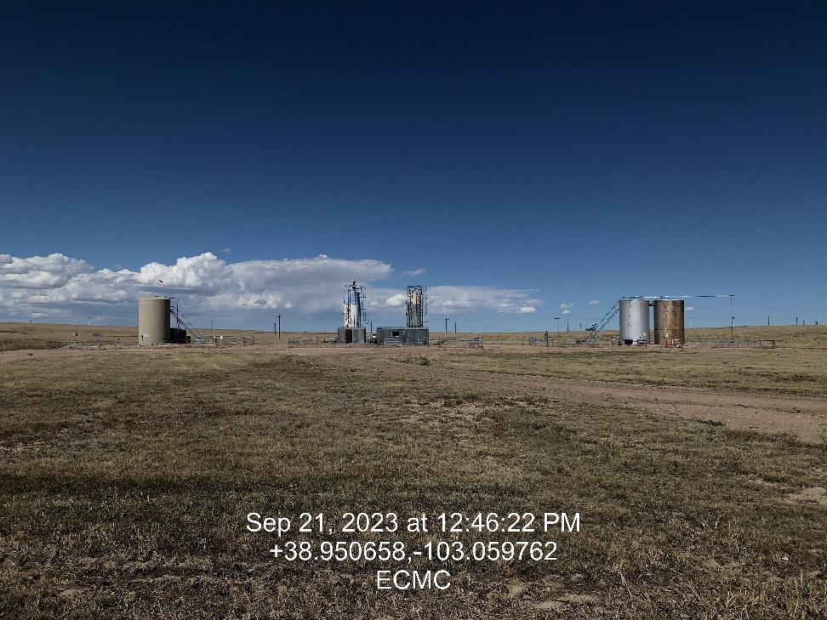
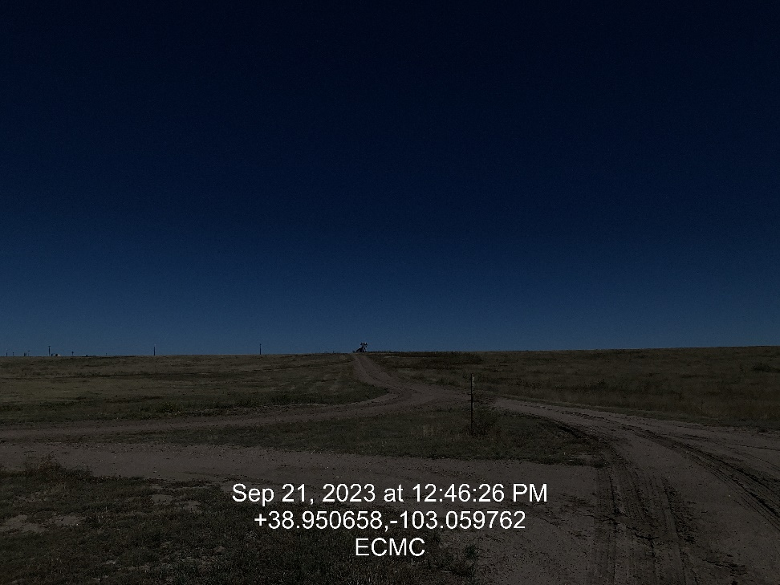
Inspection Photos
Location: Berge 31-1 #1
Facility ID: 321688
Photo 5 – Overview
Photo 6 – Access

