Slide 1
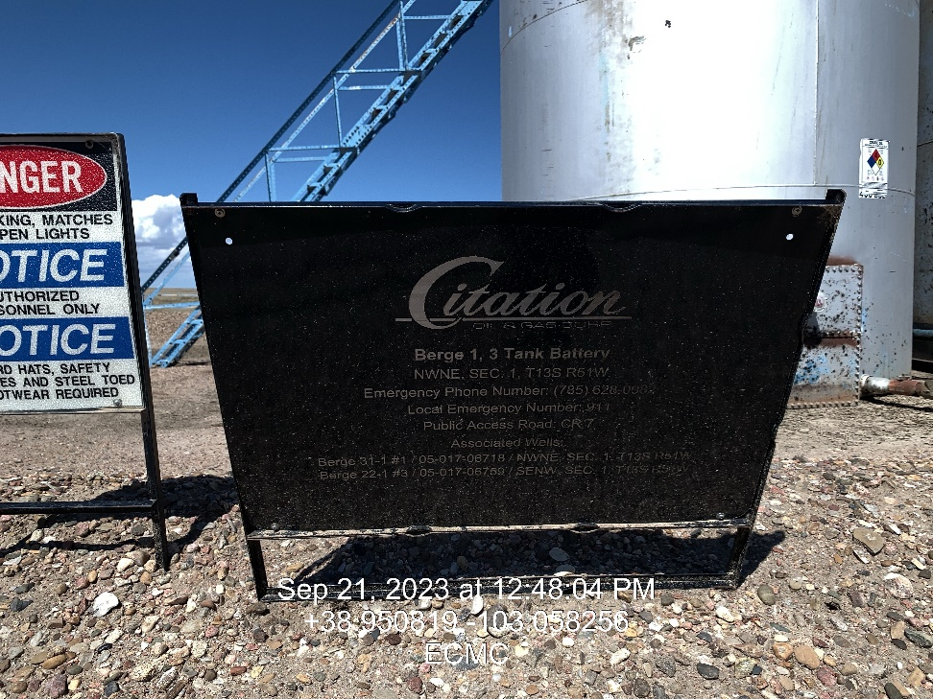
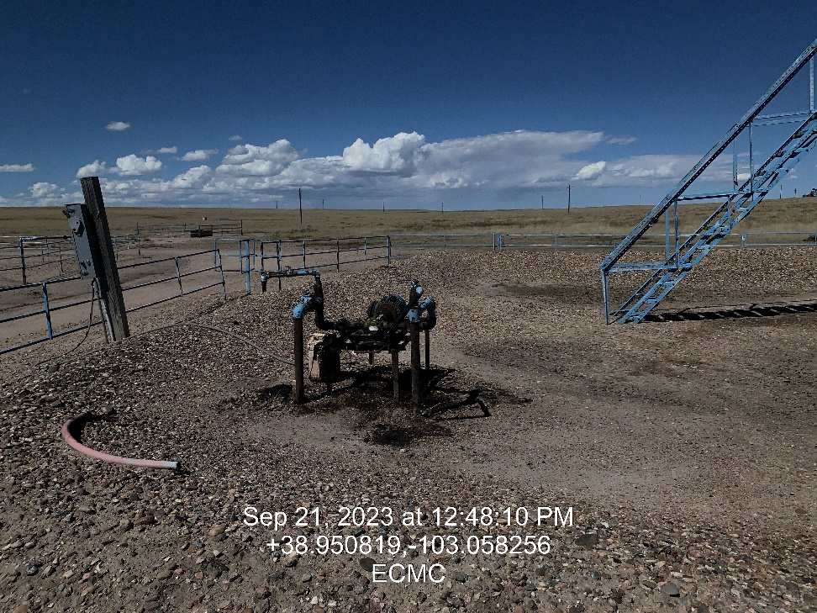

Inspection Photos
Location: Berge #’s 1 & 3 Tank Battery
Facility ID: 321688
Photo 1 –Wellhead Placard
Photo 2 – Soil staining at transfer pump

Slide 2
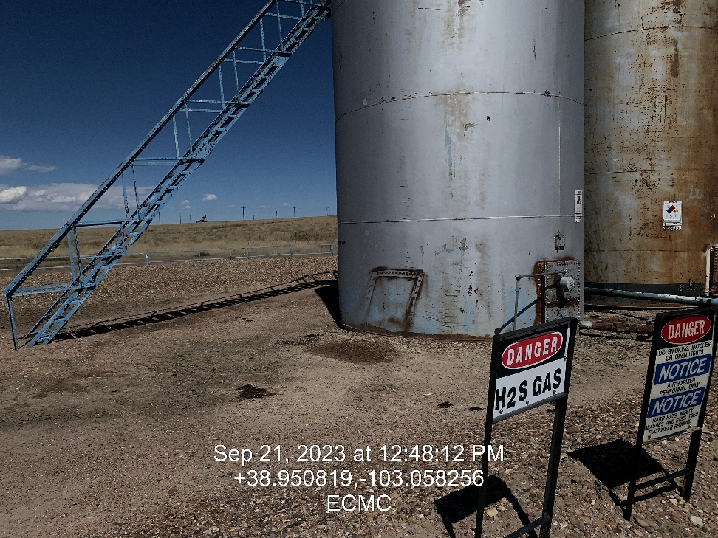
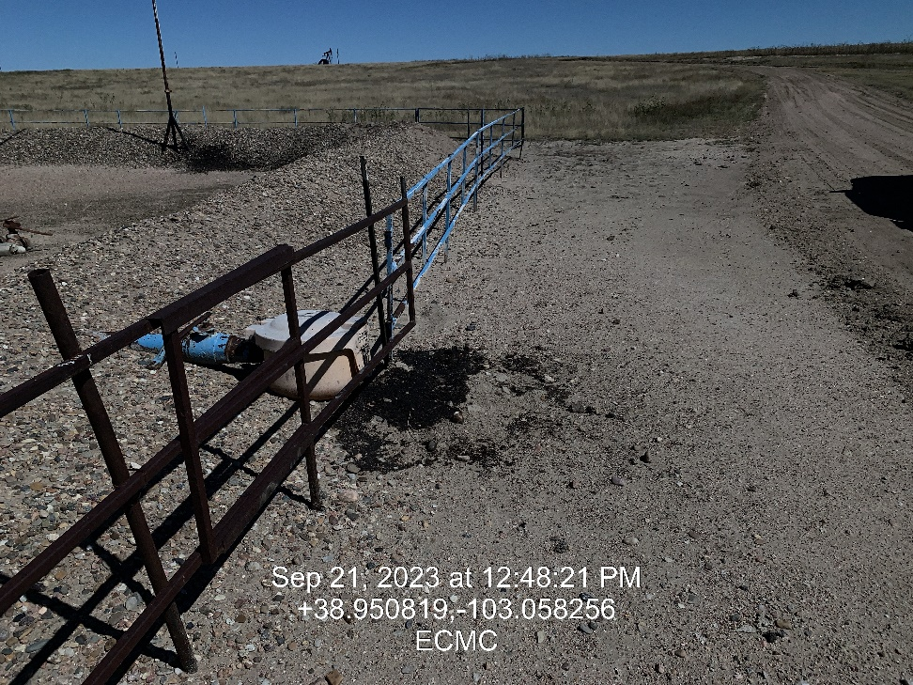
Inspection Photos
Location: Berge #’s 1 & 3 Tank Battery
Facility ID: 321688
Photo 3 – Minor soil staining within containment
Photo 4 – Stained soil at load-out

Slide 3
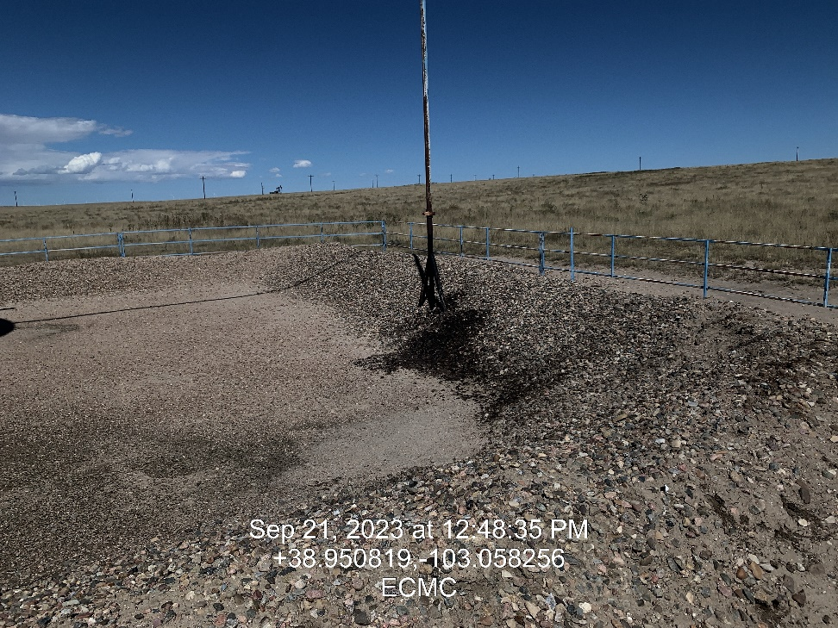
Inspection Photos
Location: Berge #’s 1 & 3 Tank Battery
Facility ID: 321688
Photo 5 – Stained soil under PRV

