Slide 1
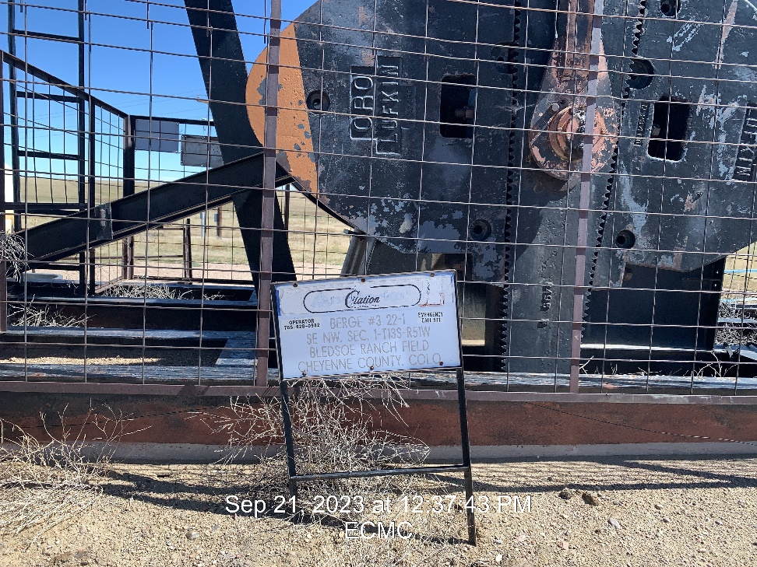
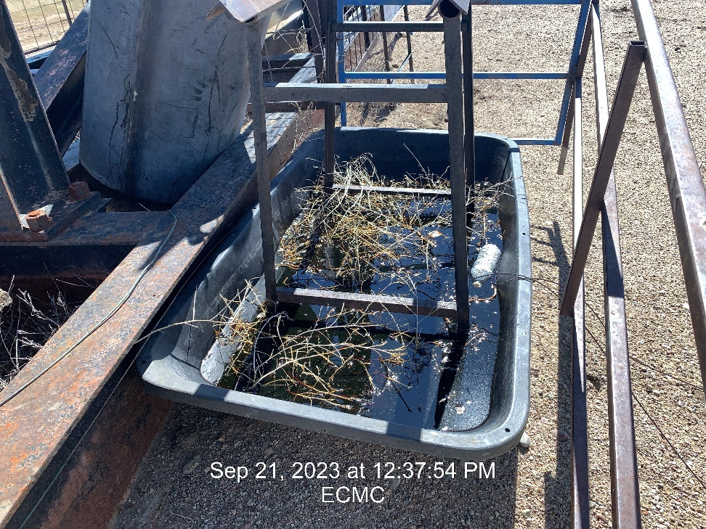

Inspection Photos
Location: Berge 22-1 #3
Facility ID: 321705
Photo 1 –Wellhead Placard
Photo 2 – Containment needing Fluids pulled

Slide 2
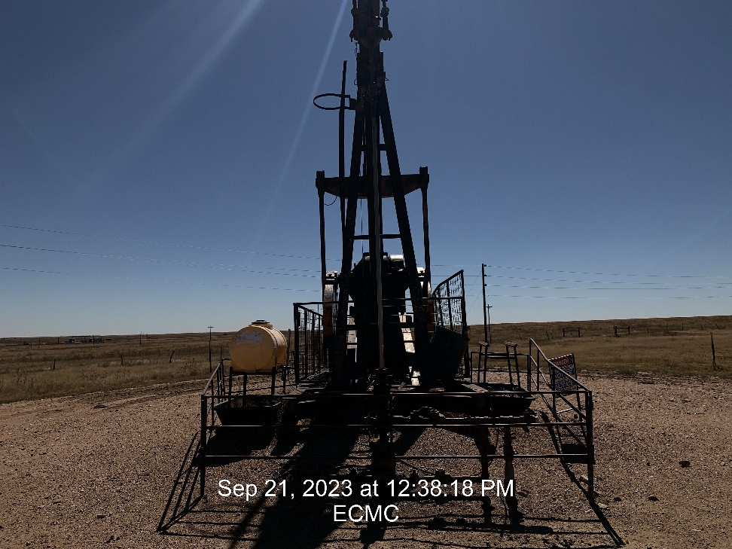
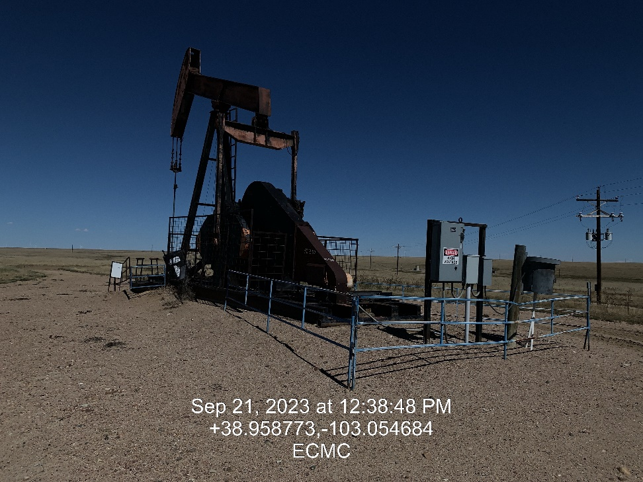
Inspection Photos
Location: Berge 22-1 #3
Facility ID: 321705
Photo 3 – Pumping Unit
Photo 4 – Looking North

Slide 3
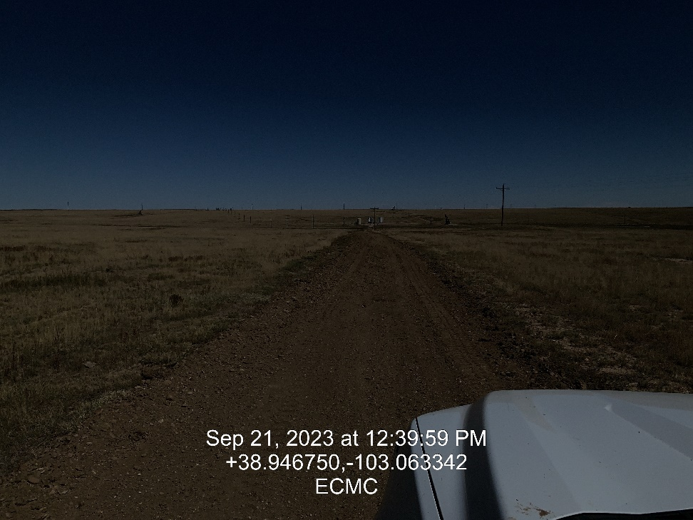
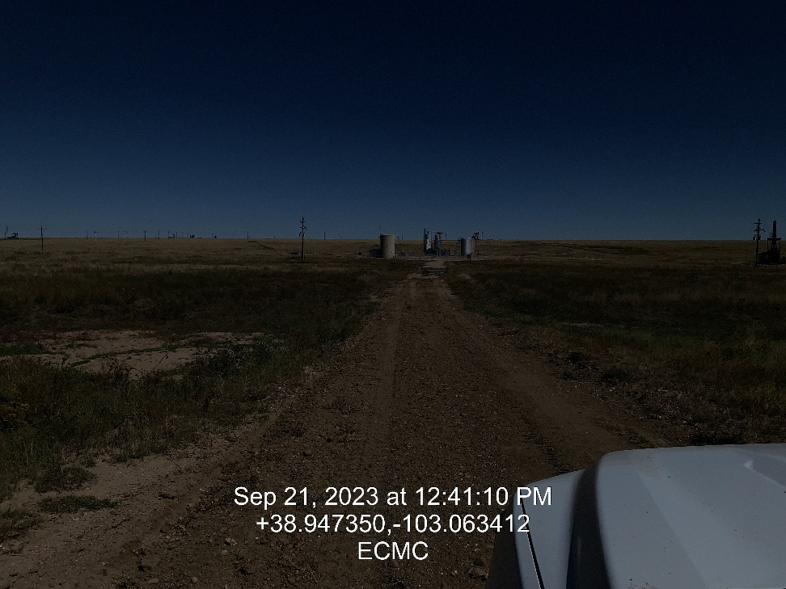
Inspection Photos
Location: Berge 22-1 #3
Facility ID: 321705
Photo 5 – Access road
Photo 6 – Access road

Slide 4
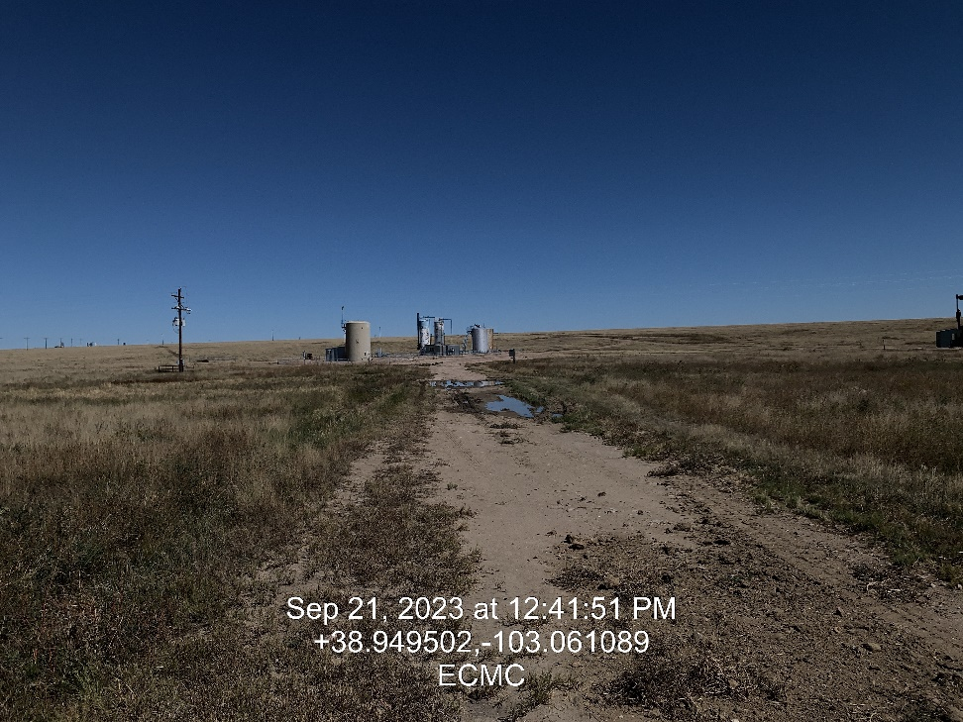
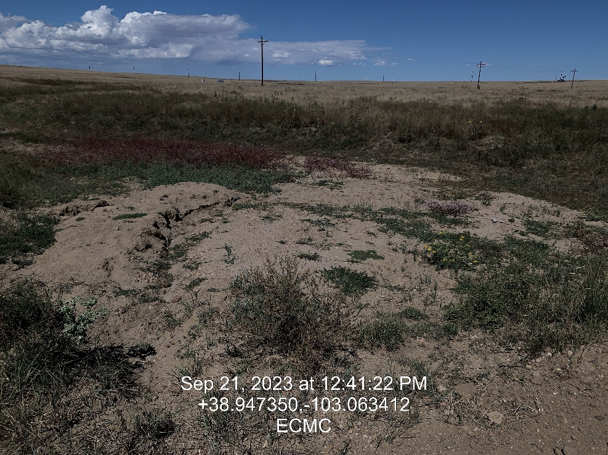
Inspection Photos
Location: Berge 22-1 #3
Facility ID: 321705
Photo 7 – Pooling water and deep ruts on access road
Photo 8 – Sediment Migration observed in drainage adjacent to road.

