Slide 1
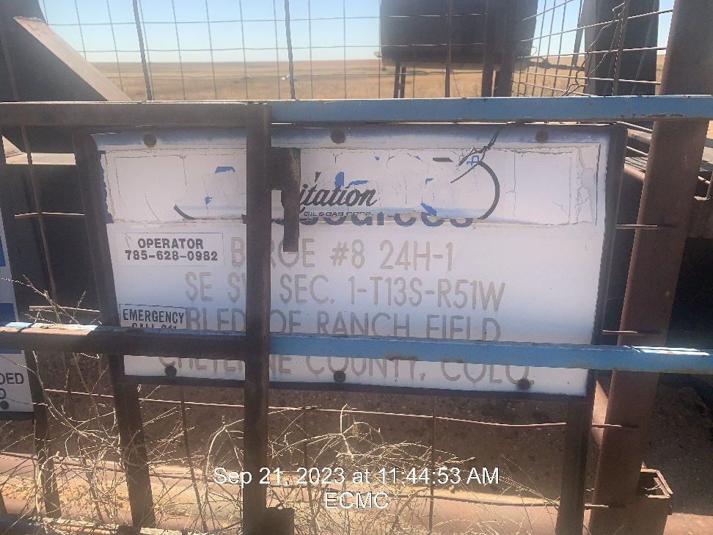
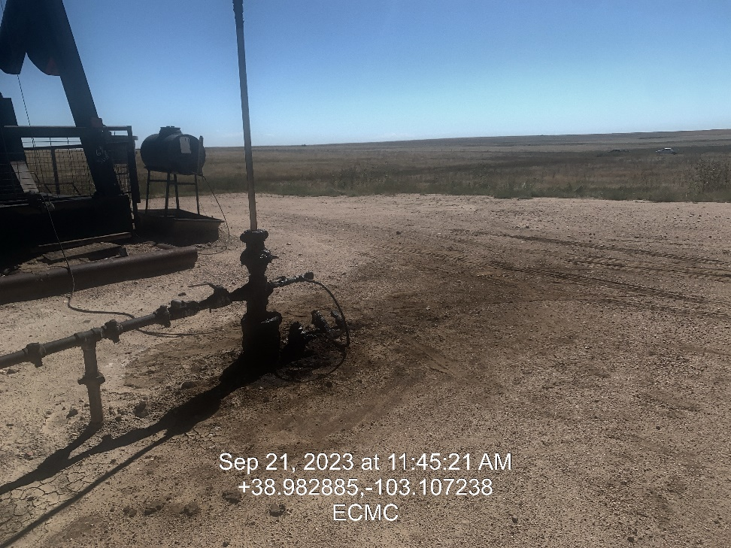

Inspection Photos
Location: Berge 24H-1, 8
Facility ID: 321761
Photo 1 –Wellhead Placard
Photo 2 – Wellhead

Slide 2
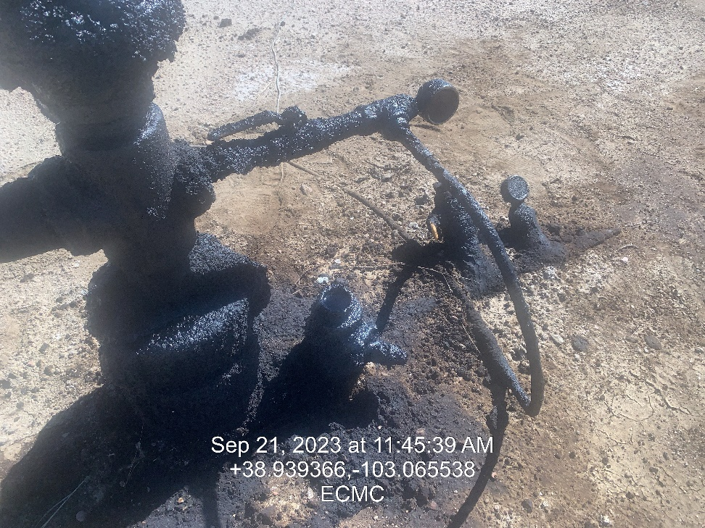
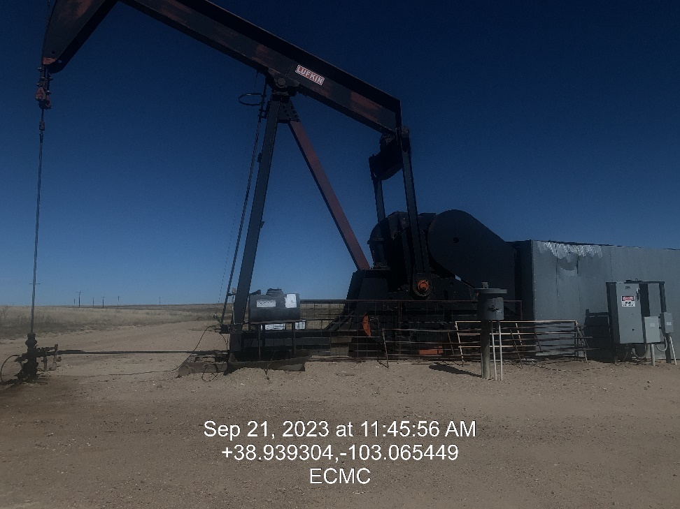
Inspection Photos
Location: Berge 24H-1, 8
Facility ID: 321761
Photo 3 – Stained Soil and missing plug
Photo 4 – Looking north

Slide 3
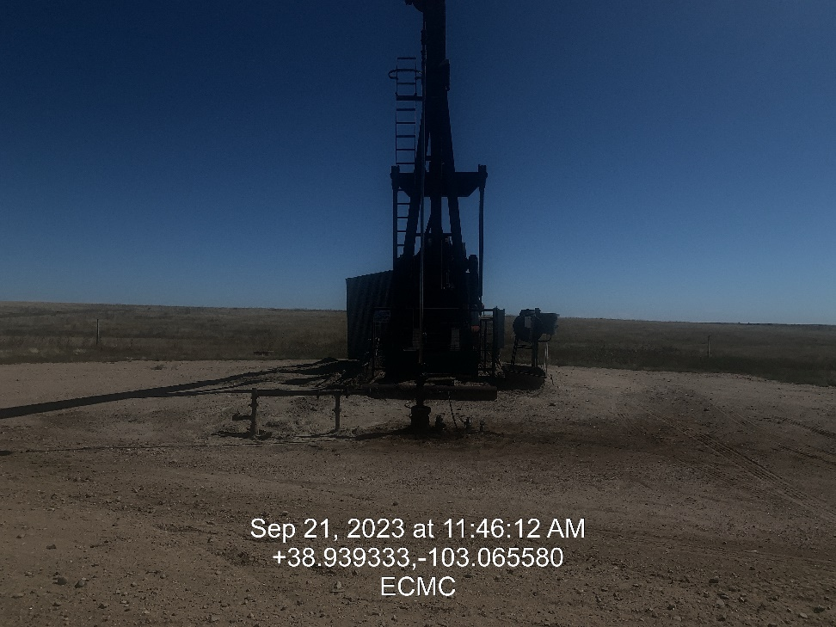
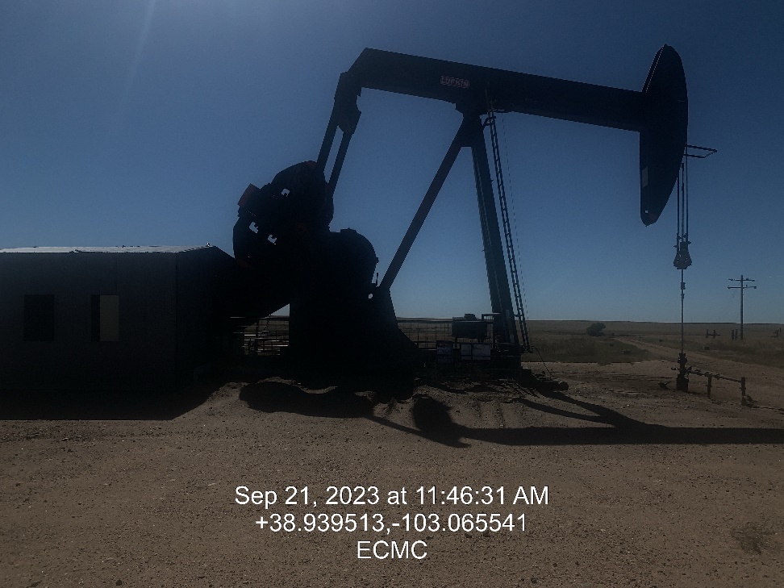
Inspection Photos
Location: Berge 24H-1, 8
Facility ID: 321761
Photo 5 – Looking east
Photo 6 – Looking south

Slide 4
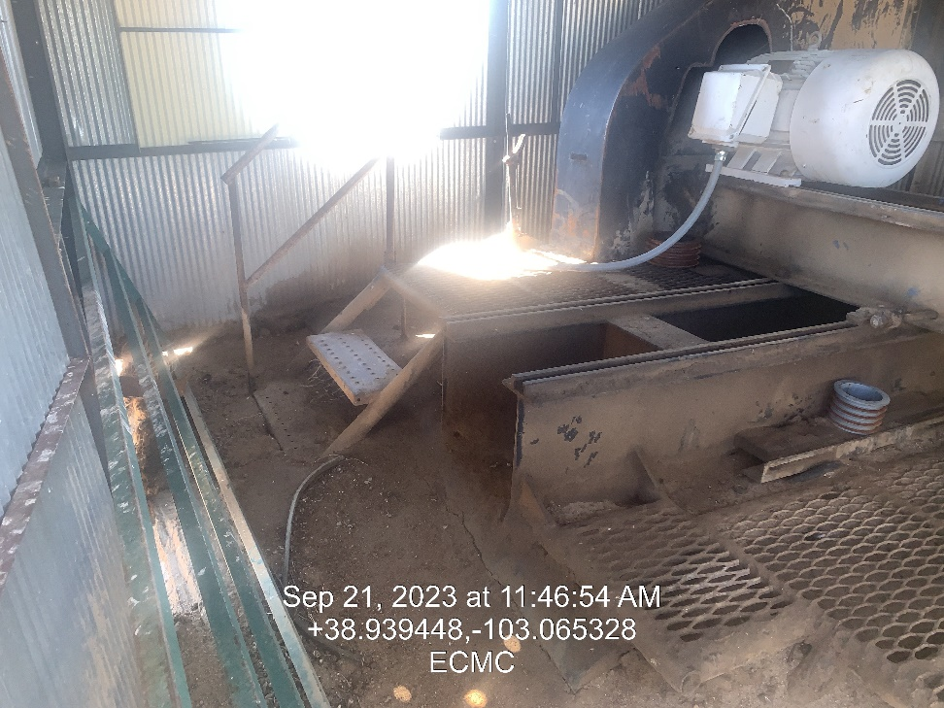
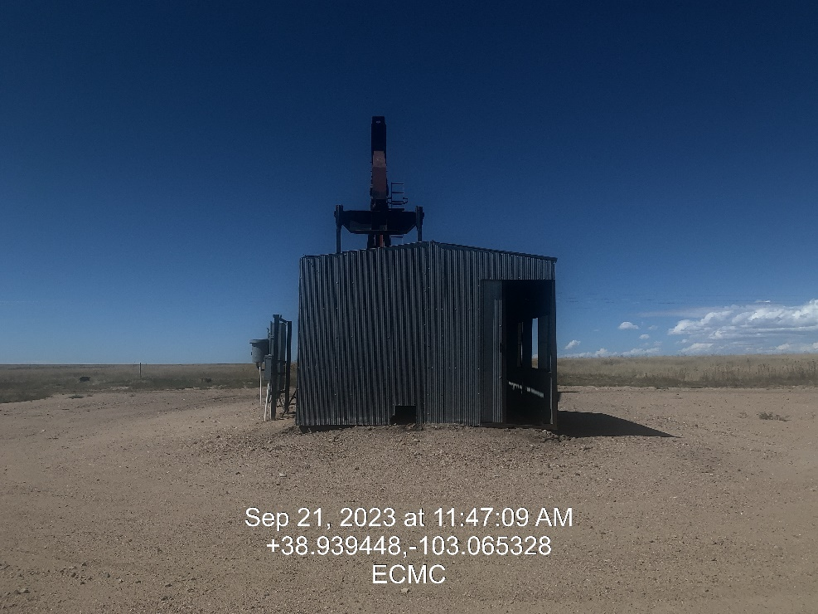
Inspection Photos
Location: Berge 24H-1, 8
Facility ID: 321761
Photo 7 – Oily soil in shed covering electric motor
Photo 8 – Looking west

Slide 5
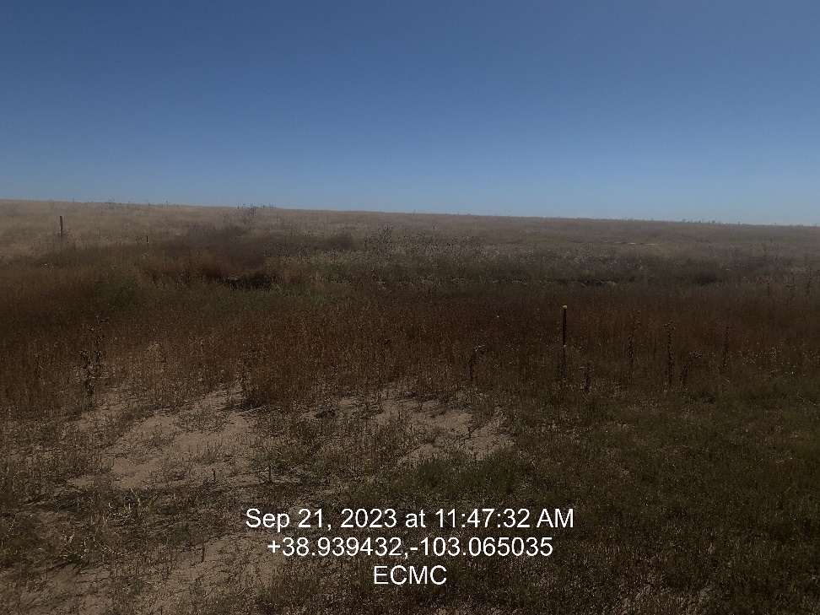
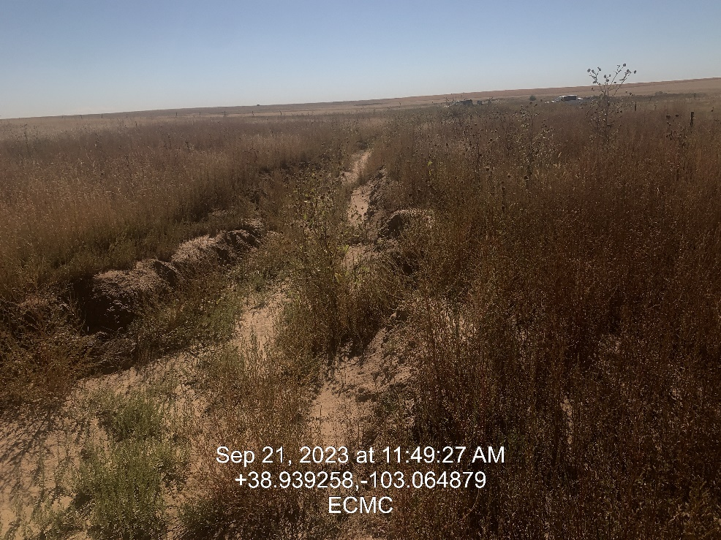
Inspection Photos
Location: Berge 24H-1, 8
Facility ID: 321761
Photo 9 – Area of Remediation # 19704
Photo 10 – Open Remediation Trench

Slide 6
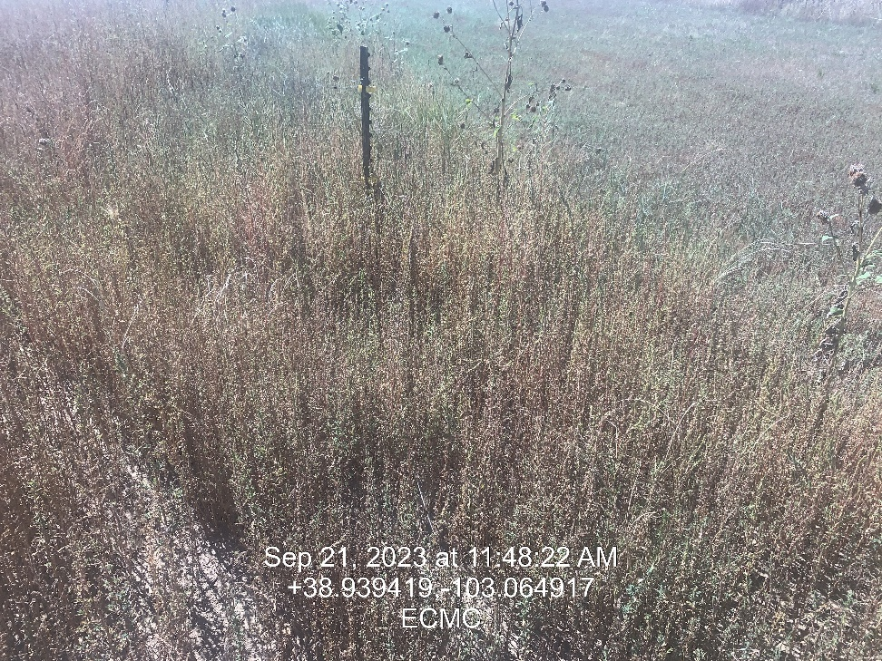
Inspection Photos
Location: Berge 24H-1, 8
Facility ID: 321761
Photo 11 – Electric fencing around open remediation compromised

