Slide 1
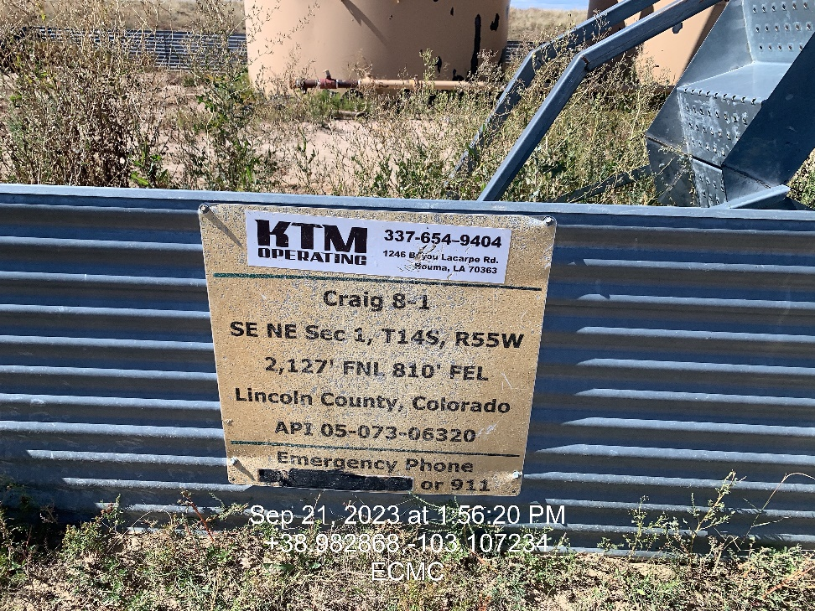
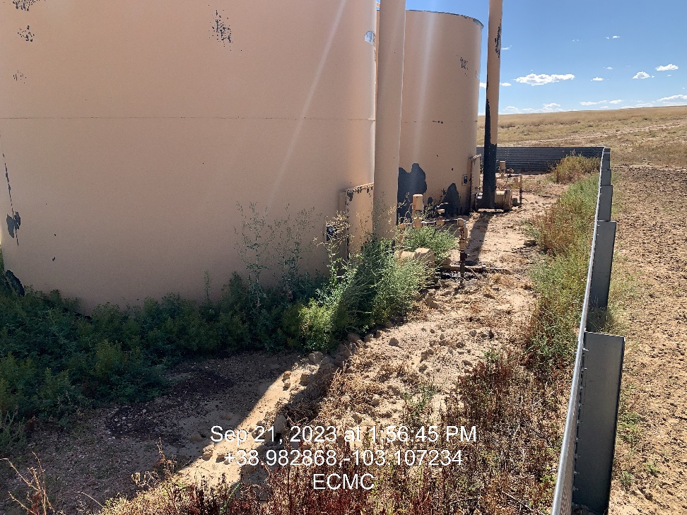

Inspection Photos
Location: Craig 8-1
Facility ID: 309619
Photo 1 –Wellhead Placard
Photo 2 – Tank battery, Areas of impacted soil observed throughout west side of battery within containment

Slide 2
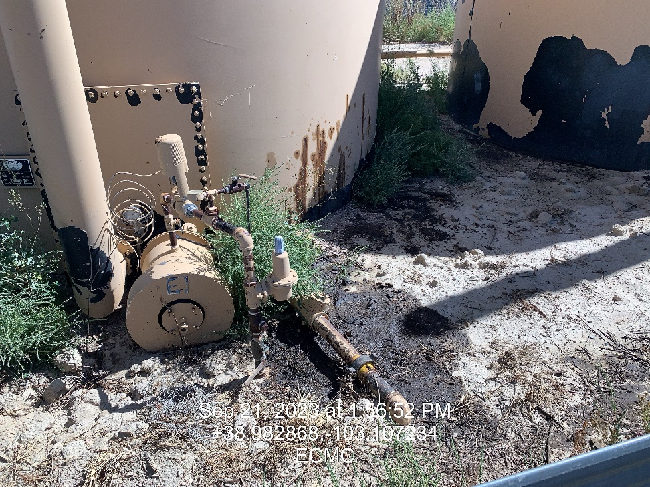
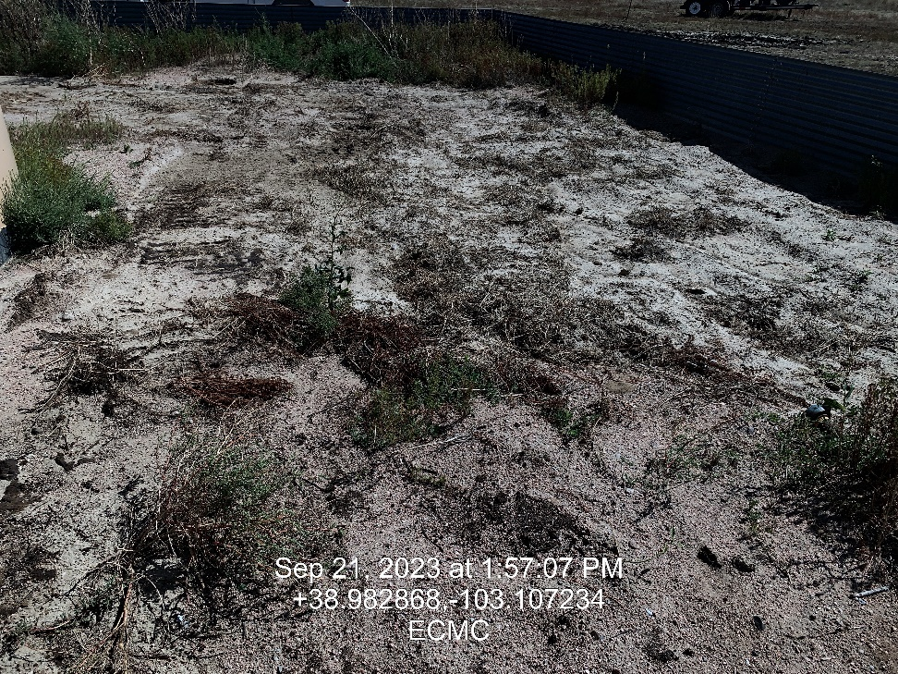
Inspection Photos
Location: Craig 8-1
Facility ID: 309619
Photo 3 – Impacted soil
Photo 4 – Area of impacted soil which looks to have recently been disturbed

Slide 3
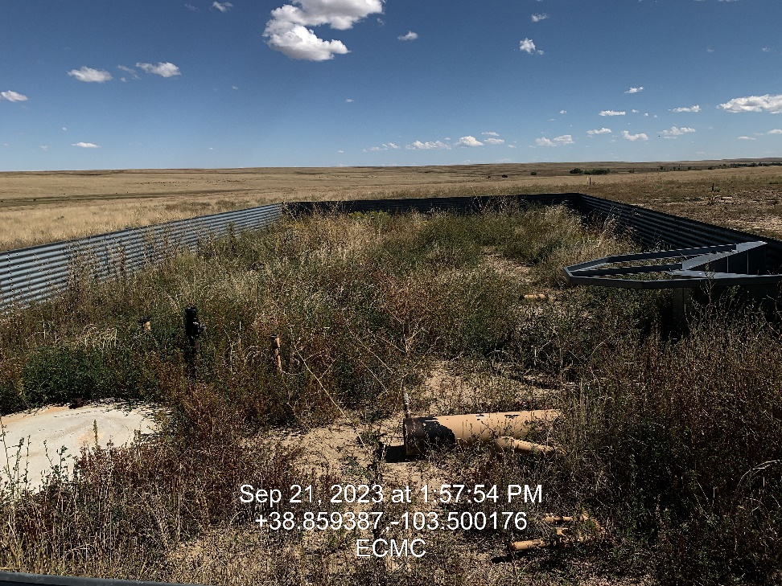
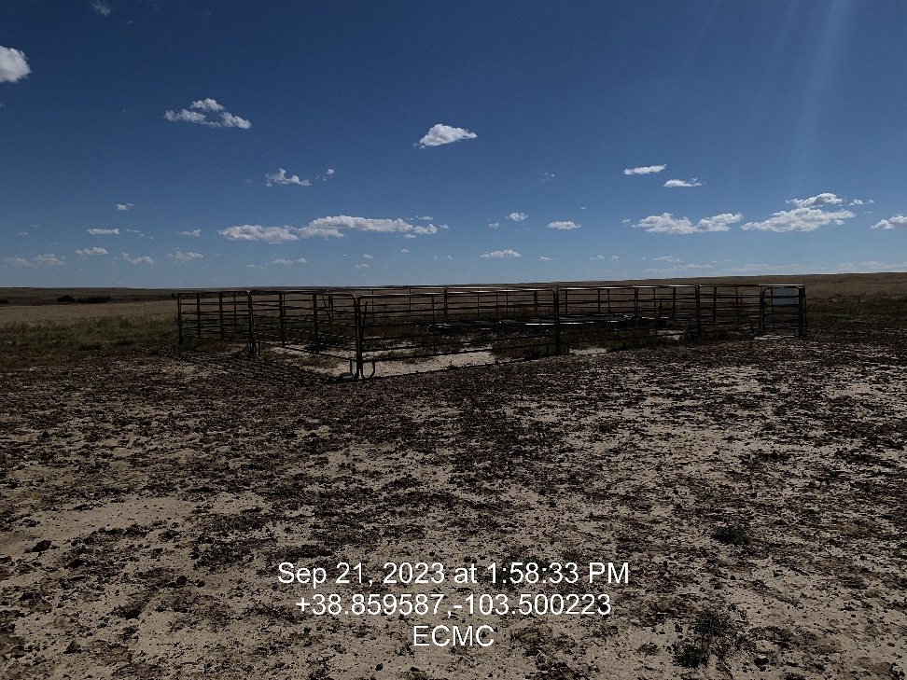
Inspection Photos
Location: Craig 8-1
Facility ID: 309619
Photo 5 – Unused equipment in secondary containment not being utilized
Photo 6 – View southeast toward well head

Slide 4
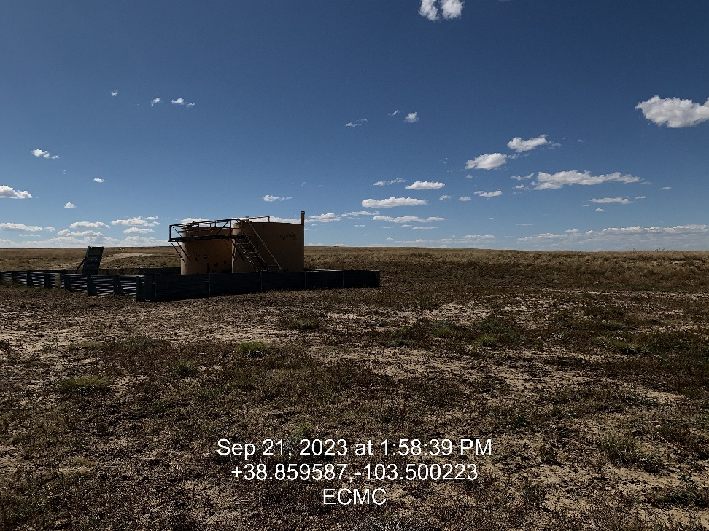
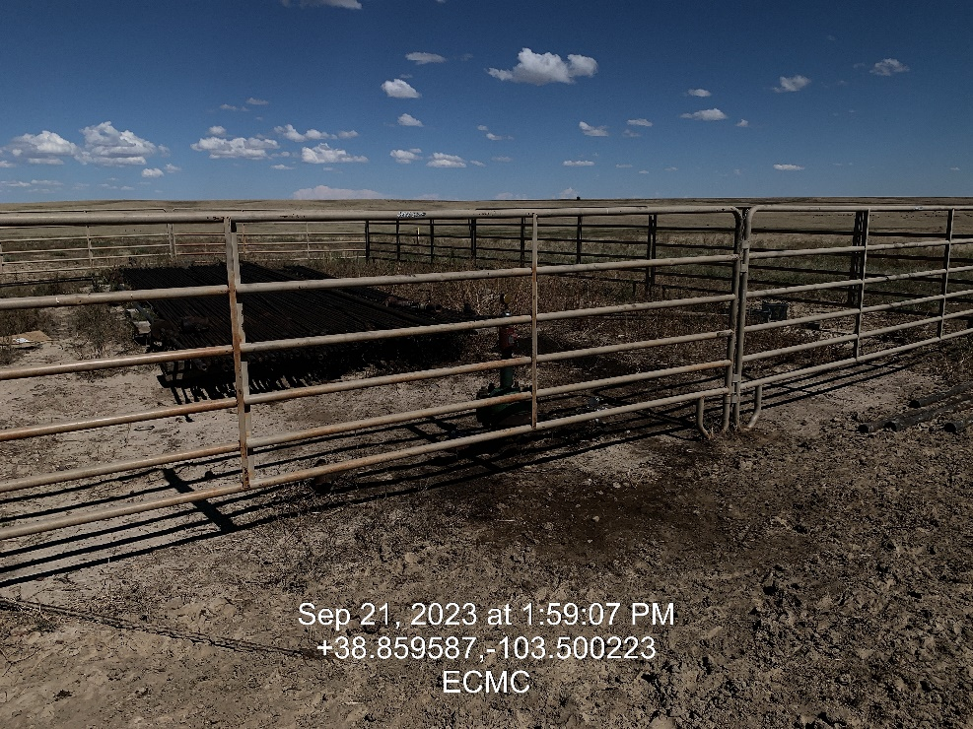
Inspection Photos
Location: Craig 8-1
Facility ID: 309619
Photo 7 – Tank Battery with impacted soil
Photo 8 – View Northeast to at well head, stained soil observed

Slide 5
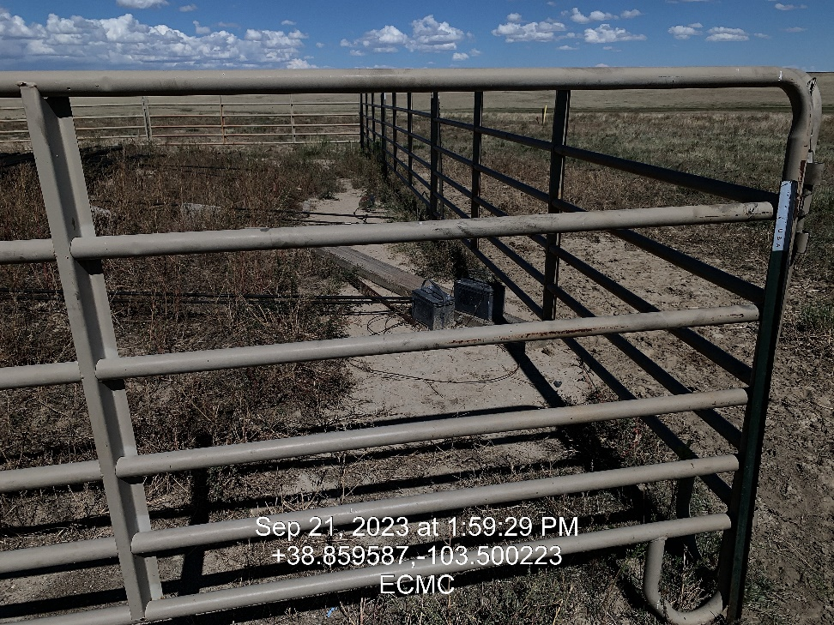
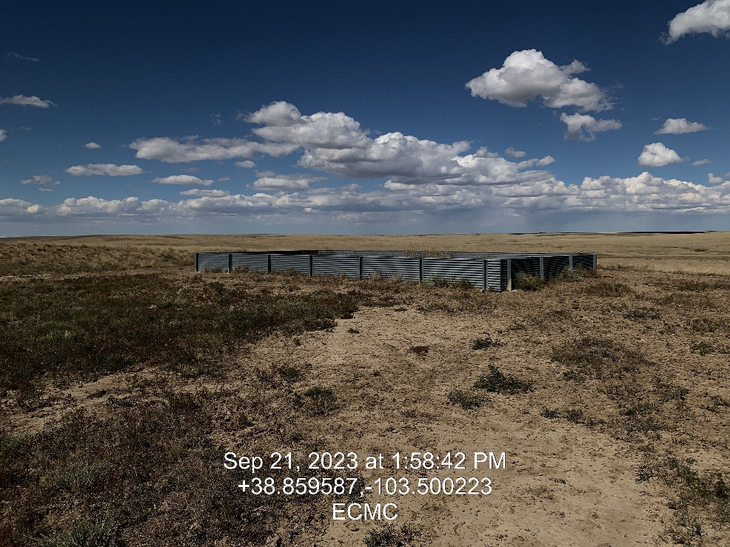
Inspection Photos
Location: Craig 8-1
Facility ID: 309619
Photo 9 – Batteries stored on location
Photo 10 – Unused secondary containment

