Slide 1
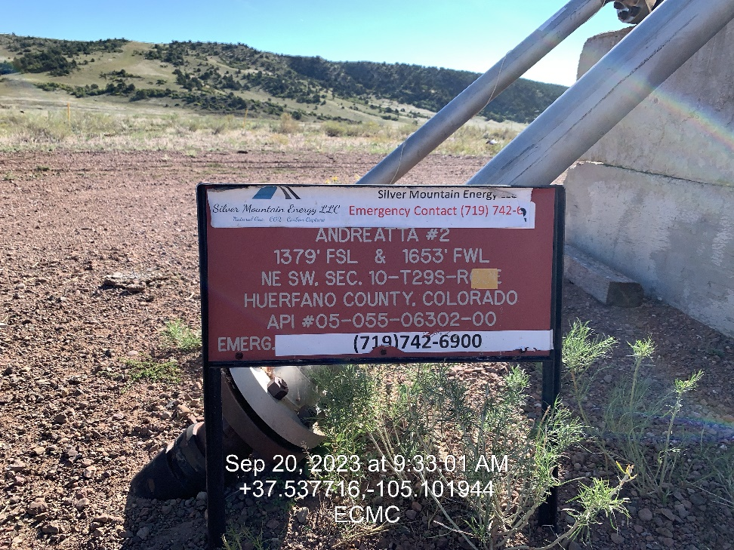
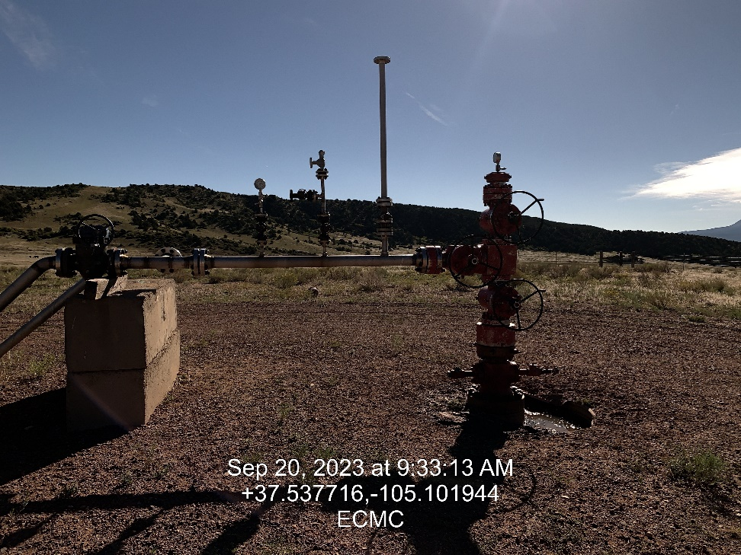

Inspection Photos
Location: Andreatta 2
Facility ID: 324578
Photo 1 –Well Site Placard
Photo 2 – Well Head

Slide 2
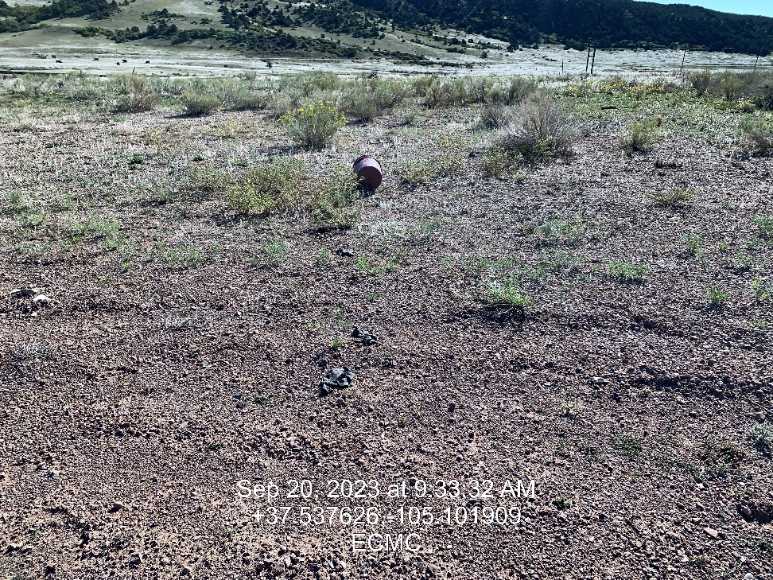
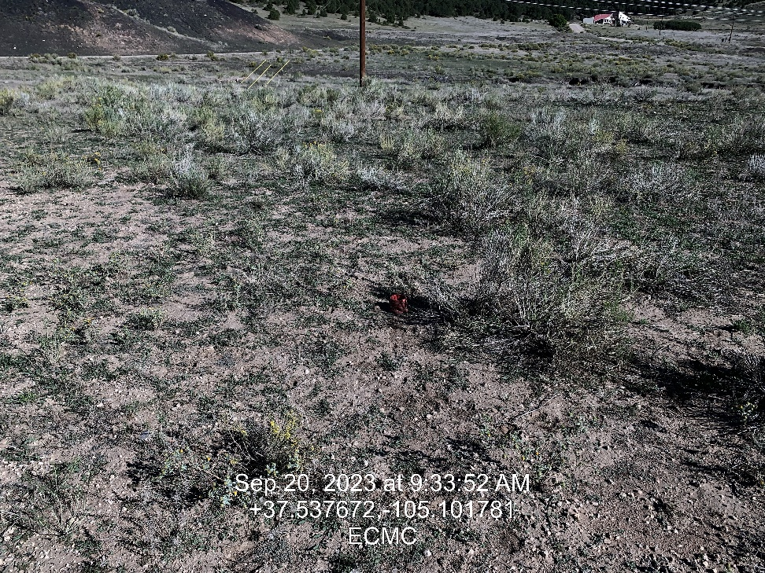
Inspection Photos
Location: Andreatta 2
Facility ID: 324578
Photo 3 – Location Looking North East, Unused Equipment/Bucket
Photo 4 – Location looking North West, Trash on location

Slide 3
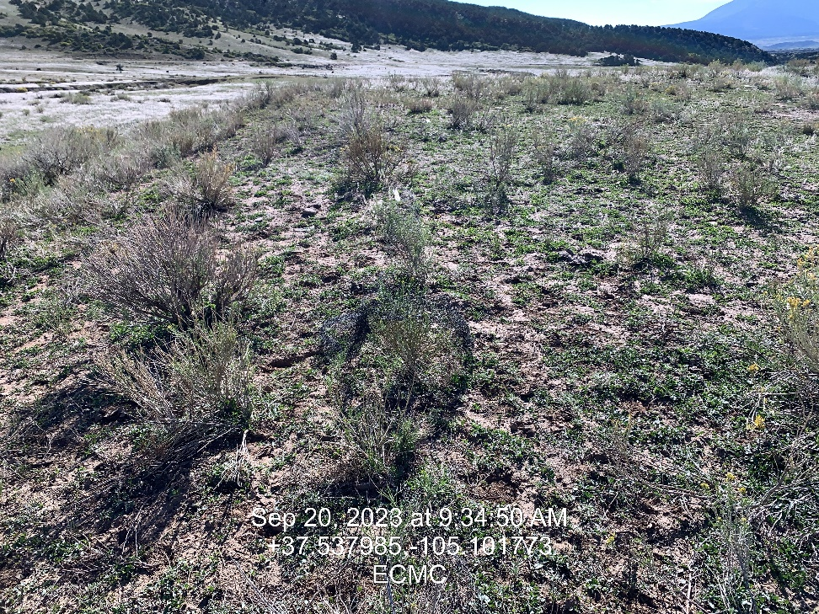
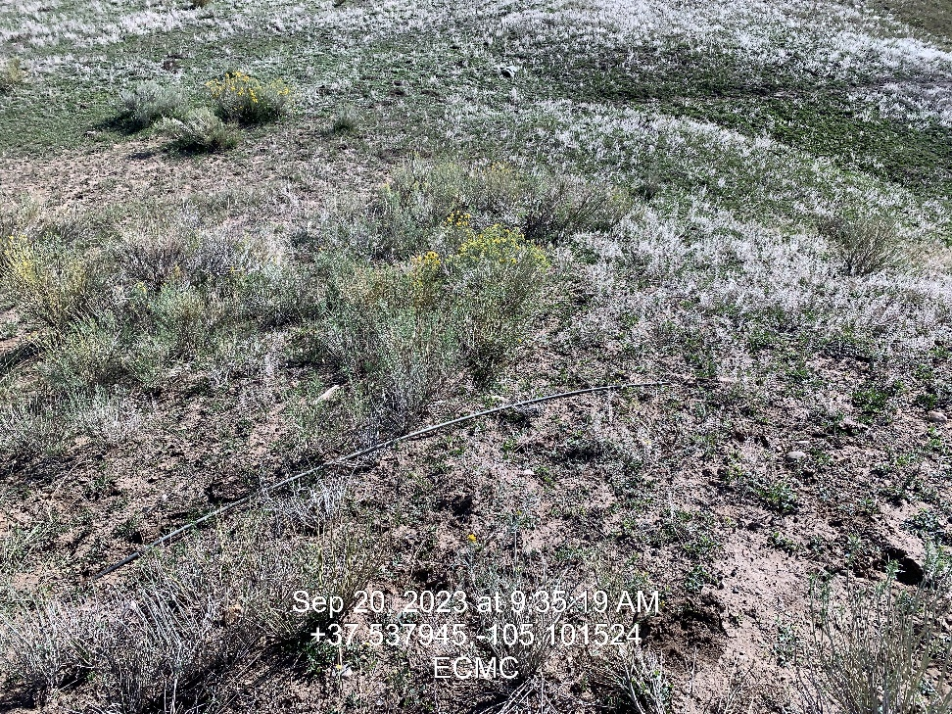
Inspection Photos
Location: Andreatta 2
Facility ID: 324578
Photo 5 – Location Looking East Waddle Webbing
Photo 6 – Unused Equipment

Slide 4
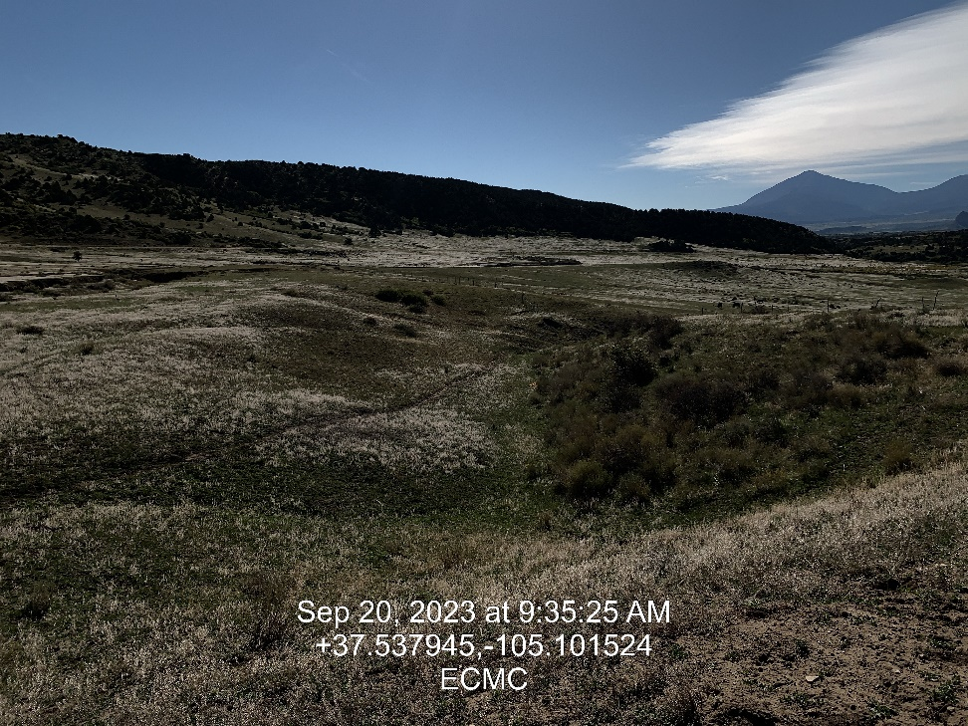
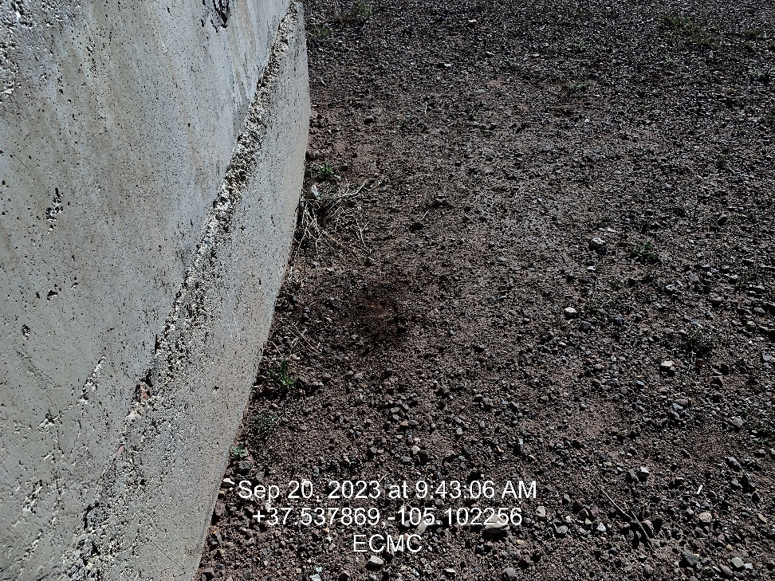
Inspection Photos
Location: Andreatta 2
Facility ID: 324578
Photo 7 – Looking east, trash off location
Photo 8 – Oil Stains on location

Slide 5
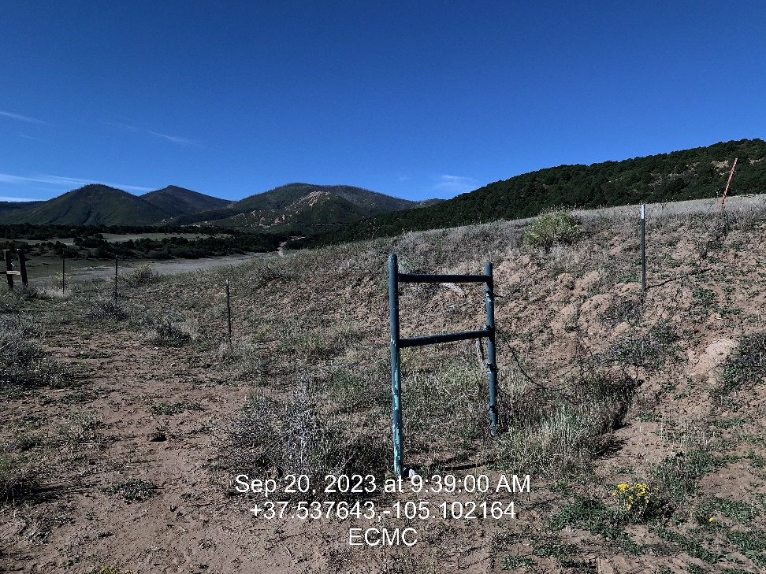
Inspection Photos
Location: Andreatta 2
Facility ID: 324578
Photo 9 – Fence along south west corner of location compromised

