Slide 1
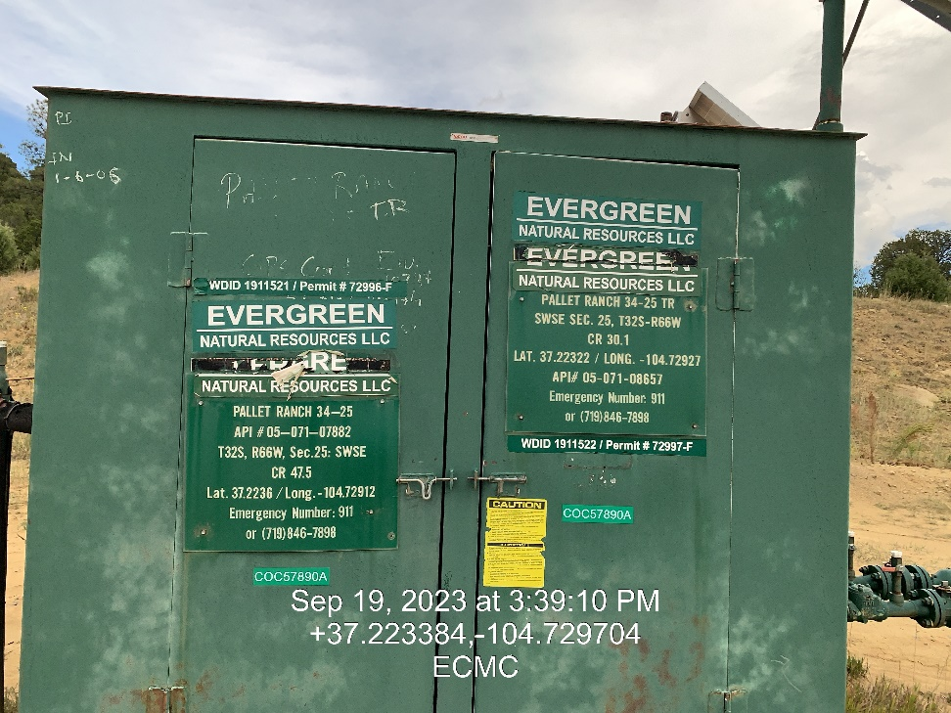
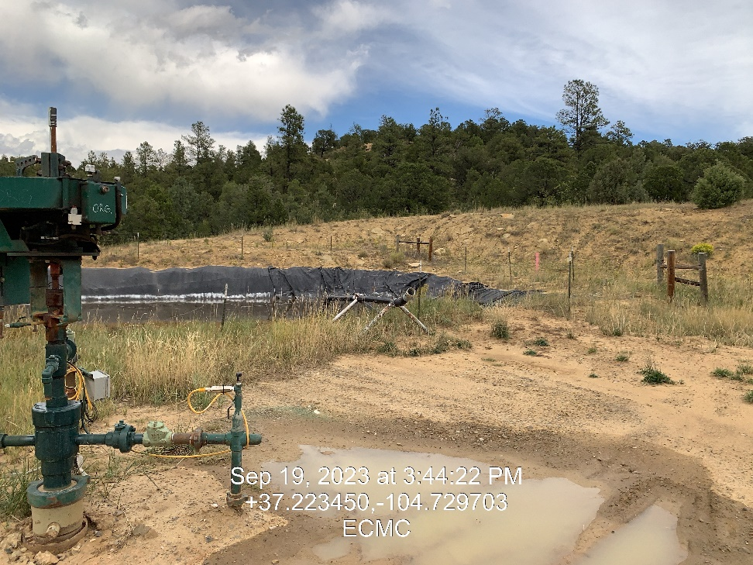

Inspection Photos
Location: Pallet Ranch 34-25
Facility ID: 333363
Photo 1 –Well Site Placard
Photo 2 – Well Head, Pit Loadout

Slide 2
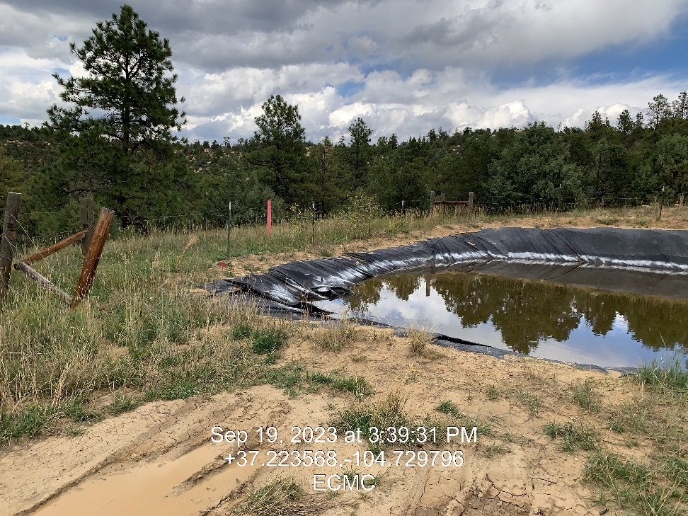
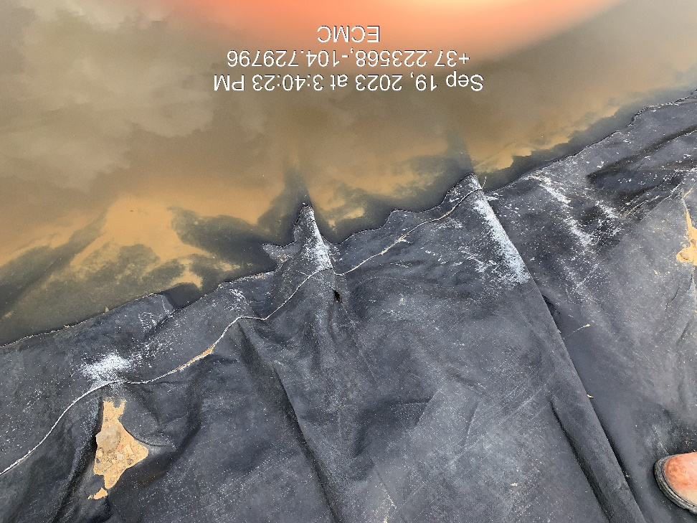
Inspection Photos
Location: Pallet Ranch 34-25
Facility ID: 333363
Photo 3 – Compromised Fence
Photo 4 – Small Hole in Pit Liner. Pit is near freeboard

