Slide 1
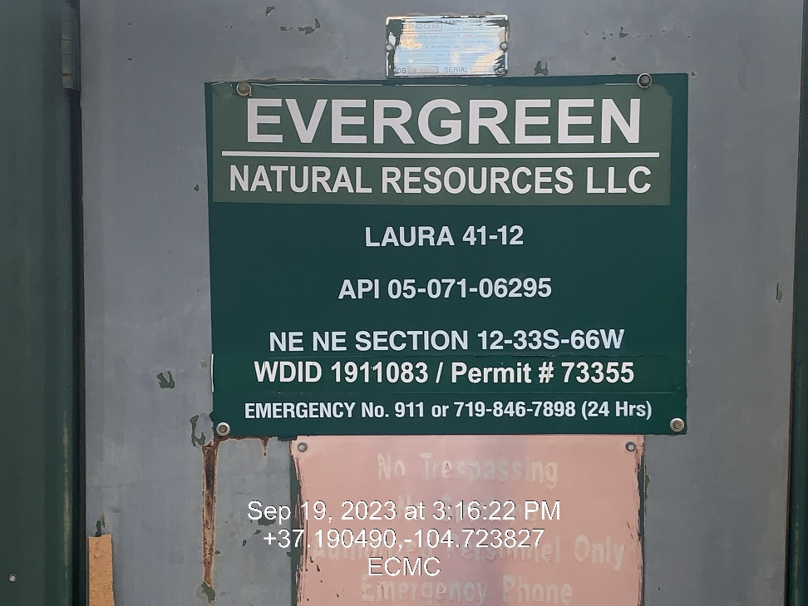
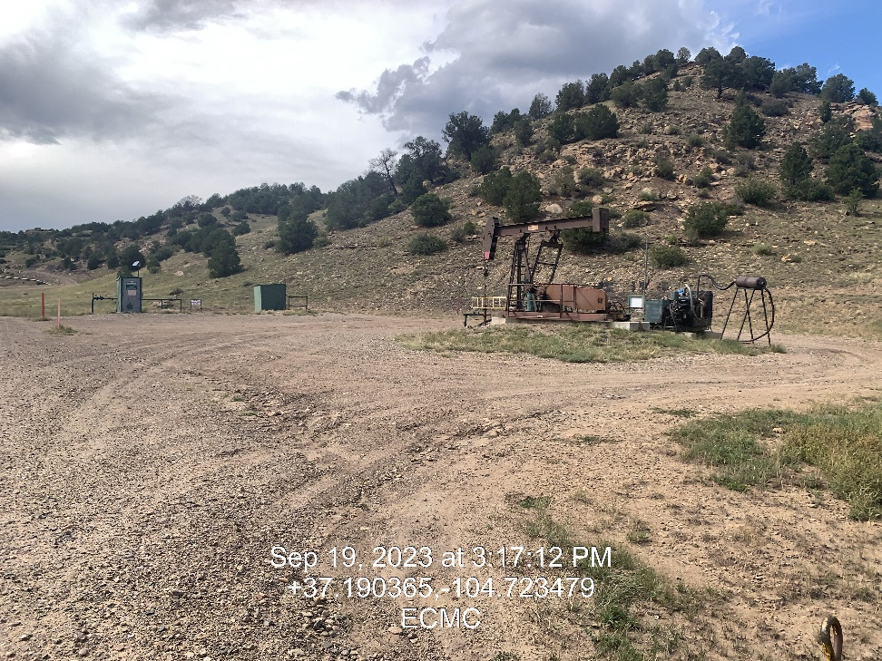

Inspection Photos
Location: Laura 41-12
Facility ID: 307344
Photo 1 –Well Site Placard
Photo 2 – Location Overview

Slide 2
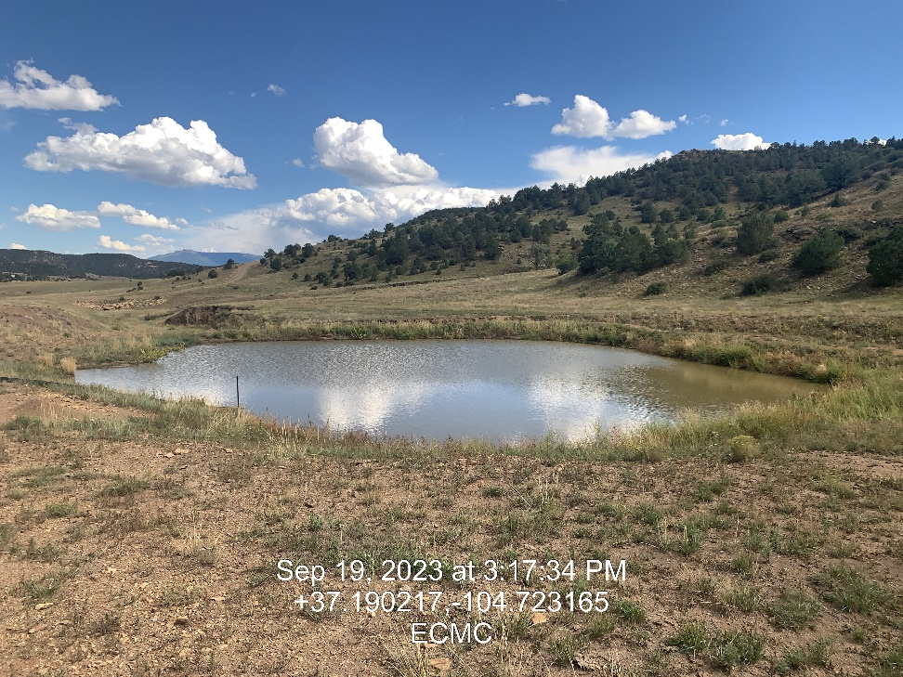
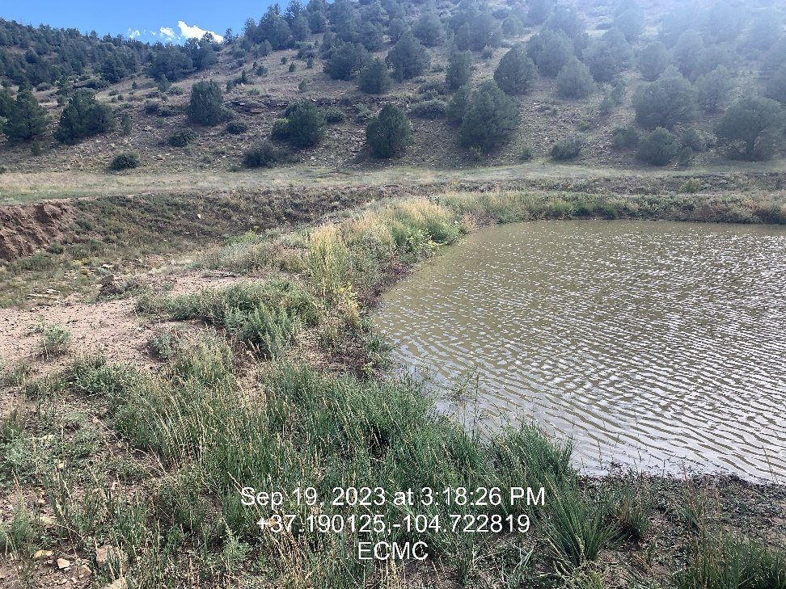
Inspection Photos
Location: Laura 41-12
Facility ID: 307344
Photo 3 – Offsite pit looking east
Photo 4 – Offsite pit looking south

Slide 3
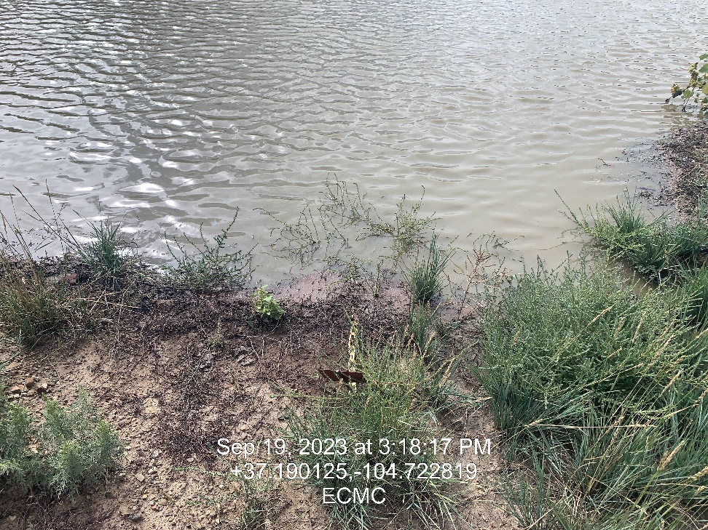
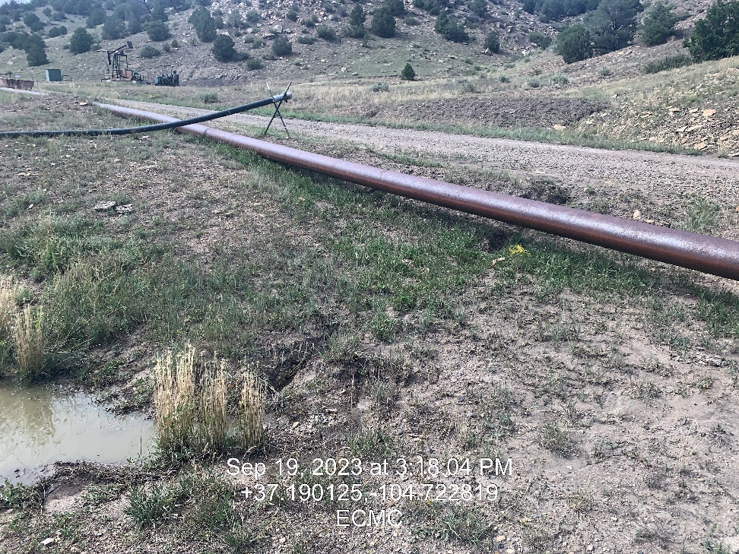
Inspection Photos
Location: Laura 41-12
Facility ID: 307344
Photo 5 – Freeboard Chain
Photo 6 – Stormwater entering Offsite Pit

Slide 4
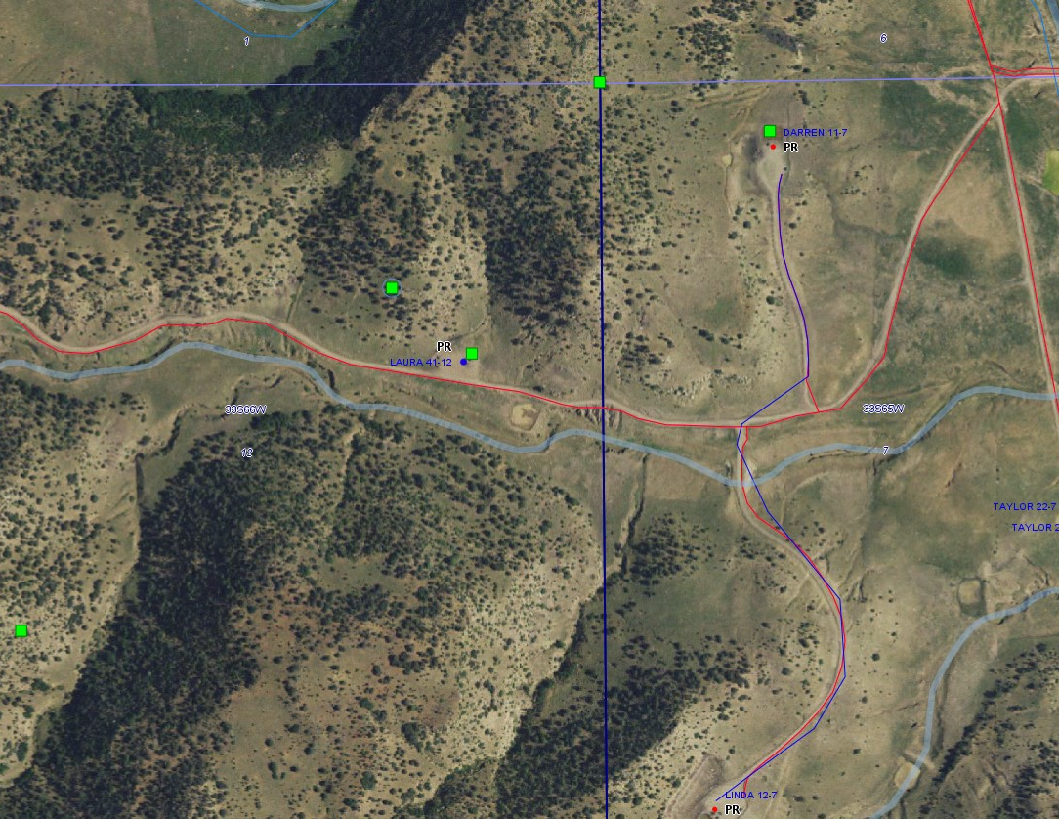
Inspection Photos
Location: Laura 41-12
Facility ID: 307344
Photo – 7 Laura Offsite pit overview, Update pit coordinates

