Slide 1
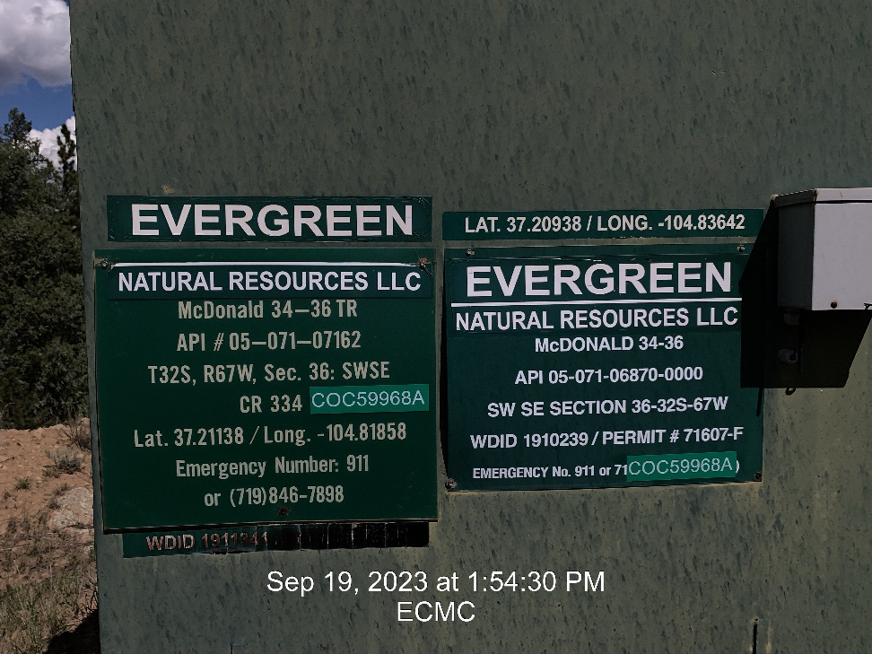
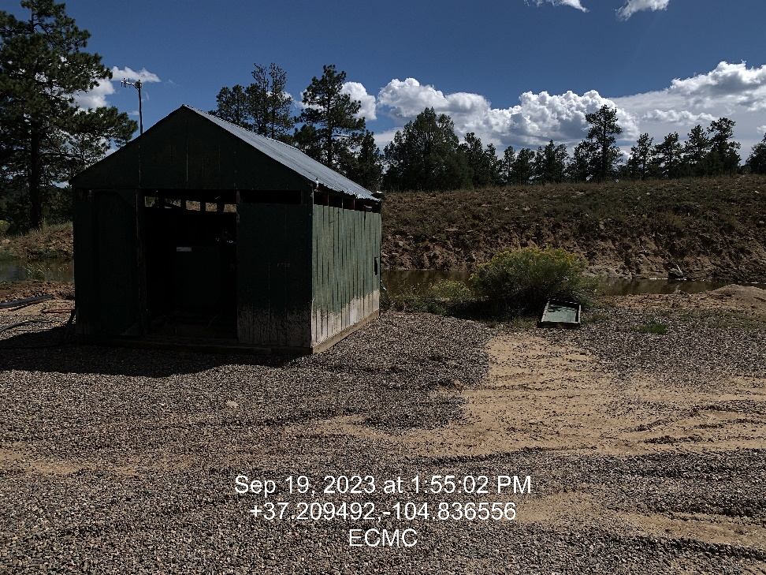

Inspection Photos
Location: McDonald 34-36
Facility ID: 307731
Unused Equipment/Shed door
Photo 1 –Well Site Placard
Photo 2 – Engine Skid Unused Equipment

Slide 2
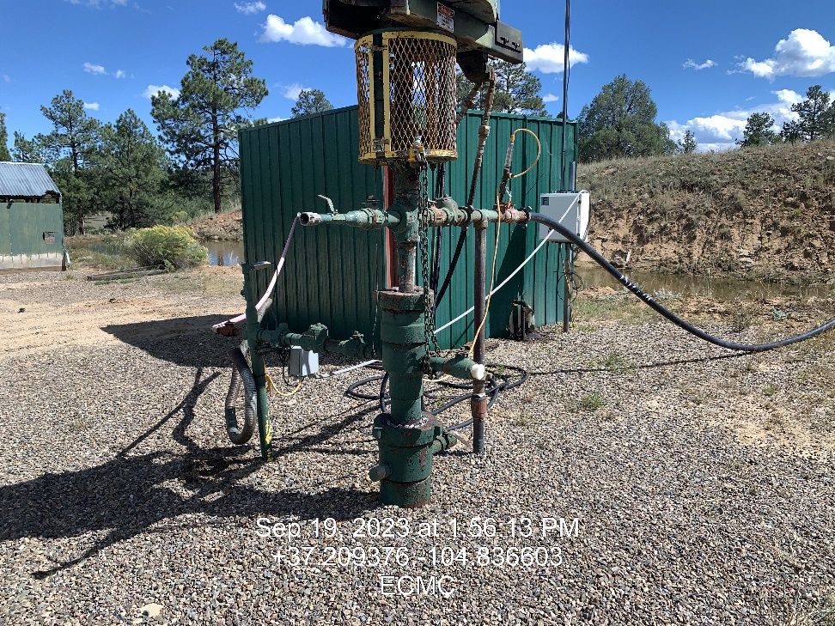
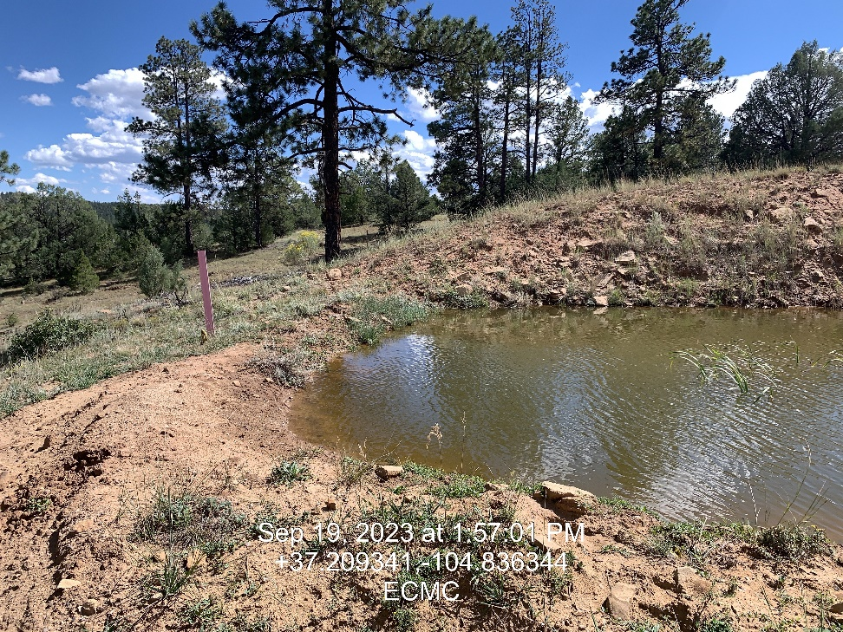
Inspection Photos
Location: McDonald 34-36
Facility ID: 307731
Photo 3 – Well head
Photo 4 – Pit Freeboard

Slide 3
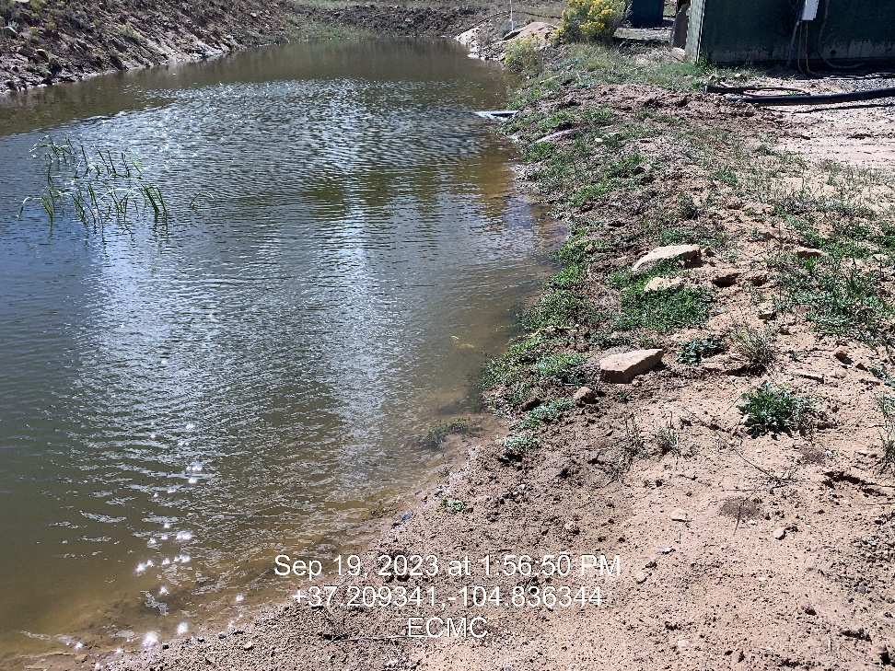
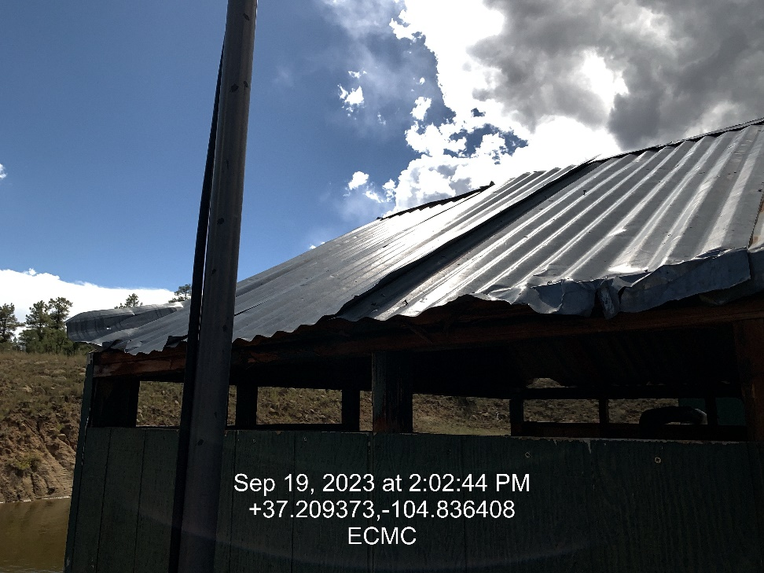
Inspection Photos
Location: McDonald 34-36
Facility ID: 307731
Unsecured Roof Panel
Freeboard marker
Photo 5 – Pit Freeboard Marker
Photo 6 – Unsecure roof panel

Slide 4
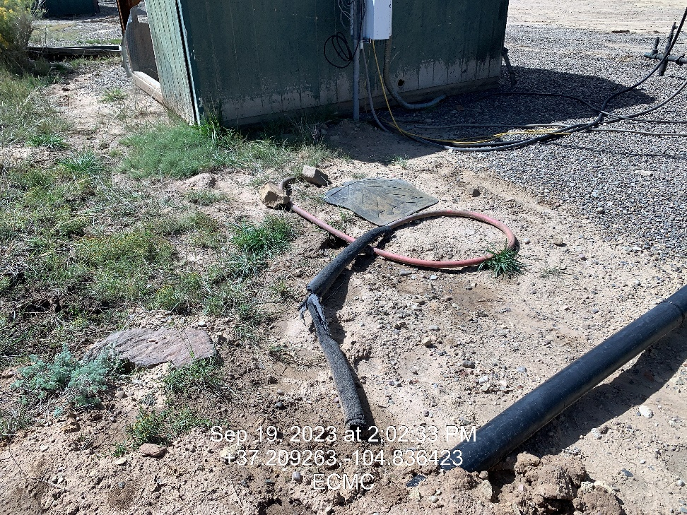
Inspection Photos
Location: McDonald 34-36
Facility ID: 307731
Photo 7 – Trash and Unused Equipment on site

