Slide 1
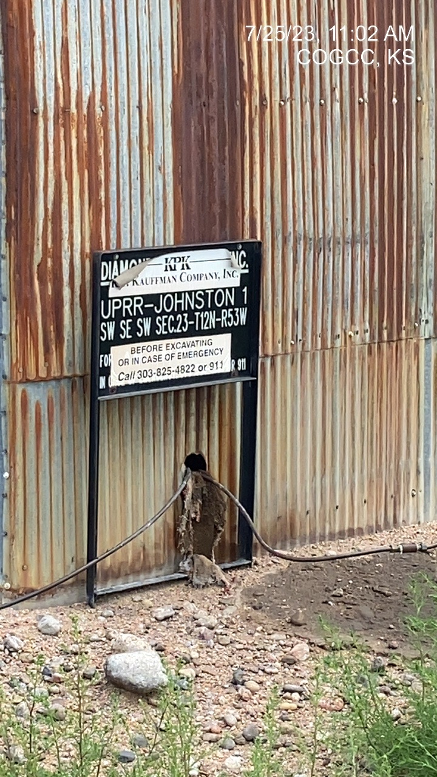
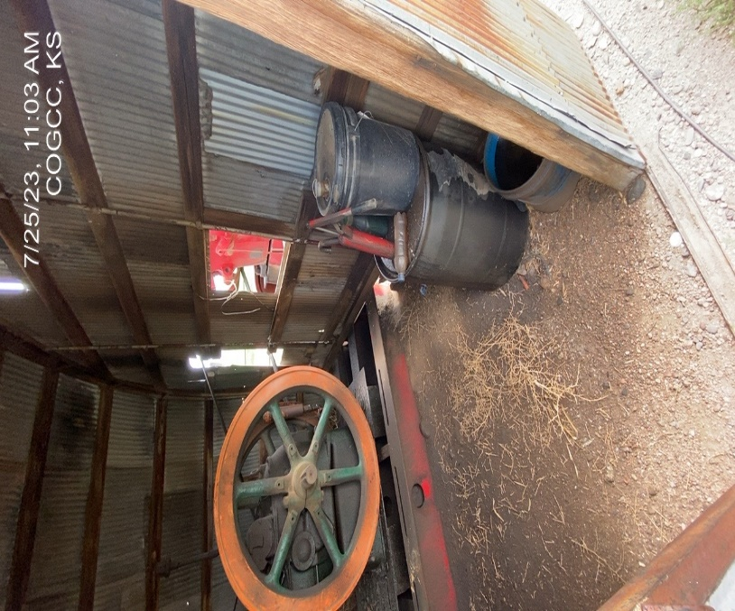
KP KAUFFMAN CO. INC
Location Name: UPRR-JOHNSON 1
Location ID: 075-07291
SIGNAGE – @ WELLHEAD/PJ
STAINED/SATURATED SOILS WITHIN PJ SHED – BARRELS/JUGS/BUCKETS REMOVE FROM LOCATION OR PROVIDE CONTAINMENT

Slide 2
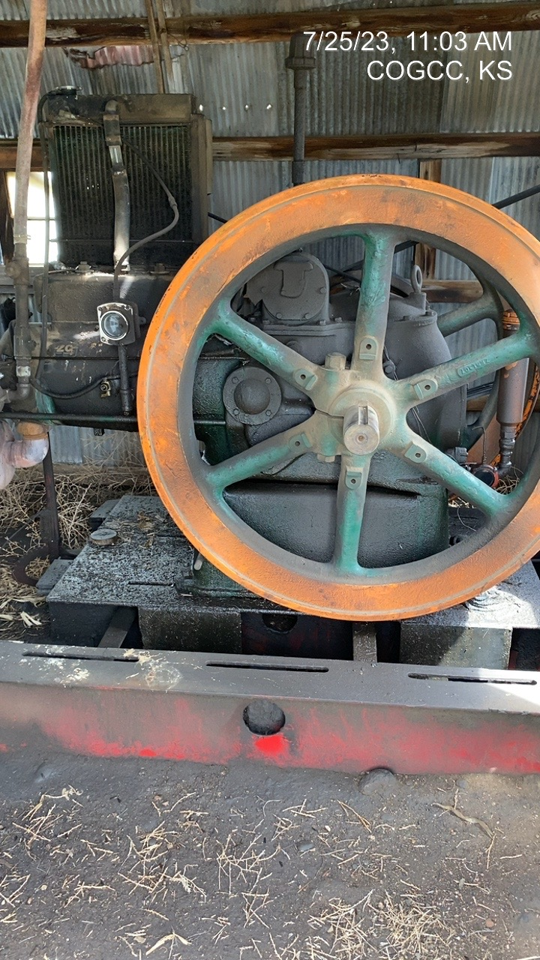
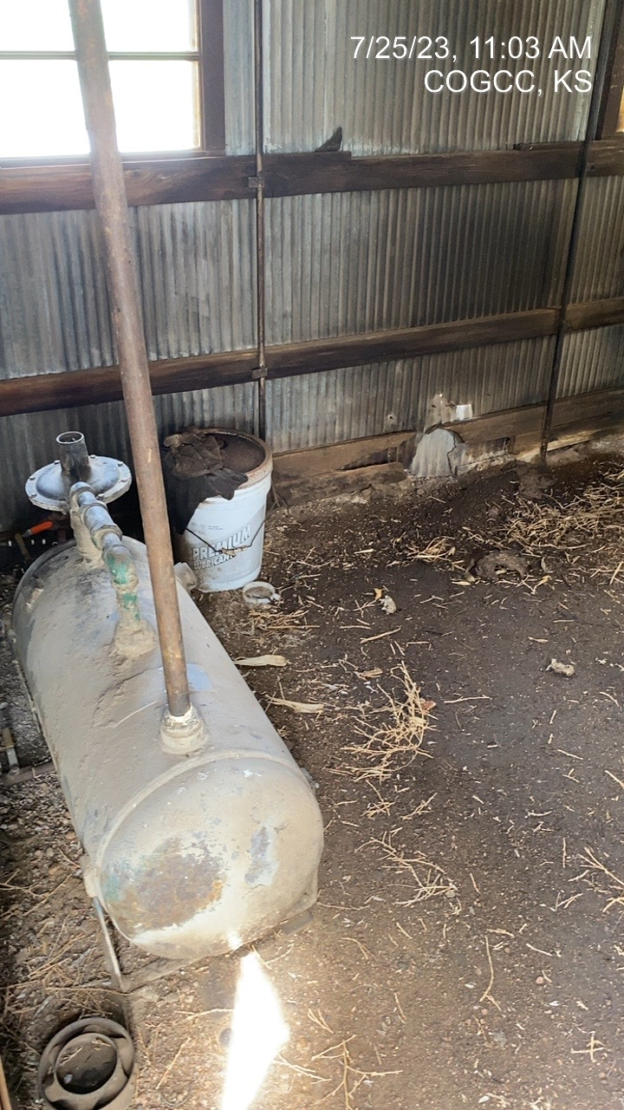
KP KAUFFMAN CO INC
UPRR-JOHNSON 1
05-075-07291
LUBRICANT/ADDITIVE STAINED/SATURATED SOILS
TRASH – STAINED/SATURATED SOILS – REMOVE AND REMEDIATE

Slide 3
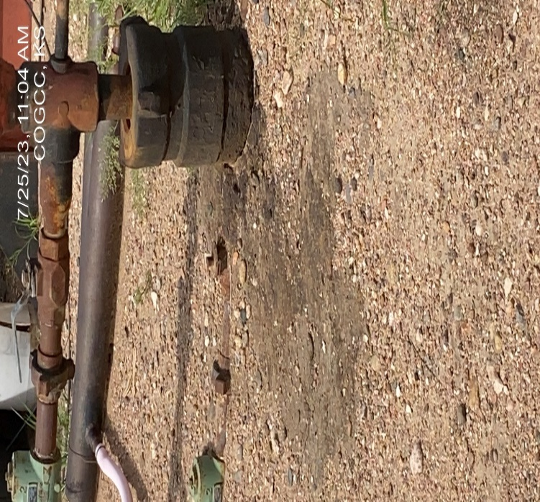
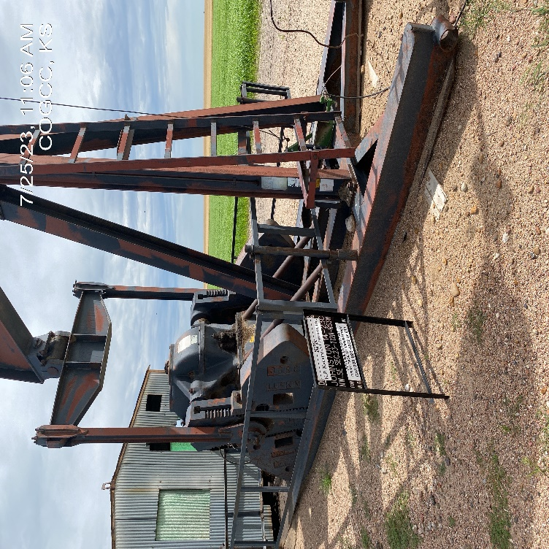
KP KAUFFMAN
UPRR-JOHNSON 1
075-07291
STAINED SOIL AT WELLHEAD
REMOVE/REMEDIATE
PJ – DEBRIS- VESSELS (NO CONTAINMENT) REMOVE DEBRIS – PROVIDE CONTAINMENT FOR TANKS/BARRELS OR REMOVE FROM LOCATION.

Slide 4
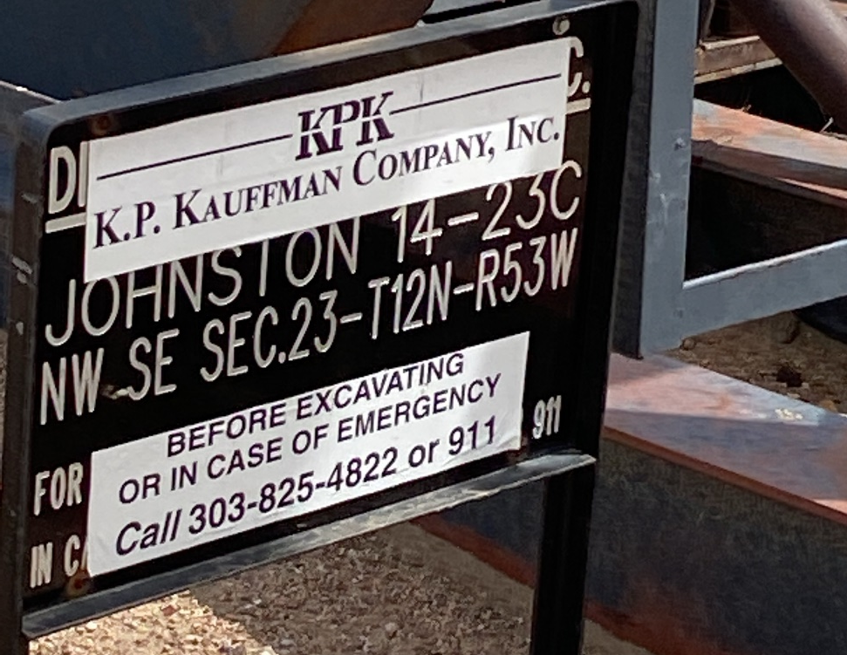
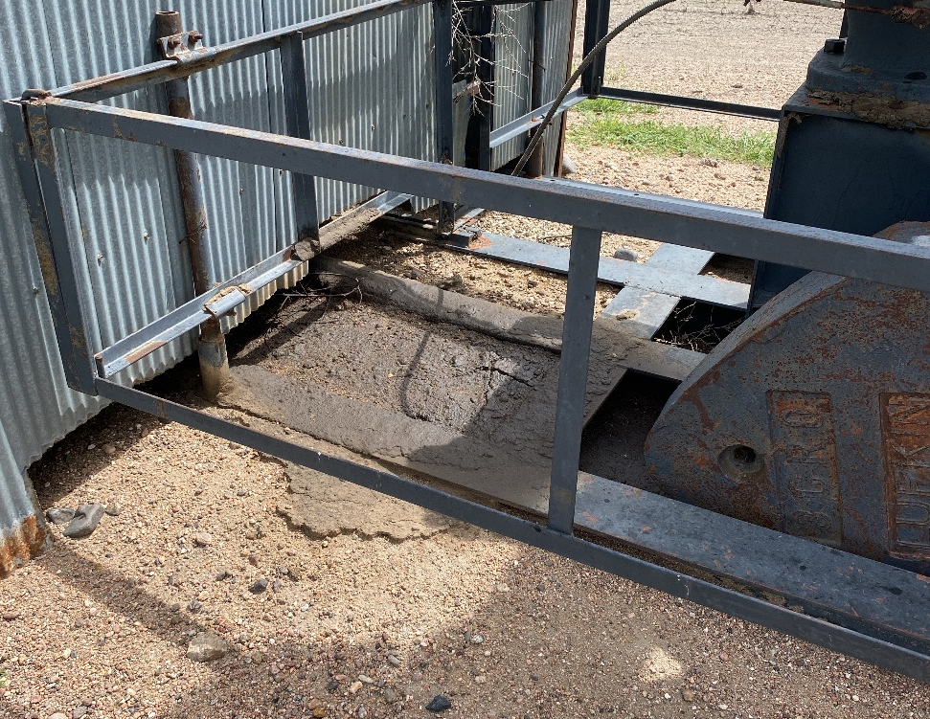
KP KAUFFMAN
UPRR-JOHNSON1
075-07291
SIGNAGE AT WELLHEAD
SATURATED SOILS @ PJ REMOVE/REMEDIATE

Slide 5
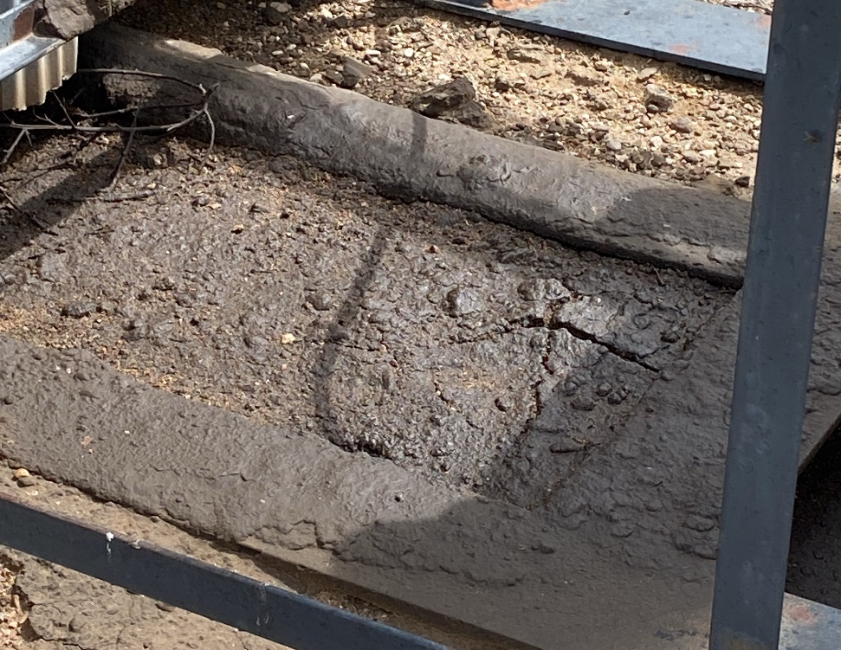
KP KAUFFMAN
UPRR-JOHNSON 1
075-07291
SATURATED SOILS – REMOVE/REMEDIATE

