Slide 1
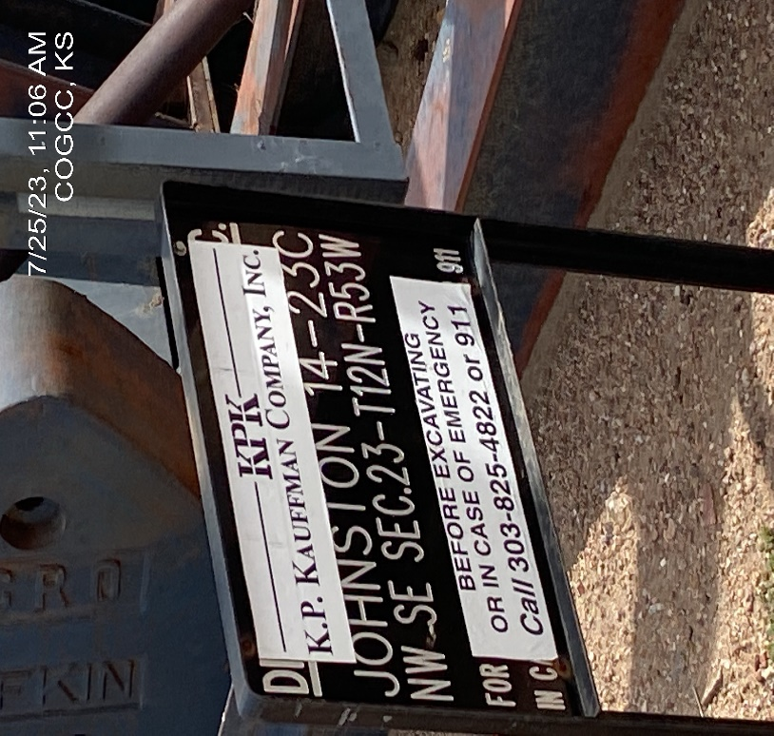
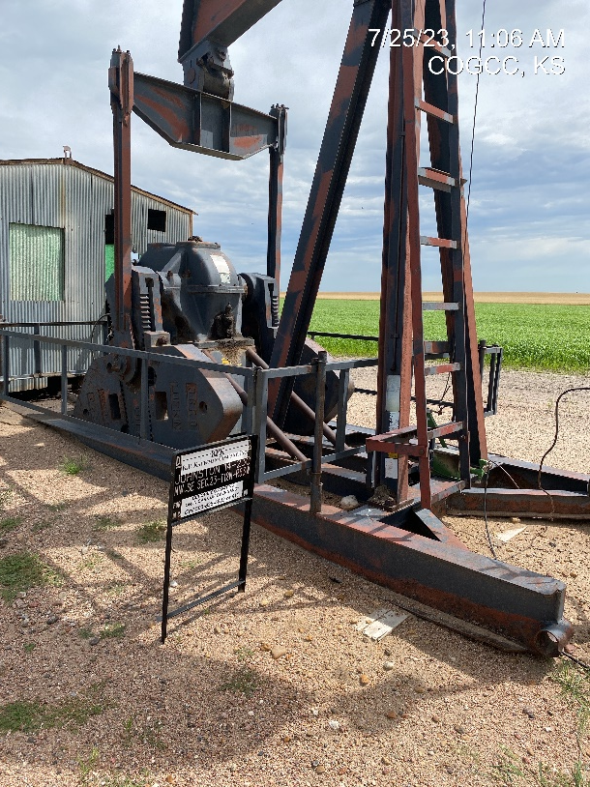
KP KAUFFMAN CO. INC
Location Name: JOHNSTON 14-23C
Location ID: 075-09316
SIGNAGE – @ WELLHEAD/PJ
PJ

Slide 2
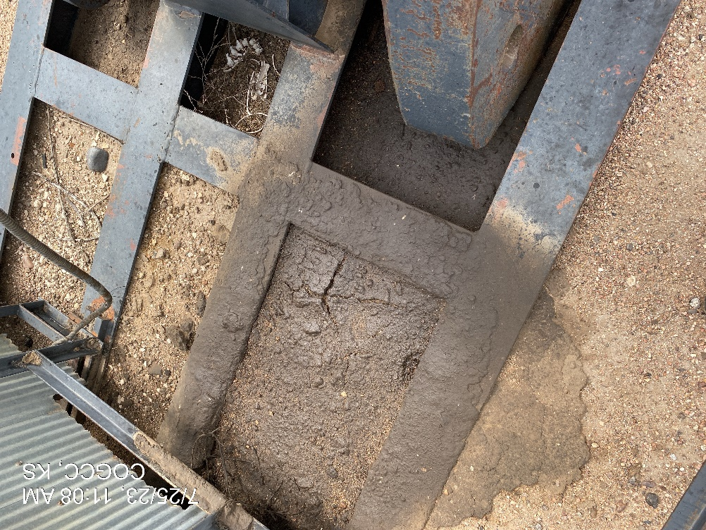
KP KAUFFMAN
JOHNSTON 14-23-C
05-09316
SATURATED SOILS AT PJ – REMOVE/REMEDIATE

