Slide 1
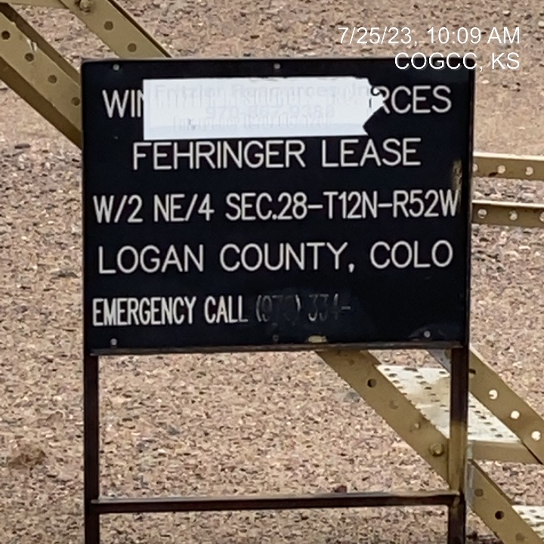
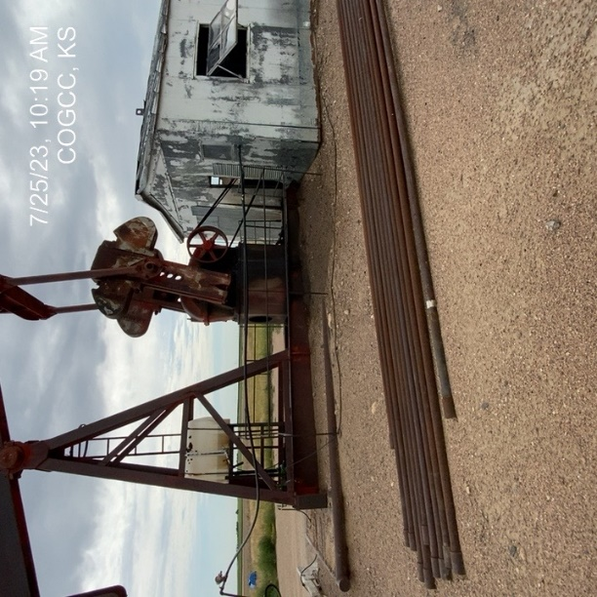
FRITZLER RESOURCES INC
Location Name: FEHRINGER 1
Location ID: 075-07023
SIGNAGE AT BATTERY
PJ – UNUSED EQUIPMENT (TUBING)

Slide 2
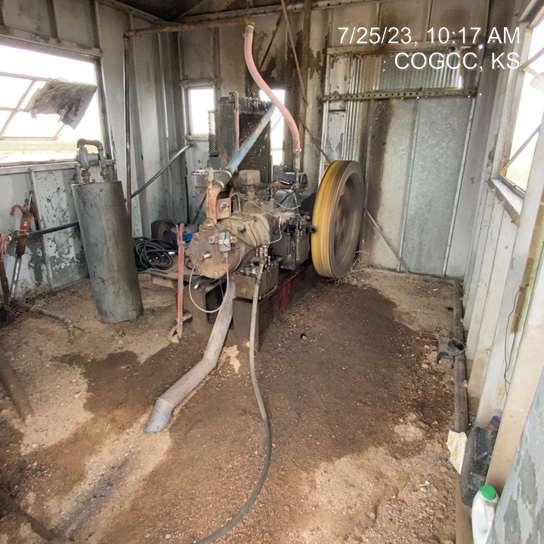
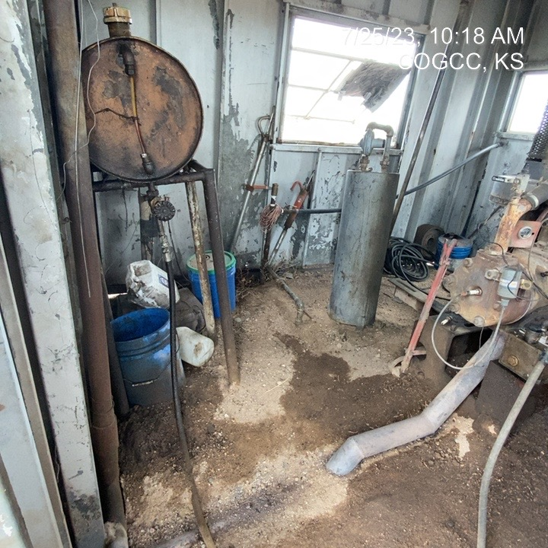
FRITZLER RESOURCES
FEHRINGER
PJ SHED – STAINED/SATURATED SOILS
LUBRICANT/ADDITIVE JUGS,TANKS, BUCKETS – NO CONTAINMENT

Slide 3
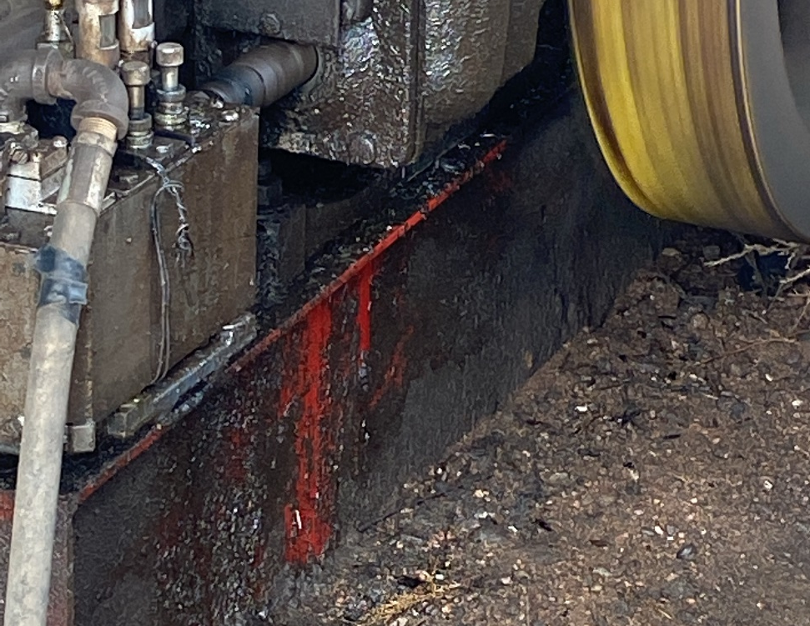
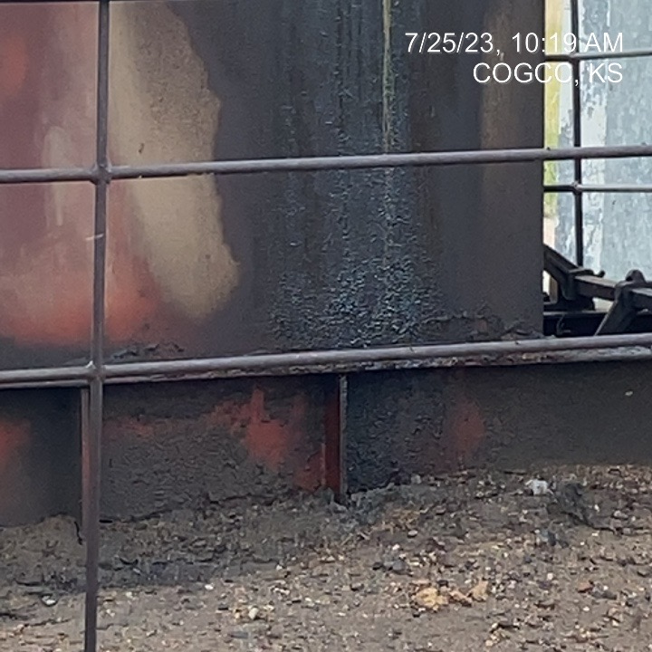
FRITZLER RESOURCES
FEHRINGER
LUBRICANT STAINED/SATURATEFD SOILS
GEAR BOX LUBRICANT – STAINED/SATURATED SOILS

Slide 4
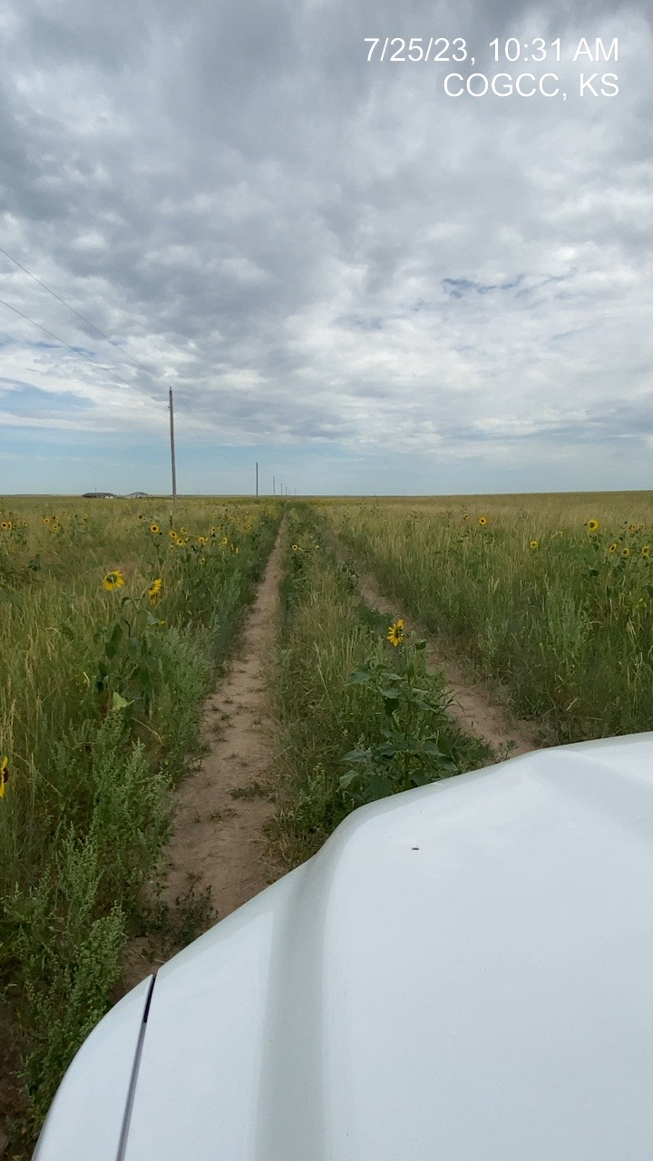
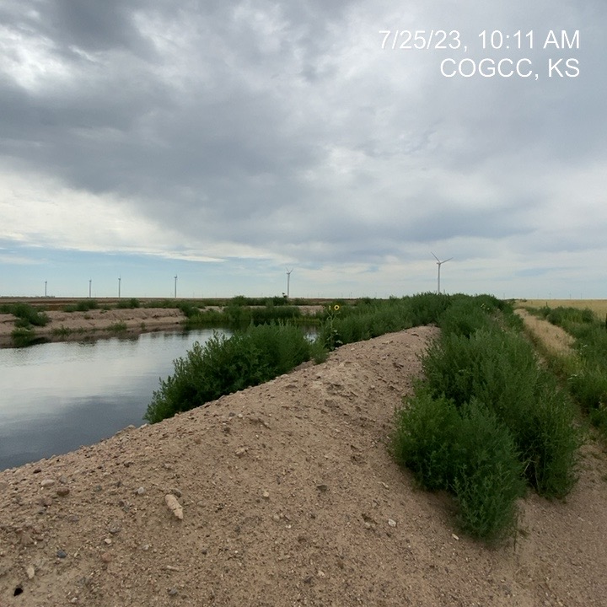
FRITZLER RESOURCES
FEHRINGER
LEASE ROAD WEEDS
WEEDS AT PW PIT BERM

