Slide 1
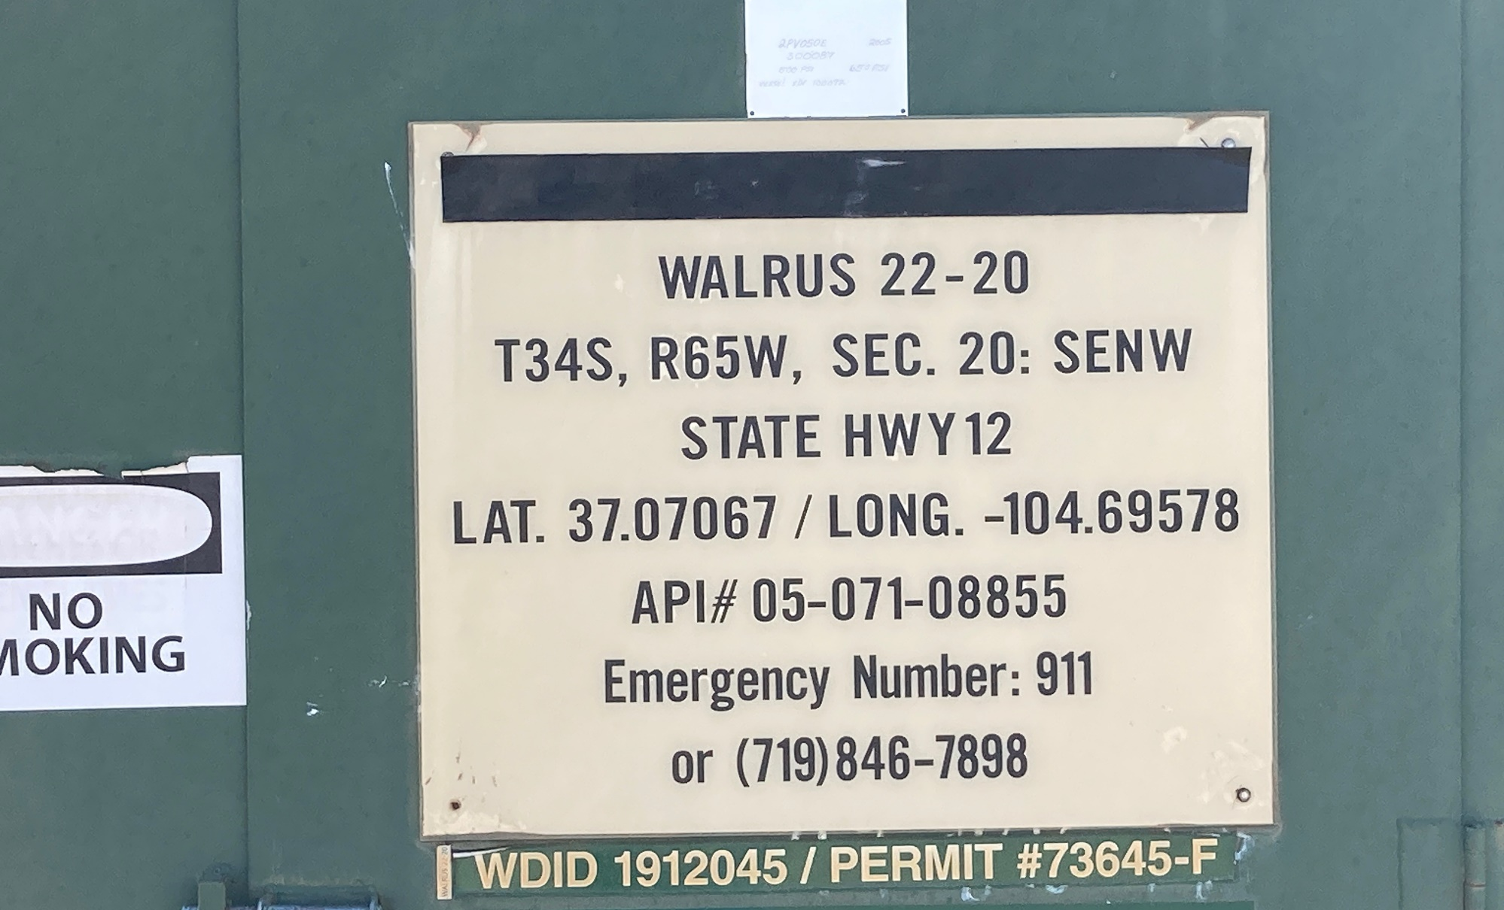
Location Name: WALRUS 22-20, API #: 071-08855, Insp. #:695107785
PHOTO 1: WELL SIGN

Slide 2
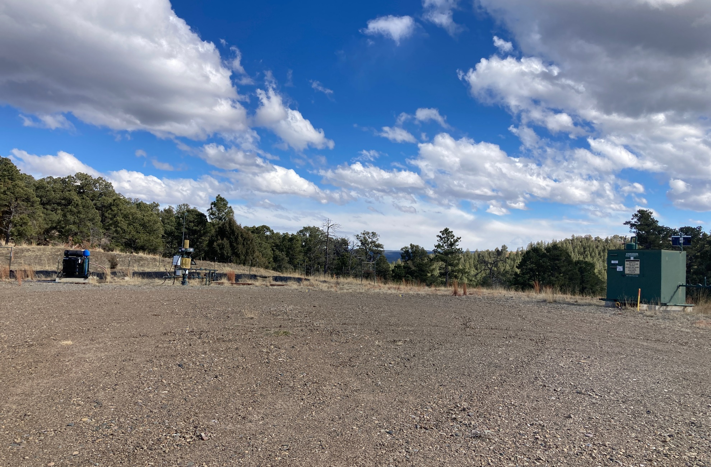
PHOTO 2: LOCATION

Slide 3
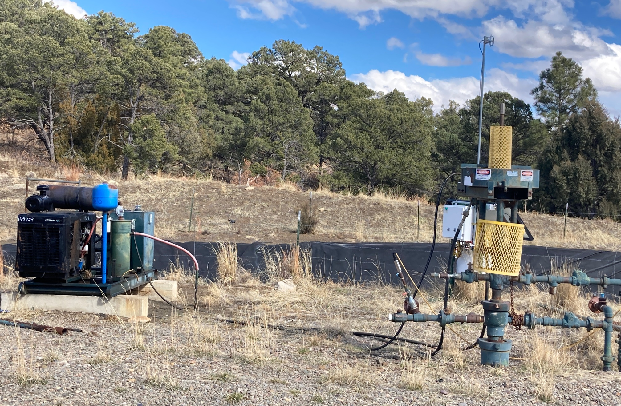
PHOTO 3: WELLHEAD AND EQUIPMENT / WEEDS SHOULD BE ADDRESSED

Slide 4
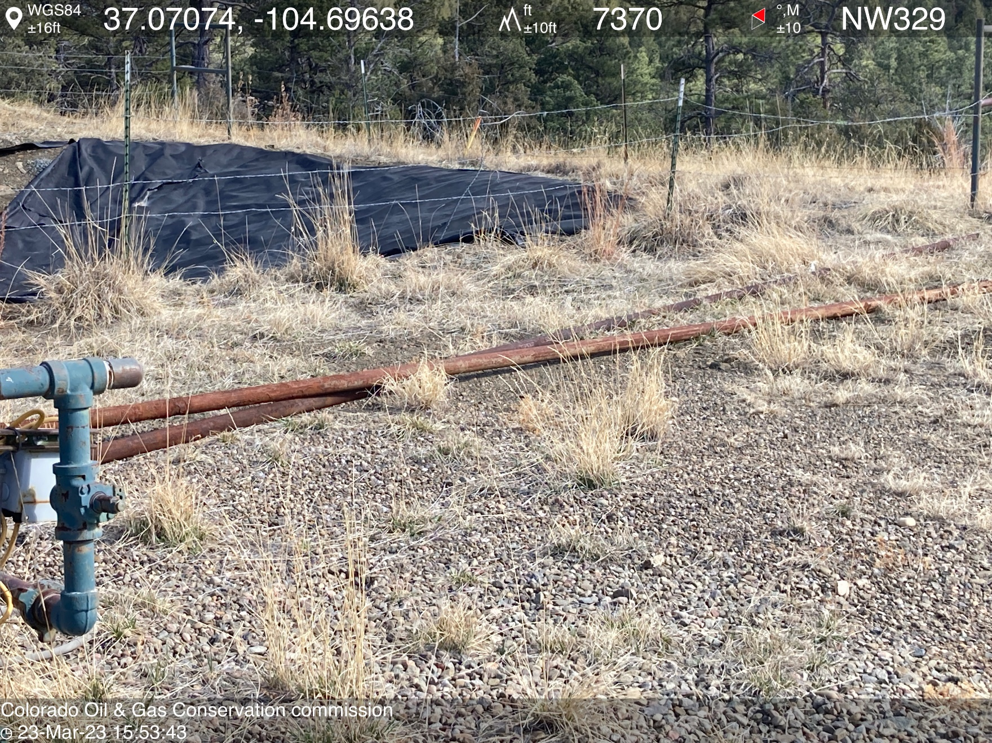
PHOTO 4: UNUSED EQUIPMENT ON LOCATION (TBG). REMOVE UNUSED EQUIPMENT PER RULE 606. CA DATE 4/4/2023.

Slide 5
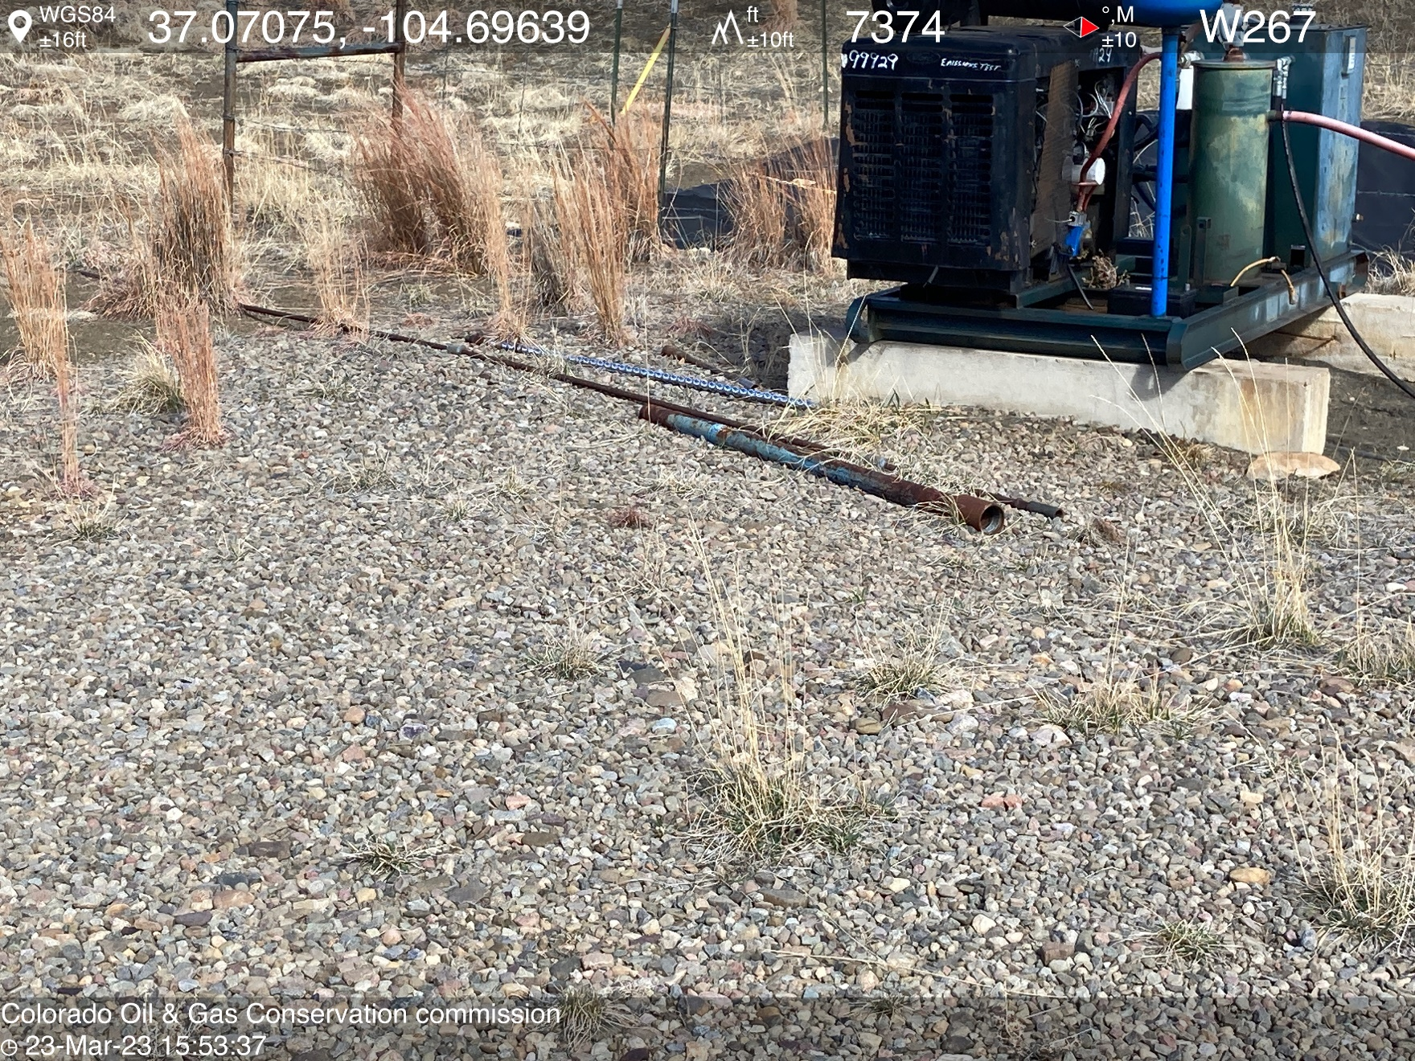
PHOTO 5: UNUSED EQUIPMENT ON LOCATION (RODS). REMOVE UNUSED EQUIPMENT PER RULE 606. CA DATE 4/4/2023.

Slide 6
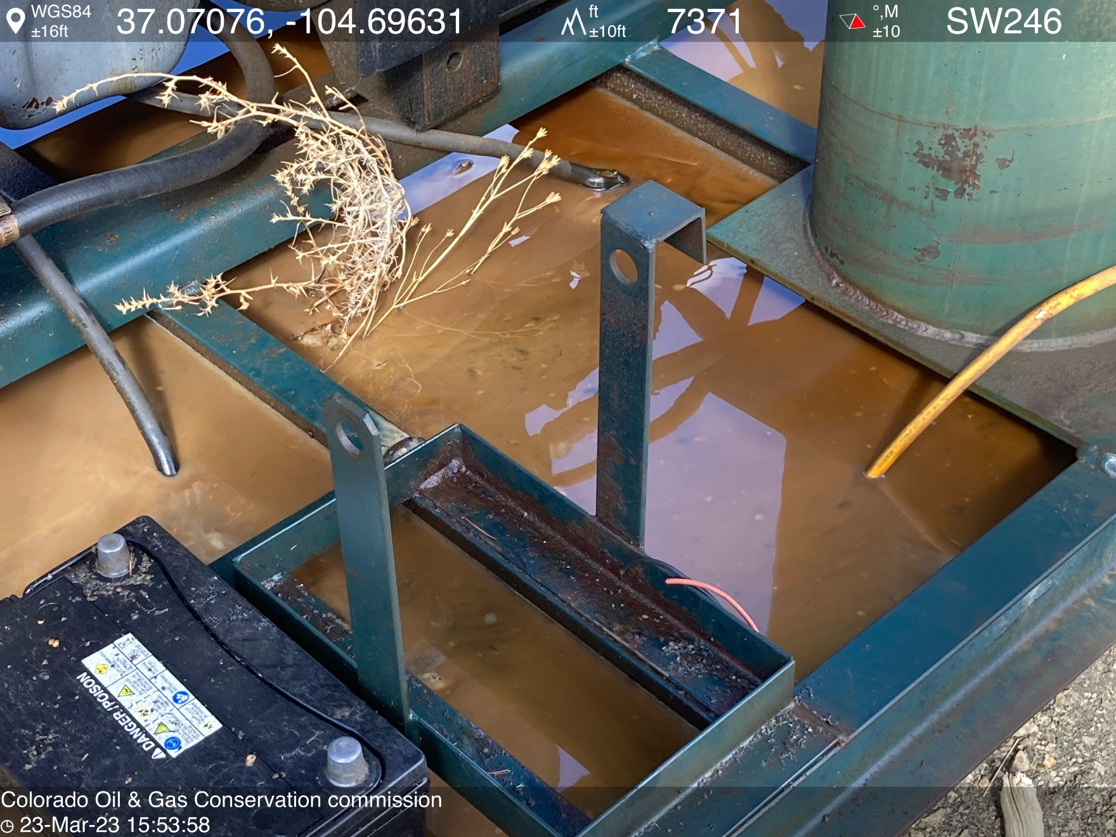
PHOTO 6: OILY WASTE MIXED WITH WATER IN PRIME MOVER ENGINE SKID. COMPLY WITH RULE 1002.f.(2)B, Comply with general provisions of the oil and gas act for wildlife protection AND SB-181. CA DATE 4-4-2023.

Slide 7
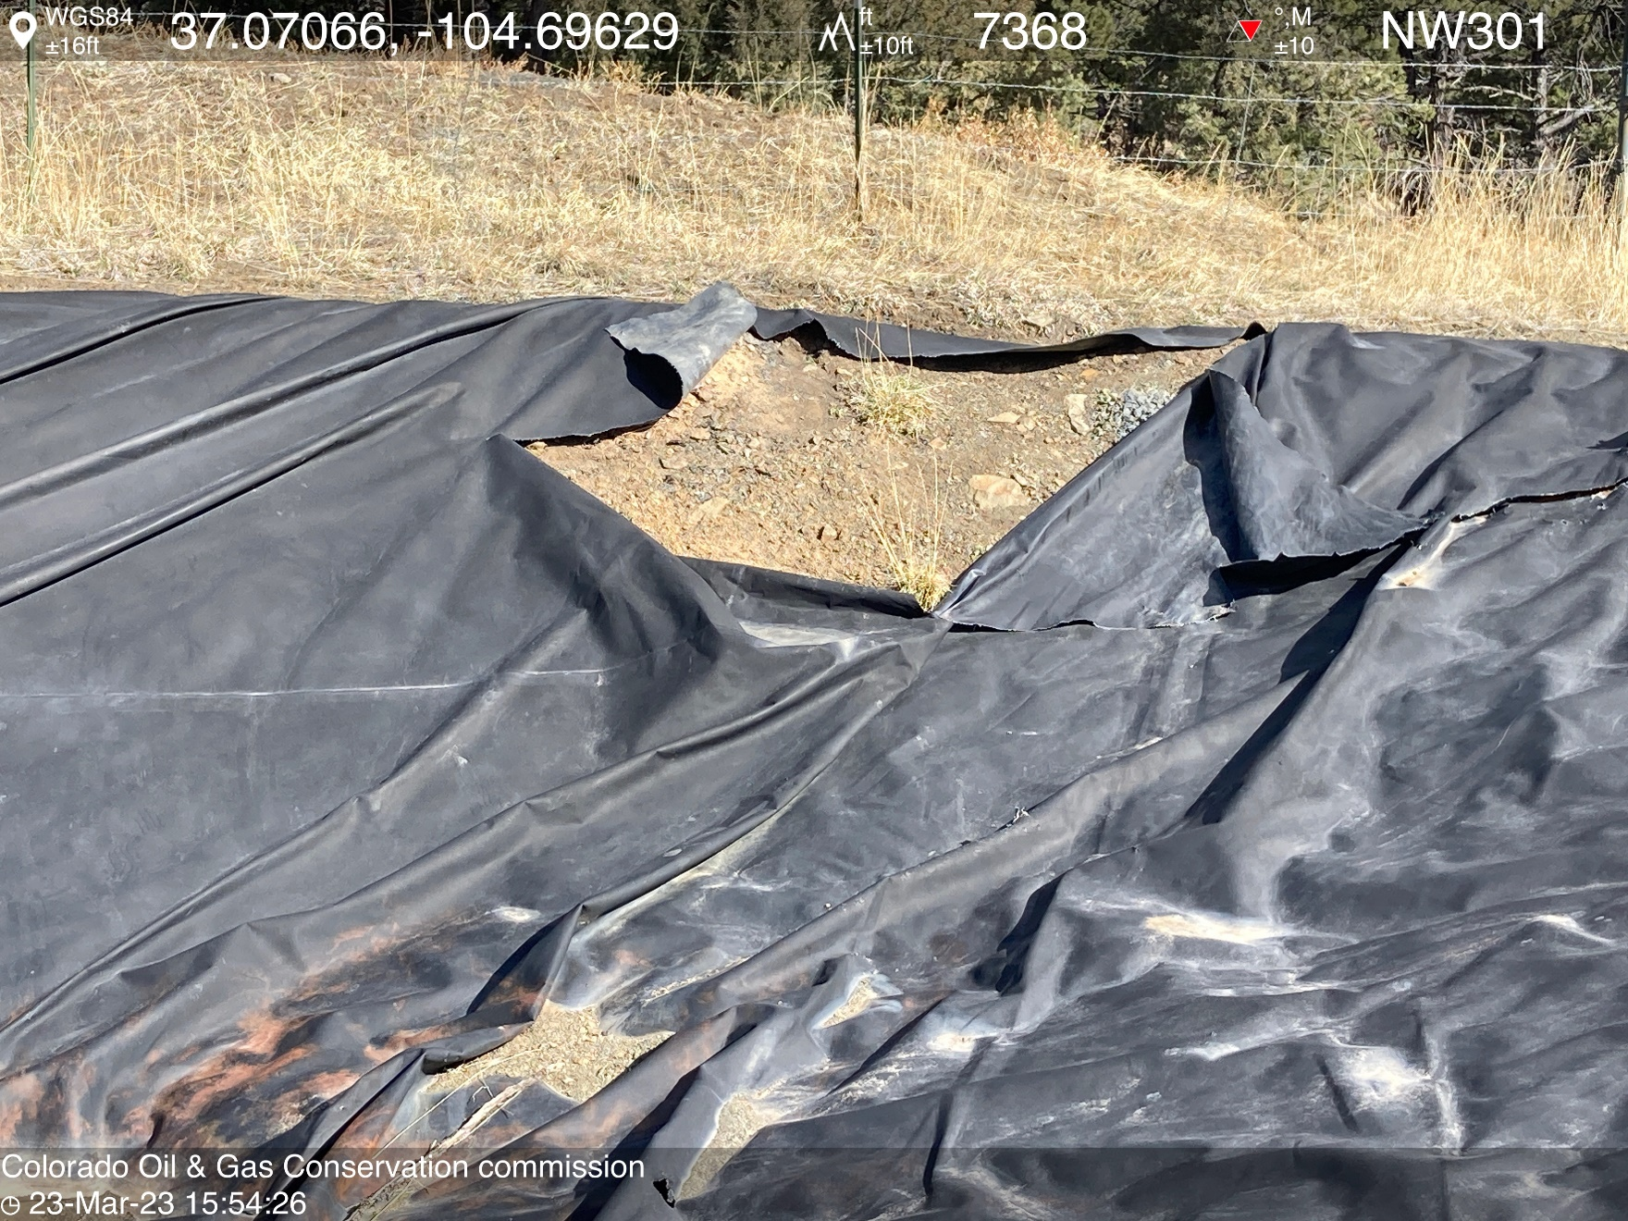
PHOTO 7: pit liner compromised (Rule 910). IMMEDIATE NOTIFICATION TO THE OPERATOR Reduce fluid level in pit, contact COGCC EPS staff for directives. CA DATE 3/25/2023.

