Slide 1
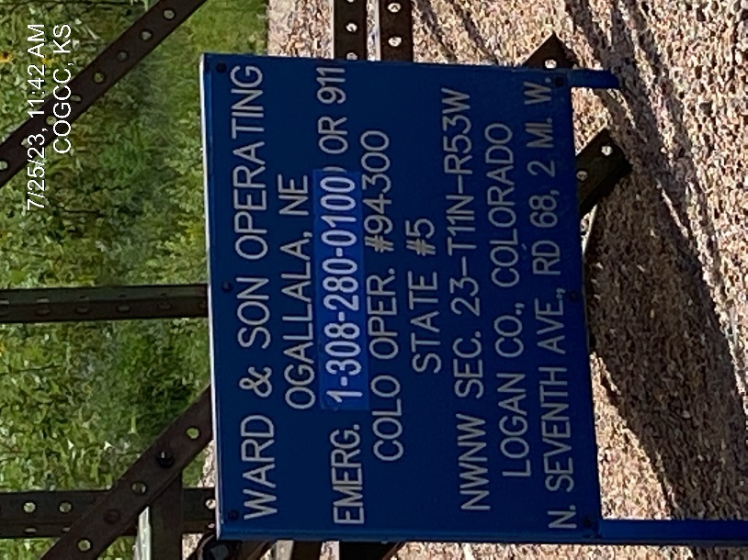
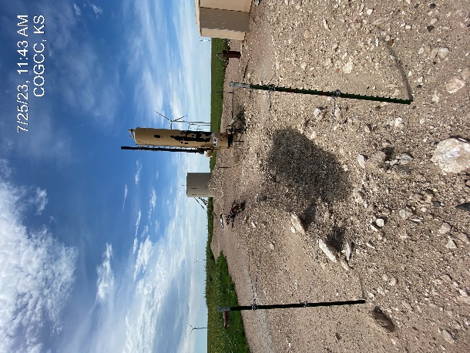
IMPETRO RESOURCES
Location Name: STATE 5
Location ID: 075-09300
NO. 1 SIGNAGE AT WELLHEAD -
INADEQUATE BERM MAINTENANCE

Slide 2
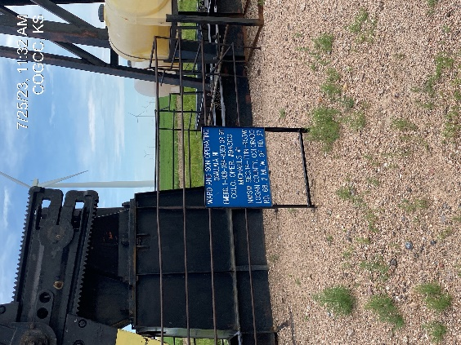
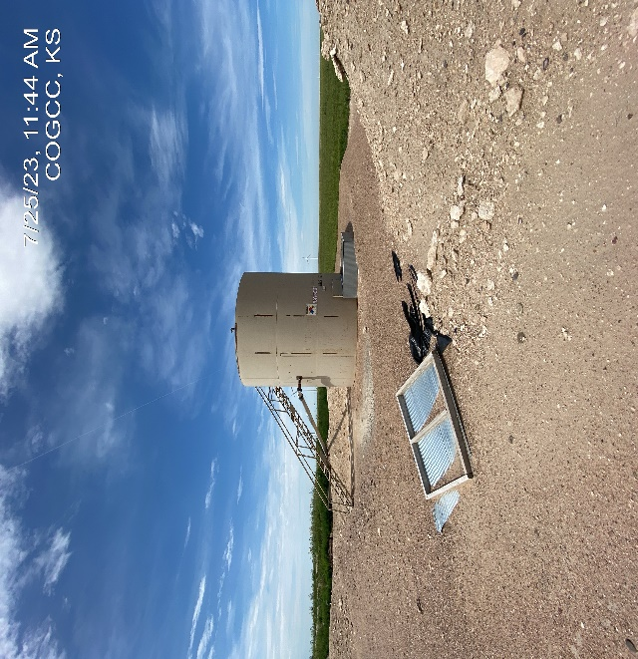
IMPETRO RESOURCES
STATE 5
PJ – WELLHEAD - SIGN
DEBRIS – INADEQUATE BERM MAINTENANCE

Slide 3
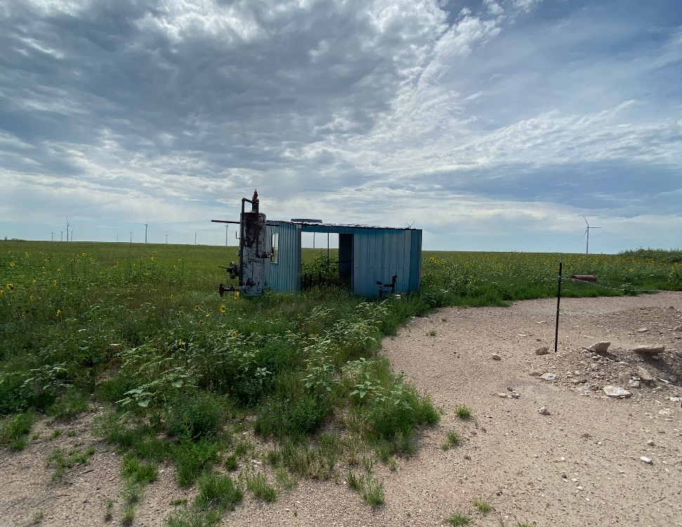
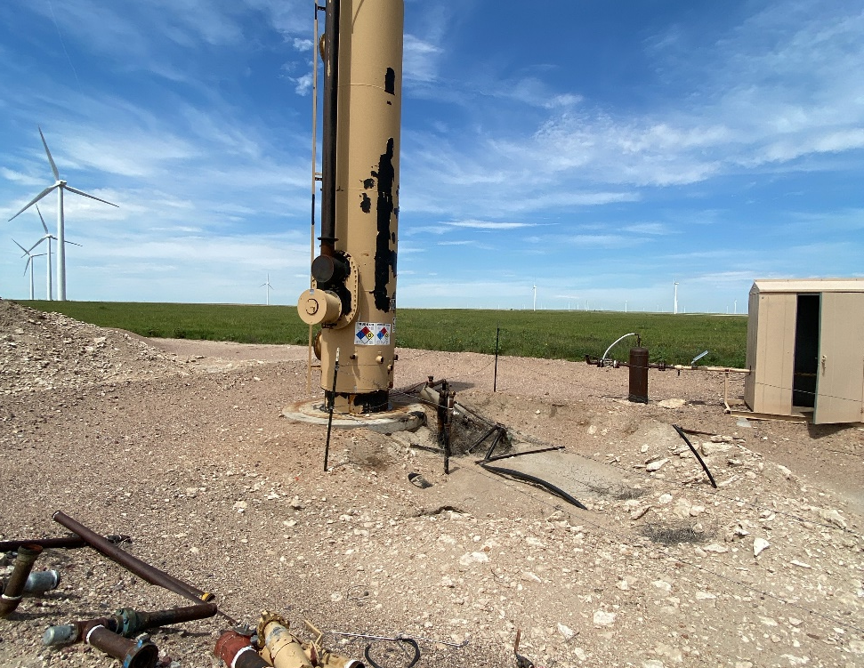
IMPETRO RESOURCES
STATE 5
WEEDS – TRANSFER PUMP
DEBRIS - MAINTENANCE

Slide 4
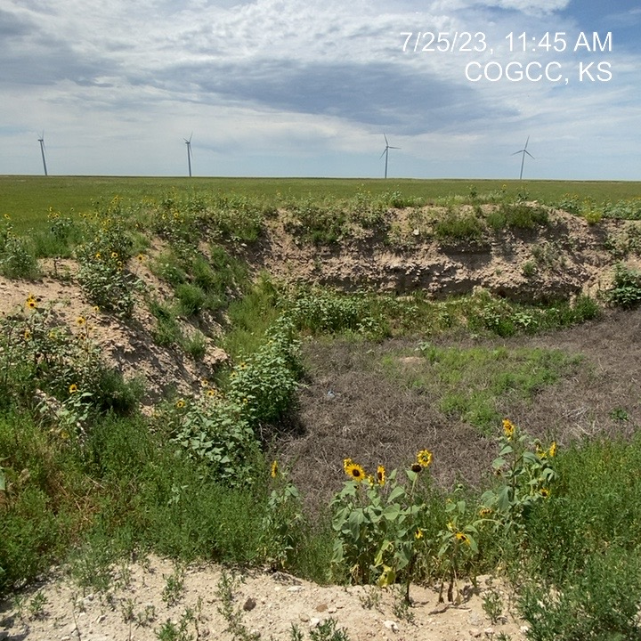
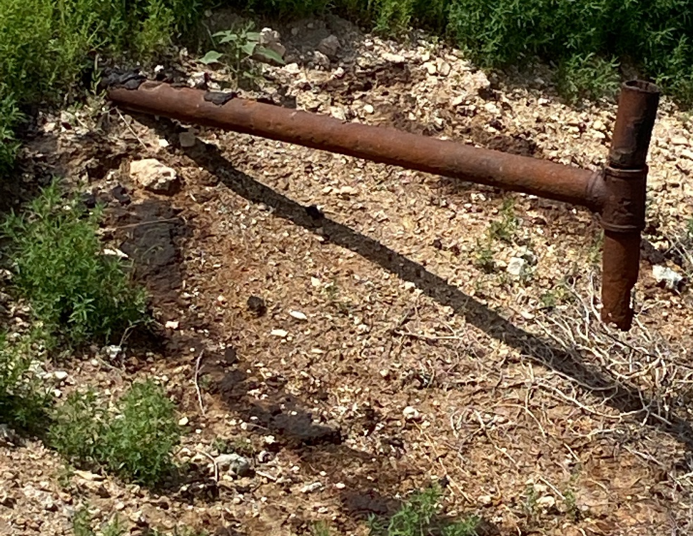
IMPETRO RESOURCES
STATE 5
PW PIT – WEEDS - MAINTENANCE
DISCHARGE PIPE AT PW PIT – SMALL AMOUNT CRUDE DRIPPED ON SOIL

