Slide 1
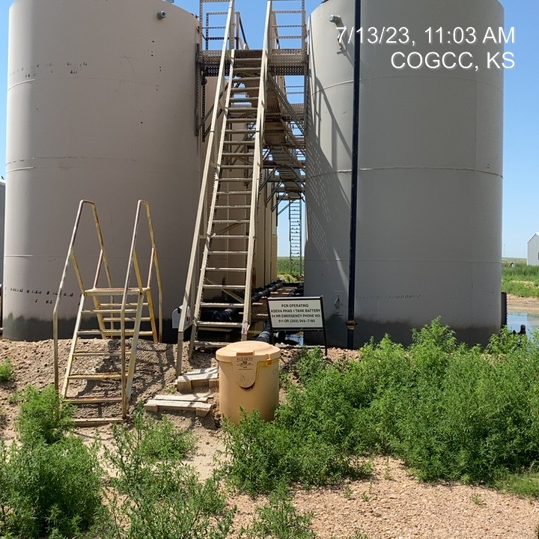
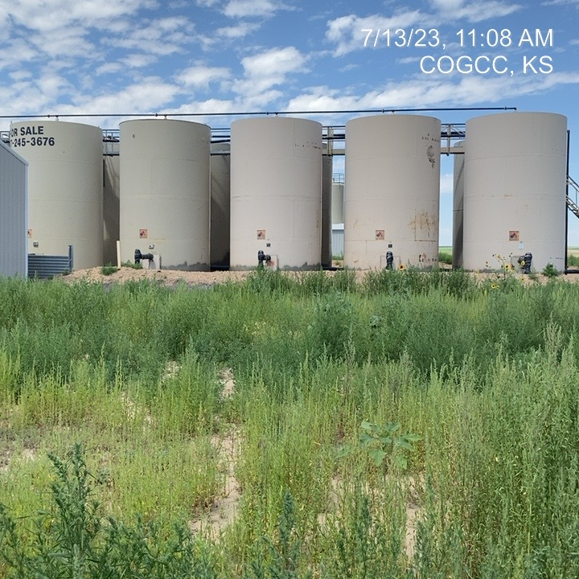
PASS CREEK RESOURCES LLC.
Location Name: PHASE 1 – TANK BATTERY
Location ID:
NO. 1 SIGNAGE AT BATTERY - HOUSEKEEPING (WEEDS)
NO. 2 TANK BATTERY – HOUSEKEEPING (WEEDS)

Slide 2
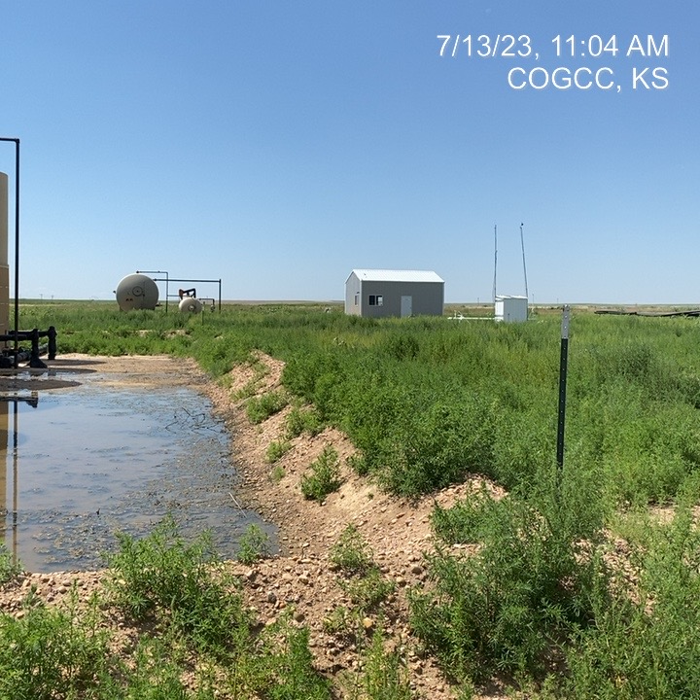
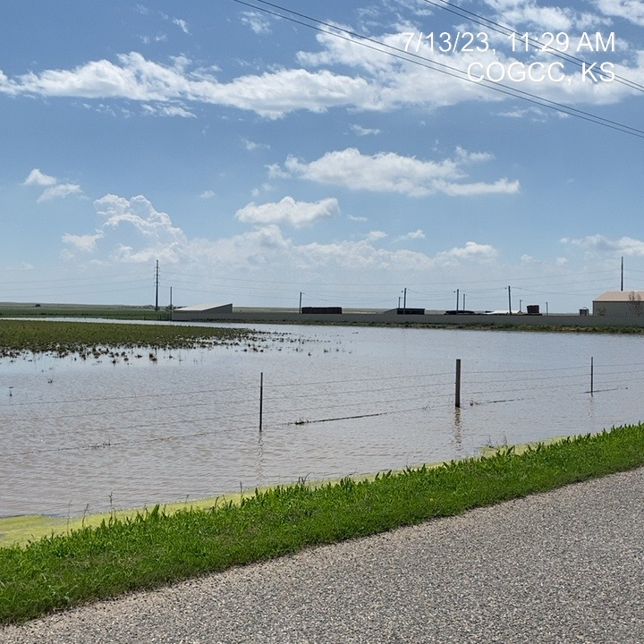
PASS CREEK RESOURCES
BERM AT TANK BATTERY – WATER WITHIN CONTAINMENT ( RAIN-WATER)
HISTORIC RAINFALL 2023 – LEASE ROADS FLOODED

Slide 3
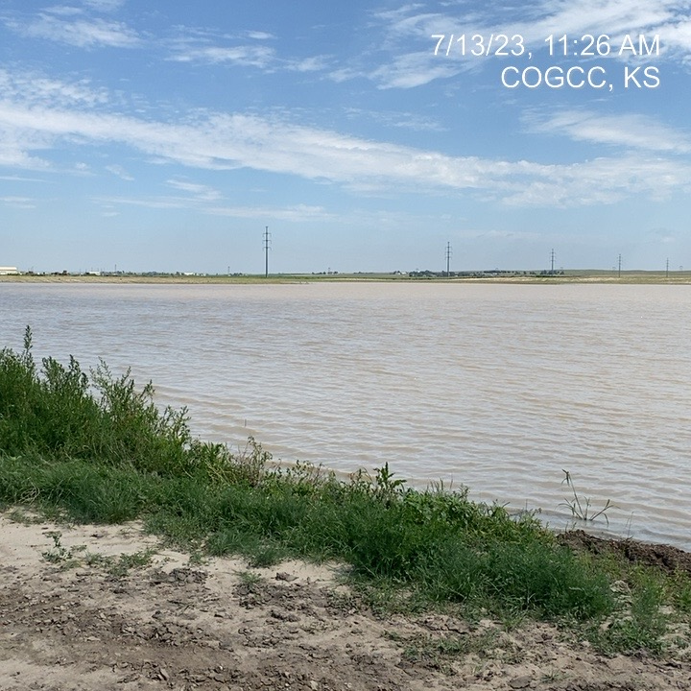
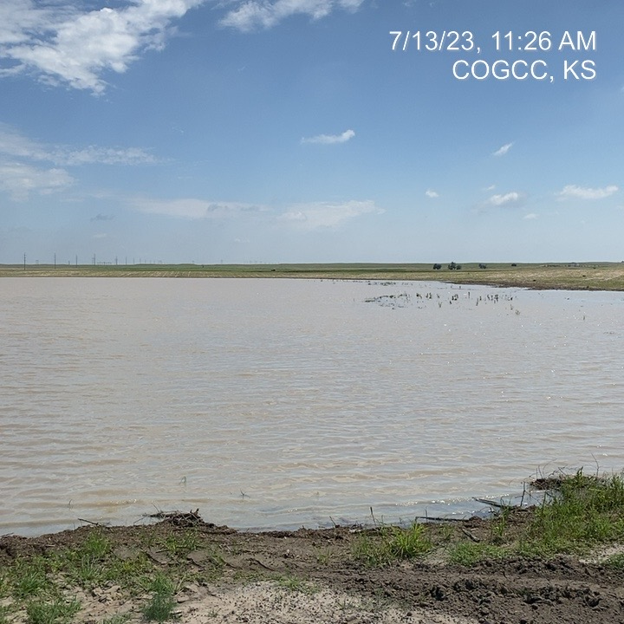
PASS CREEK RESOURCES LLC.
HISTORIC RAINFALL 2023 – LEASE ROADS FLOODED
HISTORIC RAINFALL 2023 – LEASE ROADS FLOODED

