Slide 1

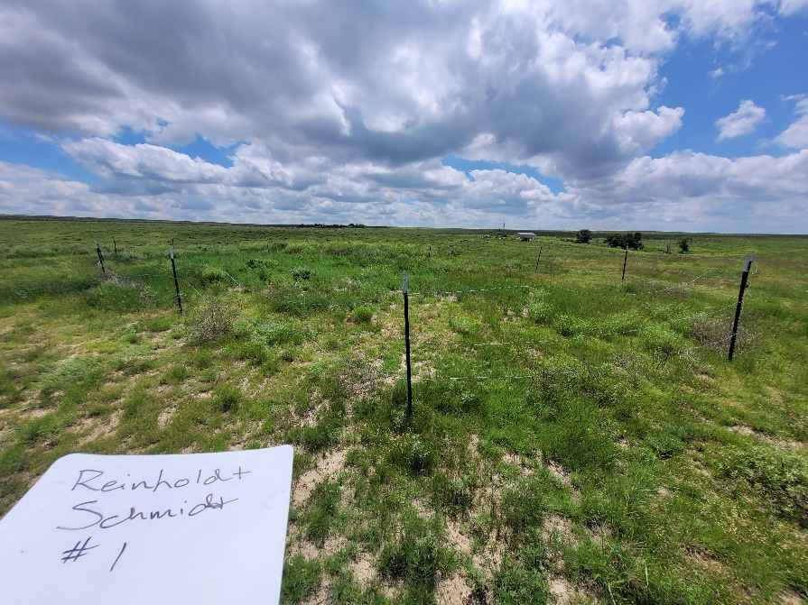
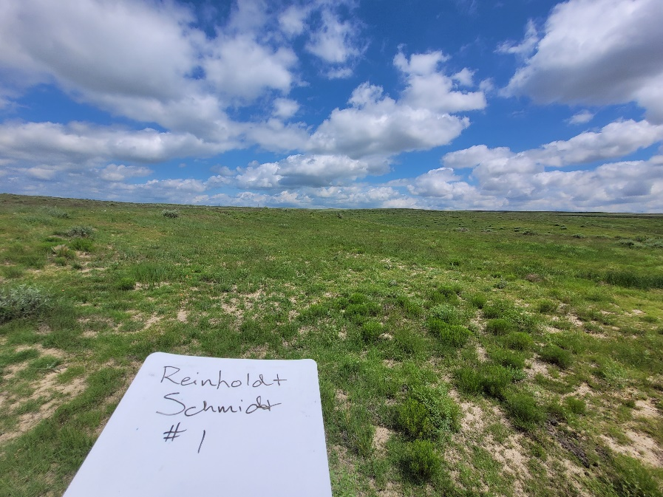
Inspection Photos
Reinholdt Schmidt 1
Location ID: 394744
This location requires weed management and fence removal
Inspection Number: 707100037

Slide 2
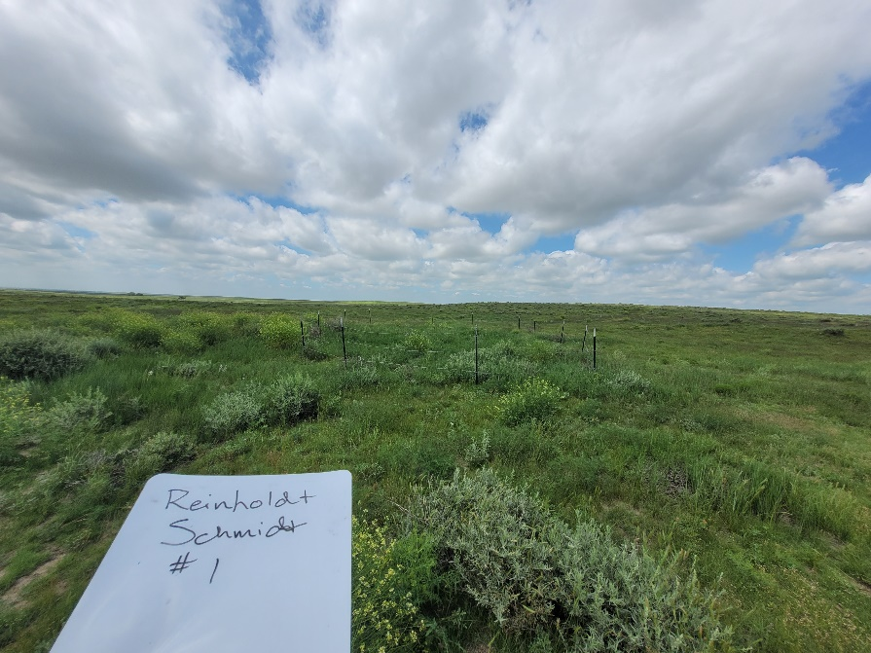
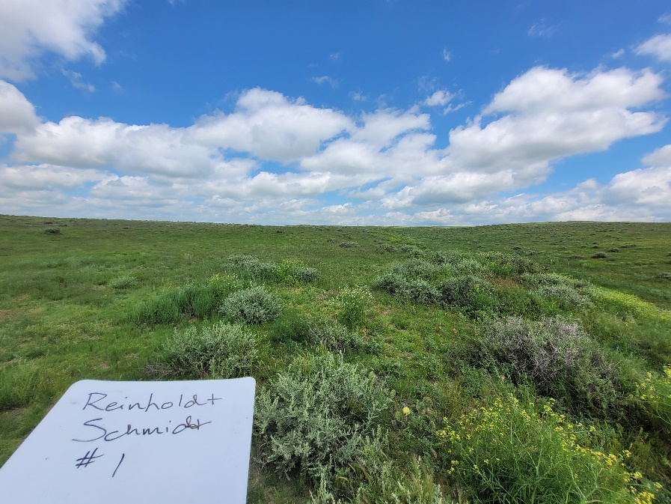
Inspection Photos
Reinholdt Schmidt 1
Location ID: 394744
This location requires weed management and fence removal
Inspection Number: 707100037

