Slide 1
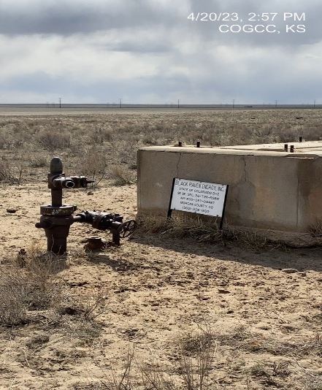
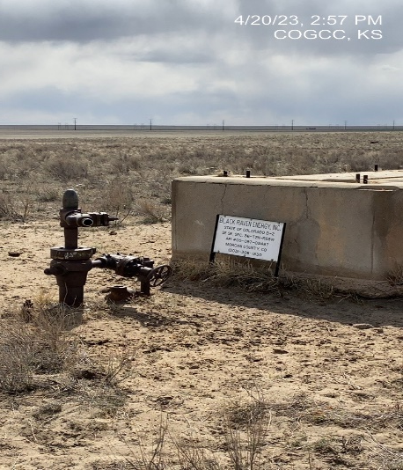
Operator: PCR
Location ID: 05-087-05487
STATE OF COLORADO B-2
WELLHEAD - PAD
SIGNAGE

