Slide 1
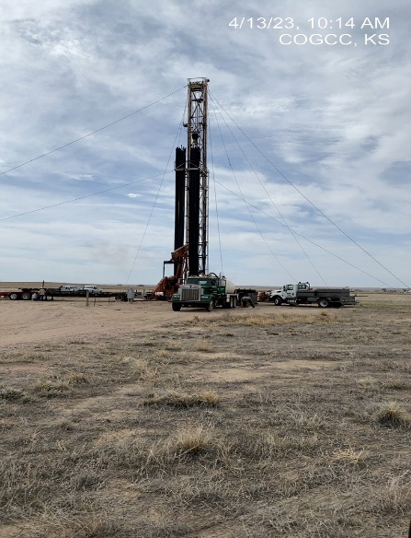

Operator: Citation O&G Corp.
Location ID: 05-075-09344
DUBOIS 6
RIG ON LOCATION
P&A IN PROGRESS

