Slide 1
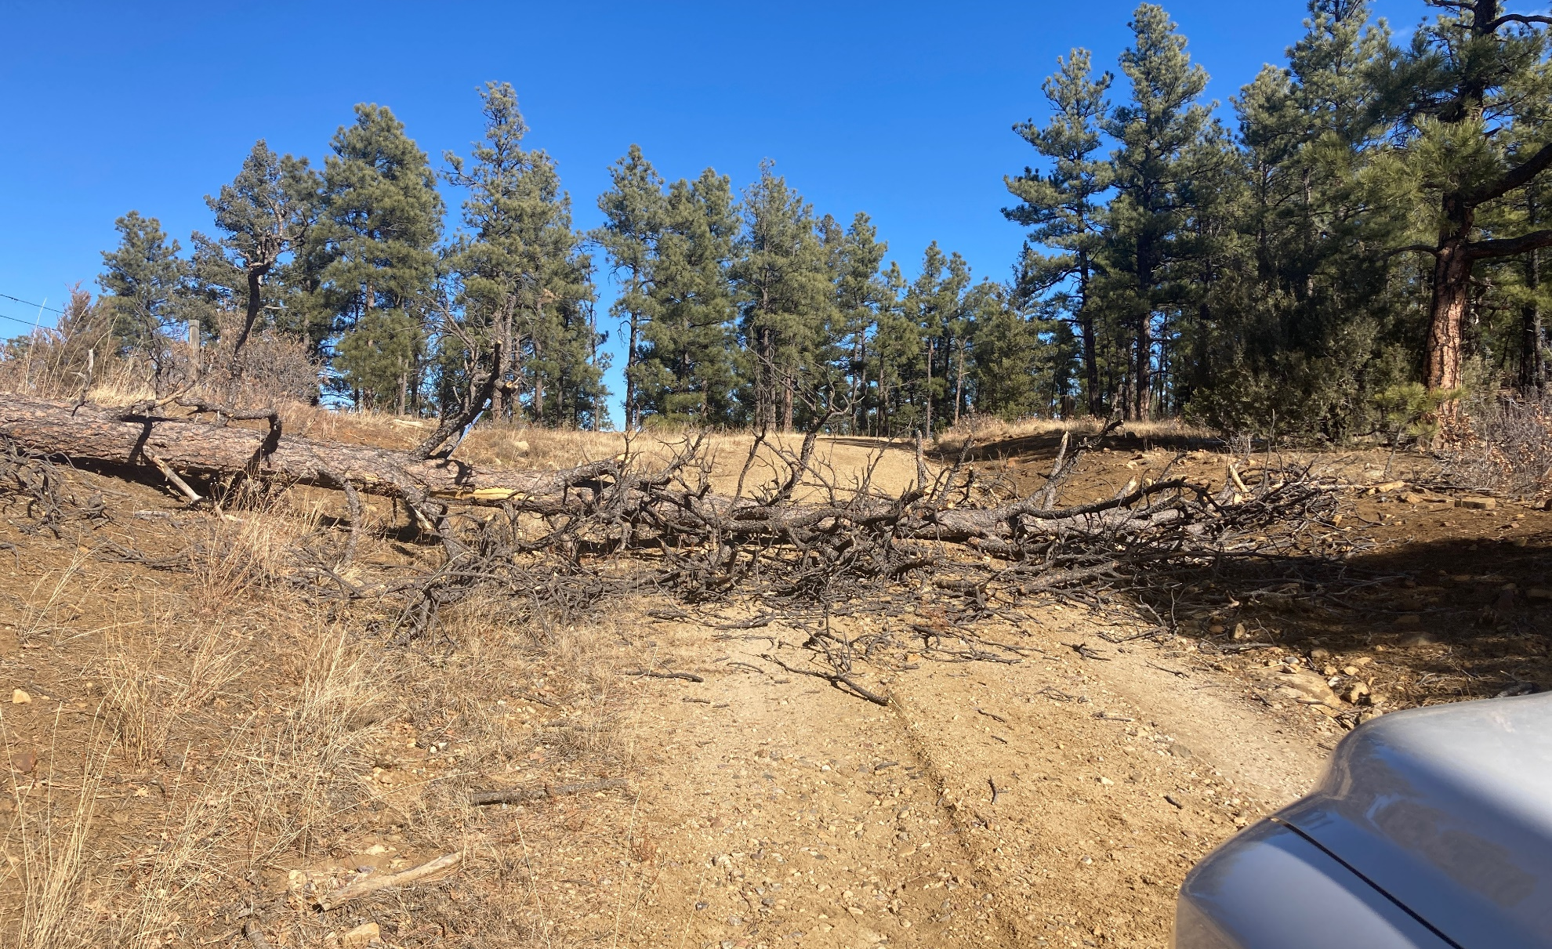
Location Name: MCINTOSH 22-1, API #: 071-09160, Insp. #:695107017
PHOTO 1: LOCATION NOT ACCESSABLE DO TO TREE FALL ACROSS ROW. Repair and maintain lease road to comply with rule 204. CA DATE 01/7/2023.

