Slide 1
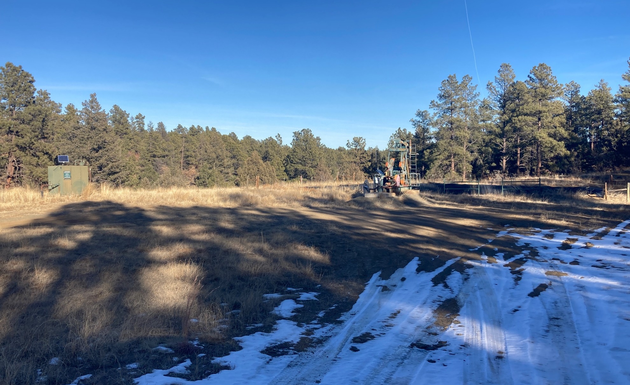
Location Name: CAESAR 22-18, API #: 071-09310, Insp. #:695107237
PHOTO 1: LOCATION

Slide 2
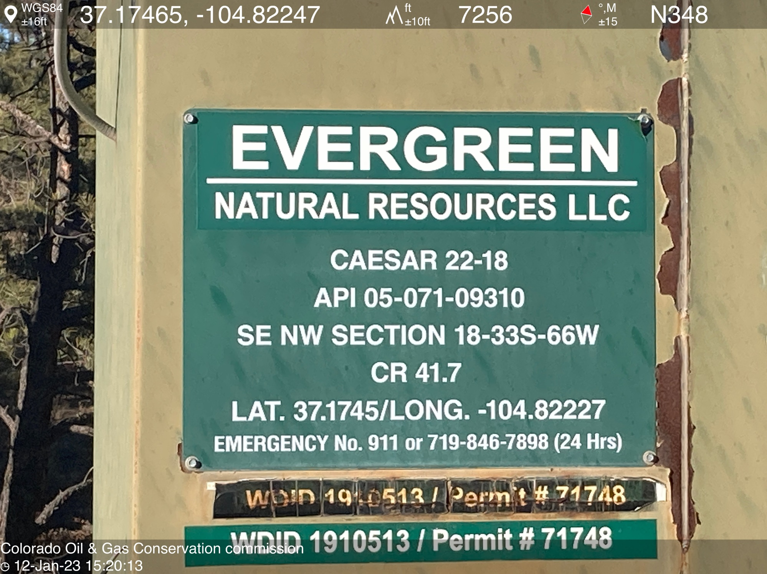
PHOTO 2: WELL SIGN

Slide 3
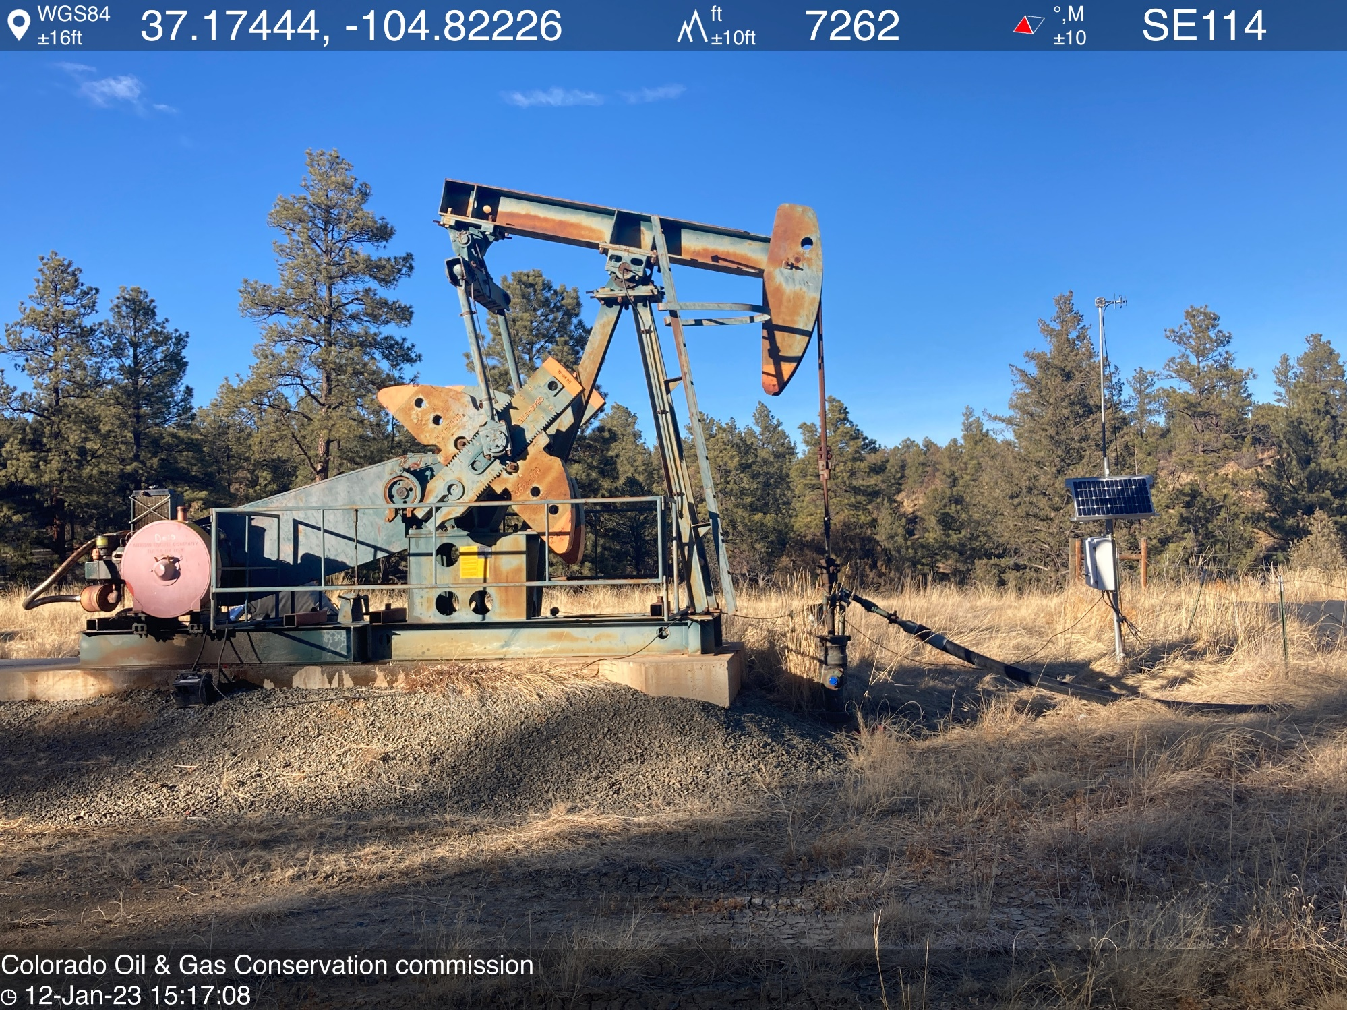
PHOTO 3: WELLHEAD AND EQUIPMENT

Slide 4
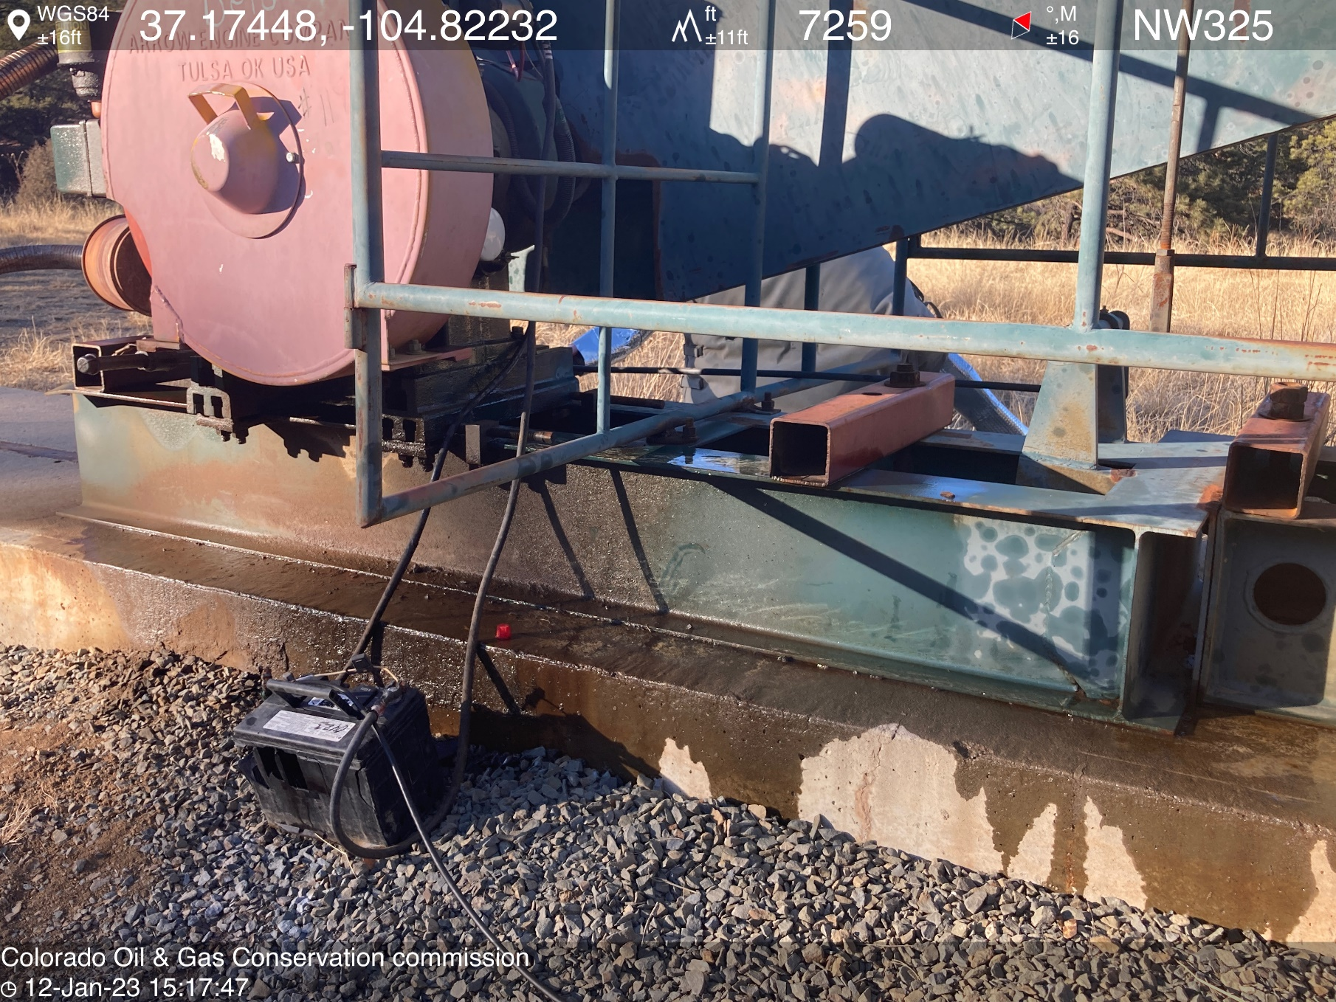
PHOTO 4: OIL LEAKING FROM PUMPJACK PRIME MOVER. Securely fasten all valves, pipes, fittings, and Production Facilities to ensure good mechanical condition, inspect at regular intervals and maintain in good mechanical condition per Rule 608.e. CA DATE 1-24-2023.

Slide 5
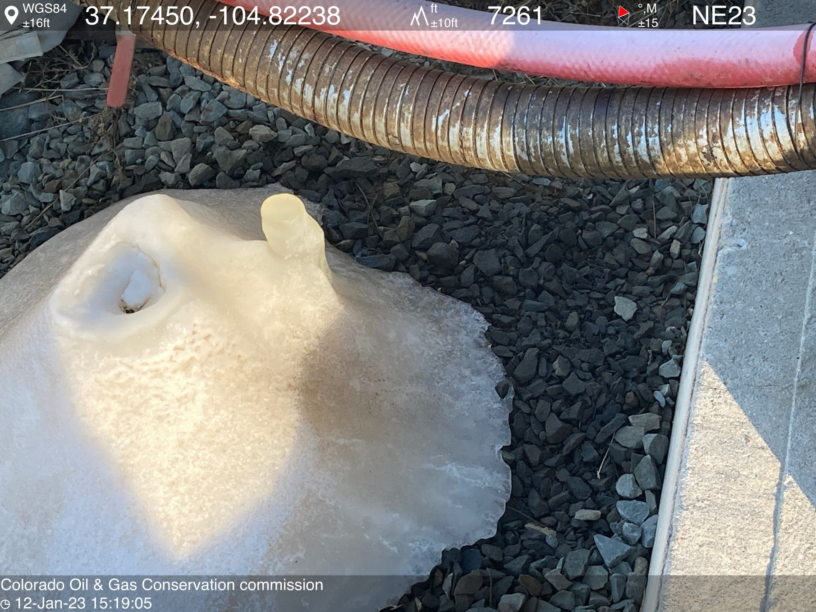
PHOTO 5: AREA OF IMPACTED SOIL NEAR LEAKING JUMPJACK PRIME MOVER ON BOTH SIDES OF CONCRETE PAD. Conduct maintenance on equipment, cleanup stained material and review self inspection processes. COMPLY WITH RULE 1002,.(2).D. CA DATE 1-24-2023.

Slide 6
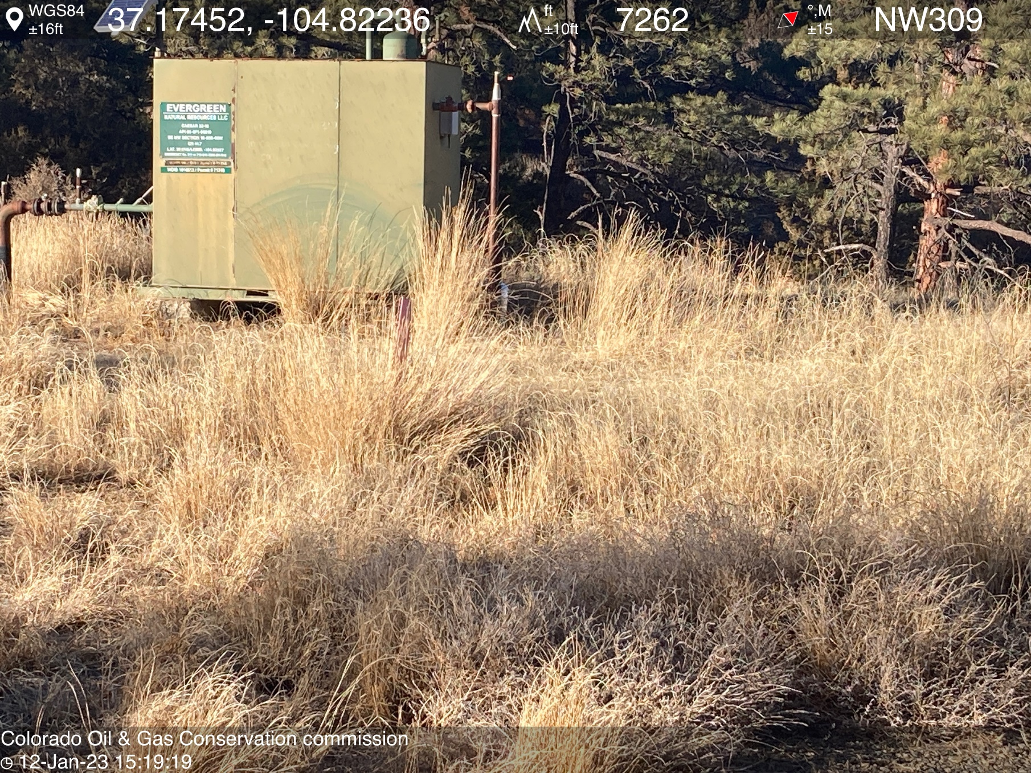
PHOTO 6: WEED OVERGROWTH AROUND METER HOUSE AND PUMPJACK IS A FIRE HAZARD. REMOVE WEEDS PER RULE 606. CA DATE 1-24-2023.

Slide 7
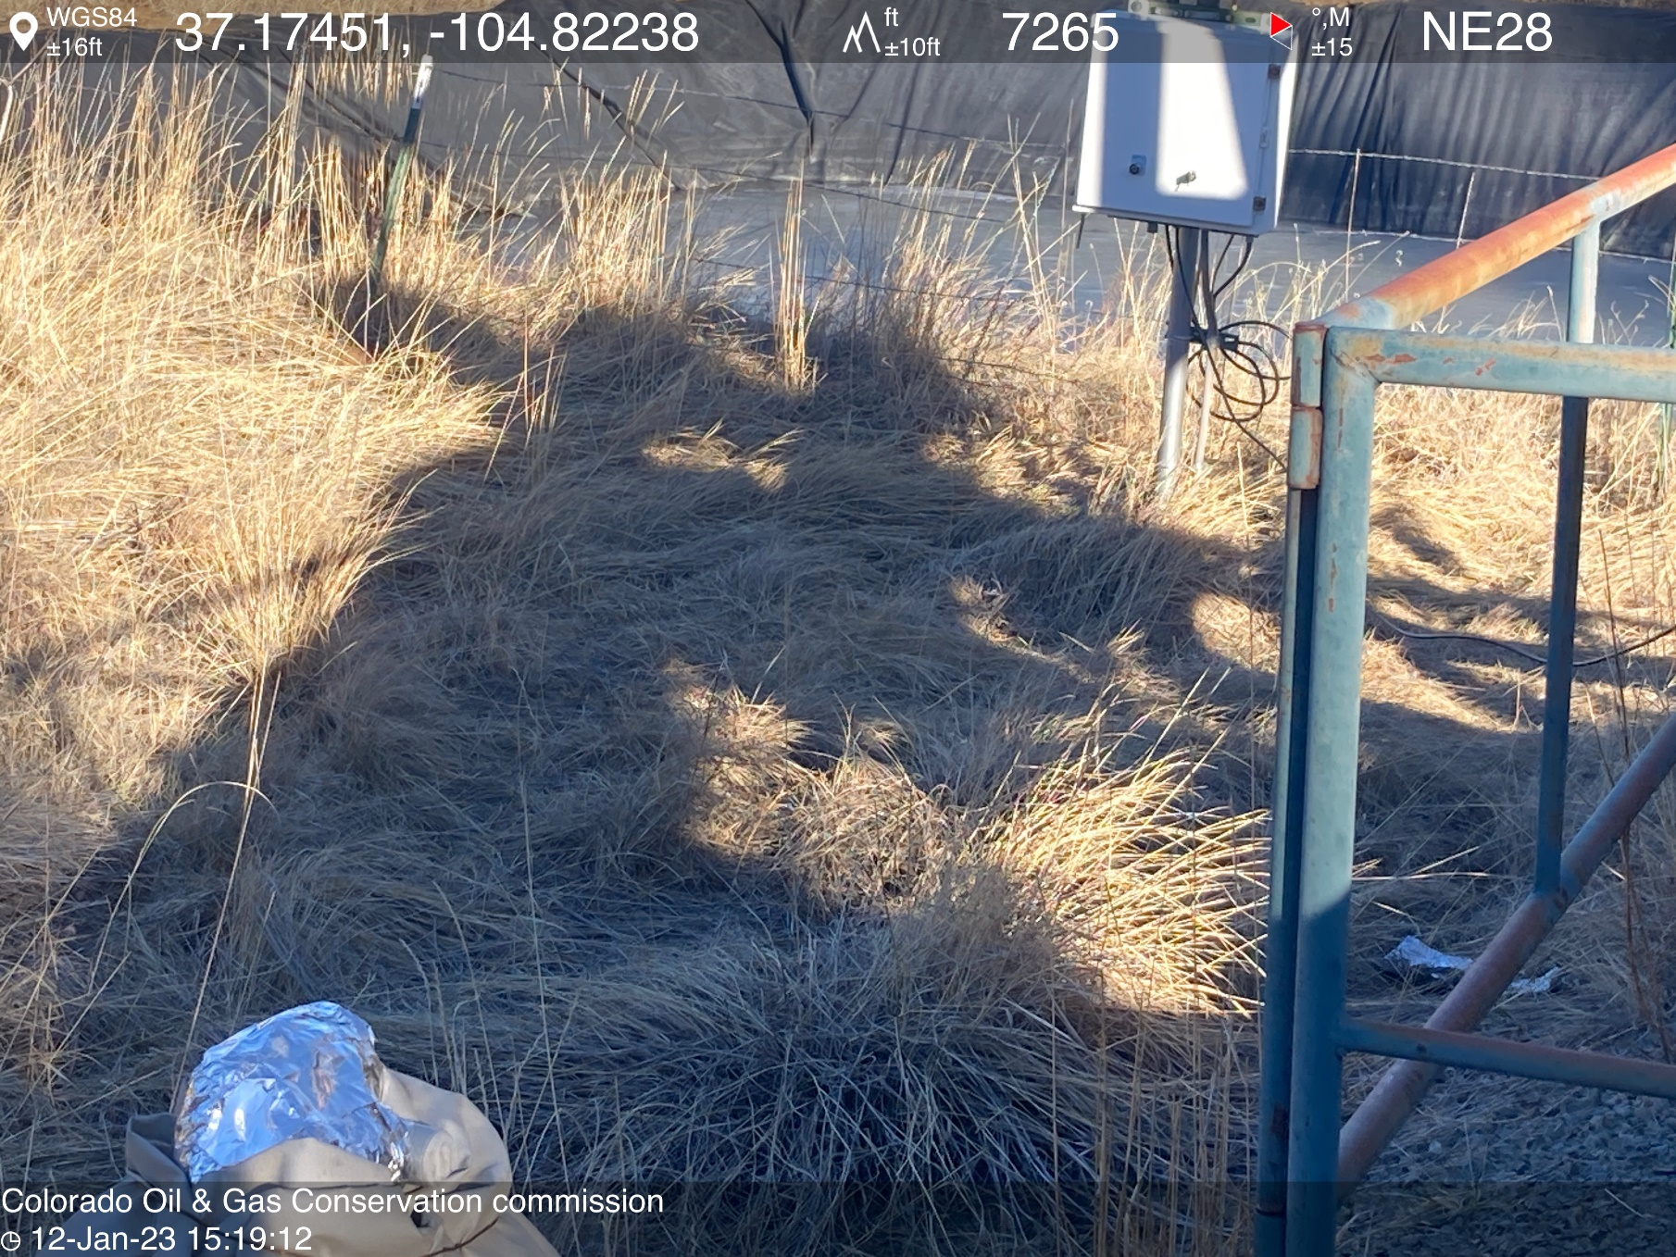
PHOTO 7: WEED OVERGROWTH AROUND METER HOUSE AND PUMPJACK IS A FIRE HAZARD. REMOVE WEEDS PER RULE 606. CA DATE 1-24-2023.

