Slide 1
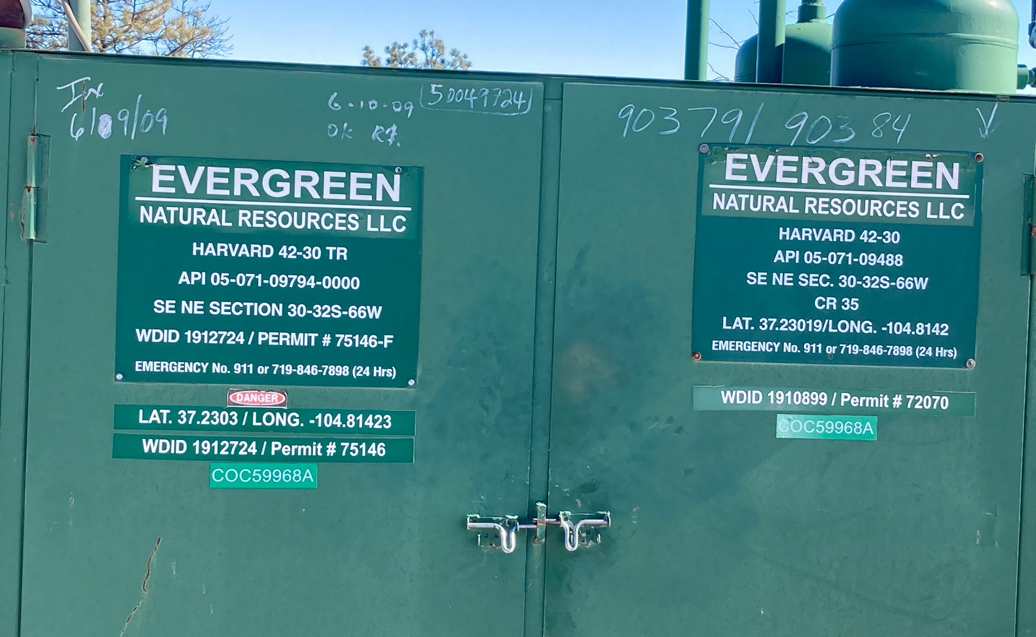
Location Name: HARVARD 42-30, API #: 071-09488, Insp. #:695107394
PHOTO 1: WELL SIGN

Slide 2
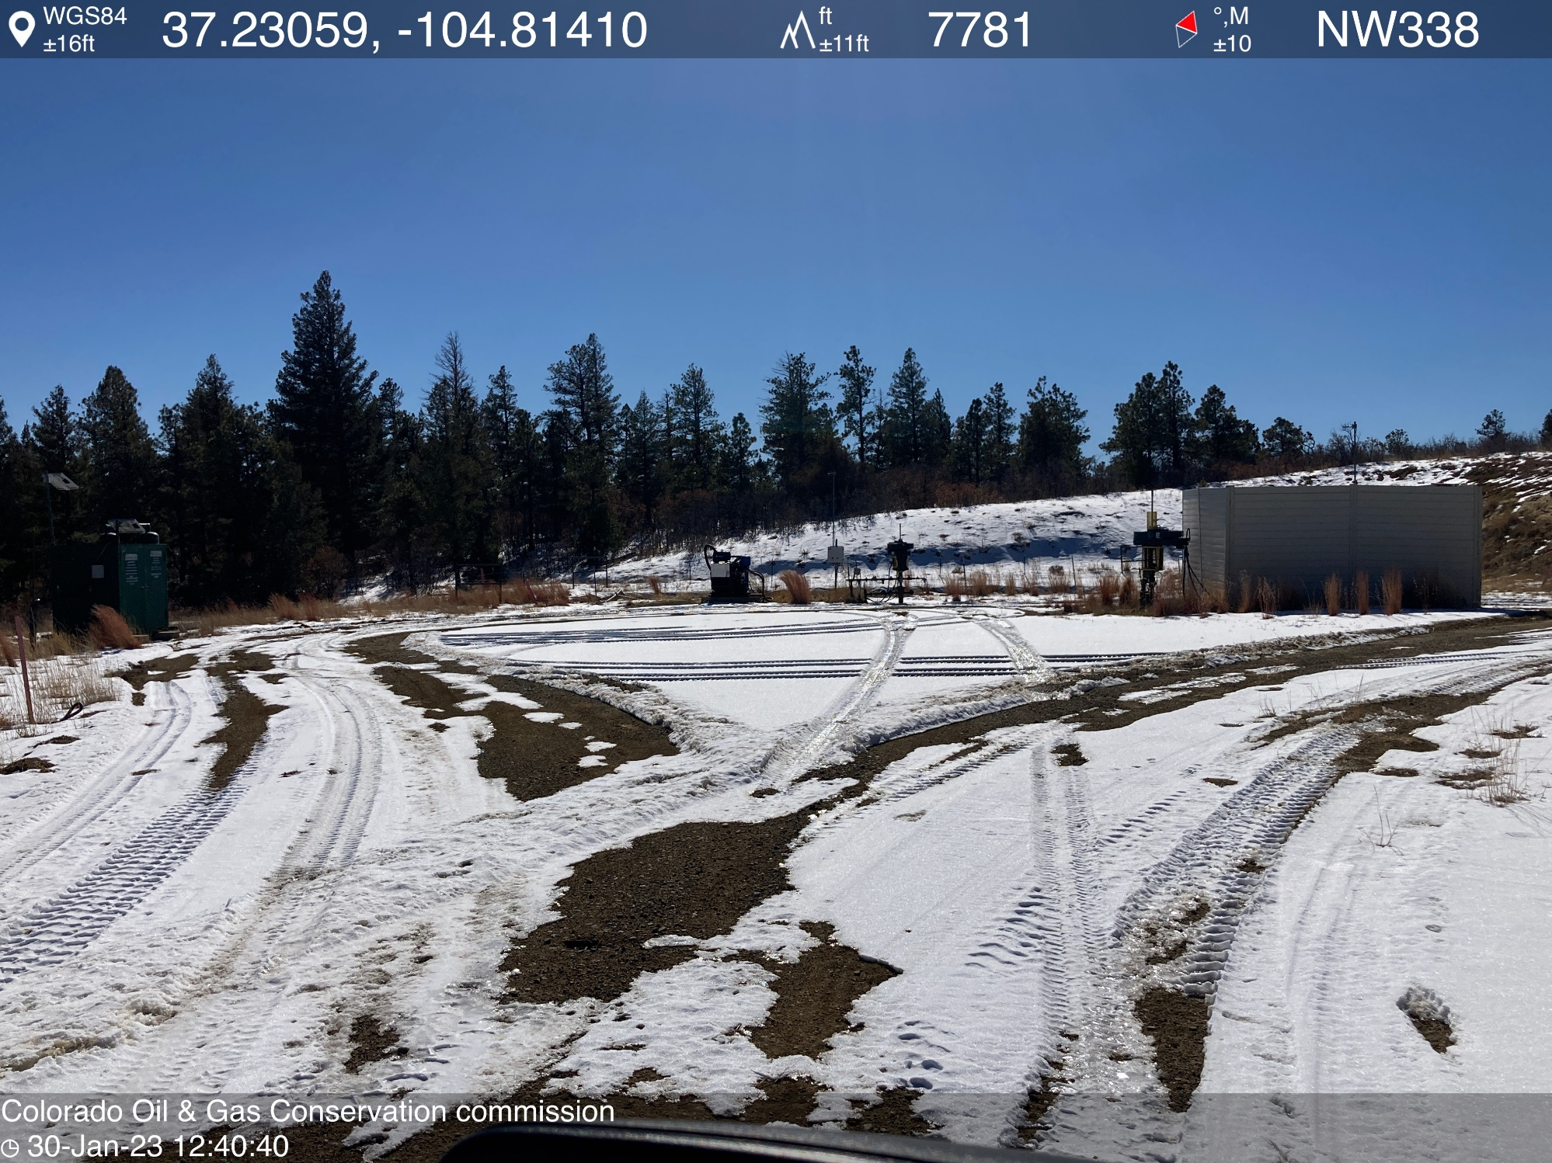
PHOTO 2: LOCATION

Slide 3
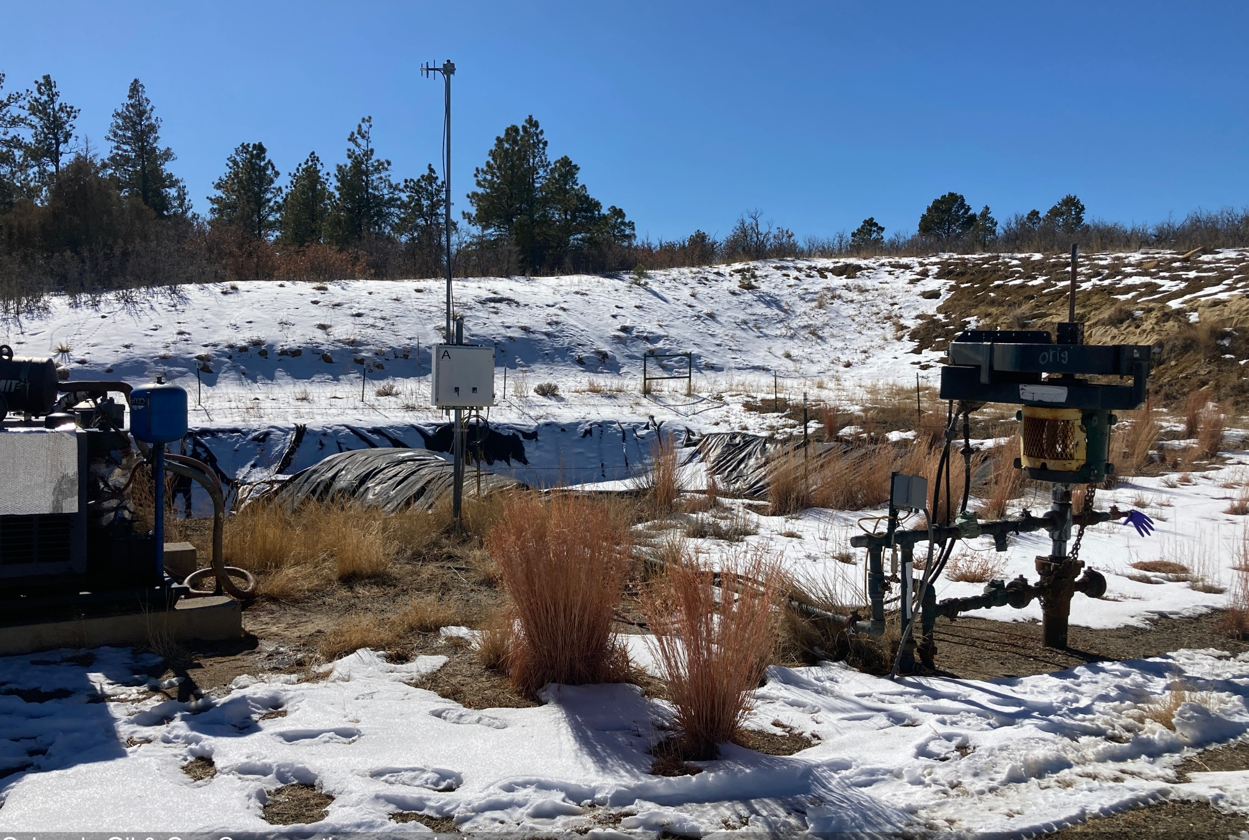
PHOTO 3: ORIG. WELLHEAD AND EQUIPMENT

Slide 4
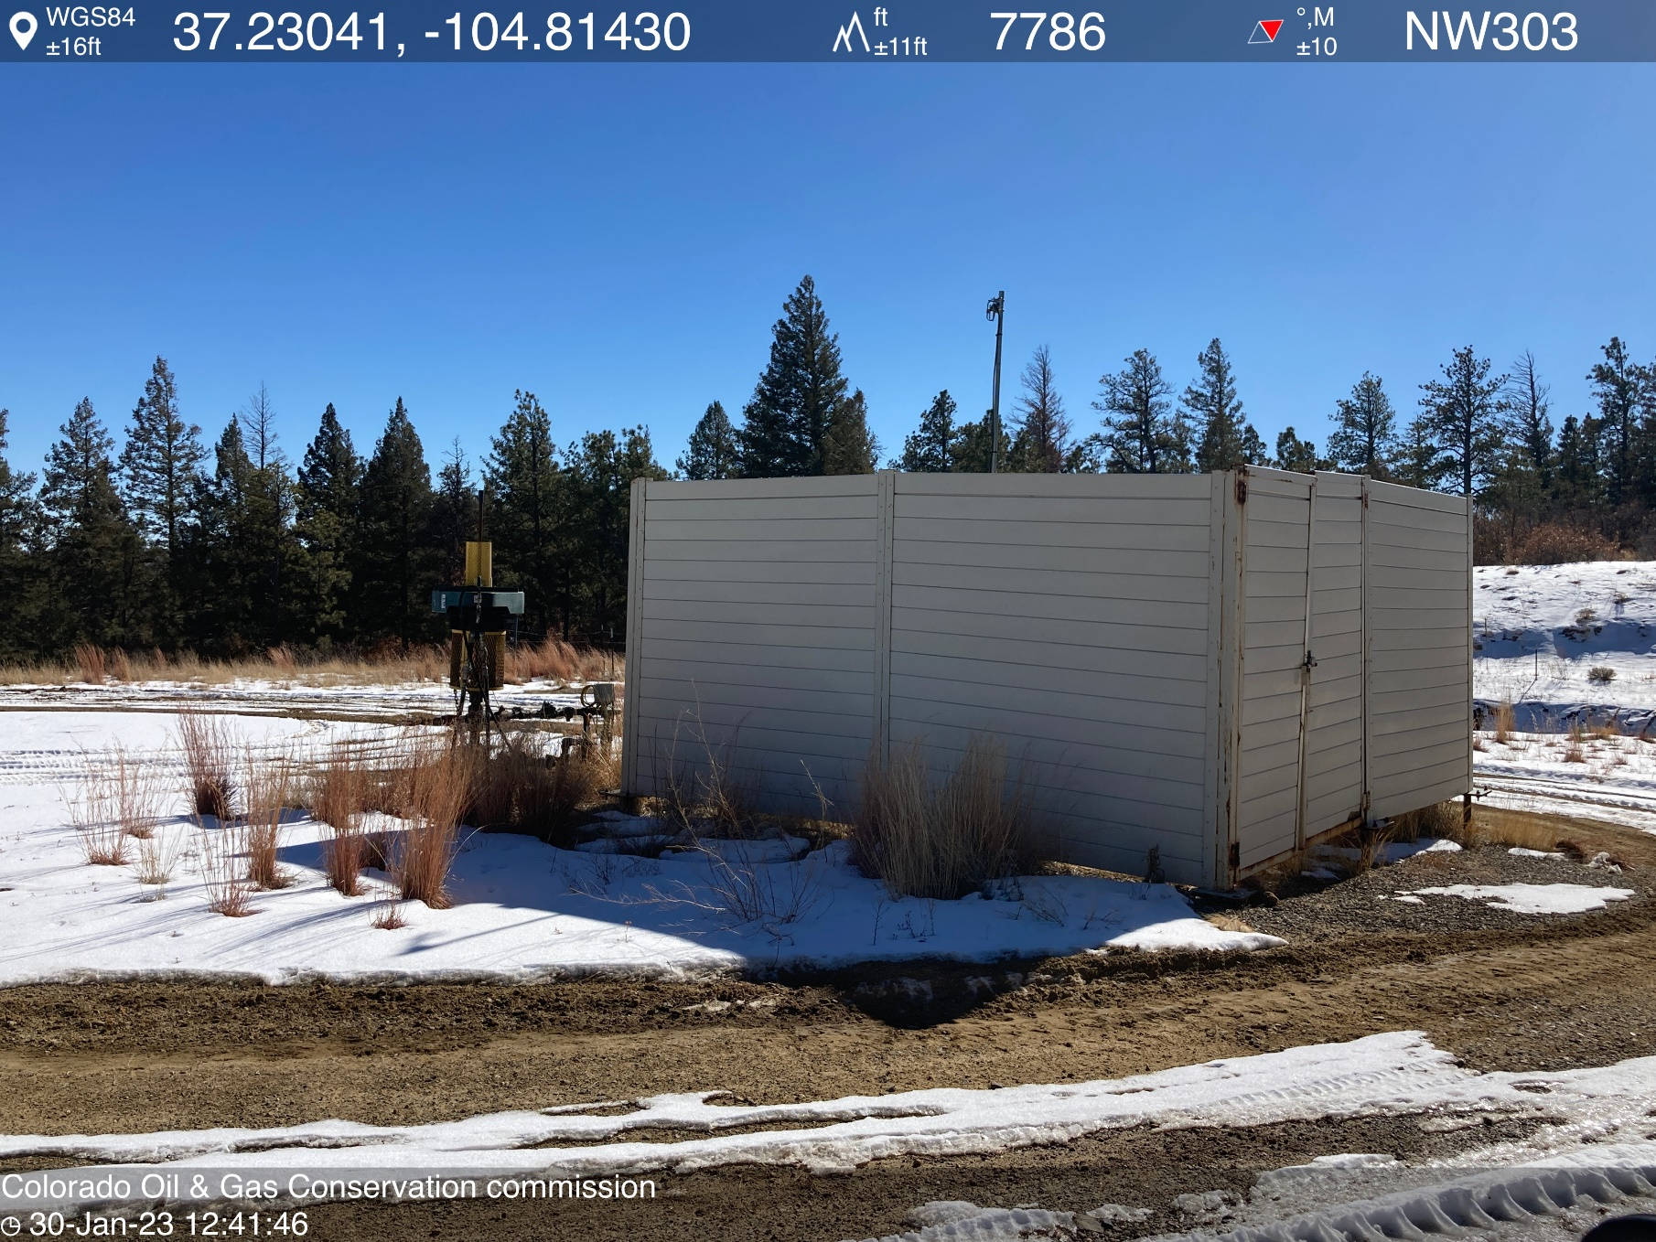
PHOTO 4: TR WELLHEAD AND EQUIPMENT

Slide 5
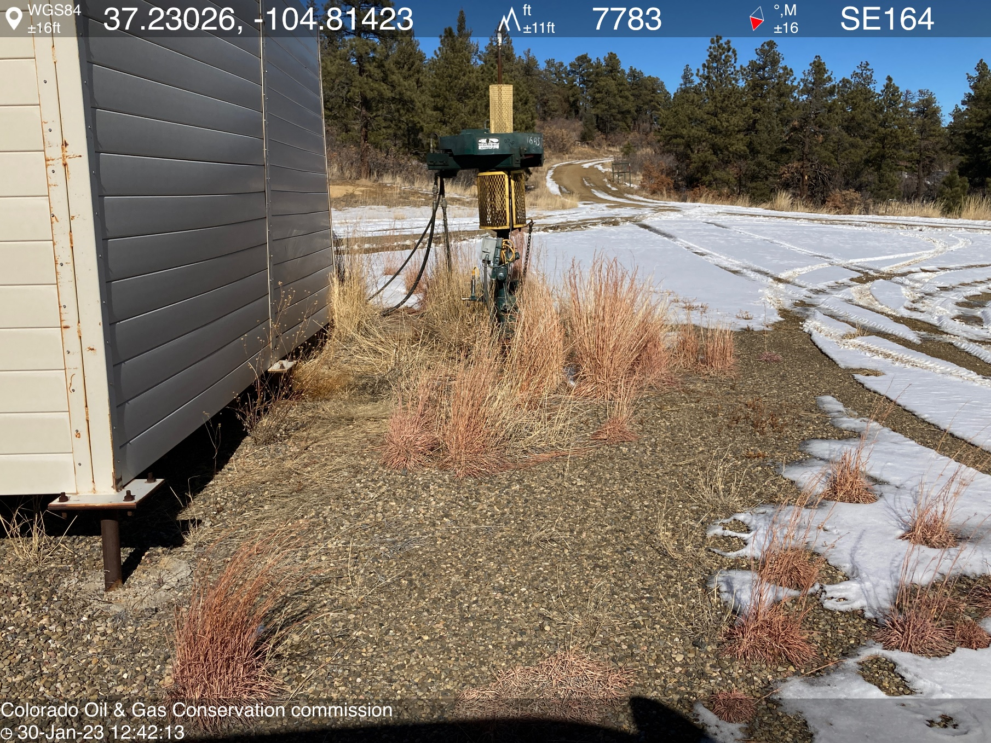
PHOTO 5: WEEDS AROUND TR WELLHEAD AND EQUIPMENT AND ORIG. WELLHEAD AND EQUIPMENT. REMOVE WEEDS PER RULE 606. CA DATE 2/10/2023.

Slide 6
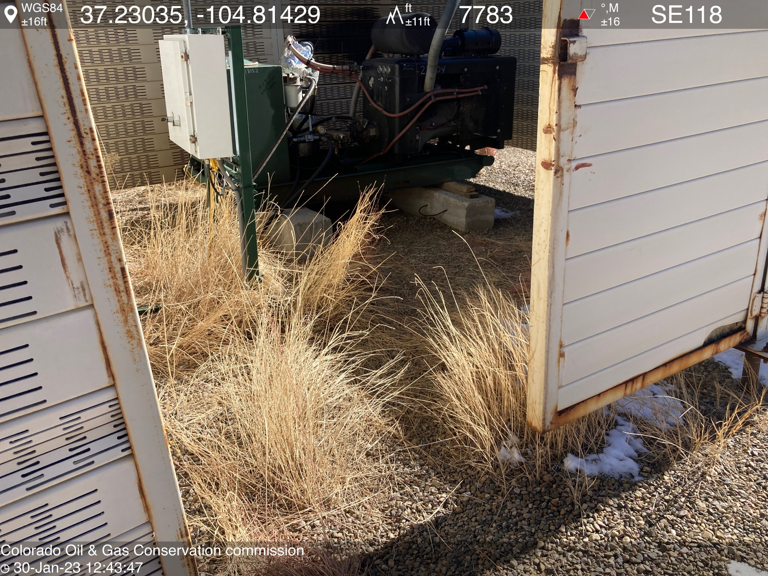
PHOTO 6: WEEDS AROUND TR WELLHEAD AND EQUIPMENT AND ORIG. WELLHEAD AND EQUIPMENT. REMOVE WEEDS PER RULE 606. CA DATE 2/10/2023.

Slide 7
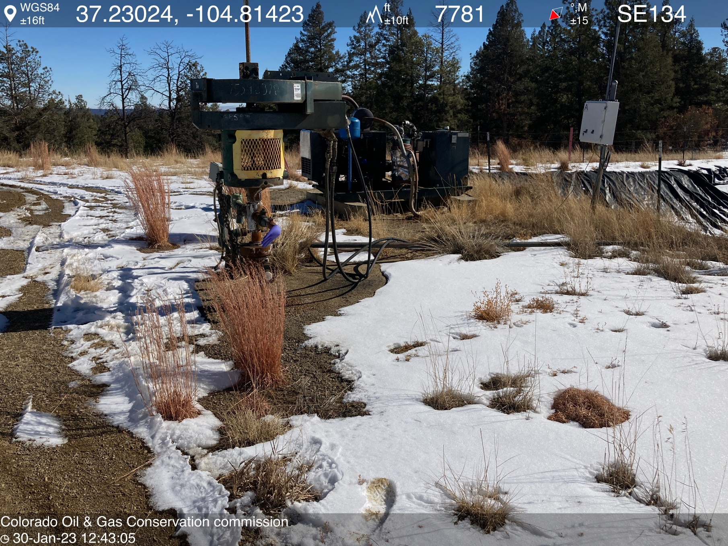
PHOTO 7: WEEDS AROUND TR WELLHEAD AND EQUIPMENT AND ORIG. WELLHEAD AND EQUIPMENT. REMOVE WEEDS PER RULE 606. CA DATE 2/10/2023.

Slide 8
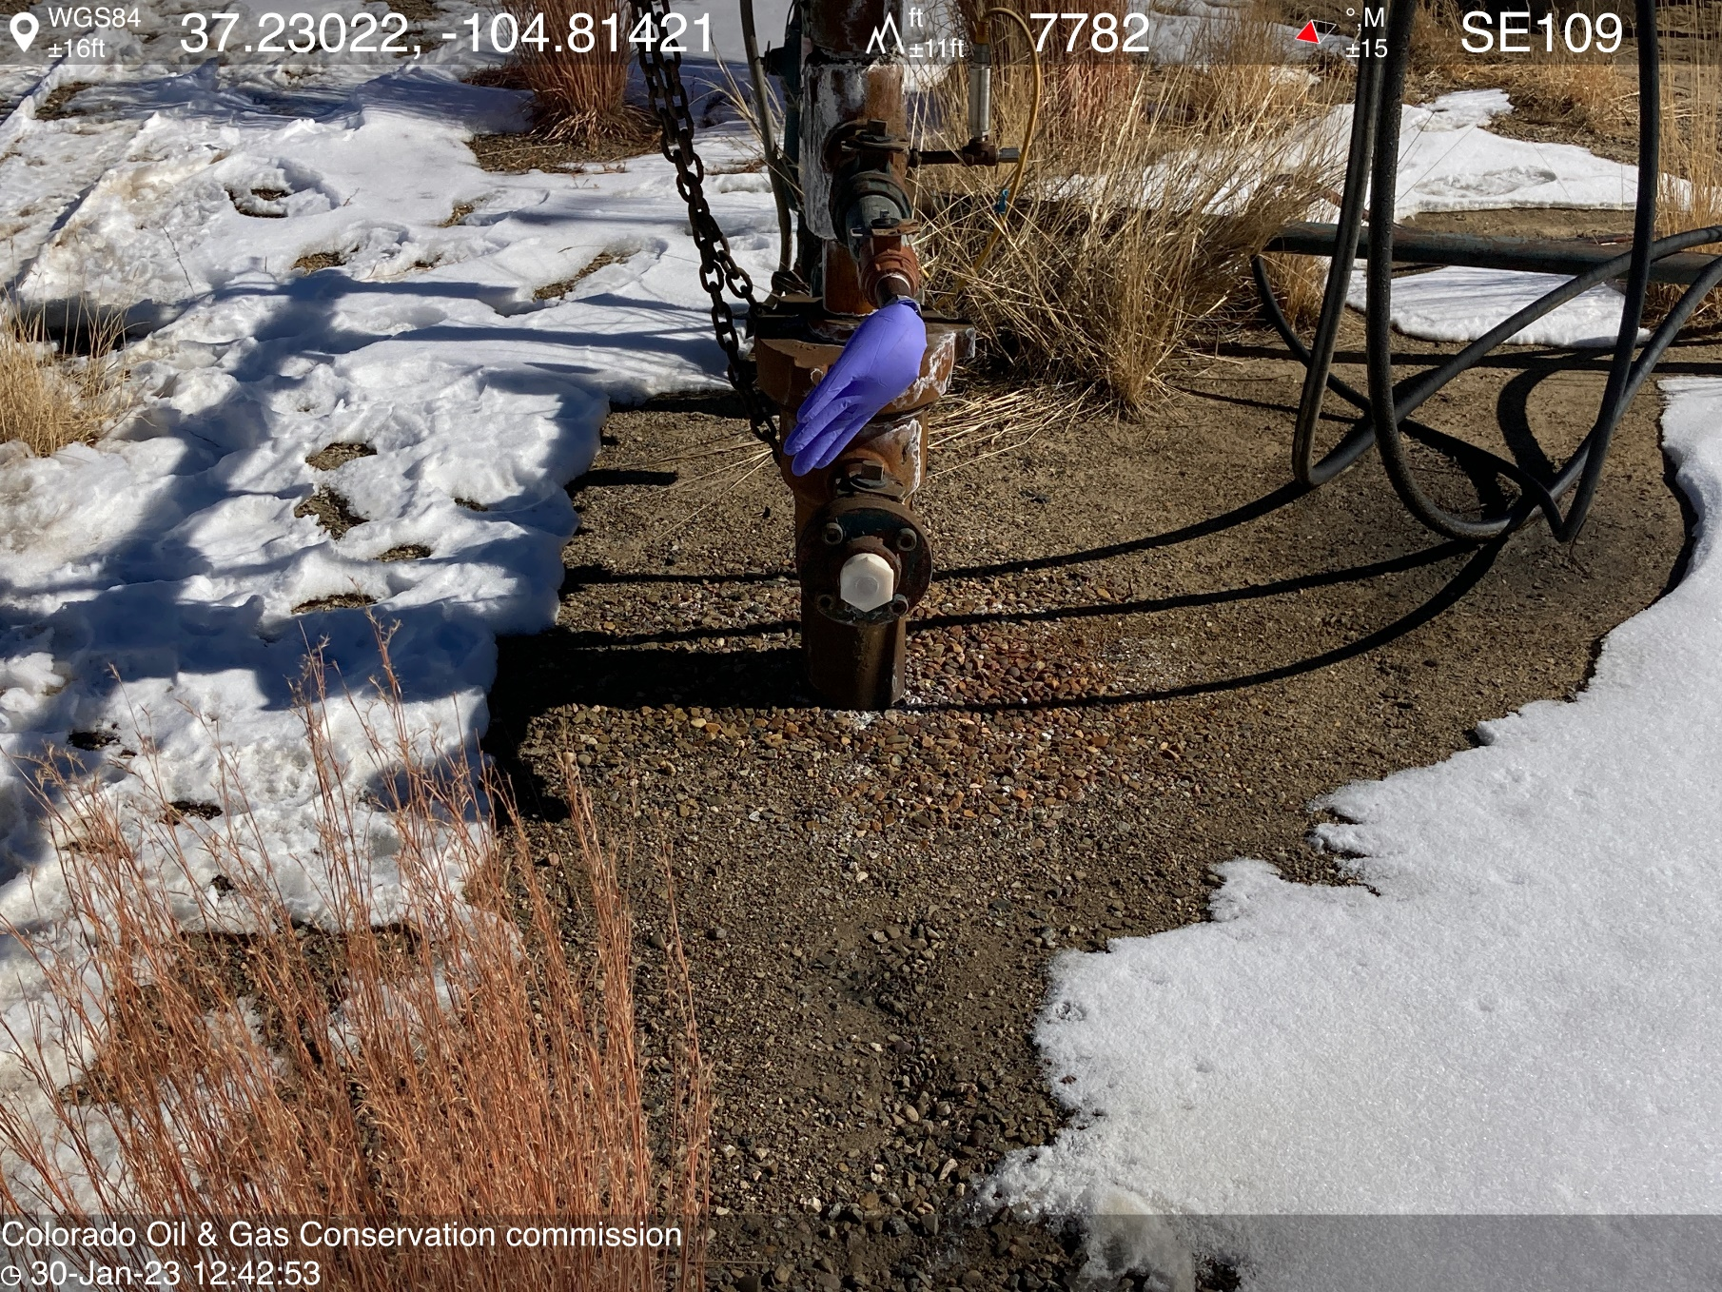
PHOTO 8: Bradenhead inaccessible or not visible. Install appropriate fittings to allow bradenhead visual inspection as per Rule 419.a.(1), (2). CA DATE 2/10/2023.

