Slide 1
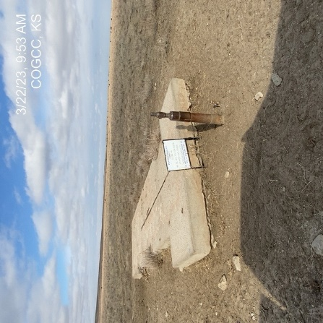

Operator: PCR
Location ID: 05-087-05605
GLENN 1-4
WELLHEAD
SIGNAGE @ WELLHEAD

