Slide 1
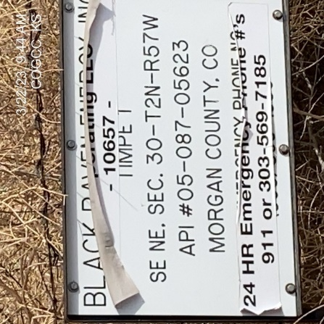

Operator: PCR
Location ID: 05-087-05623
TIMPE 1
SIGNAGE
SIGNAGE @ WELLHEAD

