Slide 1
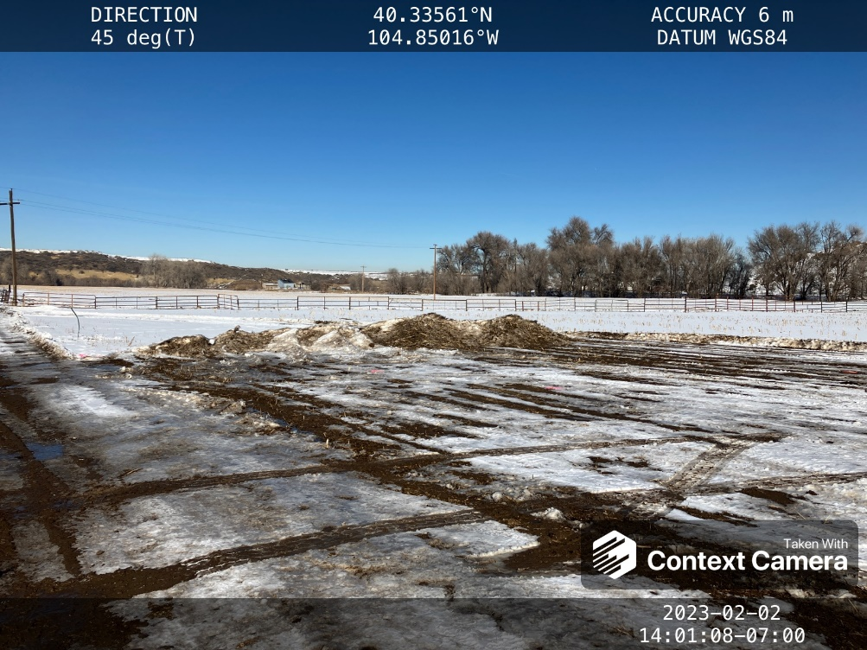
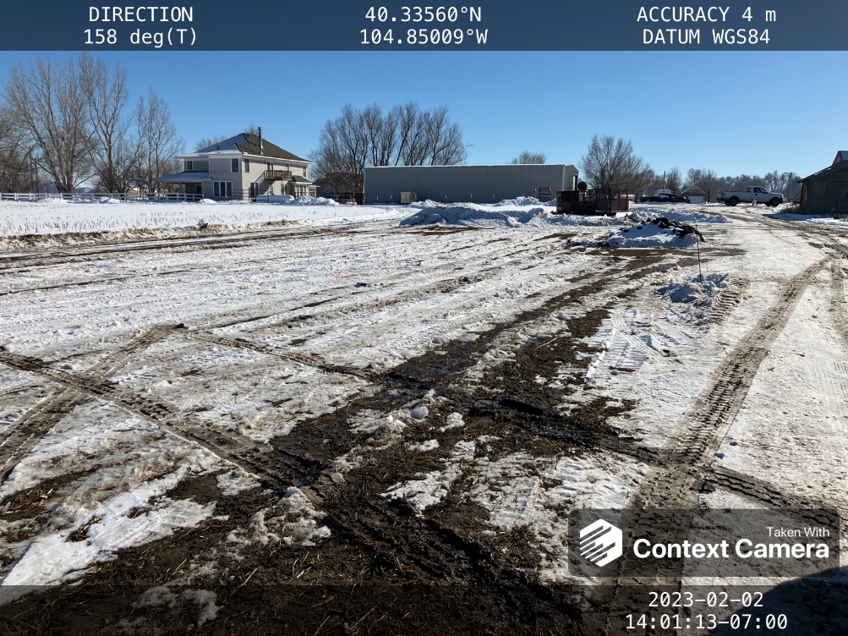

Inspection Photos
Location PDC Kielian 2-2
Photo 1 – Apr
Photo 2 –

Slide 2
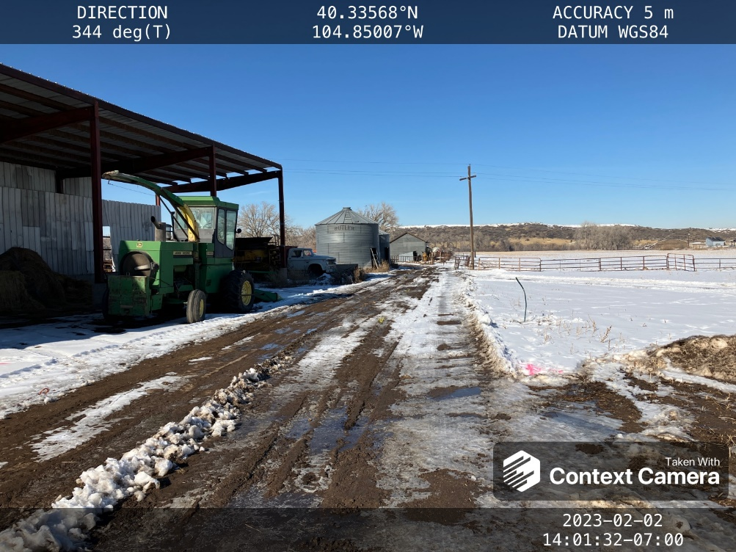
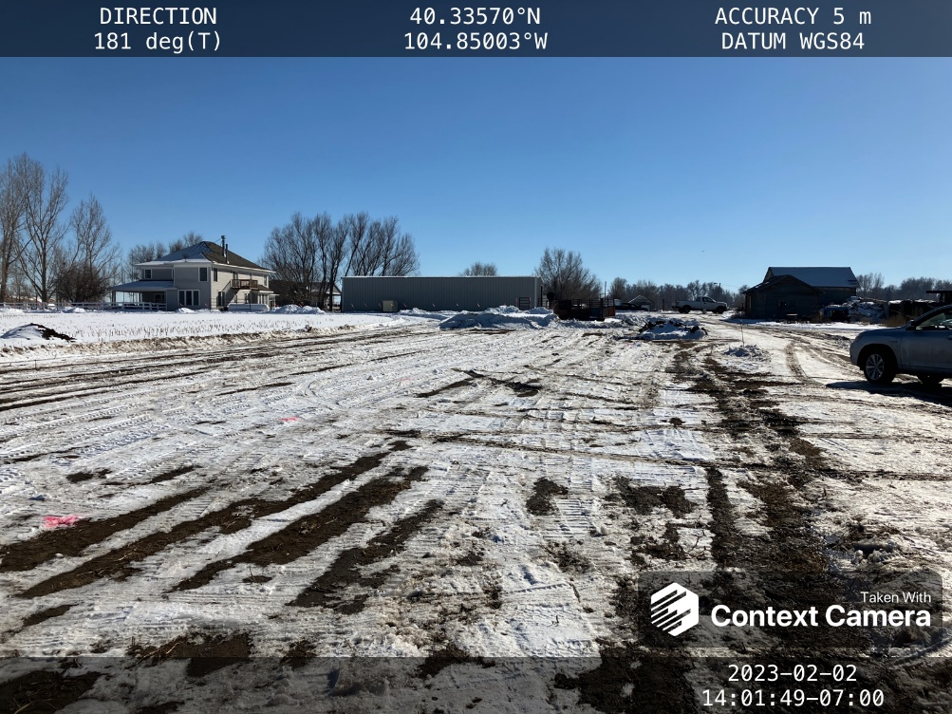
Inspection Photos
Location
Facility ID:
Photo 3 –
Photo 4 –

Slide 3
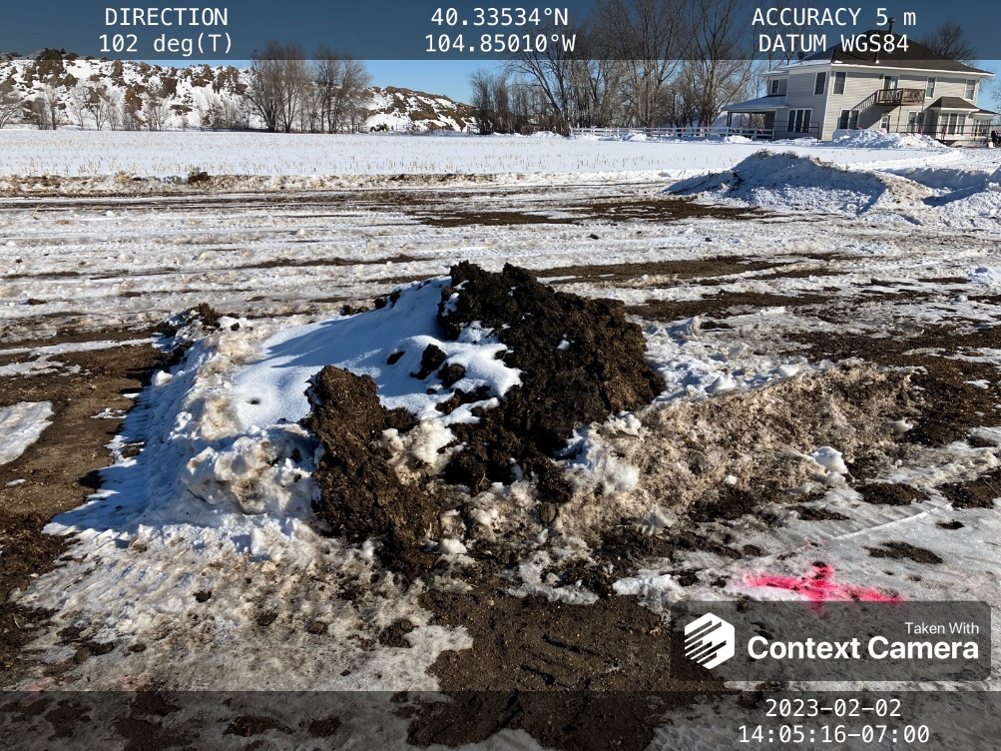
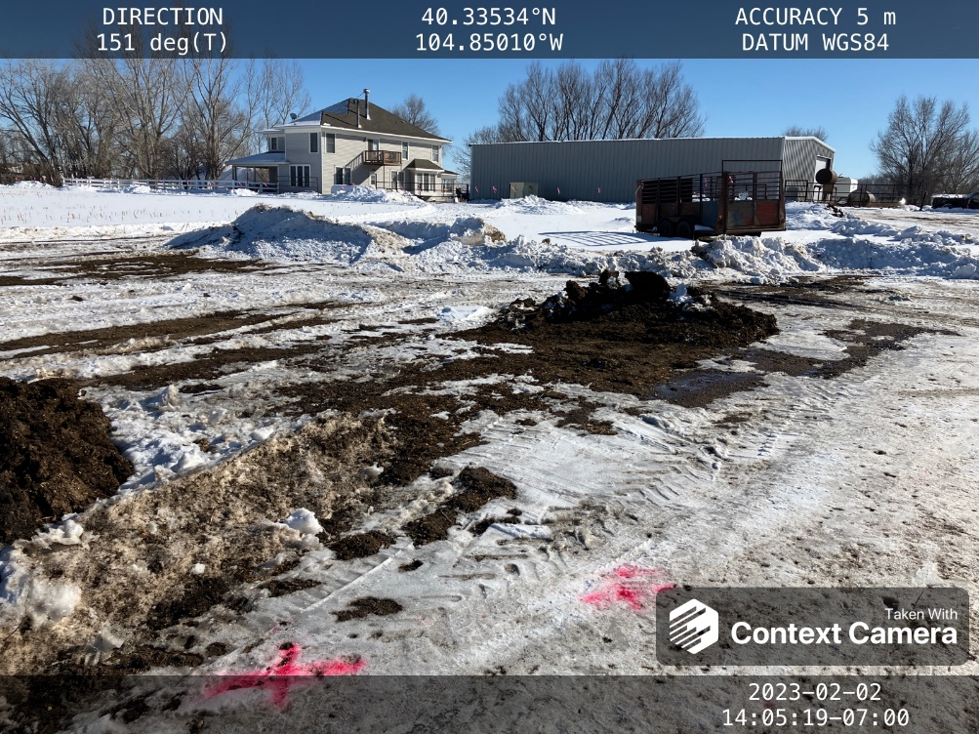
Inspection Photos
Location
Facility ID:
Photo 5 –
Photo 6 –

Slide 4
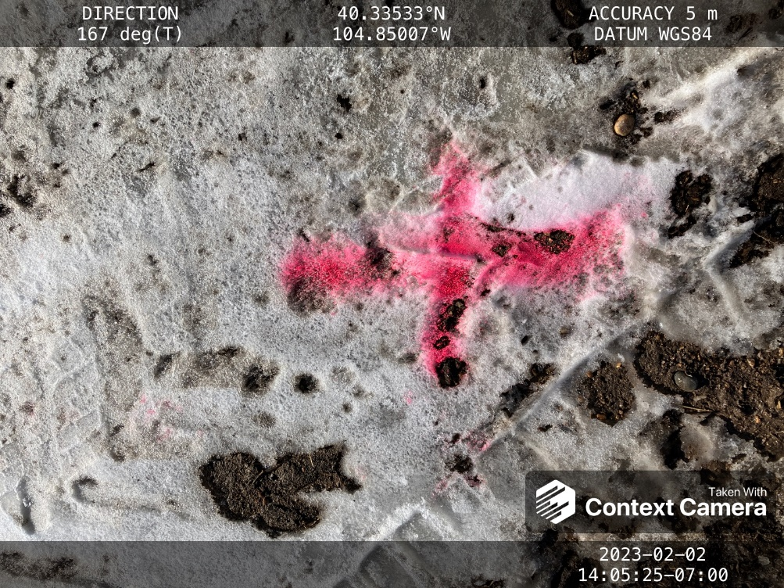
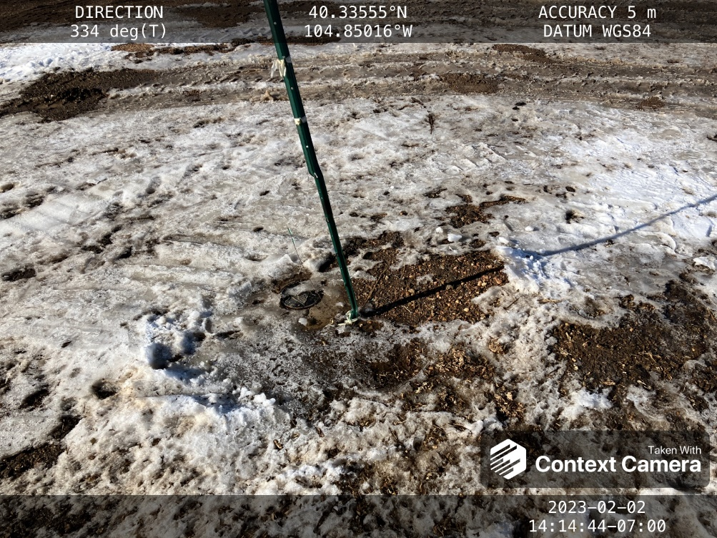
Inspection Photos
Location
Facility ID:
Photo 7 –
Photo 8 –

Slide 5
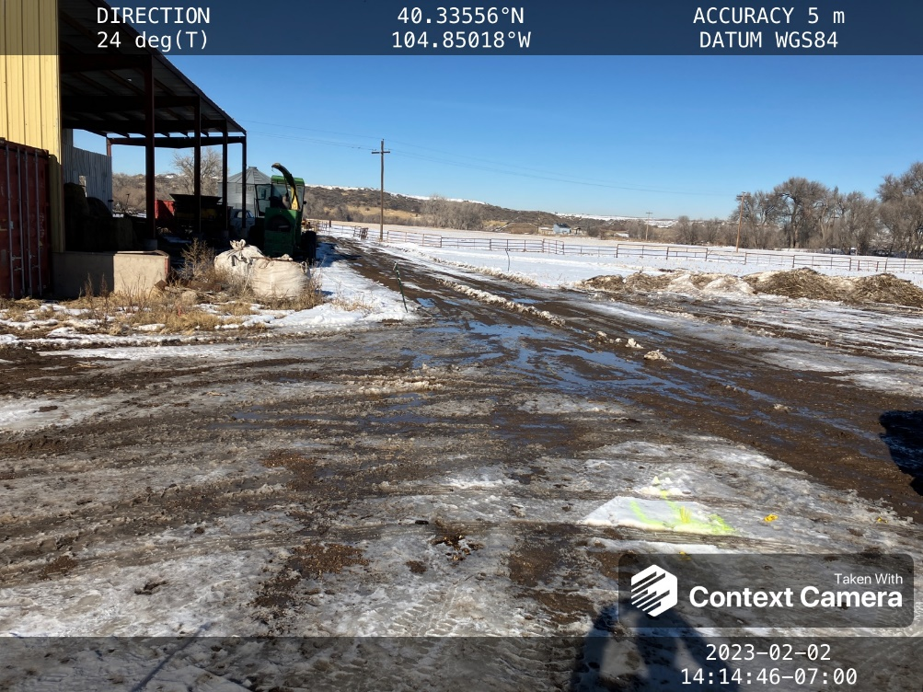
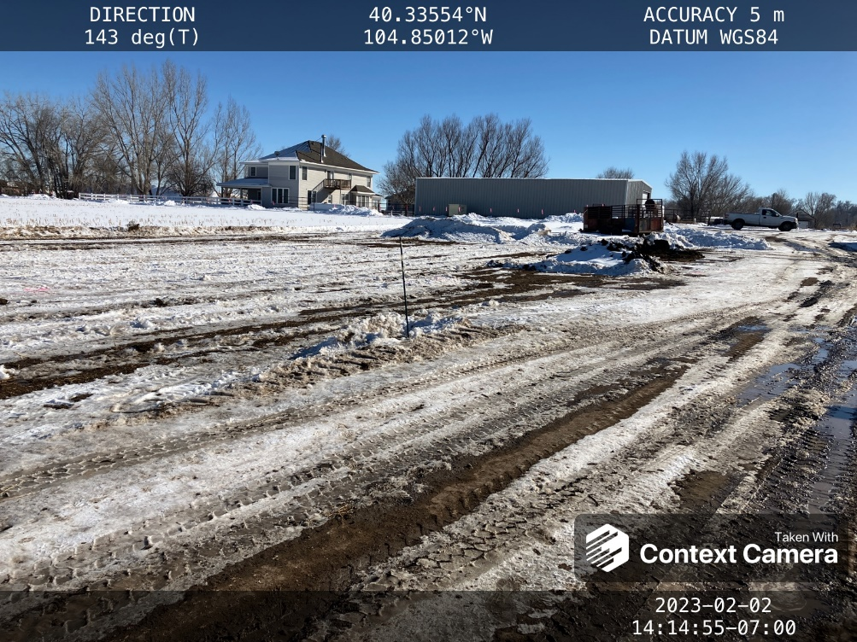
Inspection Photos
Location
Facility ID:
Photo 9 –
Photo 10 –

Slide 6
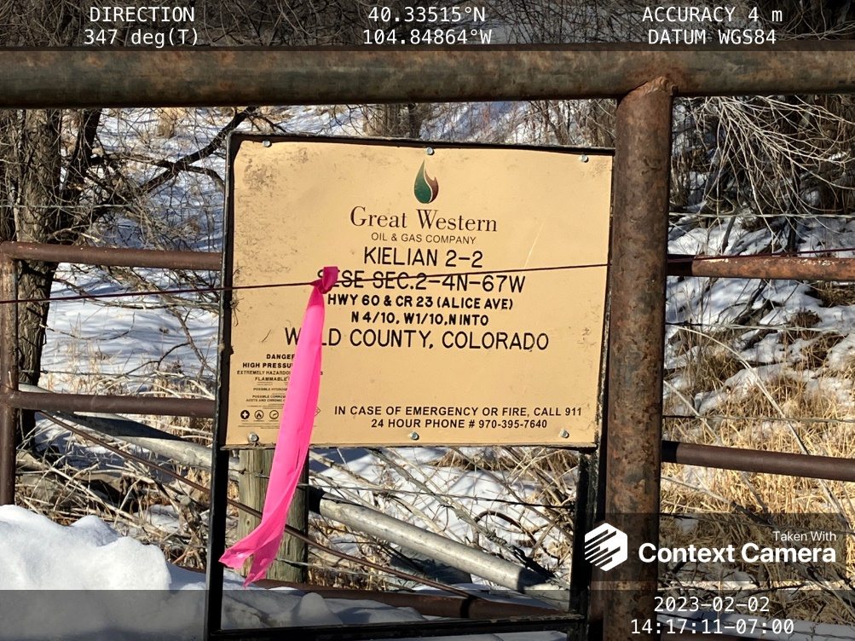
Inspection Photos
Location
Facility ID:
Photo 9 –
Photo 10 –

Slide 7
Inspection Photos
Location
Facility ID:
Photo 9 –
Photo 10 –

Slide 8
Inspection Photos
Location
Facility ID:
Photo 9 –
Photo 10 –

Slide 9
Inspection Photos
Location
Facility ID:
Photo 9 –
Photo 10 –

Slide 10
Inspection Photos
Location
Facility ID:
Photo 9 –
Photo 10 –

Slide 11
Inspection Photos
Location
Facility ID:
Photo 9 –
Photo 10 –

Slide 12
Inspection Photos
Location
Facility ID:
Photo 9 –
Photo 10 –

Slide 13
Inspection Photos
Location
Facility ID:
Photo 9 –
Photo 10 –

Slide 14
Inspection Photos
Location
Facility ID:
Photo 3 –
Photo 4 –

Slide 15
Inspection Photos
Location
Facility ID:
Photo 5 –
Photo 6 –

Slide 16
Inspection Photos
Location
Facility ID:
Photo 7 –
Photo 8 –

Slide 17
Inspection Photos
Location
Facility ID:
Photo 9 –
Photo 10 –

Slide 18
Inspection Photos
Location
Facility ID:
Photo 9 –
Photo 10 –

Slide 19
Inspection Photos
Location
Facility ID:
Photo 9 –
Photo 10 –

Slide 20
Inspection Photos
Location
Facility ID:
Photo 9 –
Photo 10 –

Slide 21
Inspection Photos
Location
Facility ID:
Photo 9 –
Photo 10 –

Slide 22
Inspection Photos
Location
Facility ID:
Photo 9 –
Photo 10 –

Slide 23
Inspection Photos
Location
Facility ID:
Photo 9 –
Photo 10 –

Slide 24
Inspection Photos
Location
Facility ID:
Photo 9 –
Photo 10 –

Slide 25
Inspection Photos
Location
Facility ID:
Photo 9 –
Photo 10 –

Slide 26
Inspection Photos
Location
Facility ID:
Photo 3 –
Photo 4 –

Slide 27
Inspection Photos
Location
Facility ID:
Photo 5 –
Photo 6 –

Slide 28
Inspection Photos
Location
Facility ID:
Photo 7 –
Photo 8 –

Slide 29
Inspection Photos
Location
Facility ID:
Photo 9 –
Photo 10 –

Slide 30
Inspection Photos
Location
Facility ID:
Photo 9 –
Photo 10 –

Slide 31
Inspection Photos
Location
Facility ID:
Photo 9 –
Photo 10 –

Slide 32
Inspection Photos
Location
Facility ID:
Photo 9 –
Photo 10 –

Slide 33
Inspection Photos
Location
Facility ID:
Photo 9 –
Photo 10 –

Slide 34
Inspection Photos
Location
Facility ID:
Photo 9 –
Photo 10 –

Slide 35
Inspection Photos
Location
Facility ID:
Photo 9 –
Photo 10 –

Slide 36
Inspection Photos
Location
Facility ID:
Photo 9 –
Photo 10 –

Slide 37
Inspection Photos
Location
Facility ID:
Photo 9 –
Photo 10 –

Slide 38
Inspection Photos
Location
Facility ID:
Photo 9 –
Photo 10 –

Slide 39
Inspection Photos
Location
Facility ID:
Photo 9 –
Photo 10 –

Slide 40
Inspection Photos
Location
Facility ID:
Photo 9 –
Photo 10 –

