Slide 1
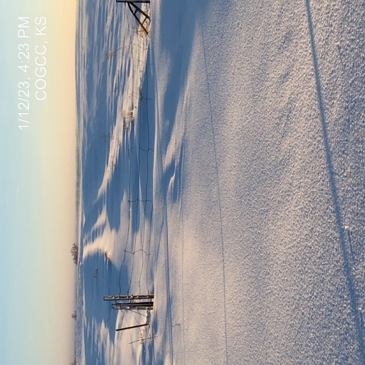
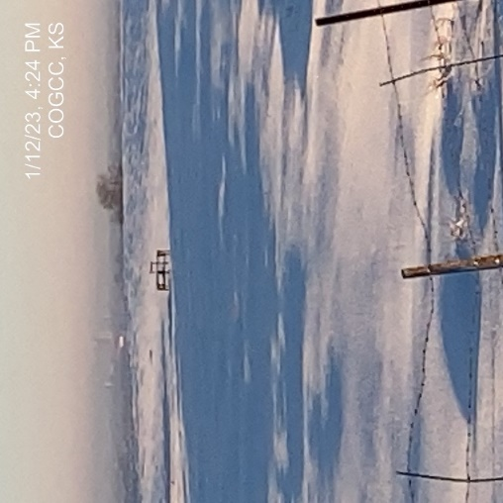
Operator: KPK
Location ID: 05-075-06127
KNUDSEN #1
LEASE ROAD ACCESS
WELL HEAD & BATTERY ACCESS - INACCESSIBLE

