Slide 1
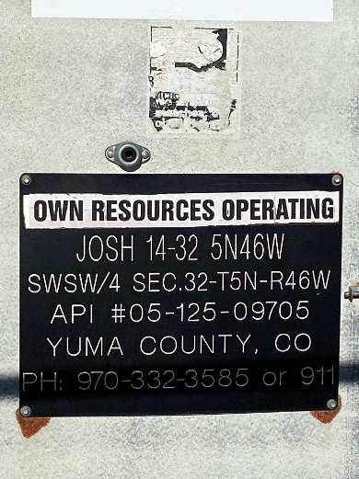
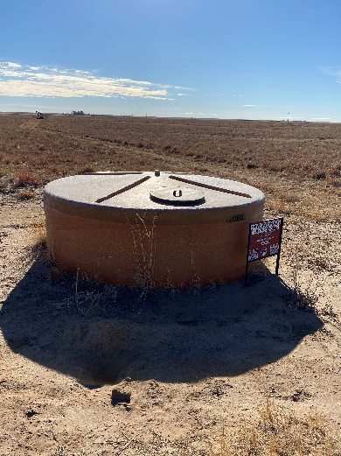
Operator: OWN
Location ID: 05-125-09705
JOSH 14-32
MR - SIGNAGE
SIGN @ PW TANK

