Slide 1
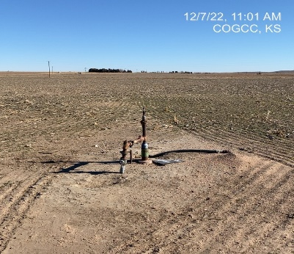
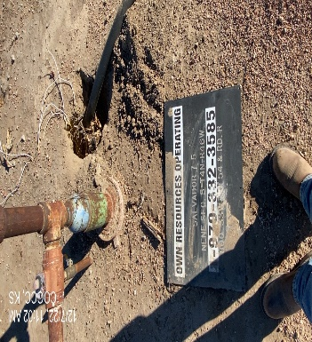
Operator: OWN
Location ID: 05-125-09676
SALVADOR 7-5
WH
SIGN

