Slide 1
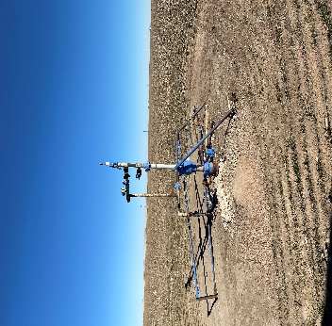
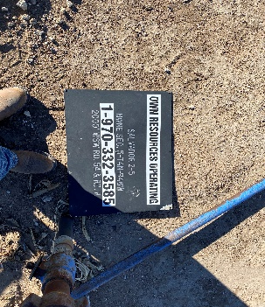
Operator: OWN
Location ID: 05-125-06612
SALVADOR 2-5
WH
SIGN

