Slide 1
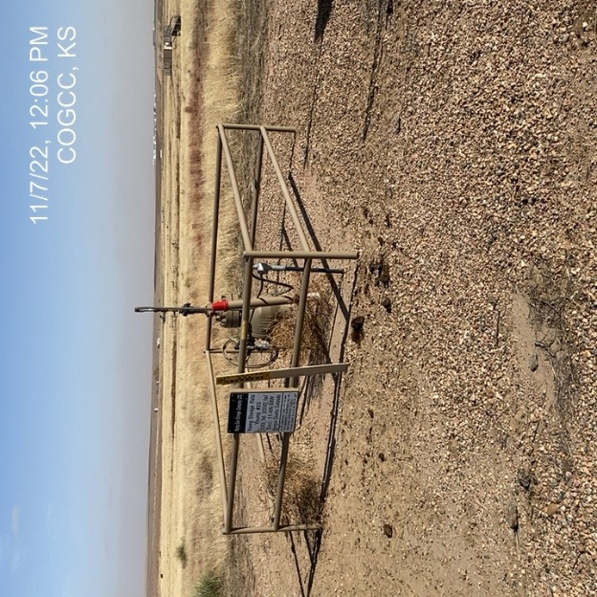
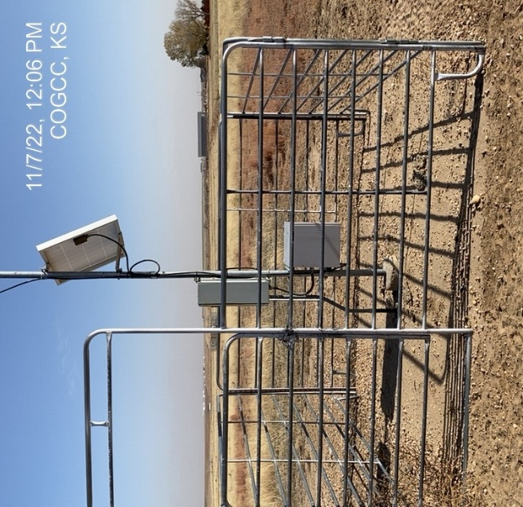
Operator: Kinder Morgan
Location ID: 05-087-08056
Young #25
Wellhead – signage - fence
Telemetry

