Slide 1
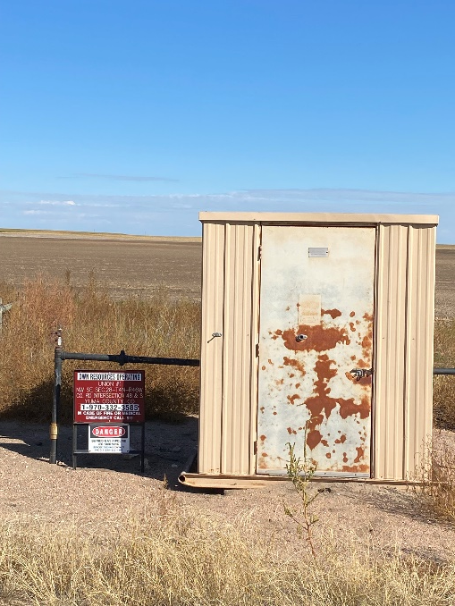
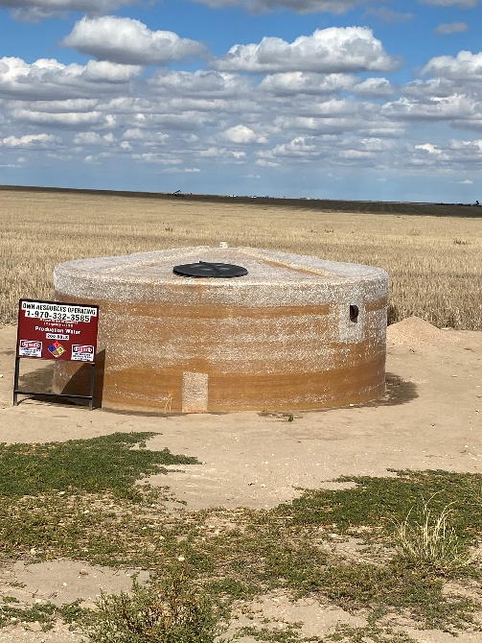
Operator: OWN
Location ID: 05-125-07433
UNION 1
MR-SIGNAGE-SEPARATOR
PW TANK - SIGNAGE

