Slide 1
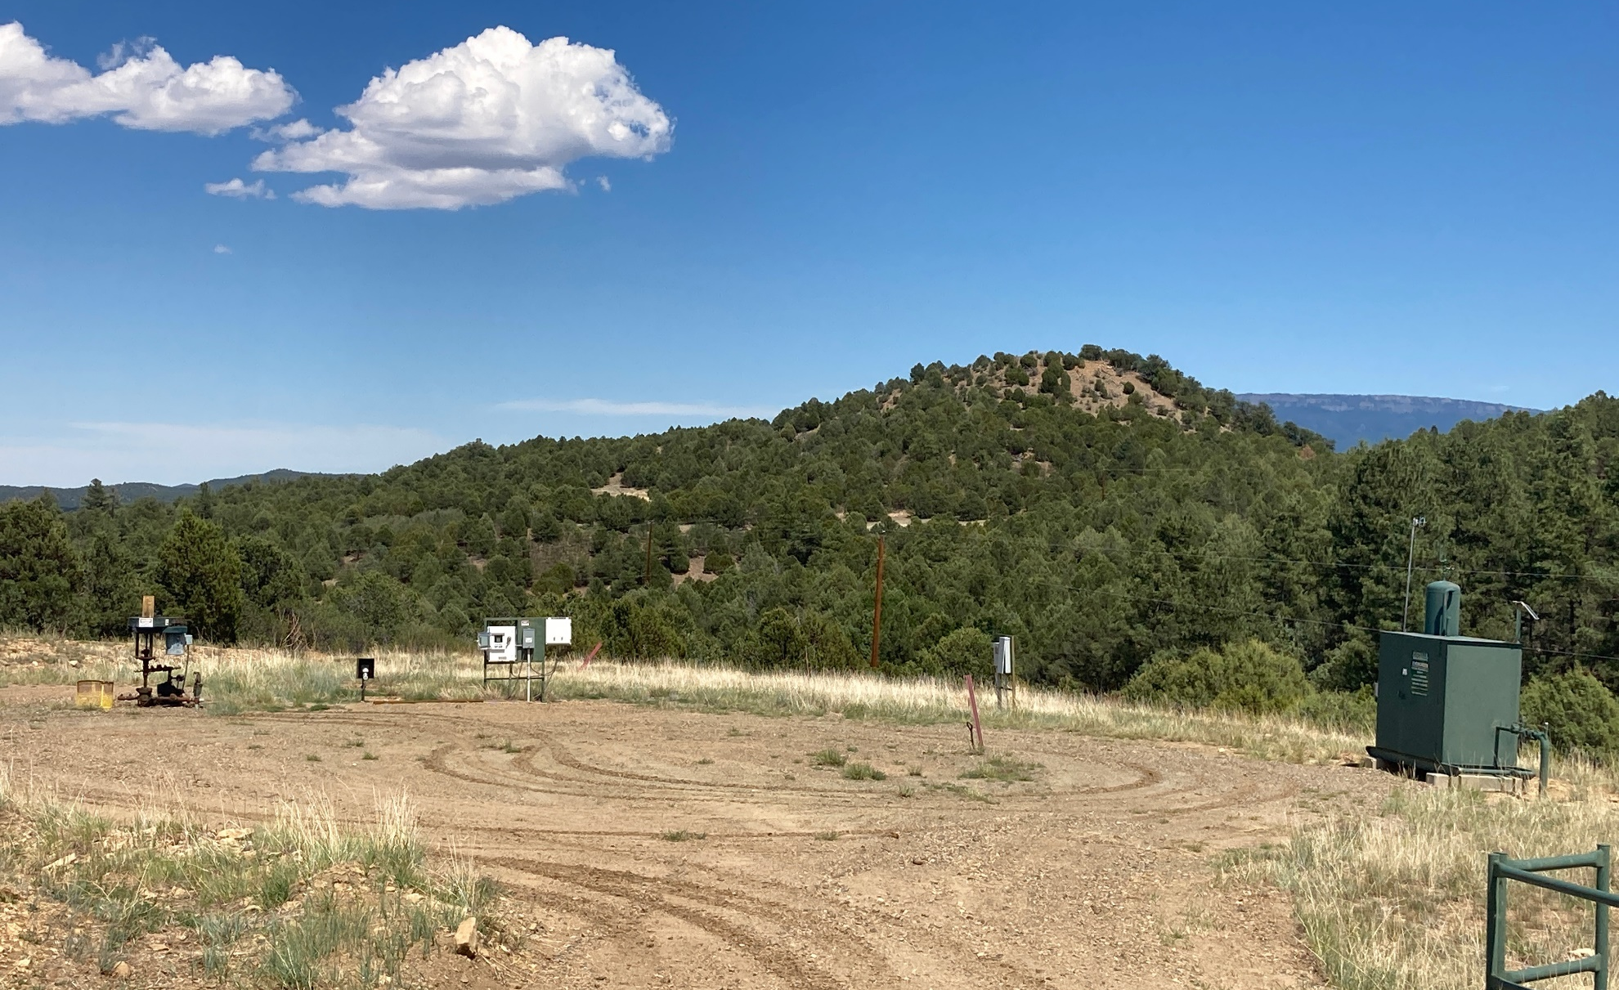
Location Name: BGR 23-11, API #: 071-06518, Insp. #:6951064529
PHOTO 1: LOCATION

Slide 2
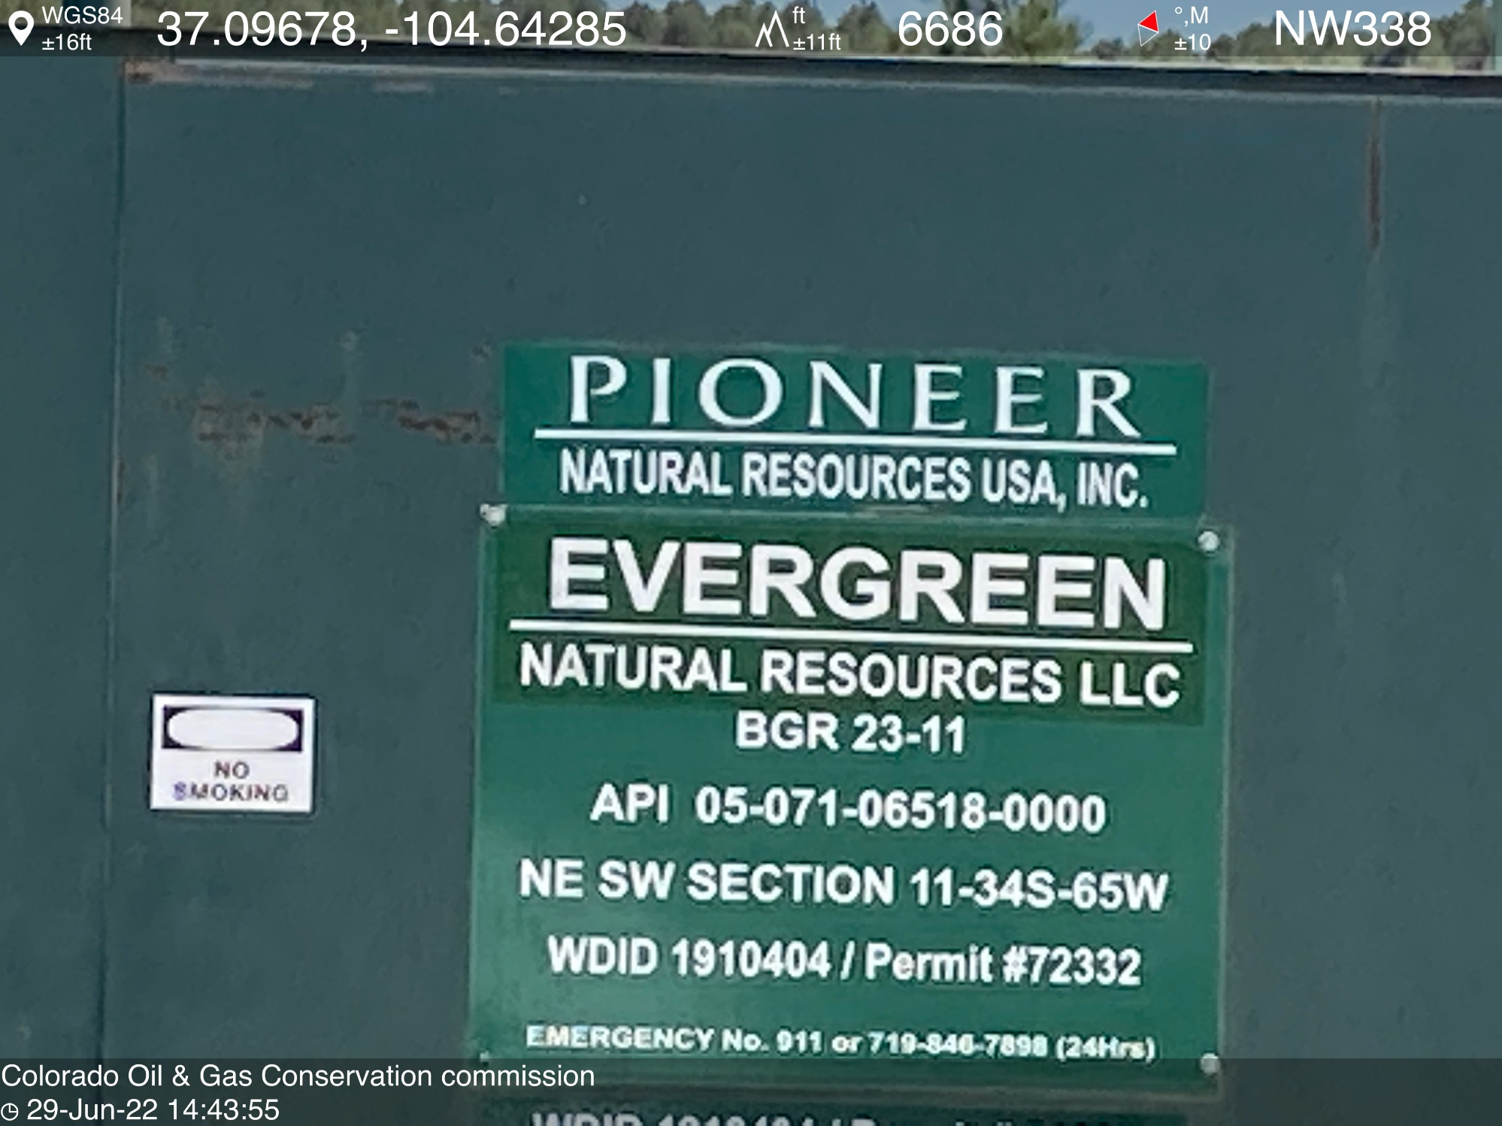
PHOTO 2: WELL SIGN

Slide 3
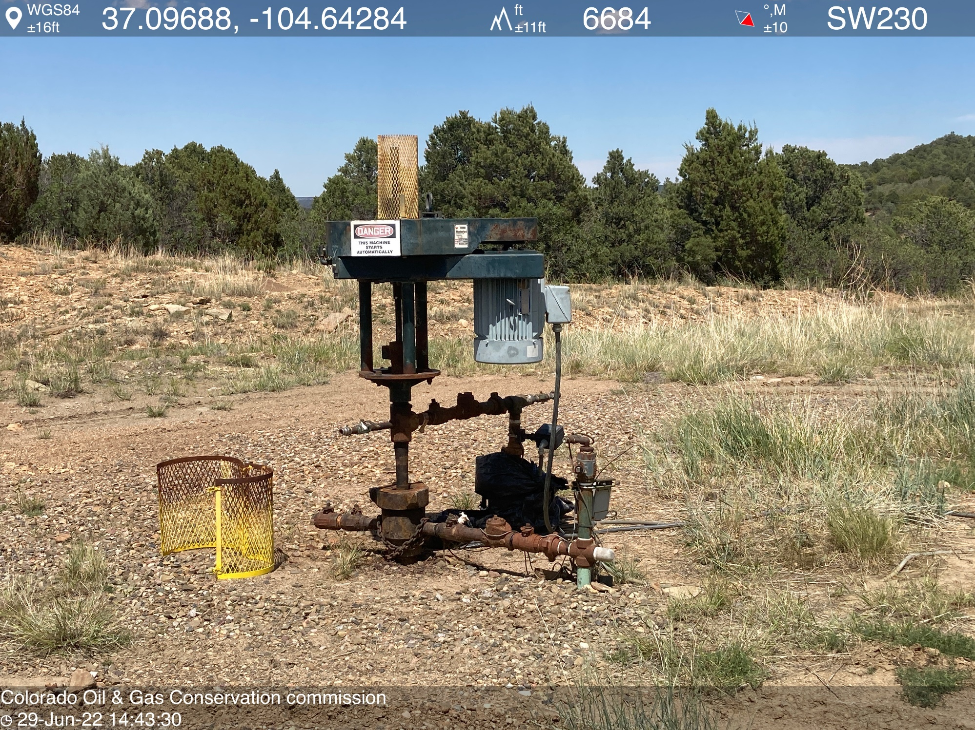
PHOTO 3: WELLHEAD AND EQUIPMENT

Slide 4
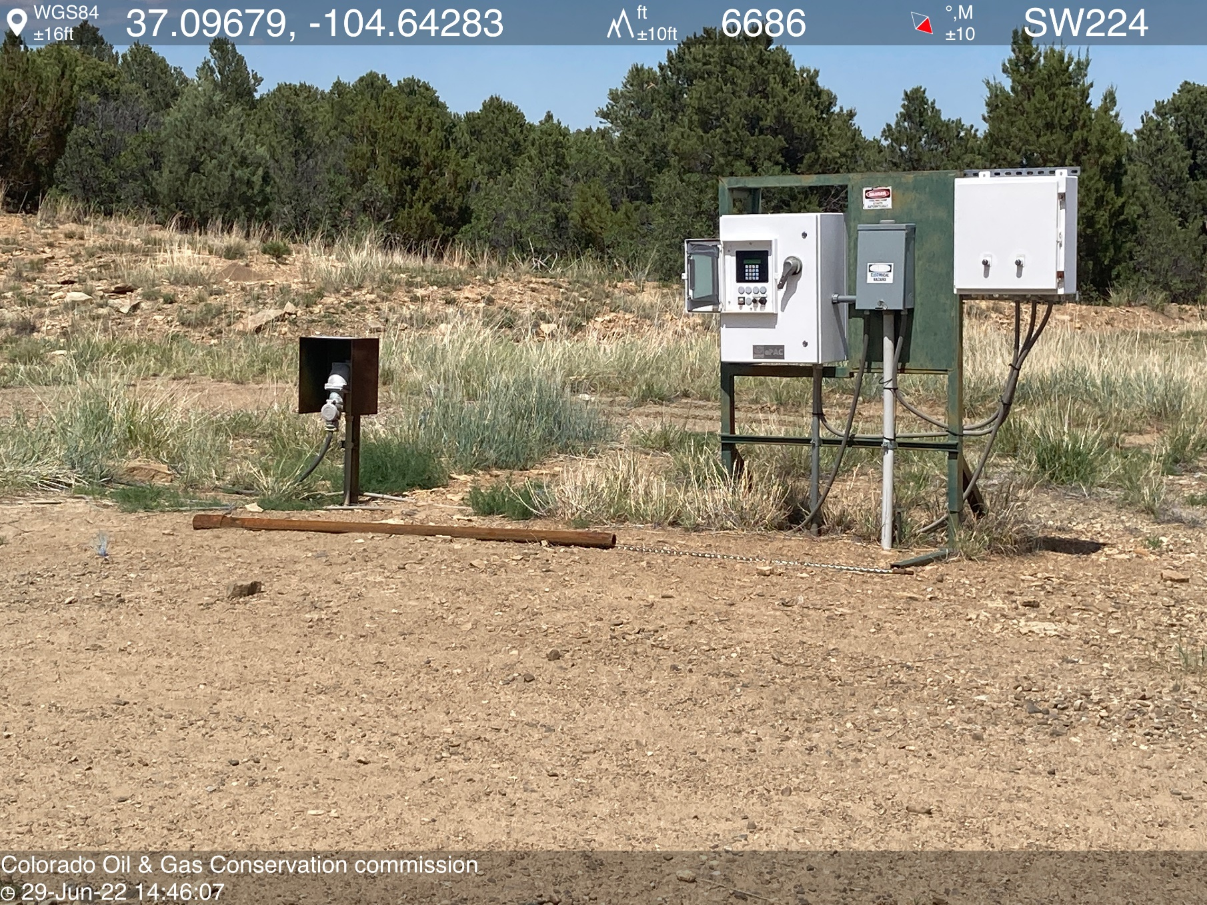
PHOTO 4: UNUSED EQUIPMENT STORED ON LOCATION (2” PUMP OR TBG). REMOVE UNUSED EQUIPMENT PER RULE 606. CA DATE 7-11-2022.

