Slide 1
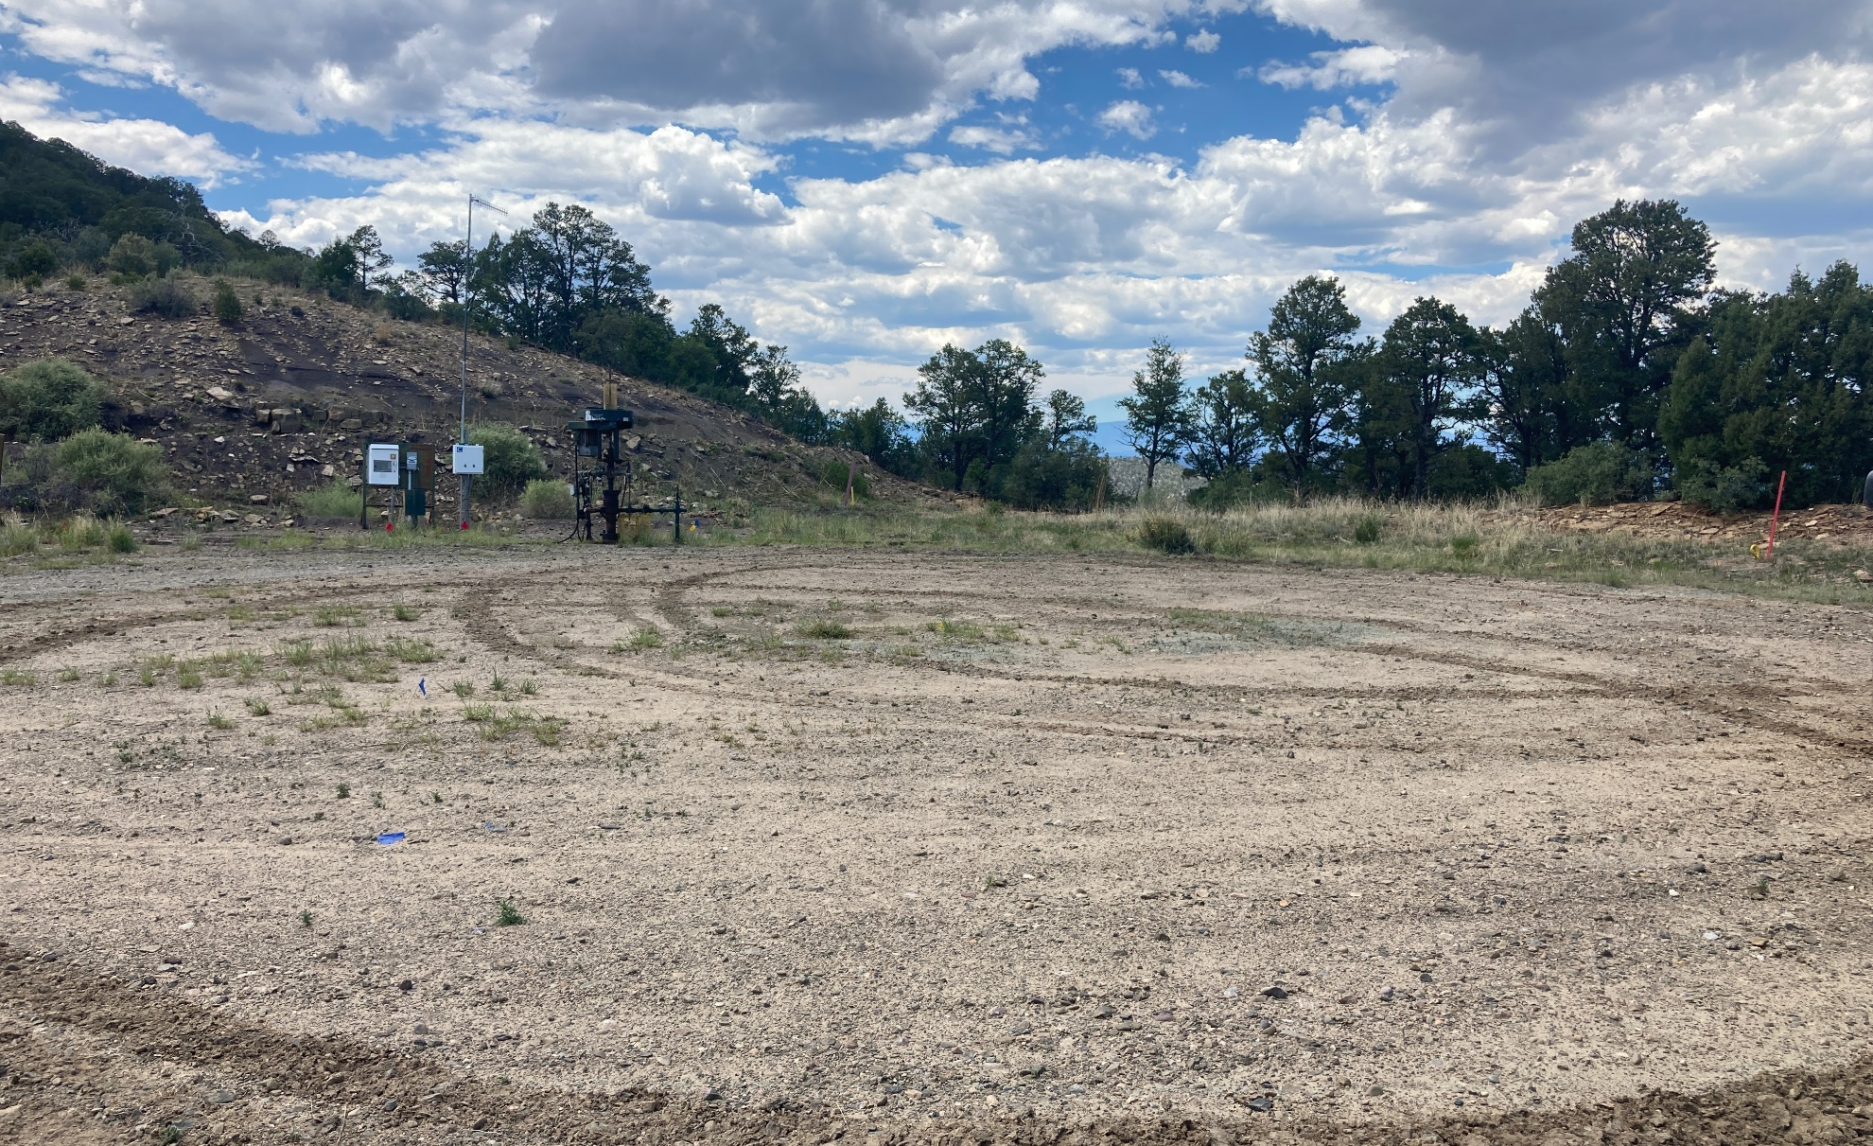
Location Name: ANTLER 44-10, API #: 071-06921, Insp. #:6951064525
PHOTO 1: LOCATION

Slide 2
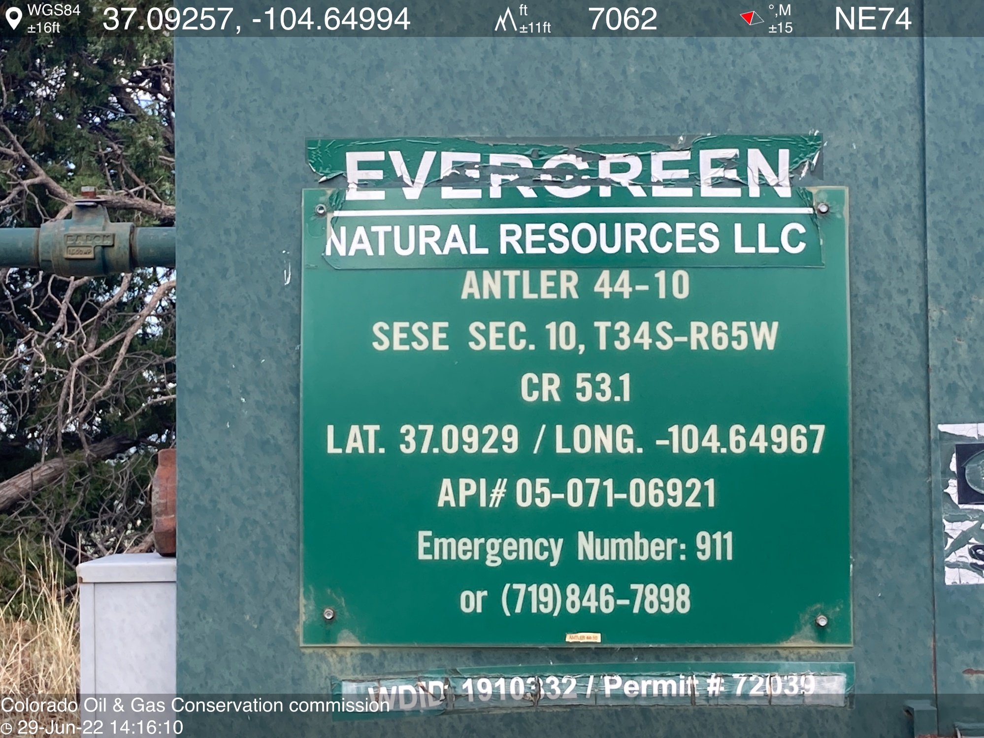
PHOTO 2: WELL SIGN

Slide 3
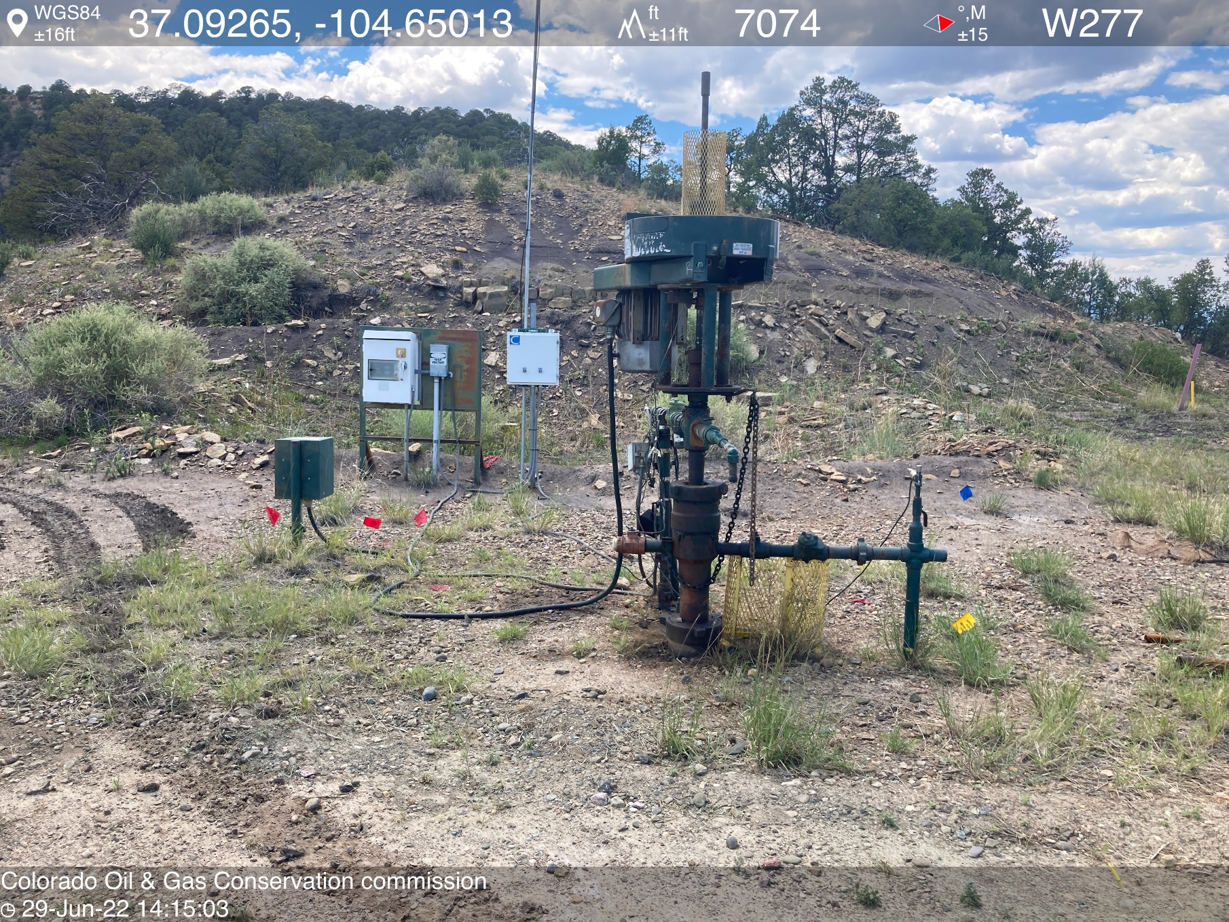
PHOTO 3: WELLHEAD AND EQUIPMENT

Slide 4
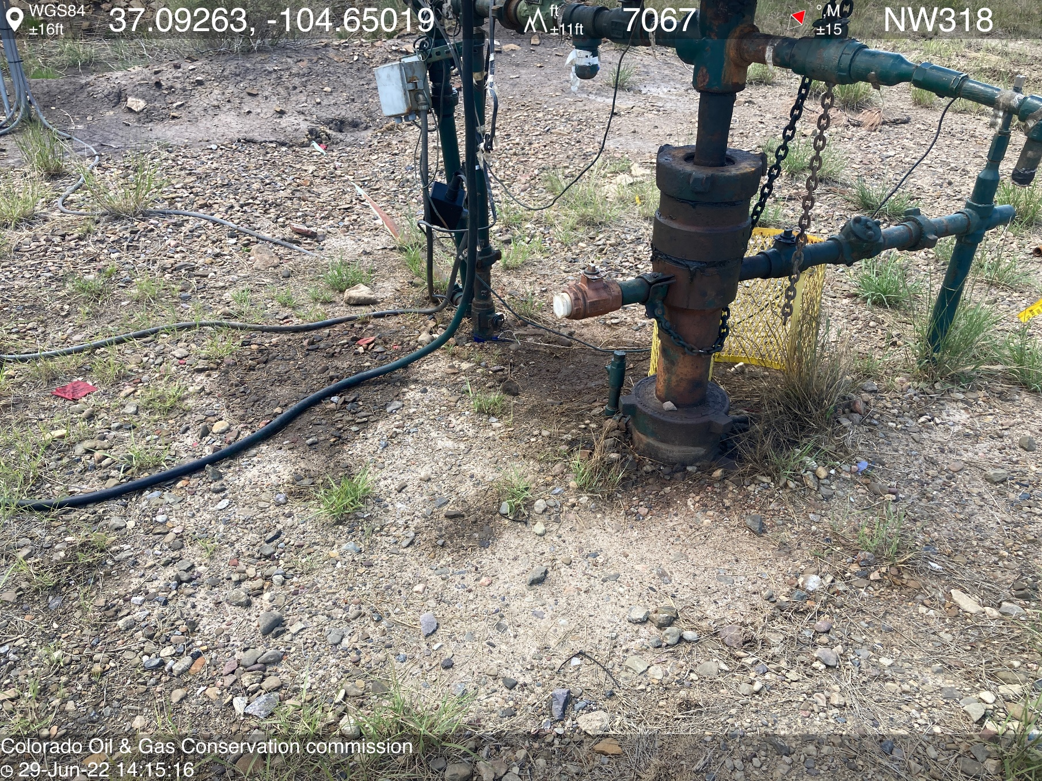
PHOTO 4: AREA OF IMPACTED SOIL AROUND WELLHEAD. Conduct maintenance on equipment, cleanup stained material and review self inspection processes. COMPLY WITH RULE 1002,.(2).D. CA DATE 7-11-2022.

Slide 5
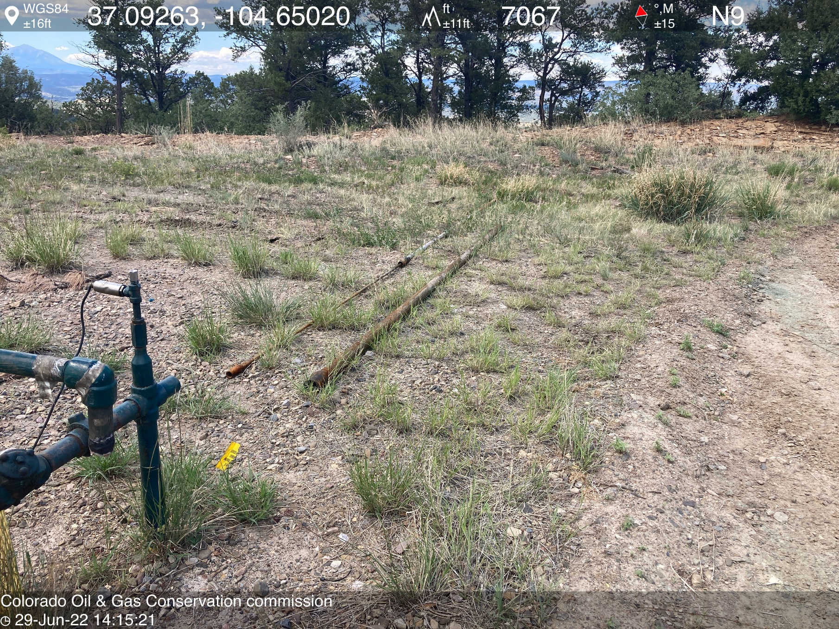
PHOTO 5: UNUSED EQUIPMENT STORED ON LOCATION (2” PUMP AND STATER). REMOVE UNUSED EQUIPMENT PER RULE 606. CA DATE 7-11-2022.

