Slide 1
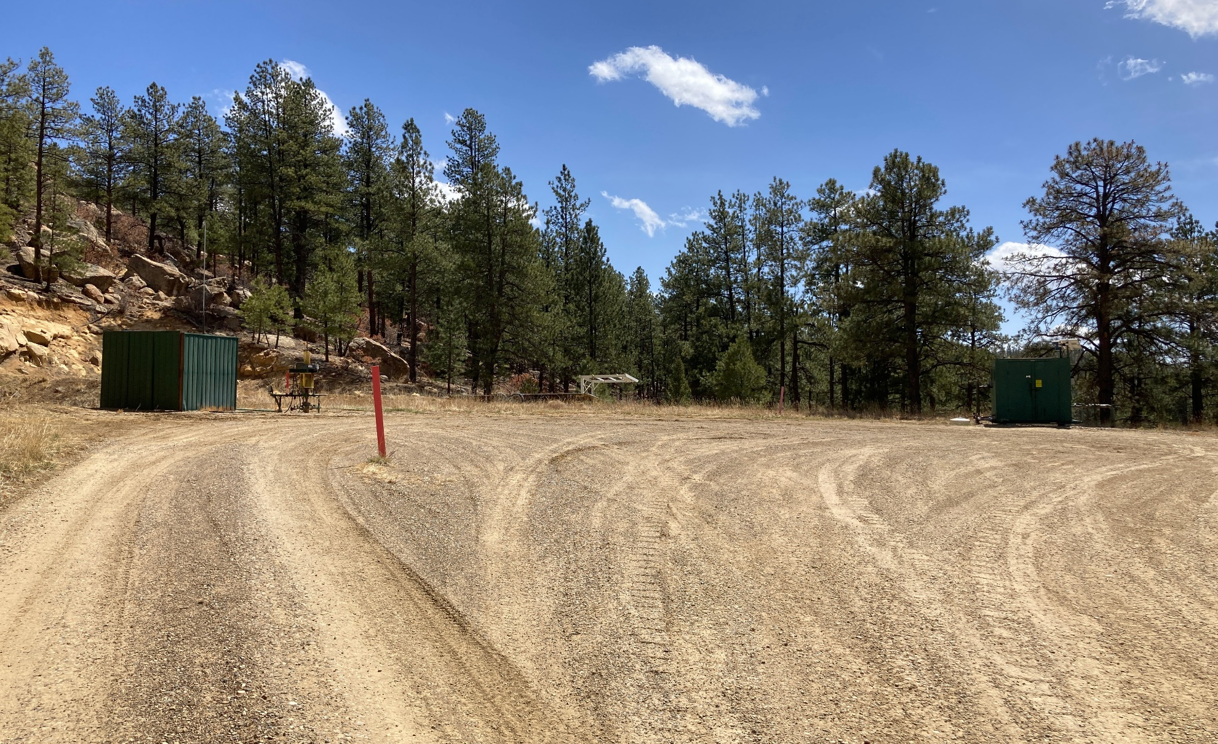
Location Name: DUDE CANYON 22-32 TR, API #: 071-08421, Insp. #:695106045
PHOTO 1: LOCATION

Slide 2
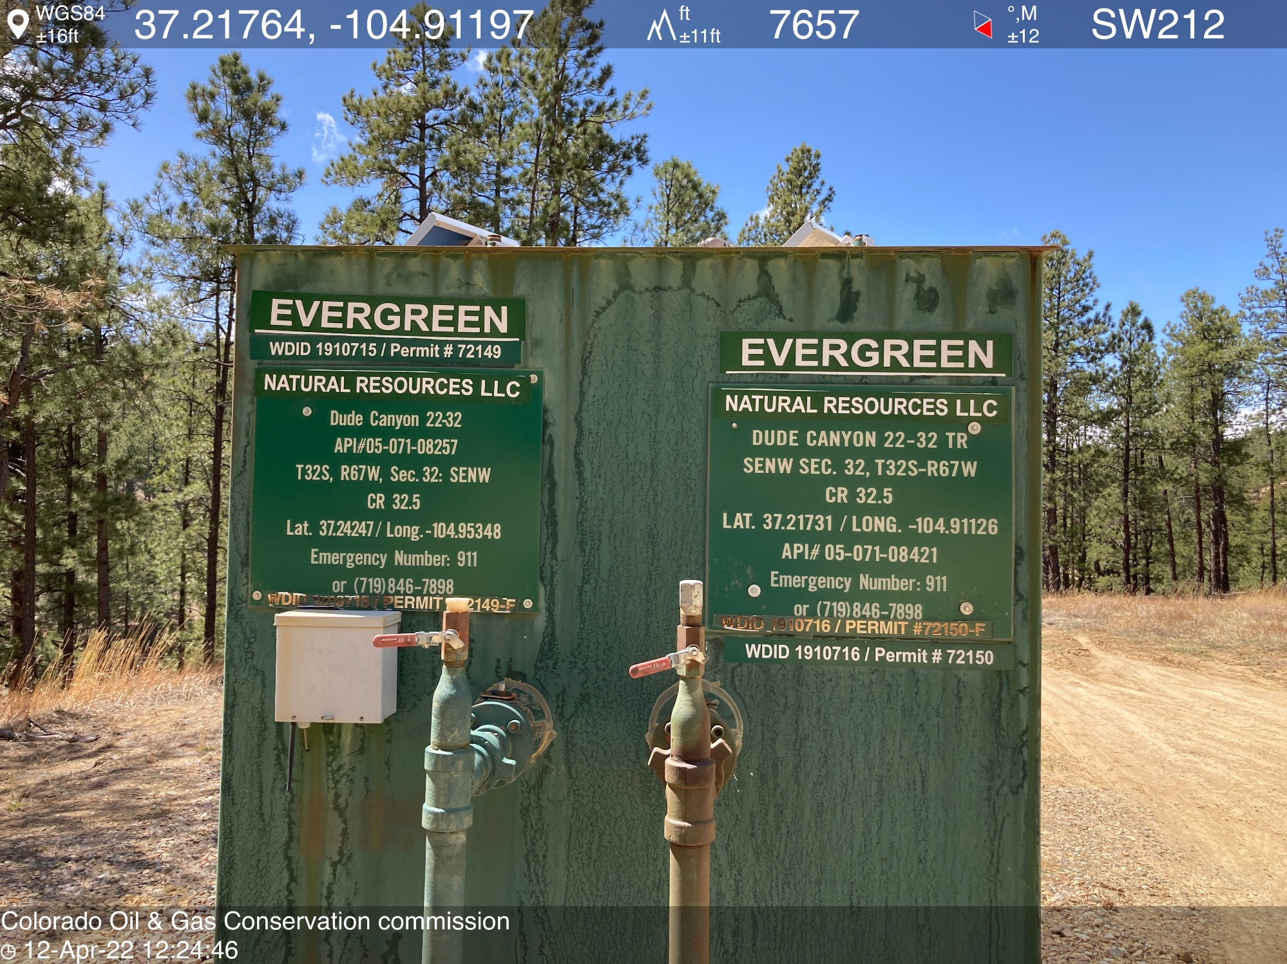
PHOTO 2: WELL SIGN

Slide 3
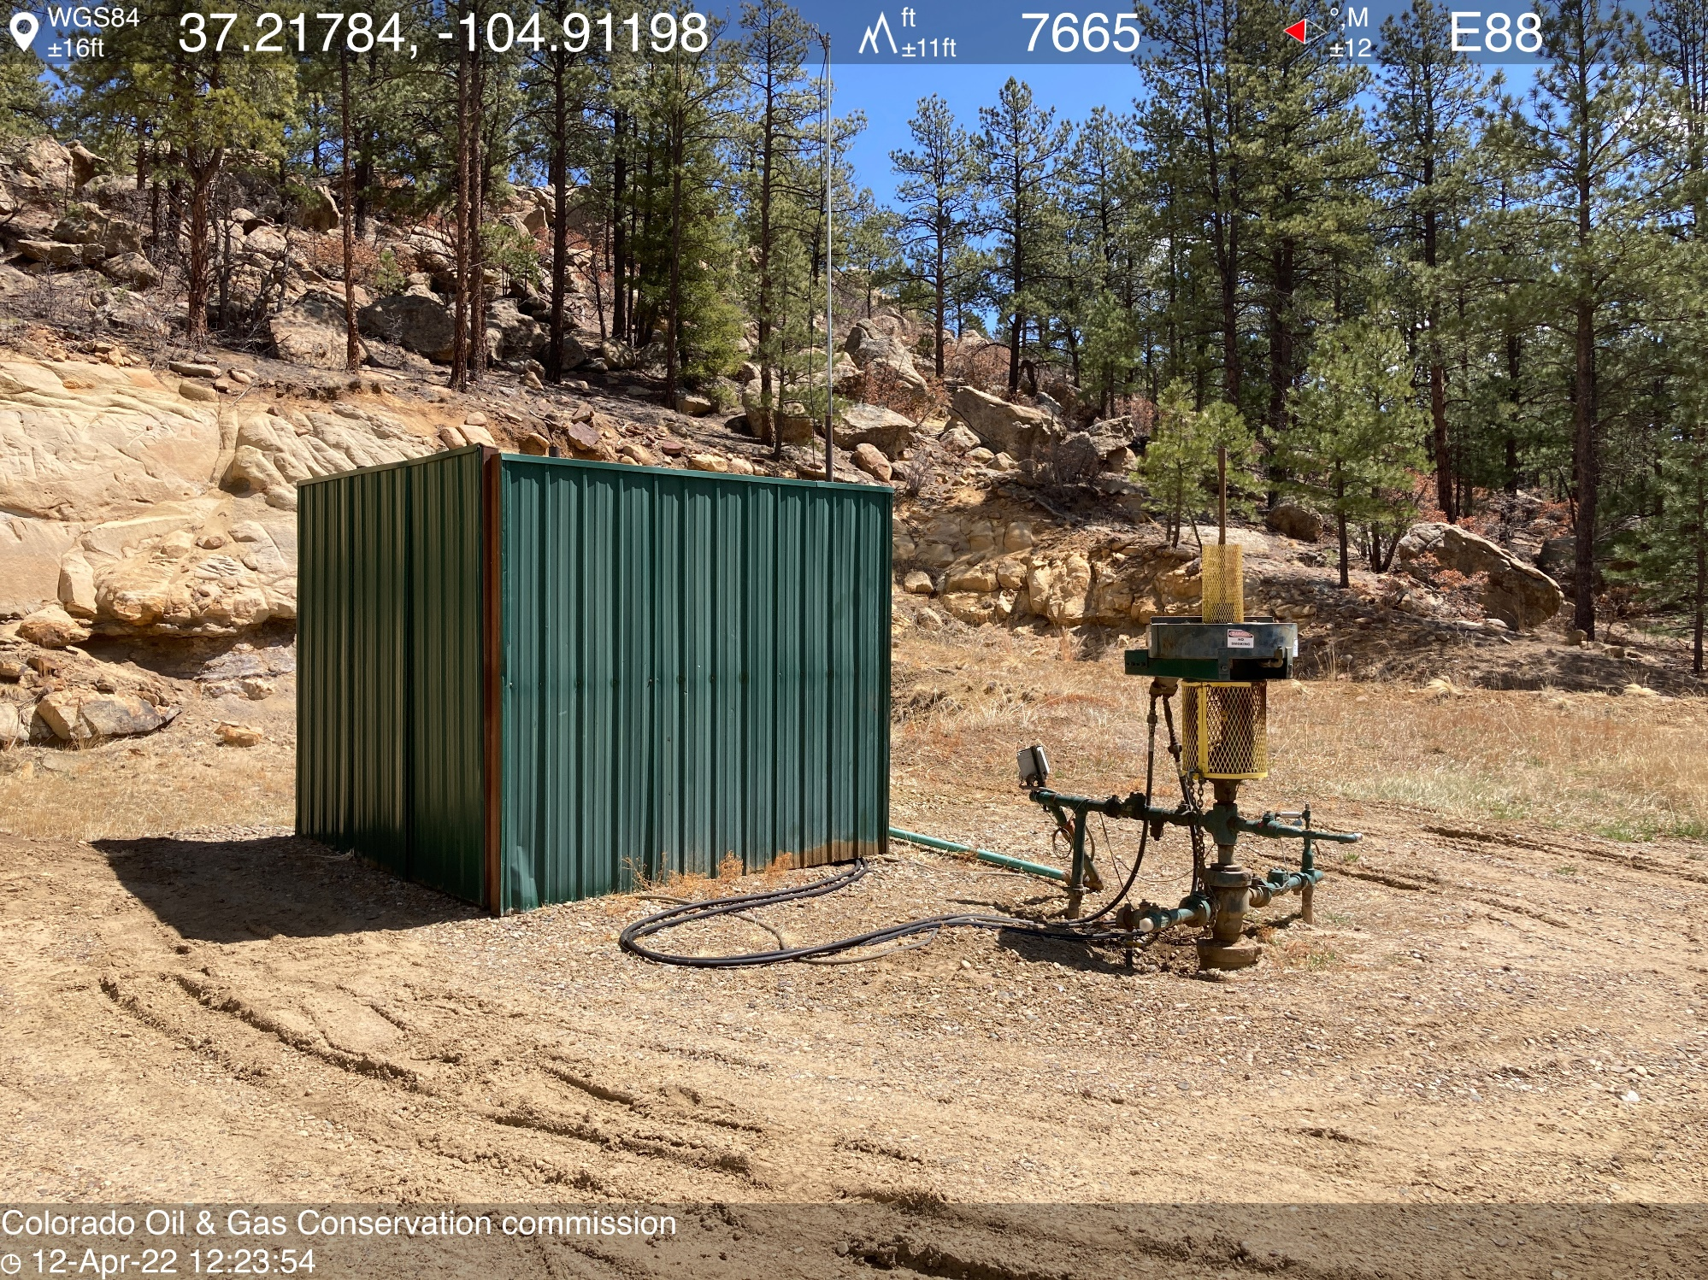
PHOTO 3: ORIGINAL WELLHEAD AND EQUIPMENT

Slide 4
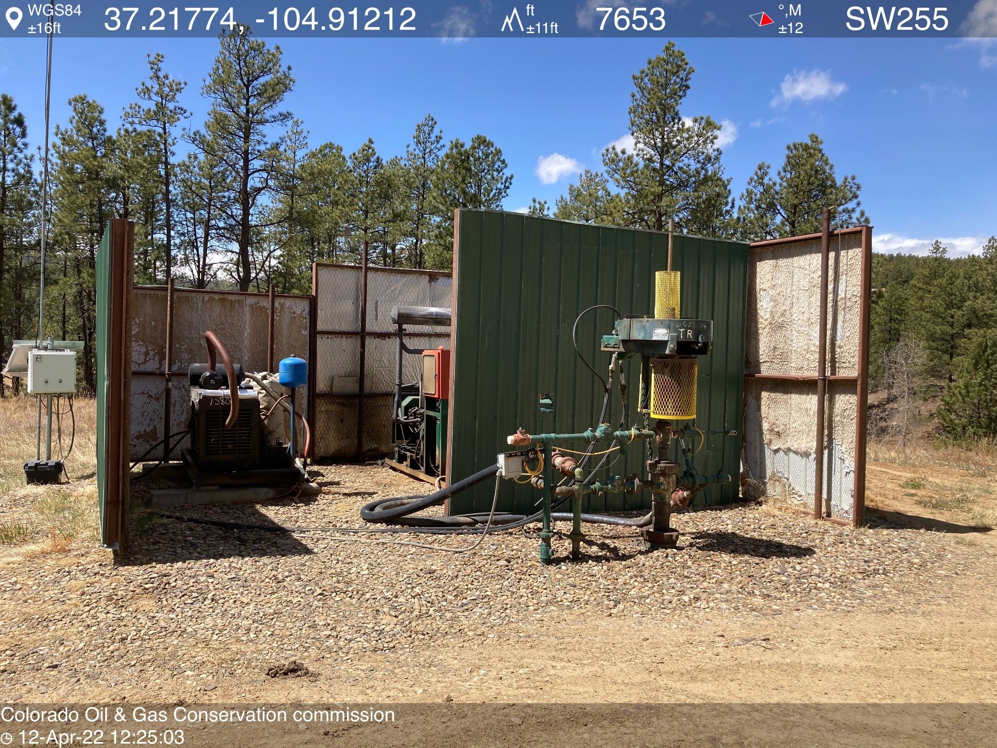
PHOTO 4: TR WELLHEAD AND EQUIPMENT

Slide 5
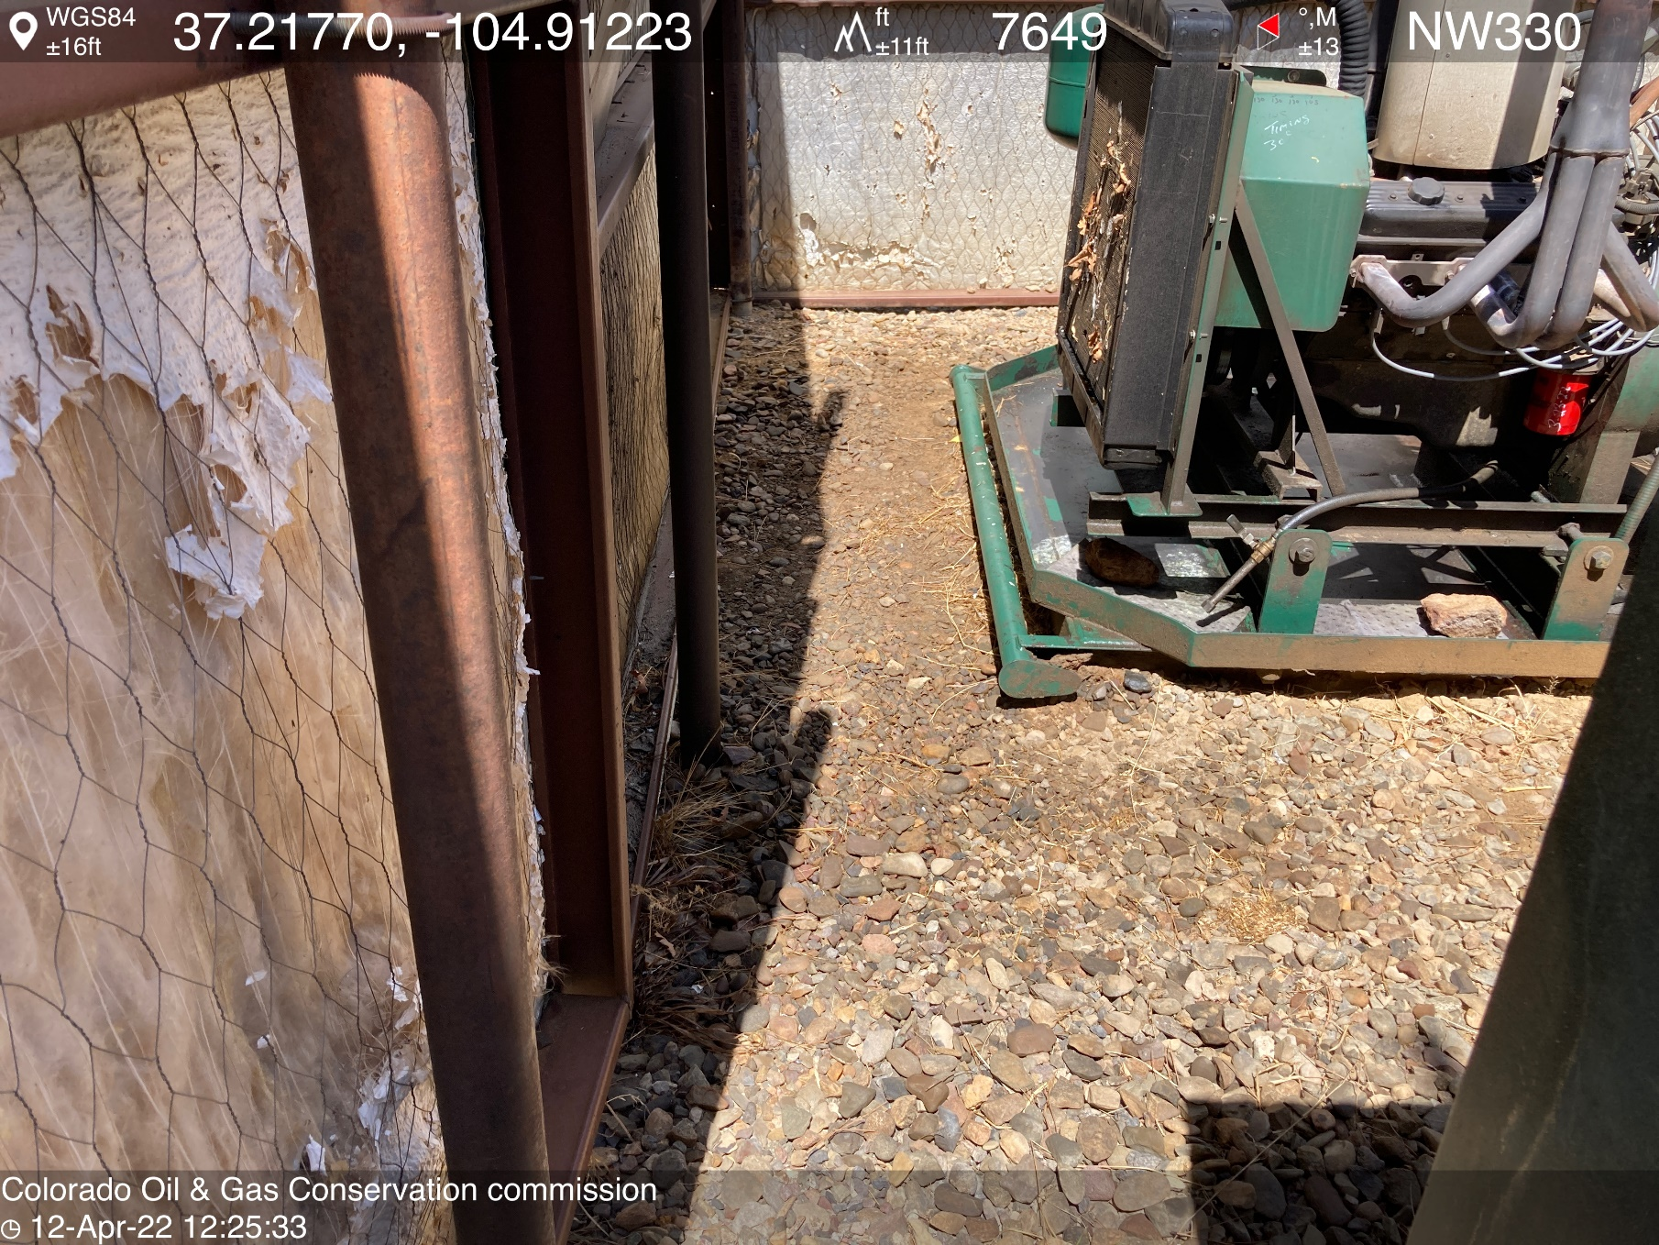
PHOTO 5: AREA OF IMPACTED SOIL APPEARS TO BE OILY WASTE FROM COMPRESSOR. Conduct maintenance on equipment, cleanup stained material and review self inspection processes. COMPLY WITH RULE 1002,.(2).D. (REPAIR LEAKING EQUIPMENT). CA DATE 4-23-22.

Slide 6
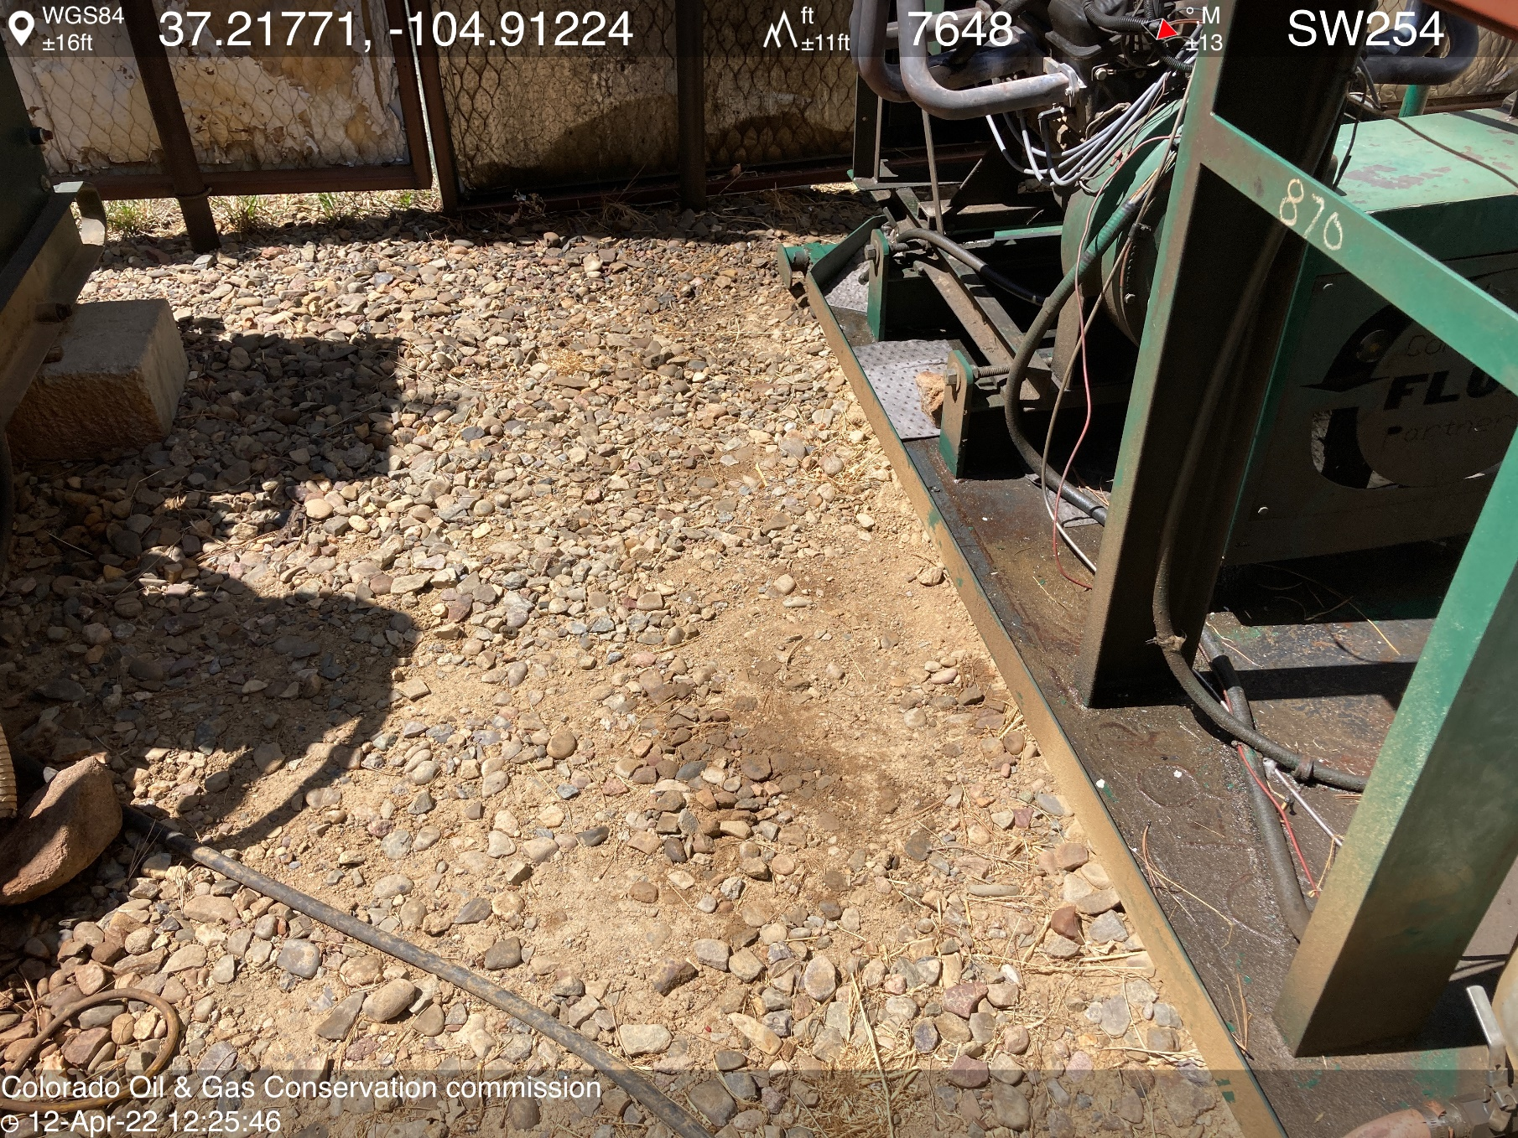
PHOTO 5: AREA OF IMPACTED SOIL APPEARS TO BE OILY WASTE FROM COMPRESSOR. Conduct maintenance on equipment, cleanup stained material and review self inspection processes. COMPLY WITH RULE 1002,.(2).D. (REPAIR LEAKING EQUIPMENT). CA DATE 4-23-22.

