Slide 1
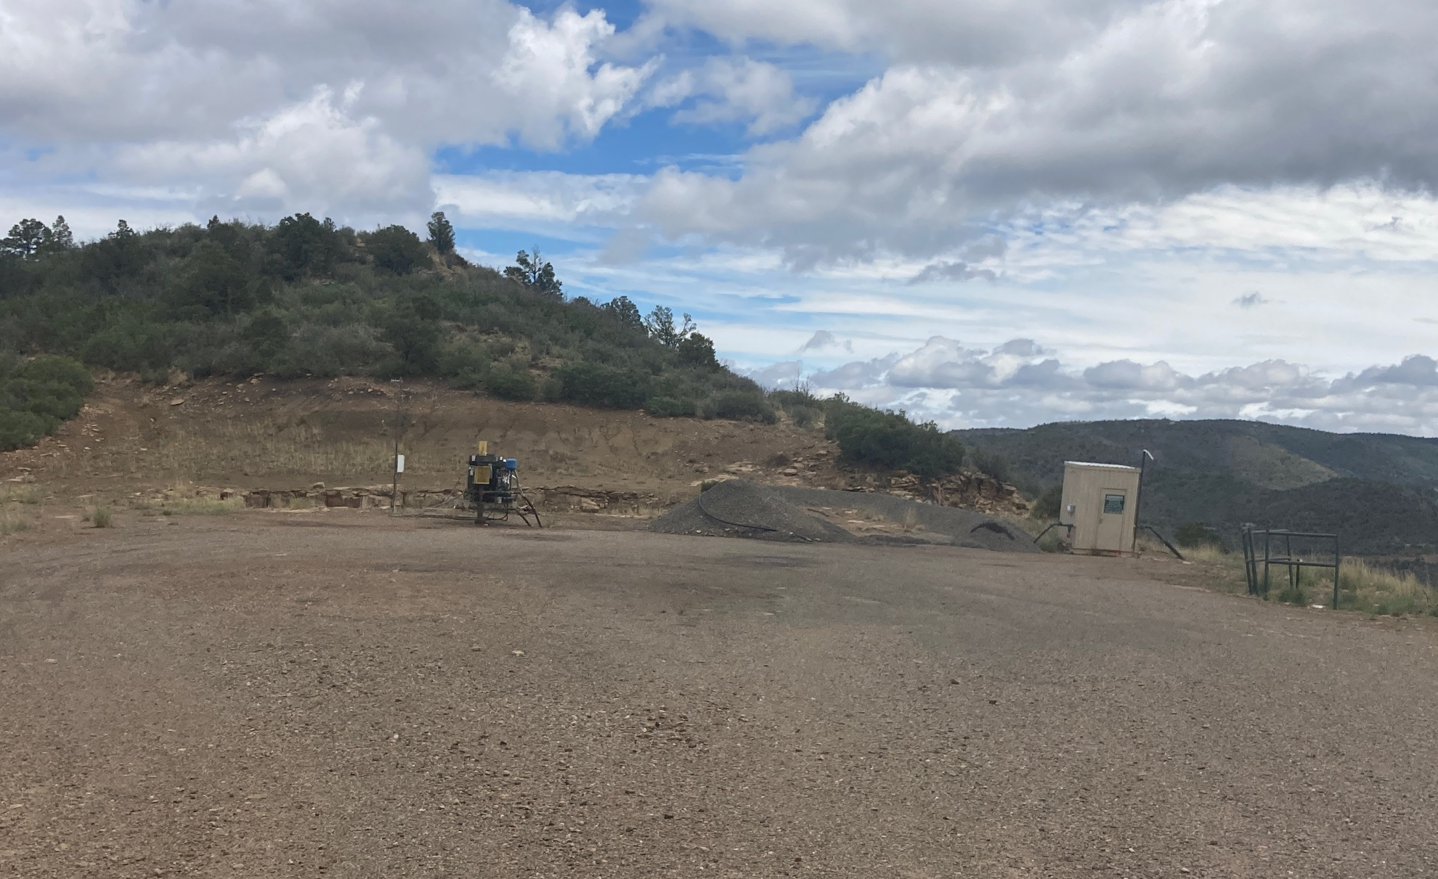
Location Name: LORENCITO 9-5, API #: 071-06977, Insp. #:695106466
PHOTO 1: LOCATION

Slide 2
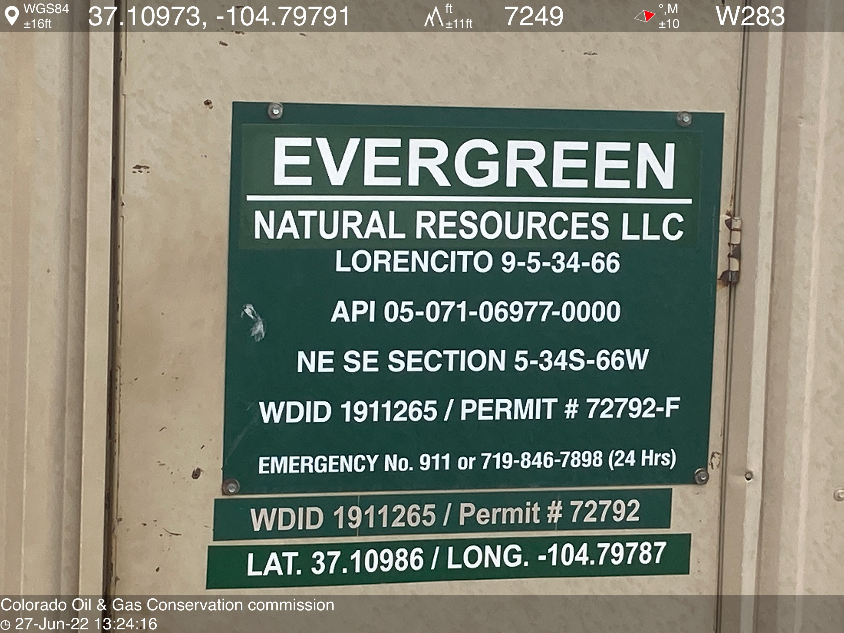
PHOTO 2: WELL SIGN

Slide 3
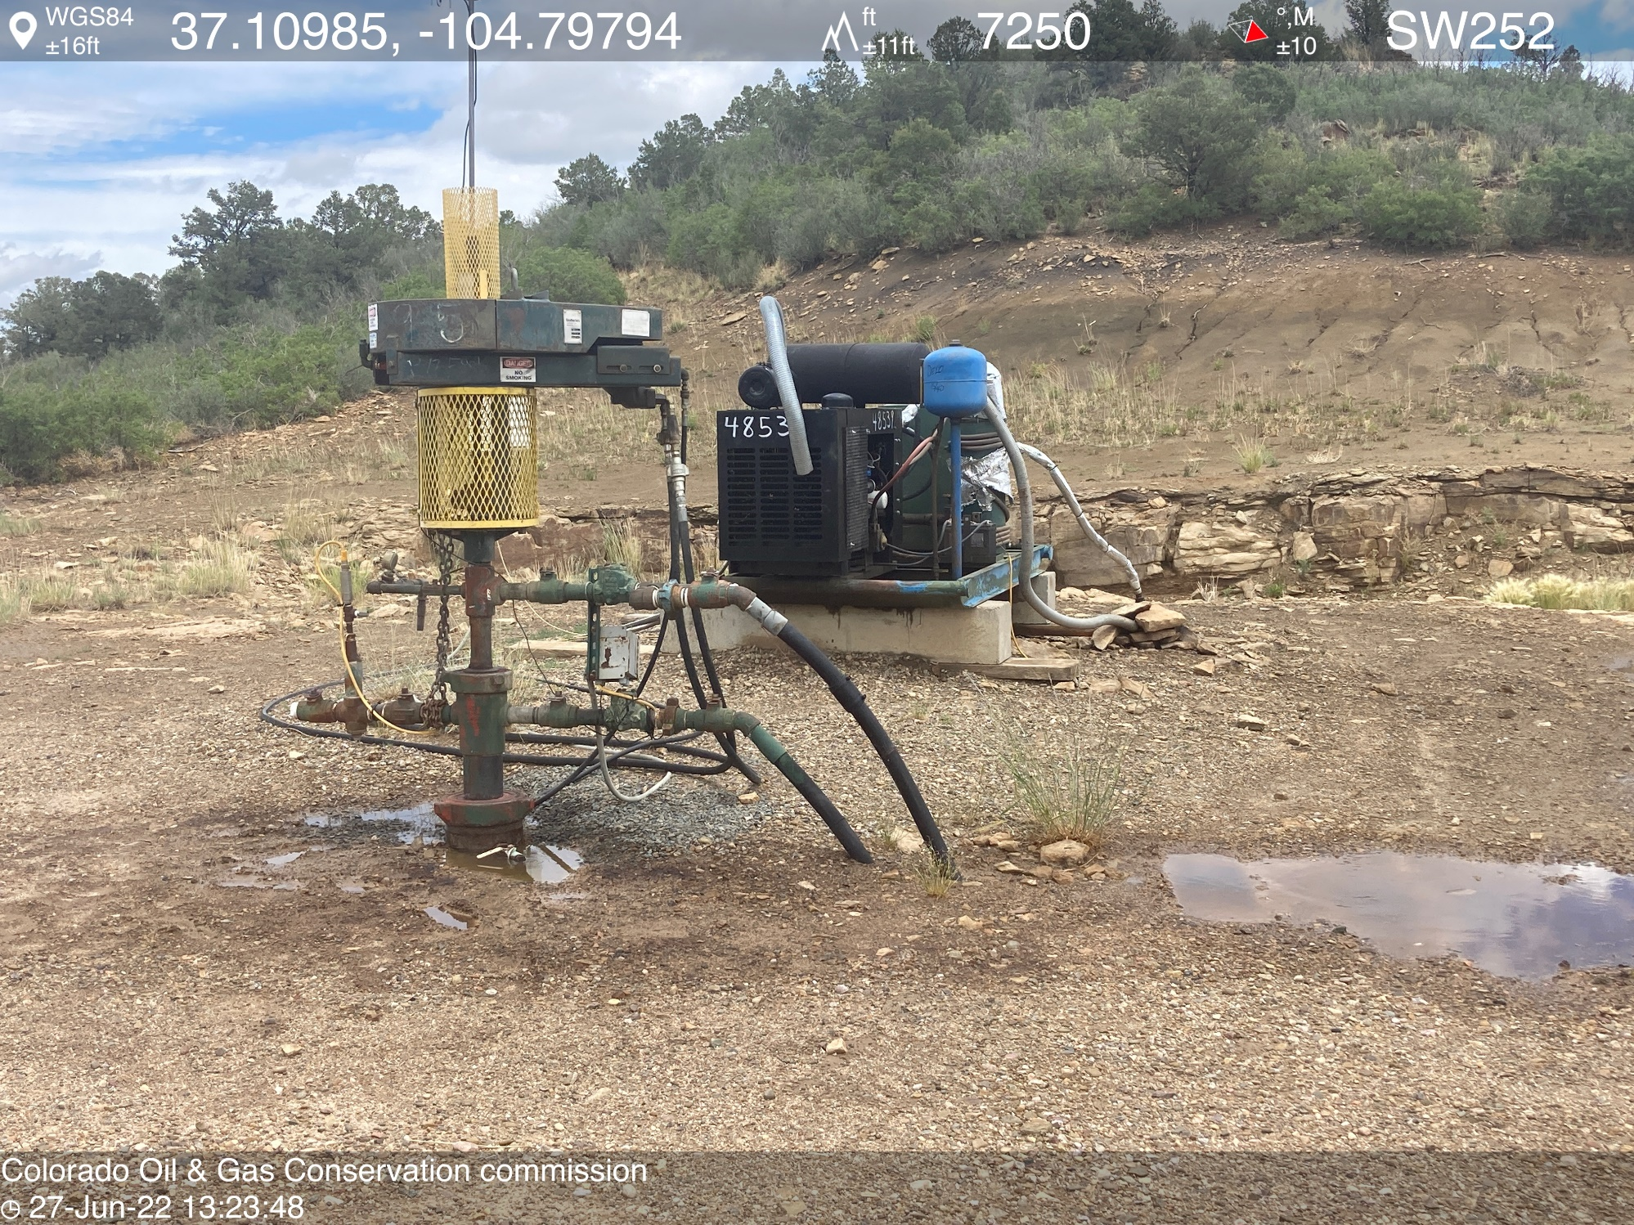
PHOTO 3: WELLHEAD AND EQUIPMENT

Slide 4
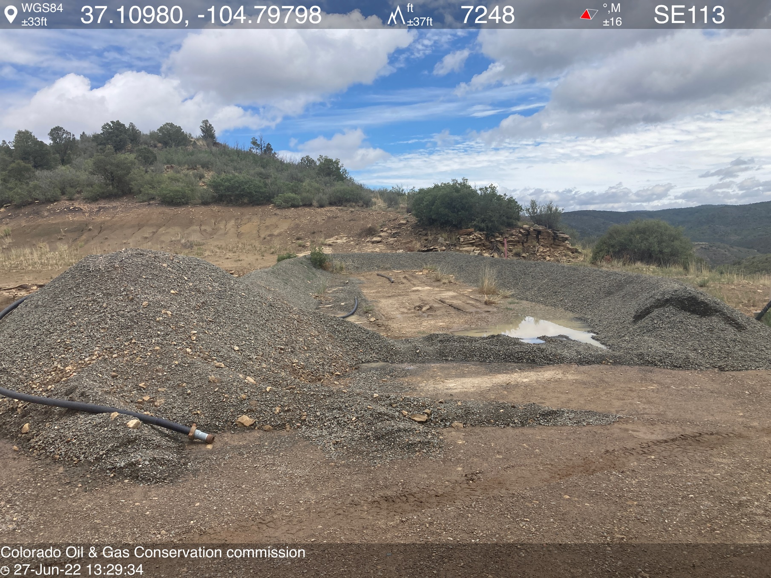
PHOTO 4: 2-2” POLY PIPES AND BERM MATERIAL LEFT ON LOCATION. REMOVE UNUSED EQUIPMENT, SPREAD OR REMOVE UNUSED BERM MATERIAL PER RULE 606. CA DATE 7-8-2022.

