Slide 1
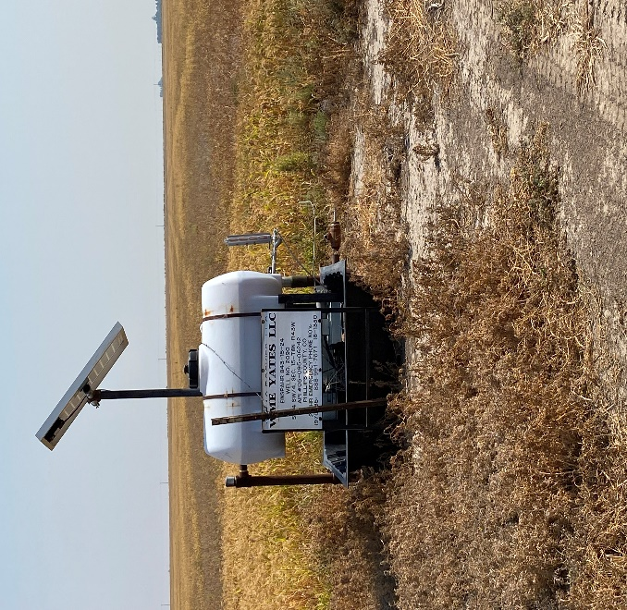
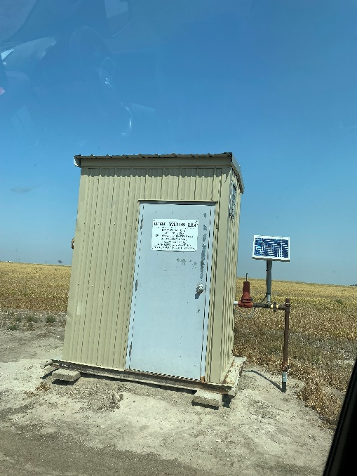
Operator: WME YATES
Location ID: 05-095-06242
Amherst Field EINSPAHR 15-24
WELLHEAD - SIGNAGE
MR - SIGNAGE

