Slide 1
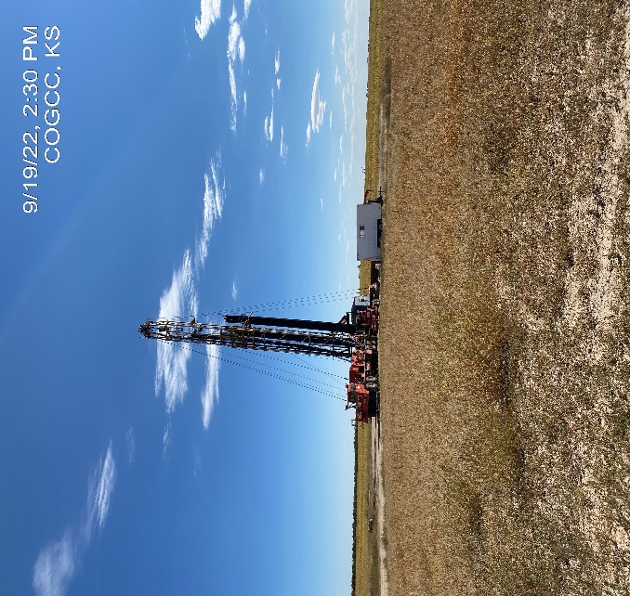

Operator: Foundation Energy LLC
Location ID: 05-075-09257
Amherst Field Baney State 16-3
MIRU – pull rods and tubing
Rig on location

