Slide 1
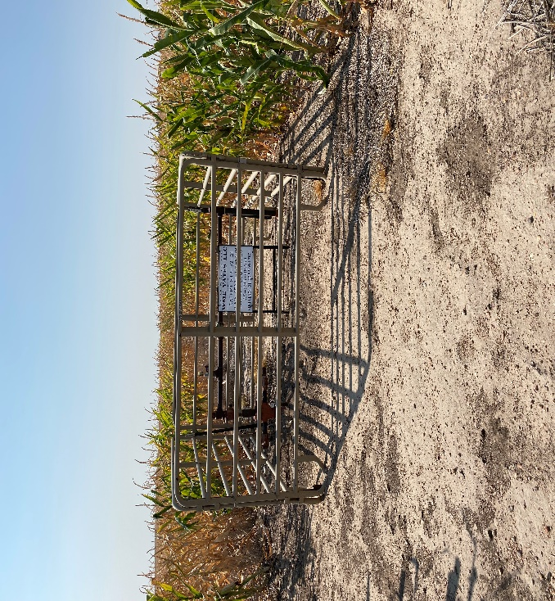
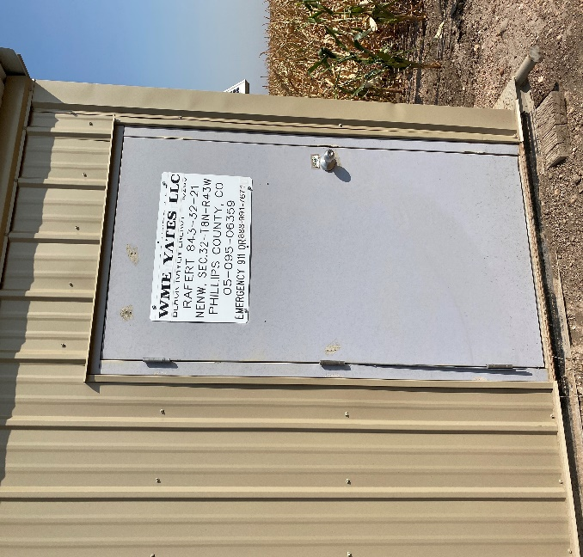
Operator: WME YATES
Location ID: 05-095-06359
Amherst Field RAFERT 32-21
WELLHEAD-PM – SIGN- FENCE
MR - SIGNAGE

