Slide 1
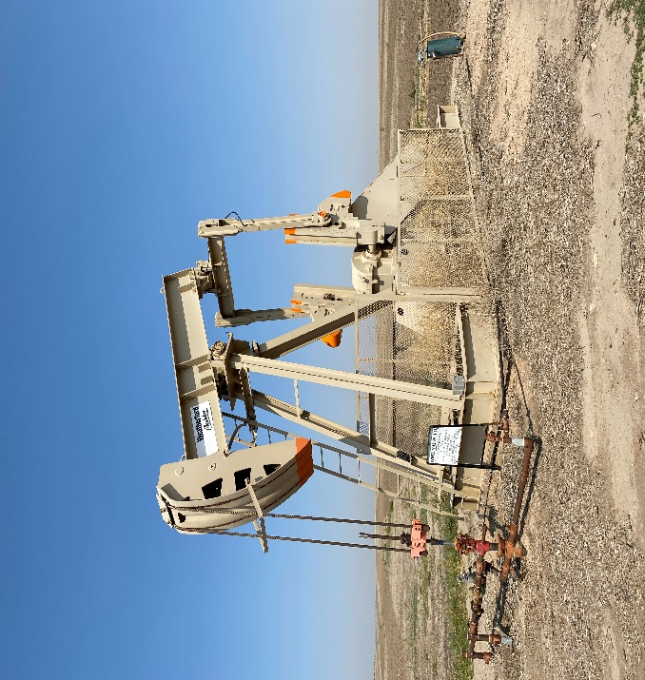
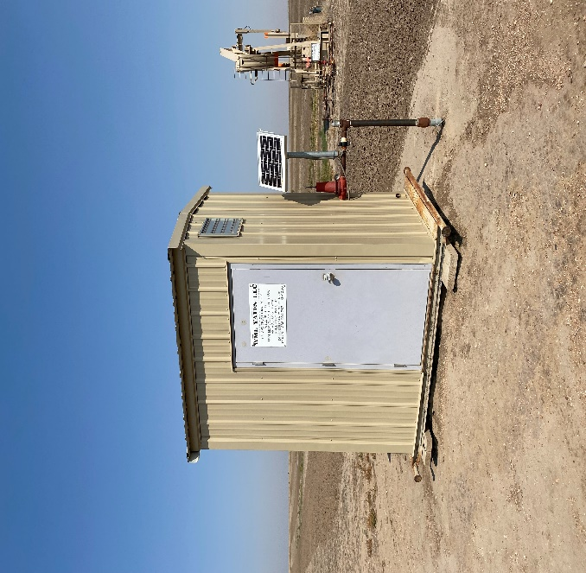
Operator: WME YATES
Location ID: 05-095-06338
Amherst Field Leland Trust 29-44
WELLHEAD-PJ-PM - SIGN
MR - SIGNAGE

