Slide 1
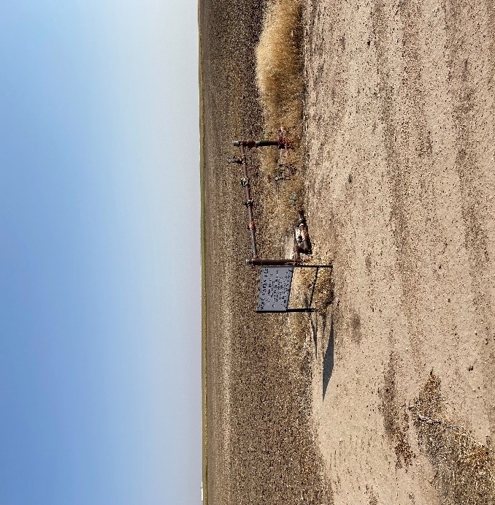
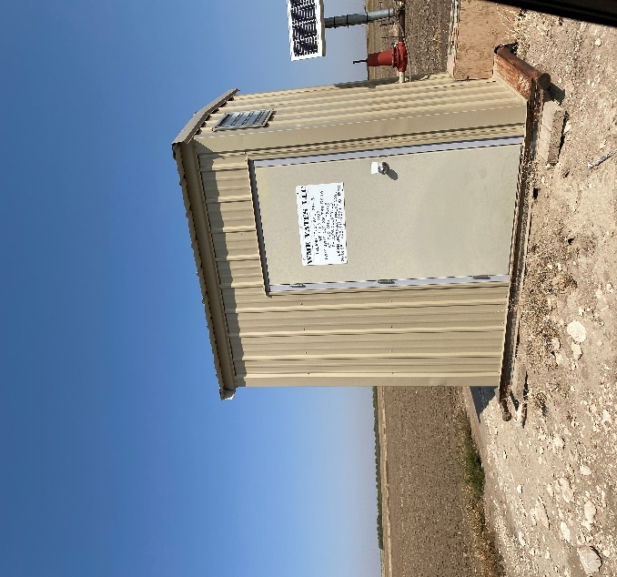
Operator: WME YATES
Location ID: 05-095-06335
Amherst Field Leland Trust 29-13
WELLHEAD -PM - SIGN
MR - SIGNAGE

