Slide 1
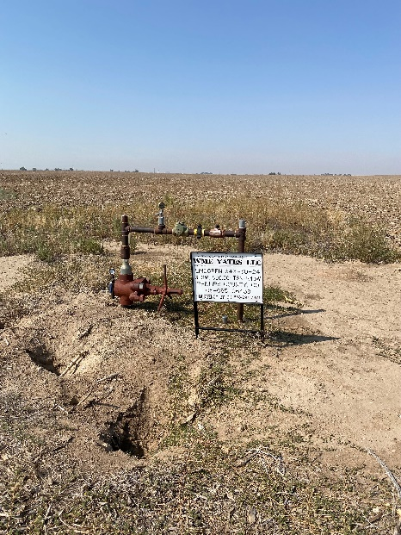
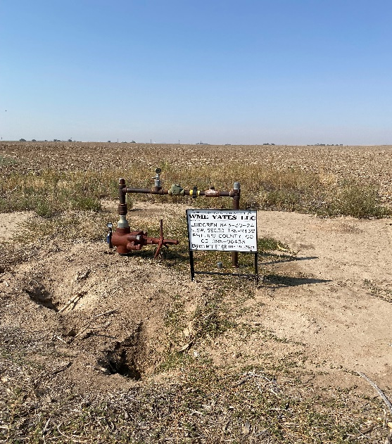
Operator: WME YATES
Location ID: 05-095-06438
Amherst Field LINDGREN 843-30-24
WELLHEAD – PM - SIGN
VARMINT HOLES

